Slide 1


AMAZON AWS
AURORA DB
- SERVERLESS DATABASE
19IT019 - Daya Anand C H
19IT027 - Eniyan M S

Slide 2
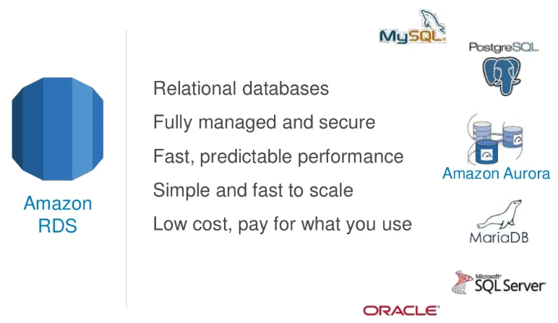

Slide 3
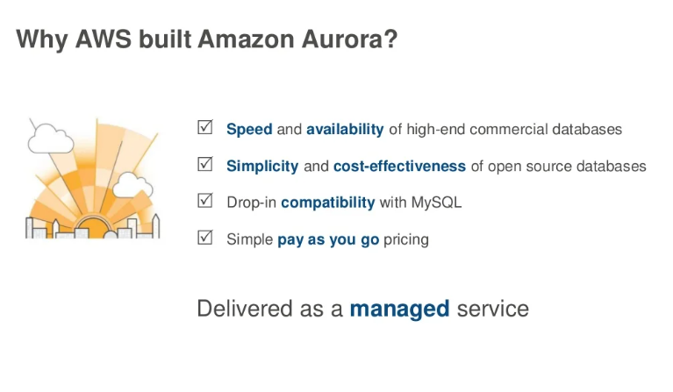

Slide 4
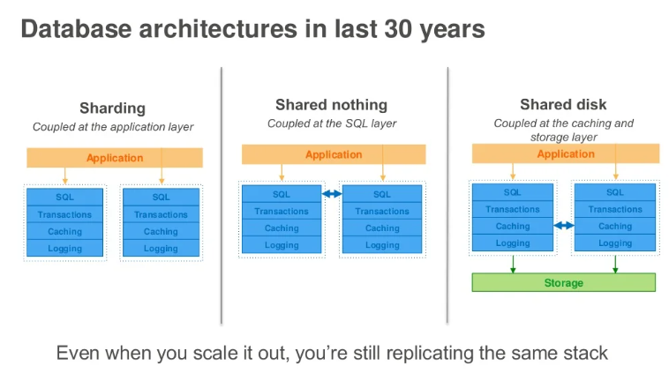

Slide 5
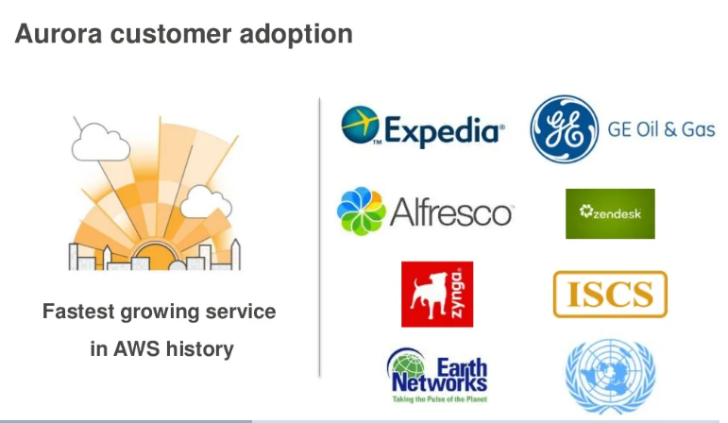

Slide 6
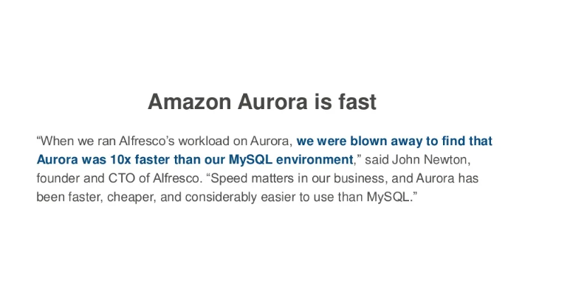

Slide 7
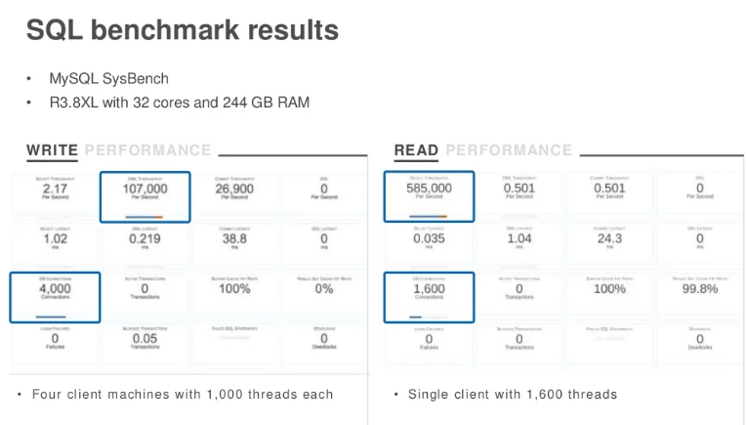

Slide 8
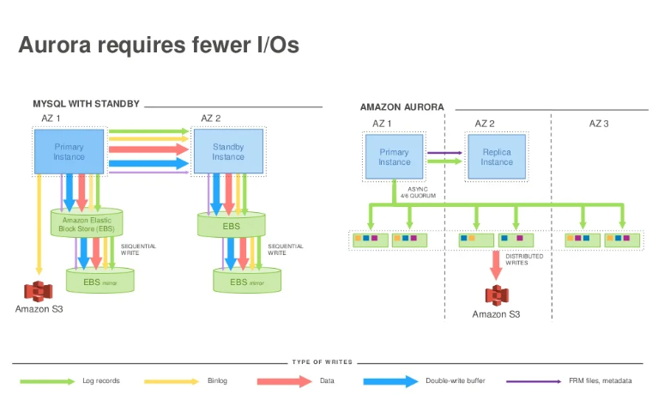

Slide 9
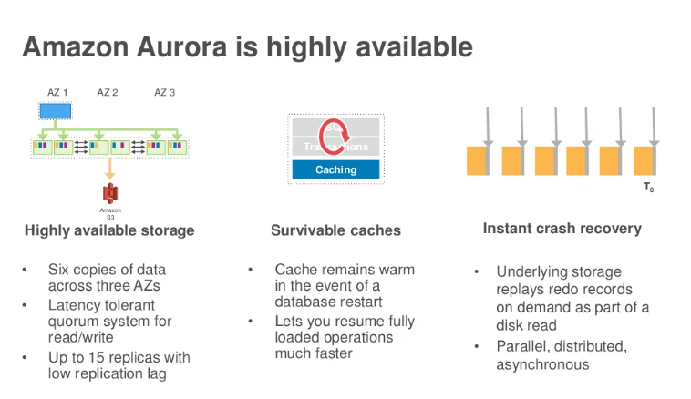

Slide 10
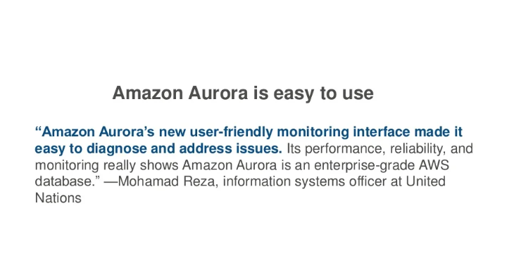

Slide 11
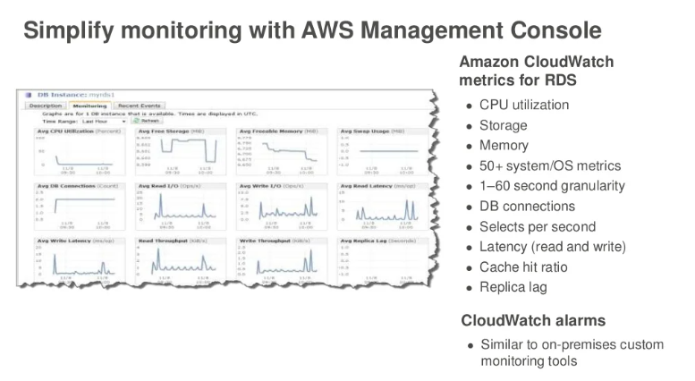

Slide 12
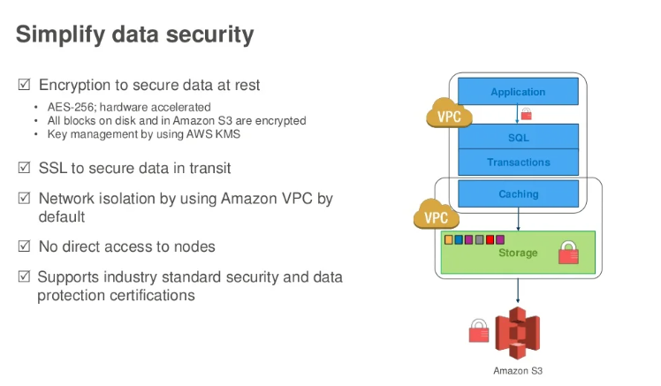

Slide 13

Packages Installation
Python Flask
boto3

Slide 14
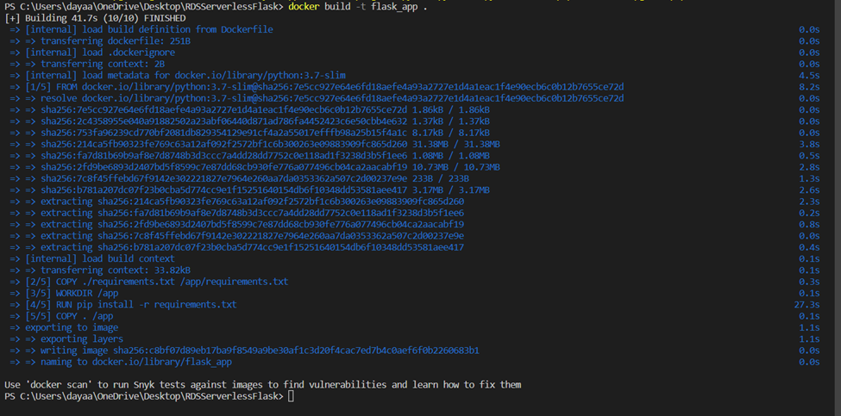
Docker - Building the Application

Slide 15

Running the Flask Application

Slide 16

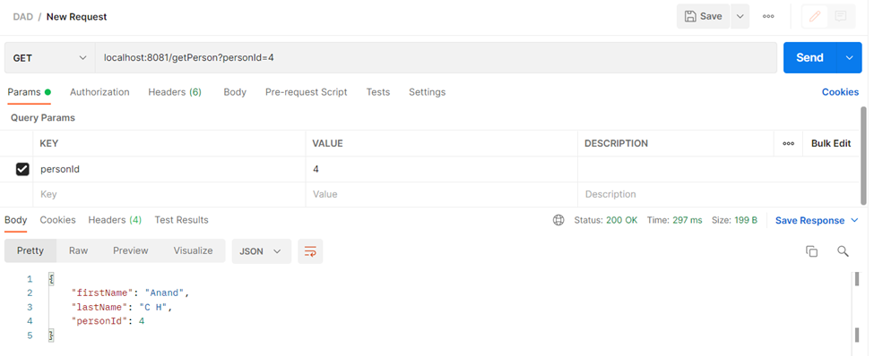
POST Request

Slide 17
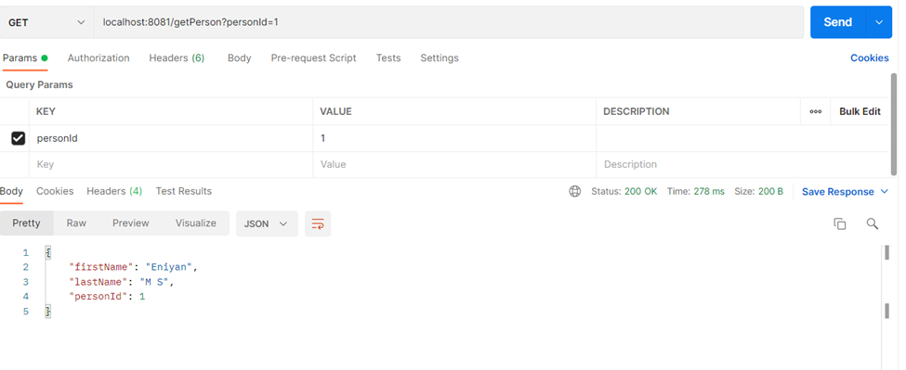
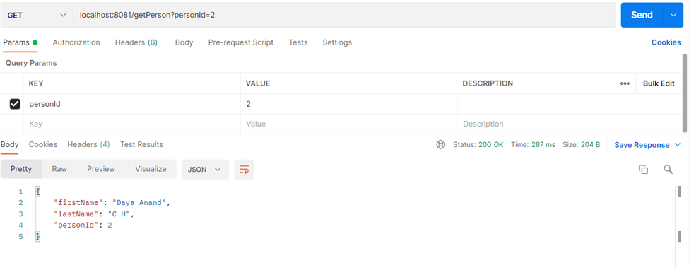
GET Request

Slide 18


Docker Images

Slide 19
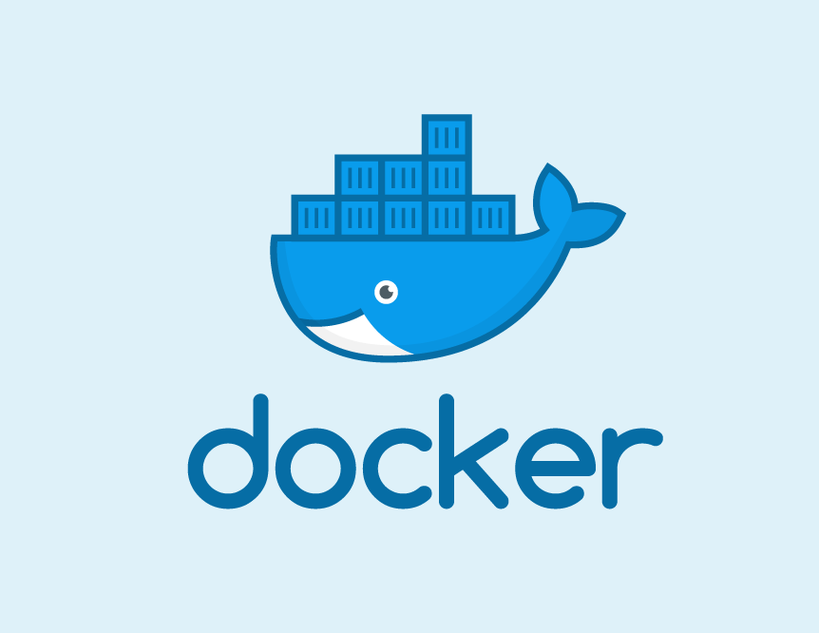
COMMANDS
docker build -t flask_app .
docker run -p 8081:8081 -it flask_app
docker images
docker images rm -f <image-id>
//netstat -ano | findstr LISTEN

Slide 20


