Slide 1
Neural MCPF Allocation
Learning the Allocation Step of Multi-Agent Path Finding
A transformer that replaces a combinatorial solver's allocation — near-optimal, any size, much faster at scale.
Ofek Yabo · Dayan Badalbaev — Multi-Agent Systems, 2026
Notes:
One-sentence framing: we taught a neural network to make the expensive decision a classic MAPF solver makes — which agent visits which goals — and studied when that trade is worth it.

Slide 2
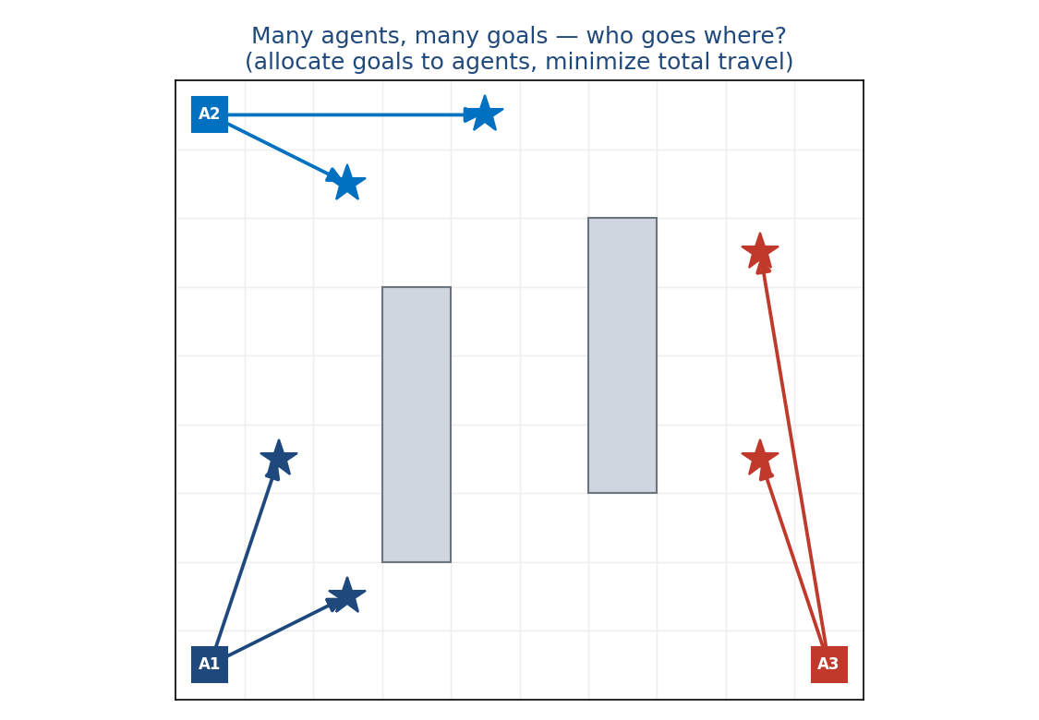
Who goes where?
• Many agents, many goals — minimize total work
• warehouse robots · delivery fleets · search & rescue
Notes:
The core decision in multi-agent coordination is the ALLOCATION: which agent takes which goals. A bad allocation wastes travel and creates collisions; real systems need it fast.

Slide 3
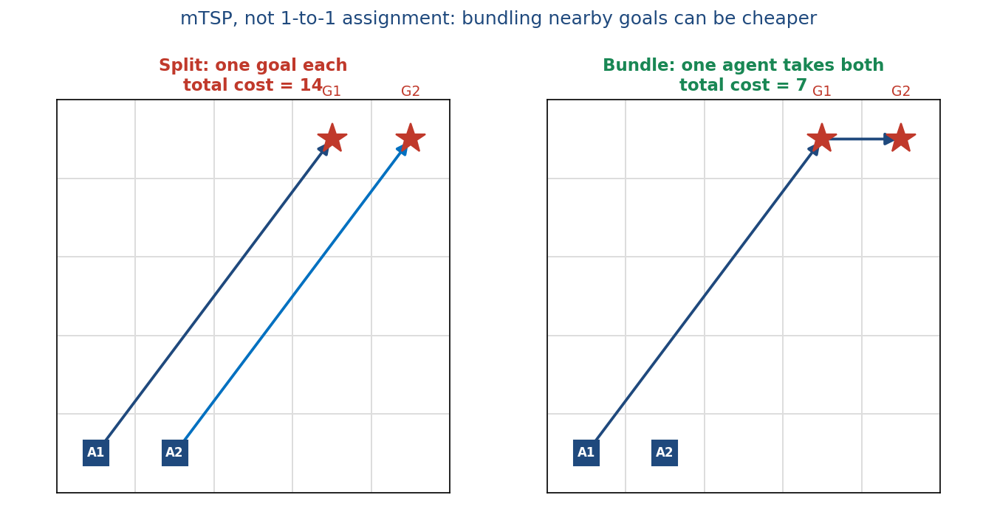
The problem (formally)
• mTSP inside MAPF: each goal visited once; agents take 0/1/many goals
• minimize total tour cost, then plan collision-free paths
Notes:
Multi-agent TSP, not 1-to-1: an agent may take several goals if cheaper (bundle cost 7 beats split 14). This is why the model outputs a per-goal distribution over agents, not a permutation.

Slide 4
The exact algorithm we build on
• RobustMCPF — the optimal solver
• LKH-TSP allocation (k-best) → CBS collision-free planning → optimal paths
• exact / near-optimal, but the TSP allocation is combinatorial
Notes:
Ground truth = RobustMCPF (BasicMAPF). LKH finds the optimal allocation/tours; CBS makes collision-free paths. Quality is great; the allocation step is the badly-scaling part. Code: solver_wrapper.py → RobustMCPF/.

Slide 5
The bottleneck — and our idea
• LKH allocation grows with problem size; CBS is needed by both
• Idea: replace only the allocation with a neural net (near-instant after training)
• Expected: imitate the solver → big speedup, especially at scale
• Accept suboptimal solutions — the NN won't always find the optimum
Notes:
Swap the expensive combinatorial allocator for a learned one, keep everything else. Hypothesis: close to solver quality, large speedup as N,M grow.

Slide 6
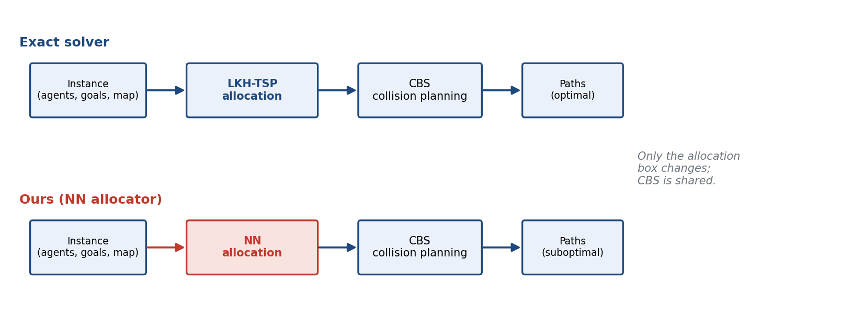
Where the NN drops in
only the allocation box changes — CBS is shared (apples-to-apples)
Notes:
Both pipelines share goal-ordering + CBS; only the allocator differs, so any cost/speed difference is attributable to the allocation. Code: evaluation/full_pipeline_eval.py.

Slide 7
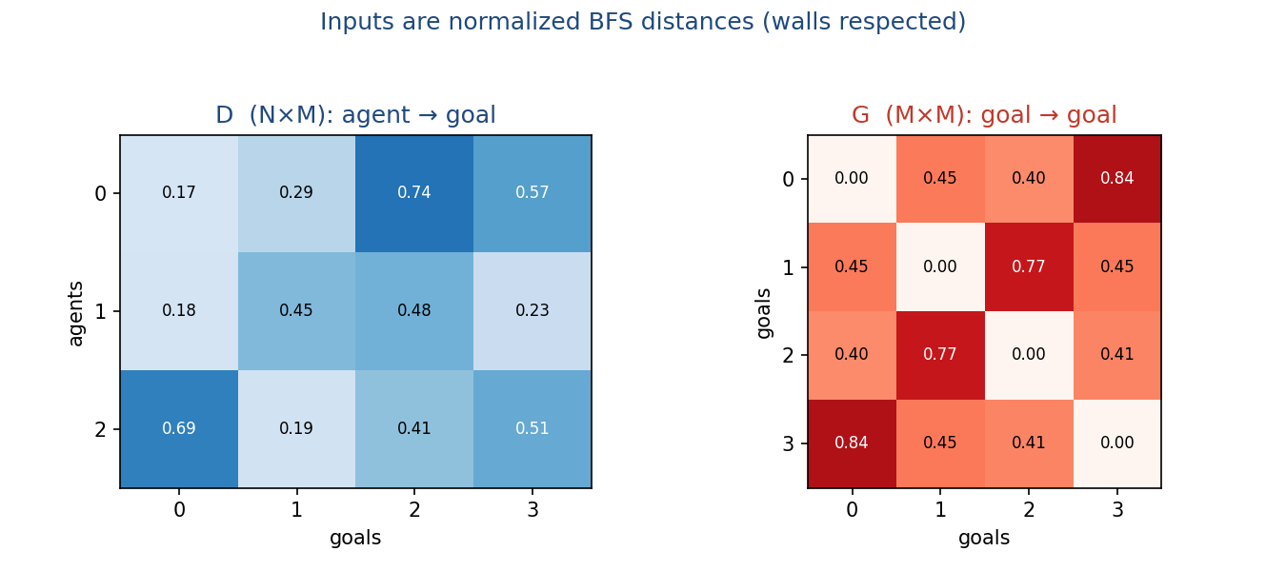
How we represent the problem
• D (N×M): agent → goal · G (M×M): goal → goal (normalized BFS)
• distances, not coordinates
• same distances as LKH-TSP — but two matrices (D, G), not one big cost table
Notes:
BFS distances respect walls and transfer across maps. G is the KEY feature — which goals are near each other (which to bundle); adding G lifted accuracy +14–18 points, more than any architecture/size/data change. Code: dataset_generation/distance.py.

Slide 8
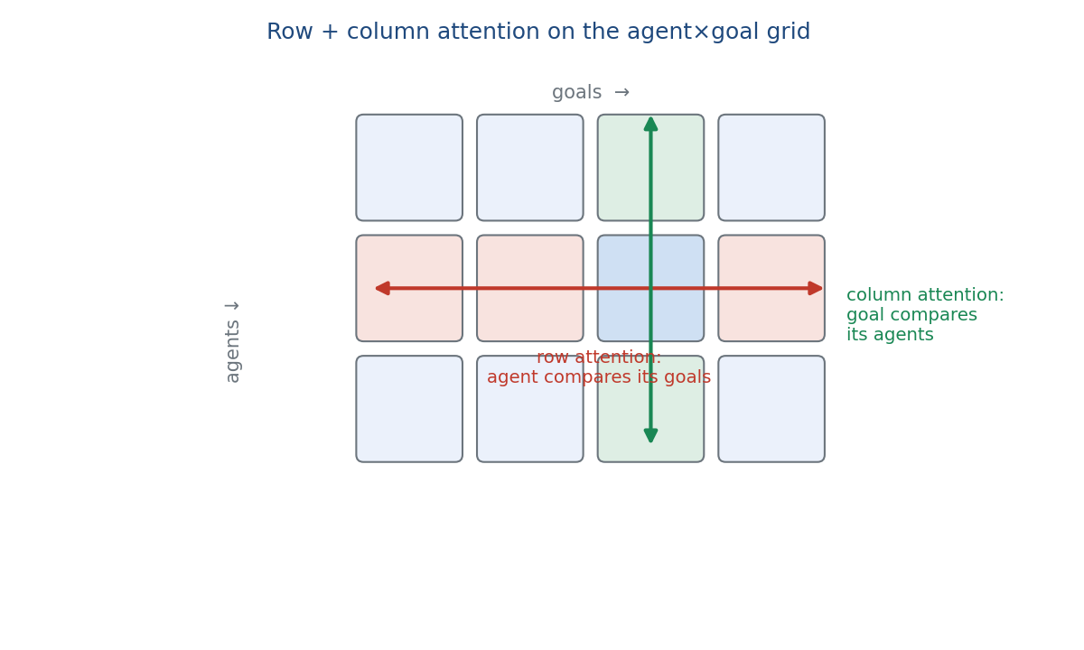
The network
• row attention — each agent attends over its goals
• column attention — each goal attends over its agents
• per block: row × column attention + FFN, repeated ×L
• output: column softmax · loss = CE + λ·MinSum
Notes:
Each agent-goal pair is embedded; stacked row/column attention captures the combinatorial structure. Output is a per-goal distribution over agents. Trained with cross-entropy to imitate the solver + small MinSum term (λ=0.1). Code: model/network.py, model/losses.py.

Slide 9
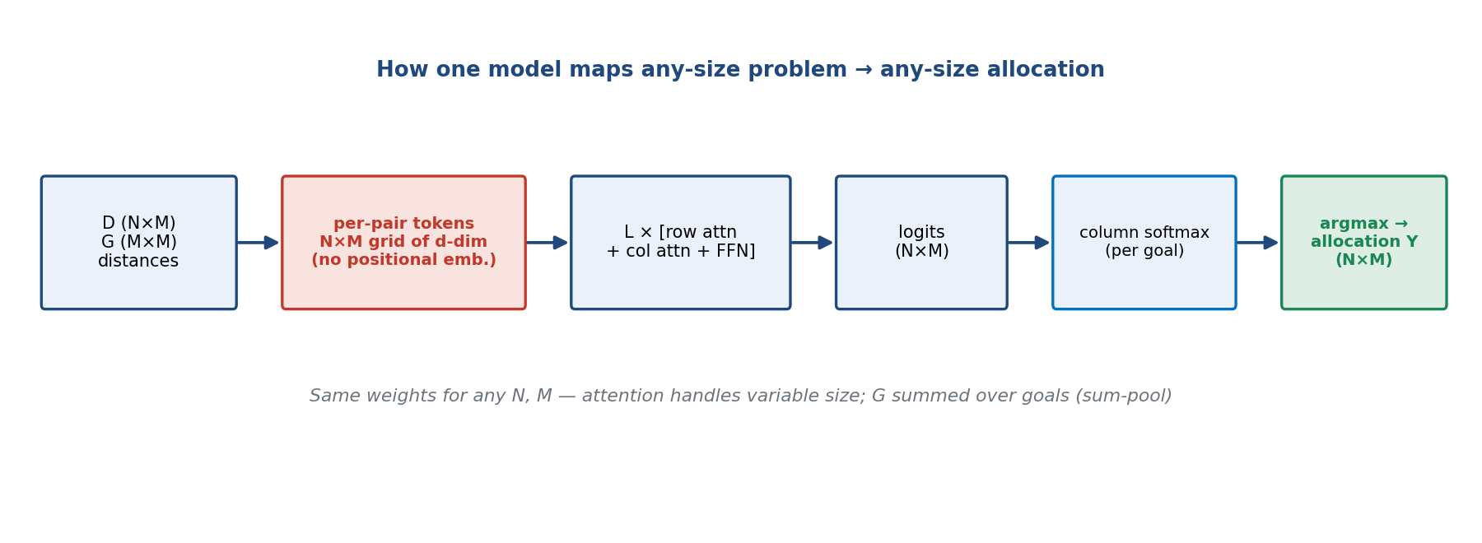
One model for ANY N, M
no positional embeddings → the same weights run a 2×2 or a 50×100 problem
Notes:
KEY slide. Every scalar D[i,j] → a d-dim token (N×M grid). G injected per goal by embedding each G[j,k] and SUMMING over k (sum-pool → any M). No positional embeddings (agents/goals unordered; attention handles variable length). Output: Linear(d→1) → N×M logits → column softmax → argmax per goal = the binary allocation matrix. Code: GoalAllocTransformerUniversal.

Slide 10
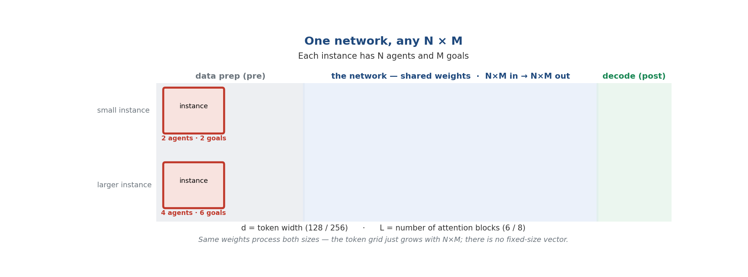
One model for ANY N, M — step by step
Notes:
Advance with the arrow keys. Pre = data prep (instance → D,G). Net = shared-weight transformer: embed each scalar → ℝ^d token (N×M grid), row+column attention ×L, per-token logit ℝ^d→1, column softmax. Post = argmax decode. G is sum-pooled per goal and ADDED into the D tokens (context, not extra tokens) → output stays N×M. d and L are fixed; the token count N×M grows with the instance — no fixed-size vector.

Slide 11
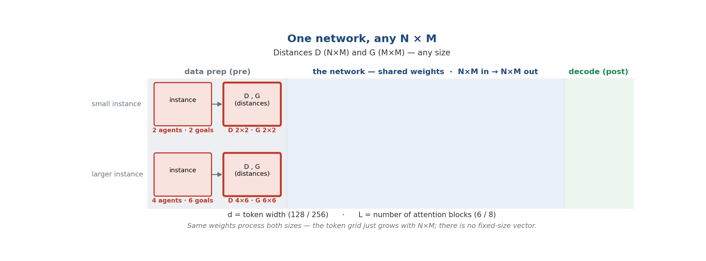
One model for ANY N, M — step by step
Notes:
Advance with the arrow keys. Pre = data prep (instance → D,G). Net = shared-weight transformer: embed each scalar → ℝ^d token (N×M grid), row+column attention ×L, per-token logit ℝ^d→1, column softmax. Post = argmax decode. G is sum-pooled per goal and ADDED into the D tokens (context, not extra tokens) → output stays N×M. d and L are fixed; the token count N×M grows with the instance — no fixed-size vector.

Slide 12
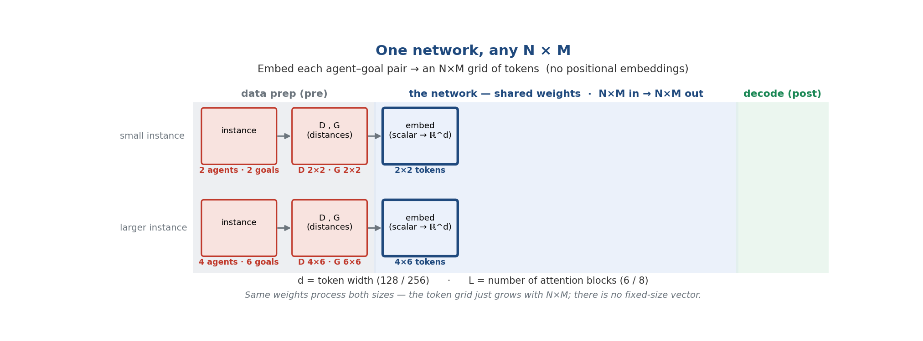
One model for ANY N, M — step by step
Notes:
Advance with the arrow keys. Pre = data prep (instance → D,G). Net = shared-weight transformer: embed each scalar → ℝ^d token (N×M grid), row+column attention ×L, per-token logit ℝ^d→1, column softmax. Post = argmax decode. G is sum-pooled per goal and ADDED into the D tokens (context, not extra tokens) → output stays N×M. d and L are fixed; the token count N×M grows with the instance — no fixed-size vector.

Slide 13
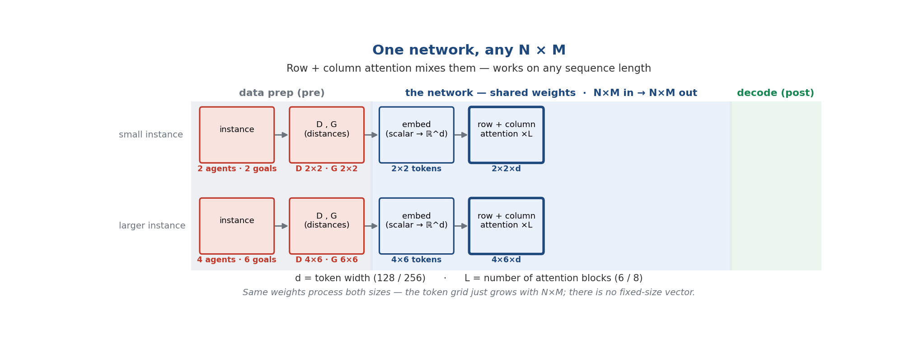
One model for ANY N, M — step by step
Notes:
Advance with the arrow keys. Pre = data prep (instance → D,G). Net = shared-weight transformer: embed each scalar → ℝ^d token (N×M grid), row+column attention ×L, per-token logit ℝ^d→1, column softmax. Post = argmax decode. G is sum-pooled per goal and ADDED into the D tokens (context, not extra tokens) → output stays N×M. d and L are fixed; the token count N×M grows with the instance — no fixed-size vector.

Slide 14
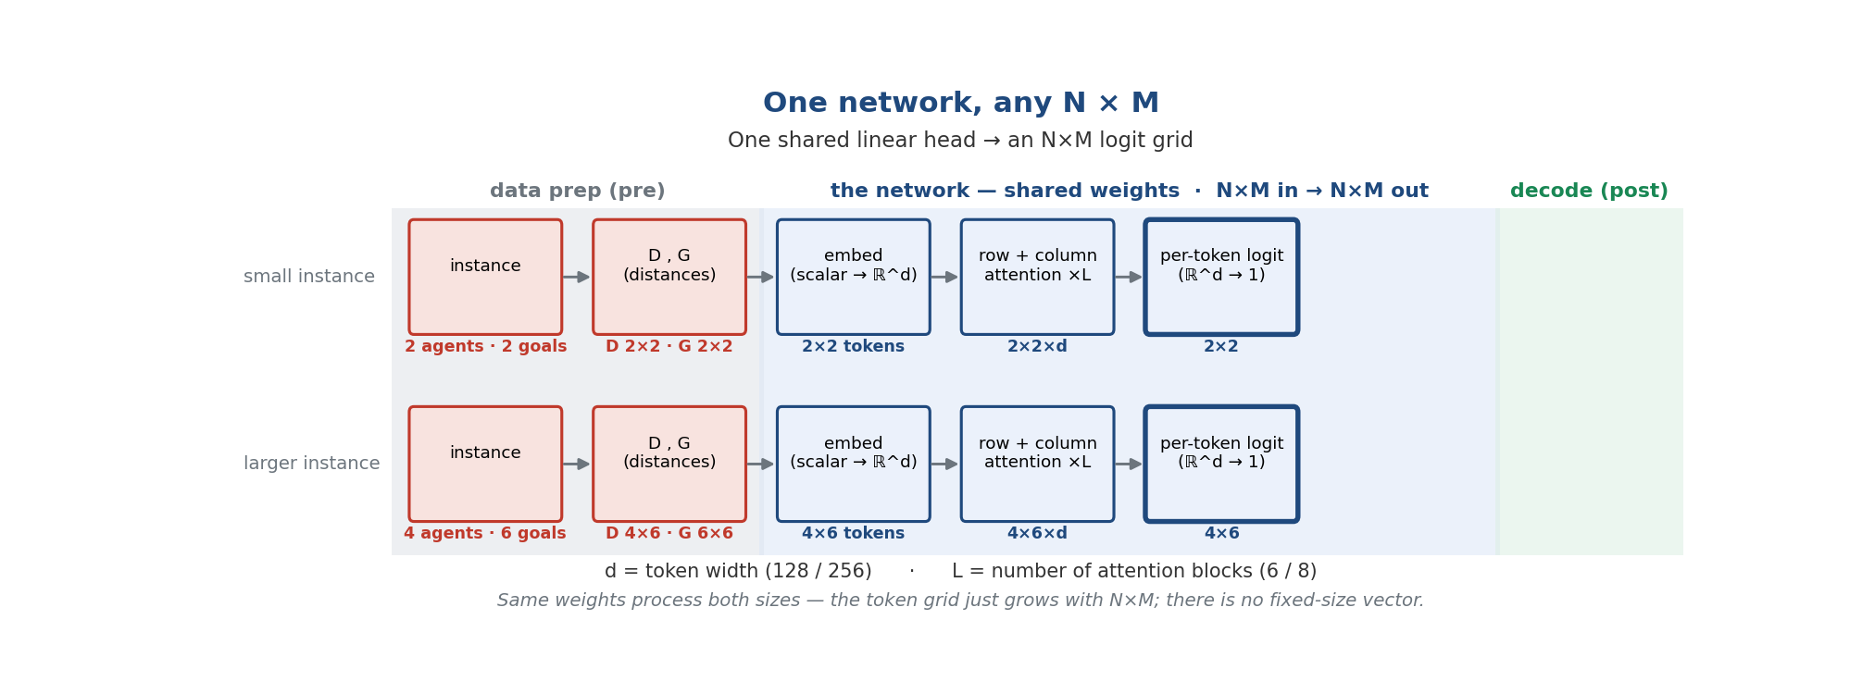
One model for ANY N, M — step by step
Notes:
Advance with the arrow keys. Pre = data prep (instance → D,G). Net = shared-weight transformer: embed each scalar → ℝ^d token (N×M grid), row+column attention ×L, per-token logit ℝ^d→1, column softmax. Post = argmax decode. G is sum-pooled per goal and ADDED into the D tokens (context, not extra tokens) → output stays N×M. d and L are fixed; the token count N×M grows with the instance — no fixed-size vector.

Slide 15
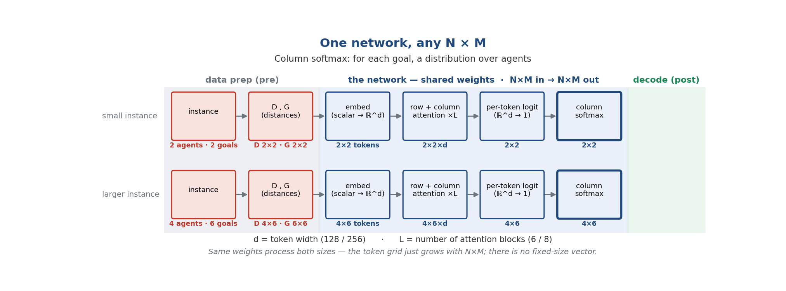
One model for ANY N, M — step by step
Notes:
Advance with the arrow keys. Pre = data prep (instance → D,G). Net = shared-weight transformer: embed each scalar → ℝ^d token (N×M grid), row+column attention ×L, per-token logit ℝ^d→1, column softmax. Post = argmax decode. G is sum-pooled per goal and ADDED into the D tokens (context, not extra tokens) → output stays N×M. d and L are fixed; the token count N×M grows with the instance — no fixed-size vector.

Slide 16
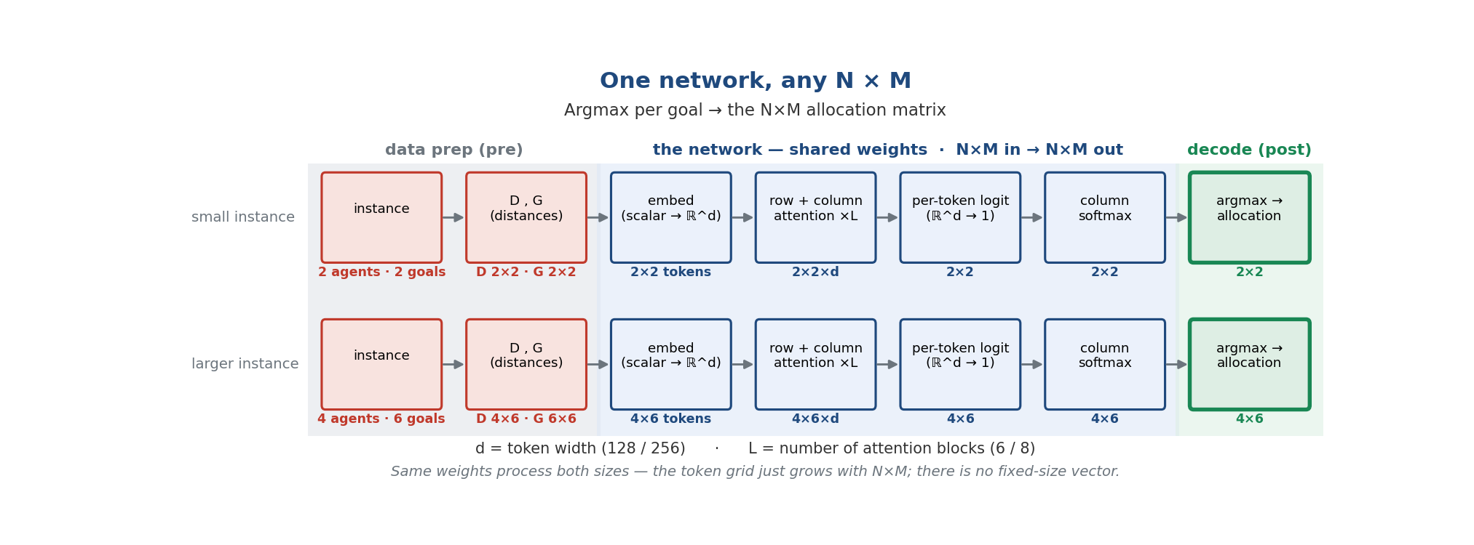
One model for ANY N, M — step by step
Notes:
Advance with the arrow keys. Pre = data prep (instance → D,G). Net = shared-weight transformer: embed each scalar → ℝ^d token (N×M grid), row+column attention ×L, per-token logit ℝ^d→1, column softmax. Post = argmax decode. G is sum-pooled per goal and ADDED into the D tokens (context, not extra tokens) → output stays N×M. d and L are fixed; the token count N×M grows with the instance — no fixed-size vector.

Slide 17
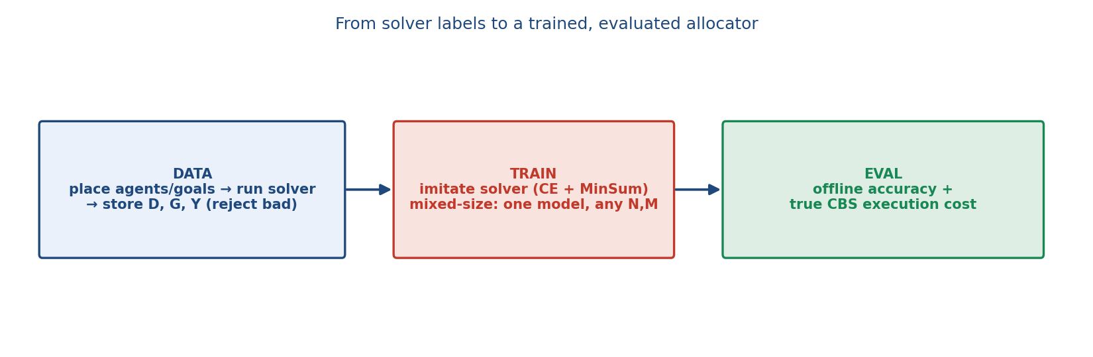
Method
• data: solver labels D,G,Y · train: imitate, mixed-size · eval: offline + true CBS cost
Notes:
Generate instances, run the solver, store D,G,Y (reject unreachable/over-budget). Train one universal model on many (N,M) shapes. Evaluate offline (accuracy) and — what matters — true execution cost (NN→ordering→CBS vs solver). Code: build_dataset.py, train.py, full_pipeline_eval.py, tests/.

Slide 18
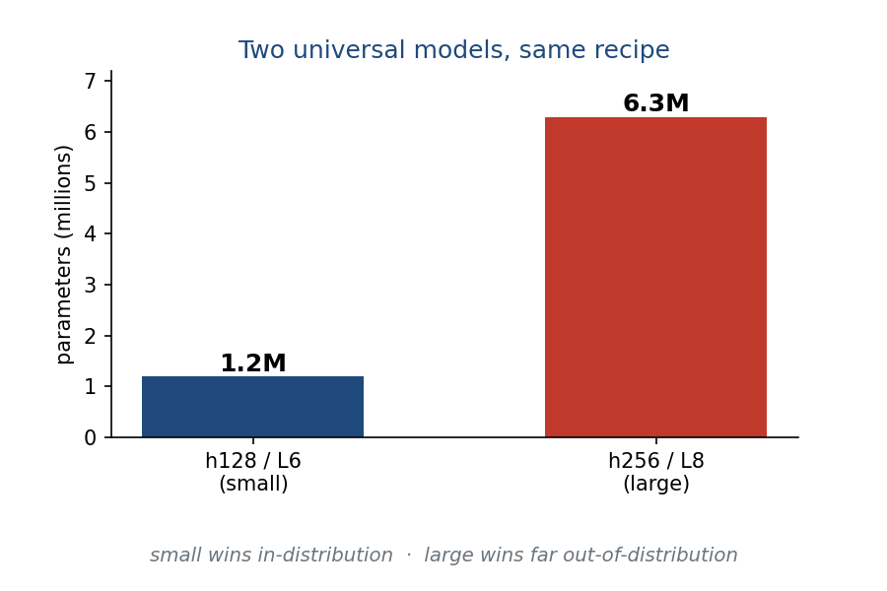
Small vs. big model
• h128/L6 = 1.2M params · h256/L8 = 6.3M
• preview: small wins in-distribution, big wins far out-of-distribution
Notes:
Identical except width/depth. In-distribution the small model is better and faster (big overfits, Exp 12); at extreme extrapolation the big one generalizes better (Exp 15).

Slide 19
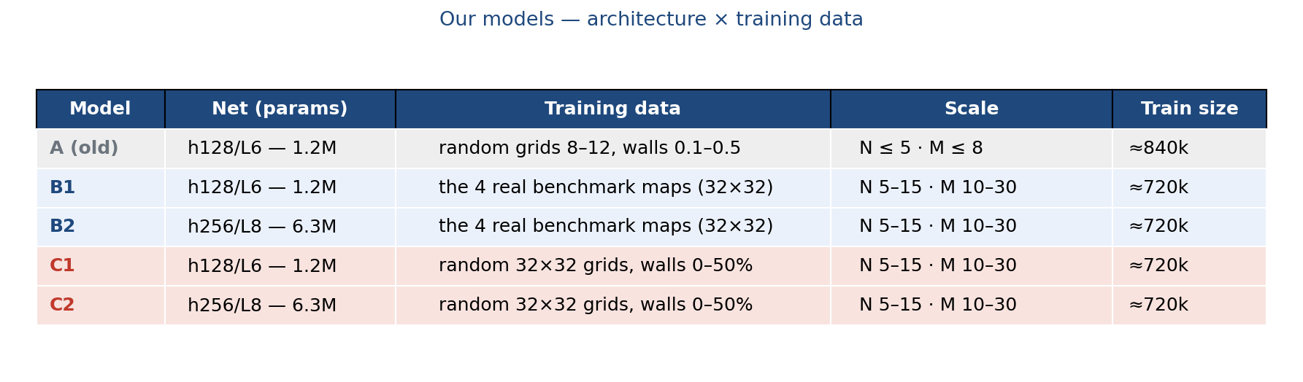
Our models: architecture × training data (A / B / C)
• A = original (small scale) · B = trained on the real maps · C = random-diverse grids
• suffix 1 = small net (h128, 1.2M) · 2 = big net (h256, 6.3M)
Notes:
Two axes: the net (h128 vs h256) and the training data. A = original small-scale model (random small grids). B = trained on the 4 real benchmark maps; C copies B's recipe but trains on random 32×32 grids (0–50% walls) — a controlled data swap. Train sizes: A ≈840k, B & C ≈720k.

Slide 20
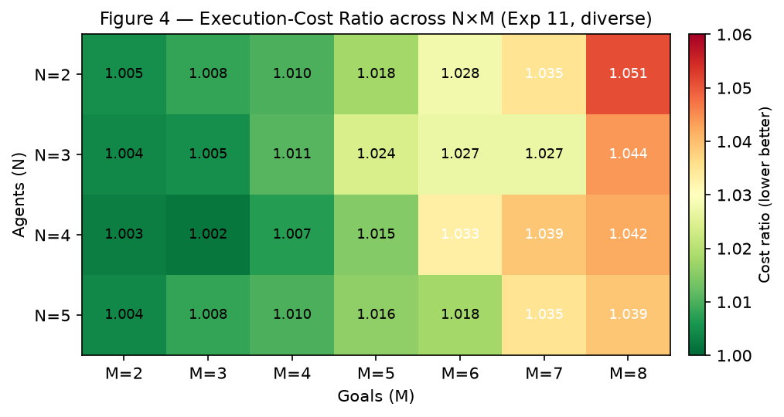
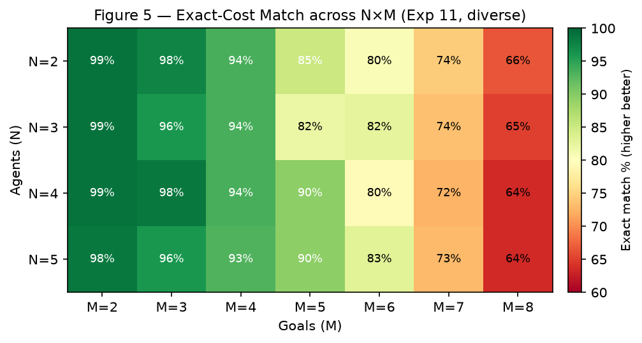
Results: near the solver, cheaper to run
• cost ratio ~1.02–1.05 (≈1–6% above optimal)
• exact-cost match ~60–99% — both track M, nearly flat in N
Notes:
Across 28 small configs the NN is ~1–6% above optimal; large diverse model mean 1.020. Most disagreements are cost-equivalent ties (exact-cost match ≫ exact-allocation match). CBS dominates full-pipeline time, so single-instance speedup is modest; batched it's ~1000×.

Slide 21
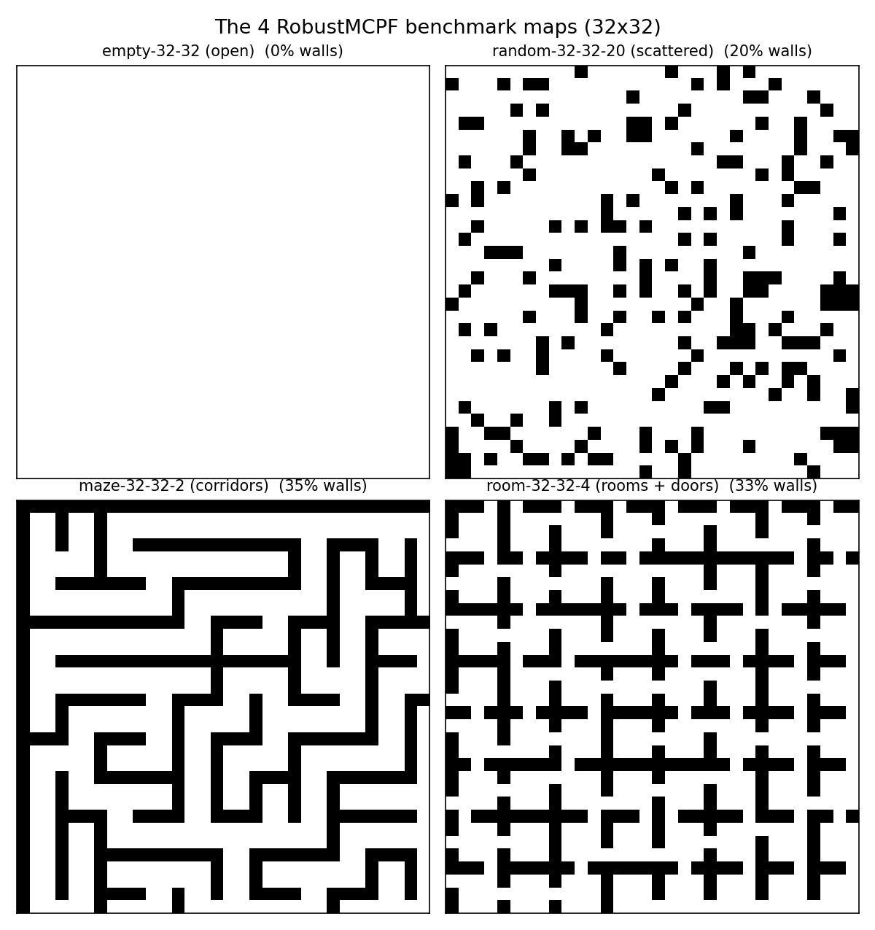
From random grids to real benchmark maps
open → scattered → maze → rooms; only maze/room are truly structured
Notes:
The 4 standard RobustMCPF benchmark maps. Only maze and room carry corridor/room structure — that distinction drives the next results.

Slide 22
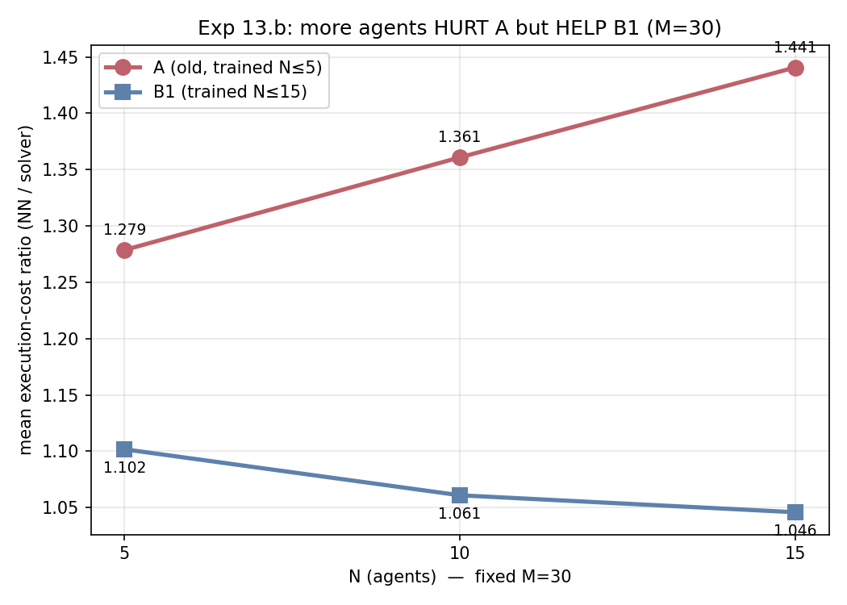
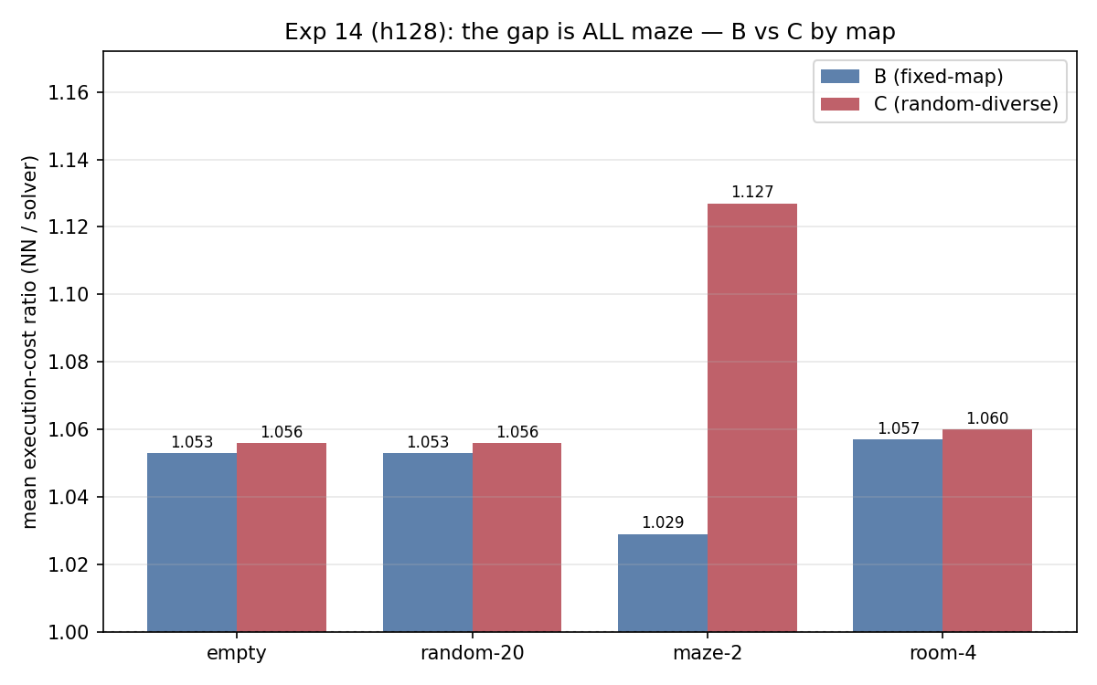
Results: generalization studies
Notes:
(a) small model zero-shot on real maps at small N/M = 1.019, but at large N/M fails (1.246 vs map-trained 1.048); scissors at M=30 — more agents hurt the old model (1.28→1.44), help the in-range one (1.10→1.05): generalizes across SHAPE, not SCALE. (b) random-grid training ties fixed-map everywhere except the maze (1.029 vs 1.127): random walls never make corridors. (c) at N≤50/M≤100 the big model extrapolates best (1.208 vs 1.244), speedup 5.9–9.4×.

Slide 23
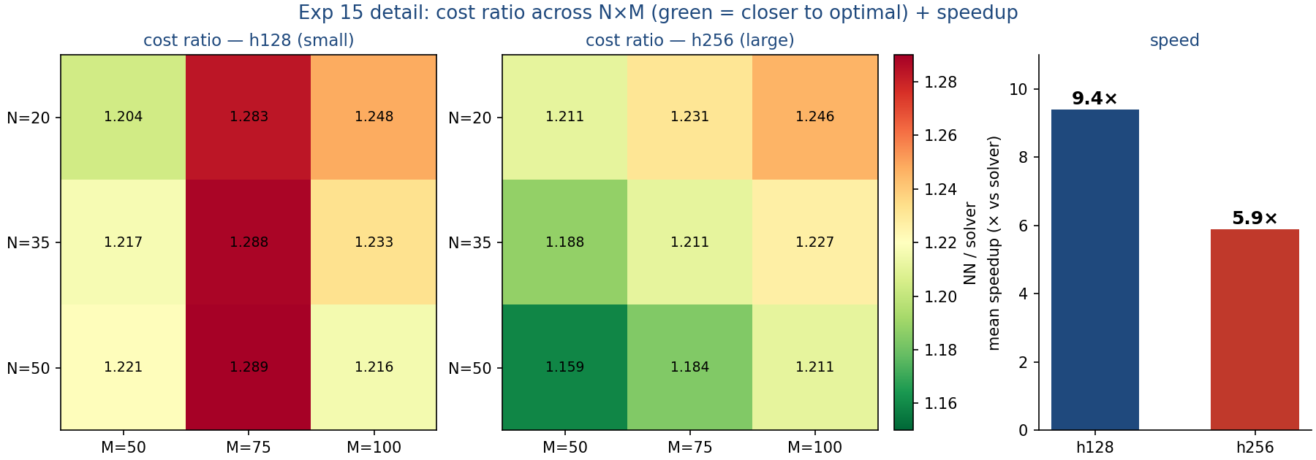
Pushing further: zero-shot XL extrapolation (Exp 15)
• B models run zero-shot at N∈{20,35,50} × M∈{50,75,100} (no retraining)
• the bigger model (h256) wins out-of-distribution (1.208 vs 1.244), and inference is 5.9–9.4× faster than the solver
green = closer to optimal · h256 better across the grid (esp. N=50) · M=75 is the hard column
Notes:
Zero-shot XL toward the paper's N≤50/M≤100. Verdict flips vs in-distribution (Exp 12): the capacity that overfit in range is the better generalizer at scale — h256 1.208 vs h128 1.244, worst-case gap roughly halved (224→124). M=75 hardest for both; maze easiest (≈1.15–1.18). Speedup 5.9–9.4× as LKH's TSP grows. Numbers: RESULTS.md Exp 15.

Slide 24
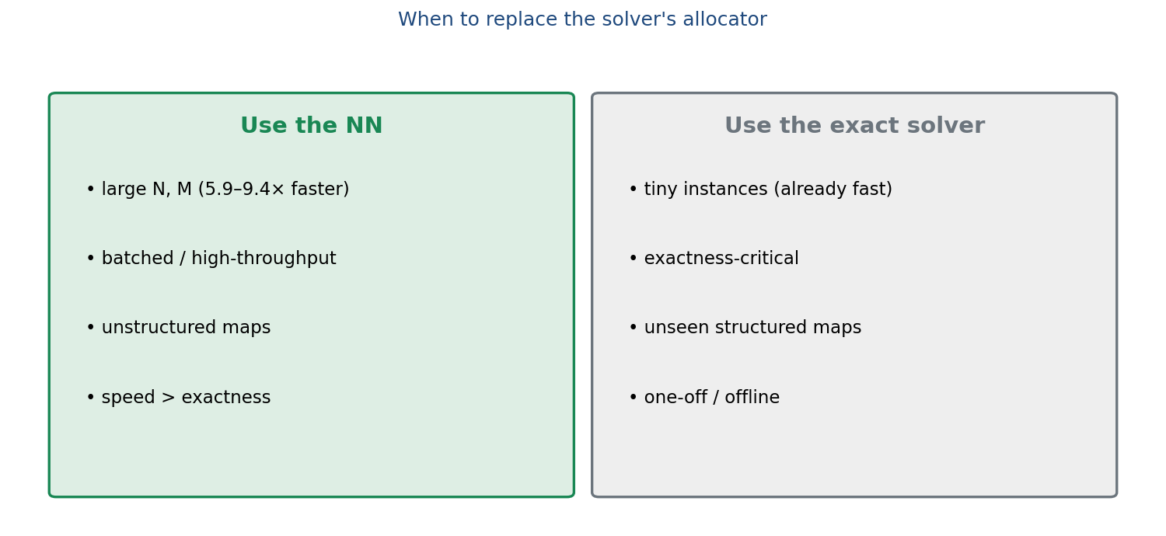
When to use the NN vs. the exact solver
Notes:
NN replaces only allocation, so it wins where allocation/TSP cost dominates and many instances are solved: big problems (5.9–9.4× at ~20% overhead), batched inference, unstructured maps. The exact solver still wins on tiny/exactness-critical/unseen-structured instances.

Slide 25
Demo: same instance, solver vs NN
different allocation, identical cost (62) — the NN found its own equally-optimal plan
Notes:
Real run of model A on the room map. Both reach cost 62, but the NN sends the two right-side goals to a different agent than the solver — CBS executes it collision-free at the same cost. A vivid example of the cost-equivalent ties behind the high exact-match rates. (GIF animates in PowerPoint slideshow; static side-by-side is assets/demo_nn_vs_solver.png.)

Slide 26
Conclusion
• Problem: optimal allocation (mTSP in MAPF) — combinatorial step scales badly
• Idea: a small universal transformer imitates it from distances — near-optimal
• Generalizes: any N,M; across scale and (with the right data) geometry
• Payoff: 5.9–9.4× at scale, within ~20% of optimal — use where speed/scale matter
Notes:
Recap the 4 messages.

Slide 27
Thank you — questions?
• Acknowledgment: the RobustMCPF solver (LKH + CBS) is the work of Yehonatan Kidushim (github.com/yehonatan280198)
• repo: Neural_MCPF_Allocation · RobustMCPF (LKH + CBS)
Notes:
Keep the backup slides ready for likely questions. Credit RobustMCPF (LKH+CBS) to Yehonatan Kidushim.

Slide 28
(Extra) Loss
• L = L_CE + λ·L_MinSum (λ = 0.1)
• CE — per-goal cross-entropy vs the solver (imitation)
• MinSum = Σ P·D — mild geometric regularizer
Notes:
CE drives imitation; MinSum prevents degenerate uniform predictions early. Code: model/losses.py.

Slide 29
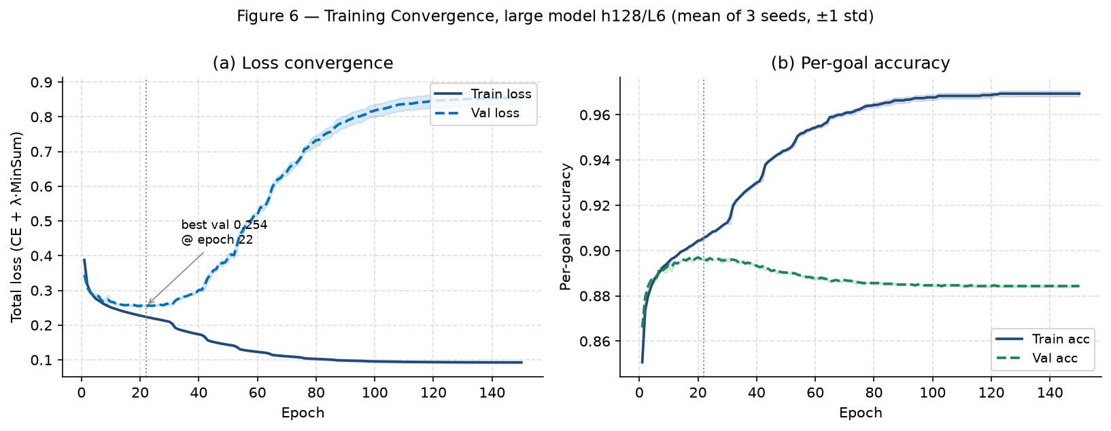
(Extra) Overfitting & small-vs-big
Notes:
Val loss bottoms ~epoch 22 then rises; best-val-loss checkpointing = effective early stopping. Explains why the big model overfits in-distribution but generalizes better far-OOD.

Slide 30
(Extra) Metrics
• Offline — allocation agreement (per-goal / full-assignment accuracy)
• Execution cost — true CBS path-length ratio (NN / solver)
• Exact match — identical integer cost (≫ exact-allocation match → ties)
Notes:
Code: evaluation/evaluate.py (offline), full_pipeline_eval.py (execution cost).

