Slide 1

Electric Vehicle Data Extraction and Analysis Using Web Scraping in Python
Prepared By : Velagada Dayana

Slide 2
About Me
Background
B.Sc. Computer Science Graduate
Academic Score: 94.4%
Why I Want to Learn Data Analysis
Strong interest in technology and data analysis
Passionate about solving problems using data
Looking to build a career in the data domain
Work Experience
1.5 years of experience in customer support at Tech Mahindra, handling customer queries, resolving issues efficiently, and delivering quality service while building strong communication and problem-solving skills
LinkedIn & GitHub
https://www. linkedin.com/in/velagada-dayana-90834a3a7
https://github.com/Dayana1320

Slide 3
Agenda
Project Overview
Objective of the Project
Problem Statement
Data Collection Process
Data Cleaning & Preprocessing
Exploratory Data Analysis
Key Analysis Questions
Results & Conclusion
Challenges Faced
Q & A

Slide 4
Problem Statement
EV data is unstructured
Manual collection is time-consuming
Difficult to compare vehicle specifications
Data exists in multiple formats
High possibility of errors
Need for automation

Slide 5
Objective of the Project
Extract EV data automatically
Collect vehicle specifications
Clean and preprocess the data
Build a structured dataset
Support analysis and visualization
Enable future ML applications

Slide 6
Data Source & Tools
EV Database Website :https://ev-database.org/
Numpy
Requests
Beautiful Soup
Pandas
Matplotlib
Seaborn

Slide 7
Data Collection Process
Send HTTP requests
Access webpage content
Parse HTML structure
Extract EV specifications
Store records in lists
Create Data Frame

Slide 8
Features Extracted
Total No of Rows : 500
Total No of Columns : 8
Brand
Model
Battery Capacity
Range
Efficiency
Price
Weight
Fast Charge Speed

Slide 9
Data Cleaning
Remove symbols
Handle missing values
Remove duplicates
Standardize units
Convert text to numeric
Improve consistency

Slide 10
Exploratory Data Analysis (EDA)
Univariate Analysis
Histogram
Count Plot
Box Plot
KDE plot
Violin Plot
Bar Chart
Bivariate Analysis
Count Plot
Bar Chart
Scatter plot
Multivariate Analysis
Correlation Heatmap

Slide 11
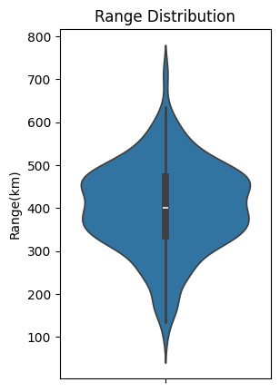
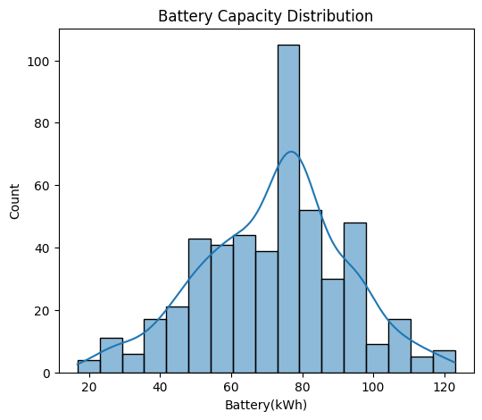
Univariate Analysis

Slide 12
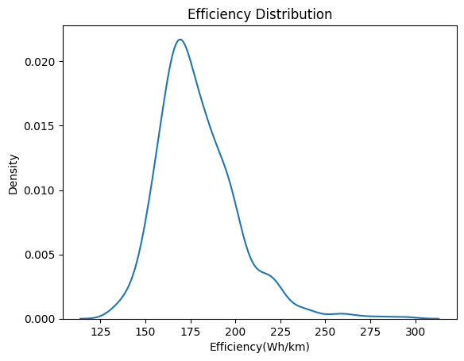
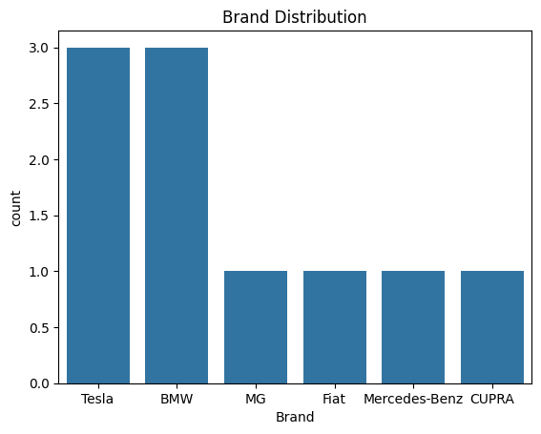
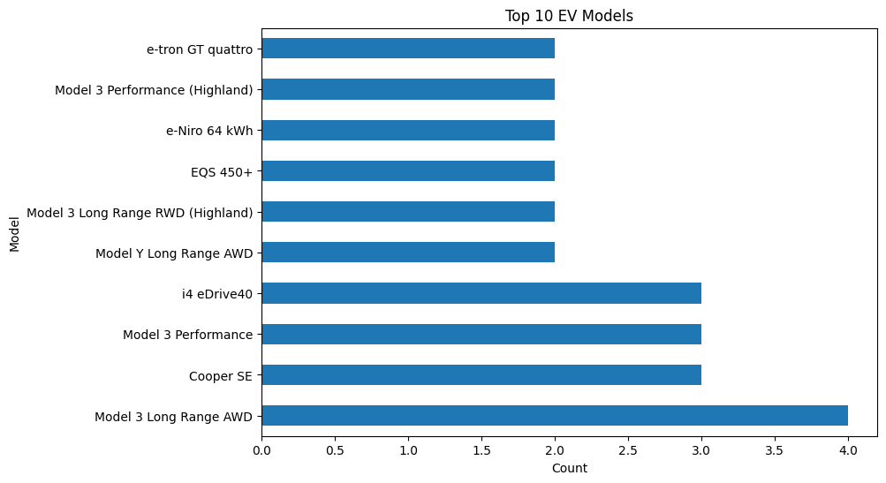
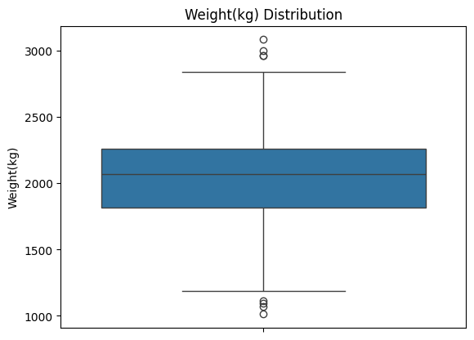

Slide 13
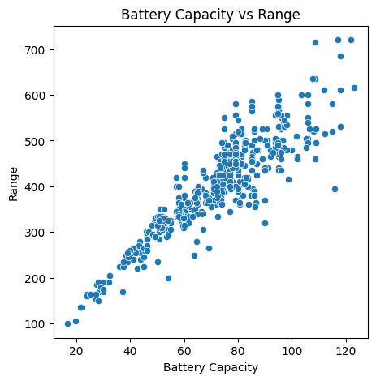
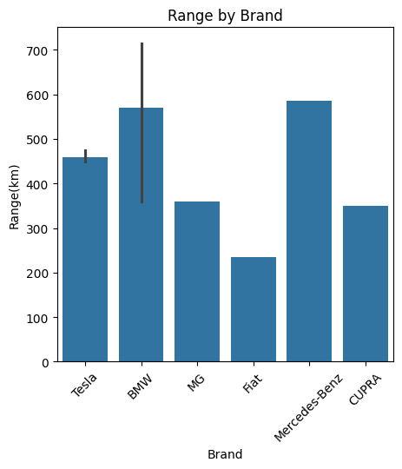
Bivariate Analysis

Slide 14
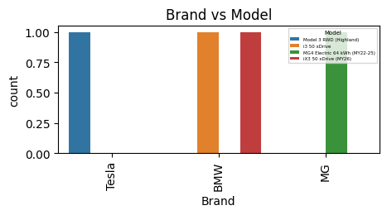

Slide 15
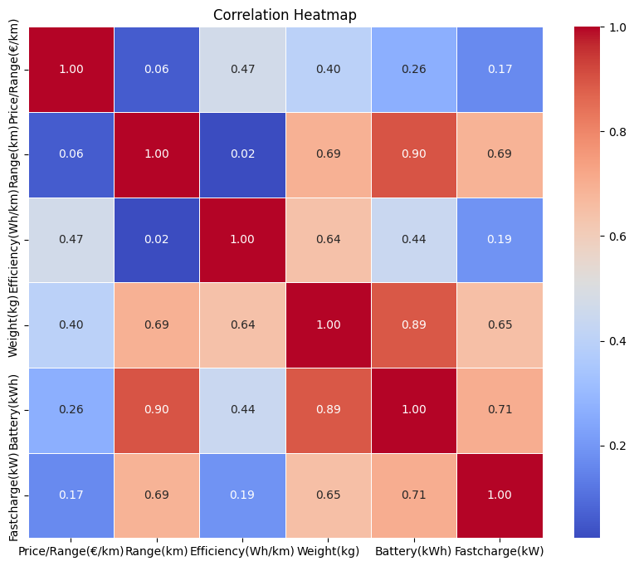
Multivariate Analysis

Slide 16
Key Analysis Questions (Use Cases)
Which brands offer the highest range?
How does battery capacity affect range?
Which EVs are most efficient?
What is the relationship between price and performance?
Which vehicles support faster Charging?
How do EV specifications vary across brands?

Slide 17
Results
Successfully extracted EV data
Built a structured dataset
Improved data accessibility
Reduced manual effort
Prepared data for visualization
Ready for further analysis

Slide 18
Conclusion (Key Findings Overall)
Web scraping automated data collection
Created a clean and organized dataset
Battery capacity influences vehicle range
Efficiency differs across EV brands
Structured data supports better comparison
Dataset can be used for ML applications

Slide 19
Challenges Faced
Understanding webpage structure
Handling missing values
Cleaning inconsistent data
Converting text into numbers
Managing large datasets
Ensuring accurate extraction

Slide 20
Experience Working on the Project
Improved Python skills
Learned web scraping techniques
Gained experience in data cleaning
Worked with real-world datasets
Practiced EDA methods
Enhanced problem-solving abilities

Slide 21
Questions and Answers ??

Slide 22

THANK YOU

