Slide 1


INNOVATION. AUTOMATION. ANALYTICS
PROJECT ON
Global Retail Sales
Using Power BI
Prepared By: Velagada Dayana

Slide 2
Project Overview
This project focuses on analyzing global retail sales data using Power BI. I analyzed sales, profit, discounts, returns, products, customers, and shipping performance. The dashboard provides useful insights into business performance and helps management make better data-driven decisions.
Developed an interactive Global Retail Sales Dashboard using Power BI
Analyzed sales data across different regions, categories, and customer segments.
Evaluated Sales, Profit, Discounts, Returns, and Shipping Performance.
Identified high- and low-performing regions, products, and customer segments.
Created interactive KPIs, charts, and slicers to support business decision-making.
The dashboard helps management make data-driven decisions and improve profitability.

Slide 3
Business Problem
The company has a large amount of sales data, but it needs to understand where it is making profit and where it is facing problems. The main challenges are differences in regional profit, discounts, returns, product performance, shipping costs, and regional manager performance.
Profit performance varies across different regions.
High discounts may reduce overall profit.
Some customer segments contribute more profit than others.
Returned orders can affect sales and profitability.
Some products and categories generate more revenue than others.
Different shipping modes have different costs and profitability.
Regional manager performance may vary across locations.

Slide 4
Objective of the Project
Analyze sales, profit, returns, and regional performance using Power BI to support data-driven decisions.
Identify which regions and segments drive the most profit
Quantify how discounts and returns affect profitability
Track actual sales against regional targets
Enable drill-through analysis from Region → Product → Customer
Give regional managers a single source of truth for performance

Slide 5
Datasets Provided
Table | Type | Purpose
Orders | Fact Table | Contains all sales transactions — order, ship, customer, product, sales, profit, discount, and quantity details
Returns | Dimension Table | Identifies which orders were returned (Order ID, Returned Yes/No, Market)
People | Dimension Table | Assigns a sales manager to each Region

Slide 6
Data Cleaning & Transformation
Checked for missing/null values and handled them where required.
Corrected data types for dates, numbers and categorical columns.
Ensured Sales, Profit, Discount and Quantity were treated as numerical fields.
Formatted Order Date and Ship Date as date fields.
Reviewed Postal Code values and handled null values appropriately.
Checked for duplicate/unwanted records.
Verified categorical fields such as Region, Segment, Category and Ship Mode.
Used the cleaned data to create DAX measures and dashboard visuals.

Slide 7
Data Model & Relationships
Returns
(Dimension)
People
(Dimension)
Order ID
Region
Orders
(Fact Table)
Fact Table: Orders
Dimension Tables: Returns and People, each connected to Orders
Orders ↔ Returns joined on Order ID
Orders ↔ People joined on Region

Slide 8
Key DAX Measures
Total Sales = SUM(Orders[Sales])
Total Profit = SUM(Orders[Profit])
Total Quantity = SUM(Orders[Quantity])
Profit Margin % = DIVIDE([Total Profit], [Total Sales], 0)
Return Rate % = DIVIDE(COUNTROWS(Returned Orders), COUNTROWS(Orders), 0)
Average Shipping Cost = AVERAGE(Orders[Shipping Cost])
Top 10 Products by Sales = RANKX(ALL(Orders[Product Name]), [Total Sales])

Slide 9
Dashboard KPI Cards
💰
📈
📊
↩️
12.64M
1.47M
11.61%
4.68%
Total Sales
Total Profit
Profit Margin %
Return Rate %
Sum of all order sales
Sum of all order profit
Profit ÷ Sales
Share of orders returned

Slide 10
Dashboard Visuals
📈
Line Chart — Monthly Sales Trend
📊
Bar Chart — Sales by Region
🍩
Donut Chart — Segment Contribution
📶
Bar Chart — Top 10 Products by Sales
🎯
Gauge — Sales vs Target

Slide 11
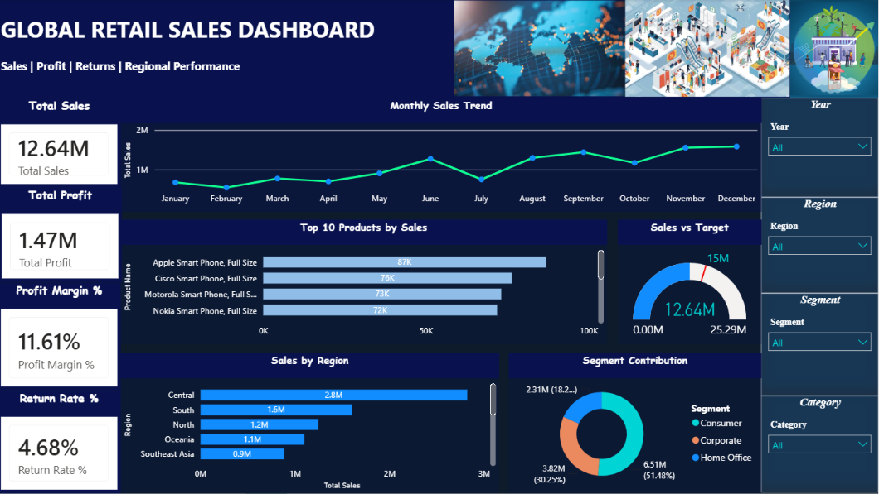
Live Dashboard Preview
12

Slide 12
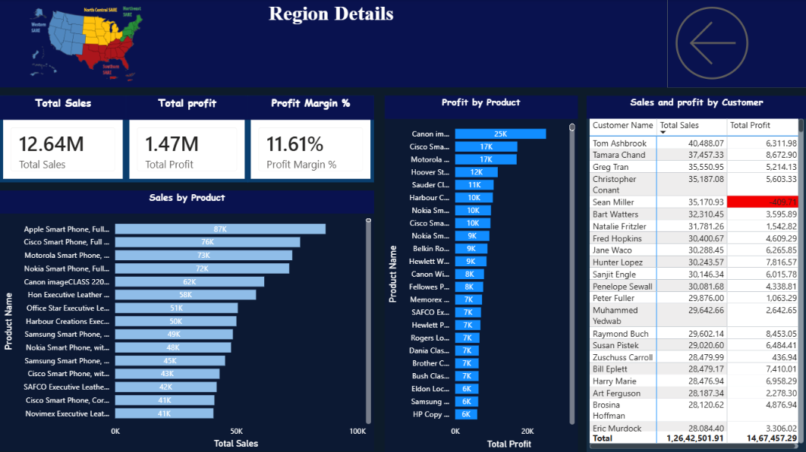
Region Details — Drill-Through Page
13

Slide 13
Sales Performance by Region
Central leads with $2.8M in sales
Canada is the smallest of the regions shown, at $ 67K in sales

Slide 14
Segment Contribution
Consumer drives 51.48% of total sales ($6.51M)
Corporate contributes 30.25% ($3.82M)
Home Office is the smallest segment at 18.27% ($2.31M)

Slide 15
Top-Performing Products
Leaders within the Top 10 Products by Sales visual — the full ranking is scrollable on the live dashboard.

Slide 16
Business Questions
Q1. Which regions have highest & lowest profits?
Central is the most profitable region - about $311.40k profit. Canada has the lowest profit –about $17.82K
Q2. Are discounts reducing profits in some orders?
Yes. Higher discounts tend to reduce profit margins. Deep discounts, especially above 30%, can result in very low or negative profit. Discounts should therefore be used selectively rather than across all orders.
Q3. Which segments are most profitable?
Consumer is the most profitable segment - about $749.24K profit. Corporate comes second - about $441.21K. Home Office is the lowest - about 277.01K. Therefore, Consumer customers should remain a key focus while improving Home Office performance.

Slide 17
Q4. How many orders are returned per region?
Canada has the highest number of returned orders and is the main region requiring attention. The other regions have comparatively fewer returns . This suggests that return-related issues in the Canada should be investigated, particularly around delivery, product quality and customer expectations.
Q5. Which products generate the most revenue?
Apple Smart Phone is the top-selling product, generating approximately 87K in sales. Other strong products include Cisco Smart Phone, Motorola Smart Phone, and Nokia Smartphone.
Q6. Which shipping modes are most cost-effective?
Standard Class is the dominant and most cost-effective shipping mode. It accounts for roughly 59% of sales/orders and generates the highest overall profit among shipping modes. The business should encourage Standard Class where fast delivery is not essential.
Q7. Are regional sales managers achieving balanced performance?
No, performance is not fully balanced. Aaron Bergman - Central manages the strongest region. North is also performing strongly.

Slide 18

Business Insights & Recommendations
Optimize discount strategy: Avoid excessive discounts on products where margins are already low.
Focus on high-performing regions: Strengthen sales strategies in profitable regions while investigating weaker markets.
Monitor returned orders: Identify the reasons behind high returns and take corrective action.
Prioritize top-selling products: Maintain adequate inventory for products generating strong sales.
Improve segment-focused strategies: Develop targeted strategies for the customer segments contributing more profit.

Slide 19
Key Challenges to Manage
Data cleaning and transformation: Handling missing values, checking data types, and preparing the raw retail data for analysis.
Creating meaningful visuals: Selecting the right charts to clearly represent sales, profit, regional and product performance without making the dashboard cluttered.
DAX calculations: Creating accurate measures for KPIs such as Total Sales, Total Profit, Profit Margin %, and Return Rate %.
Interactive features: Setting up slicers, conditional formatting, and drill-through so users can explore the data easily.
Dashboard design: Maintaining a clean and professional layout while presenting multiple KPIs and visuals on a single page.

Slide 20
Power BI Techniques Applied
Power Query — data cleaning, type conversion, and de-duplication
Star-schema data modeling — one fact table, two-dimension tables
DAX functions — SUM, AVERAGE, DIVIDE, COUNTROW,RANKX
Core visuals — line, bar, and donut charts plus a KPI gauge
Slicers for Year, Region, Segment, and Category
Drill-through pages from Region to Product to Customer
Conditional formatting to flag negative profit in red

Slide 21
Conclusion
Developed an interactive Global Retail Sales Dashboard using Power BI.
Analyzed Sales, Profit, Discounts, Returns, Products, and Shipping Performance.
Identified high and low performing regions, products, and customer segments.
Analyzed the impact of discounts and returned orders on profitability.
Compared shipping modes and regional performance.
Used KPIs, charts, slicers, and DAX measures to present the analysis clearly.
The dashboard helps management understand business performance and make better data-driven decisions.

Slide 22

🤝
THANK
YOU

