Slide 1

“School management system using SQL server”
Abisheva Dayana
SE-2016

Slide 2
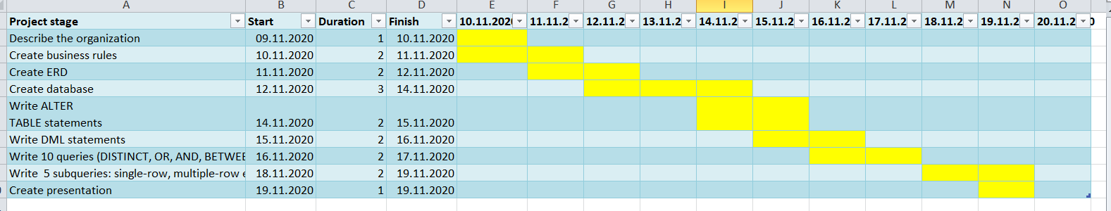
Gant chart
Notes:
Gant chart

Slide 3
References
Cathie Wilson. (2016, January 28). ERD and Business Rules. YouTube. https://www.youtube.com/watch?v=-e7yQc_WgZY
AmpCode. (2020, October 2). SQL Basics | SQL Introduction Tutorial in 15 mins | Learn SQL. YouTube. https://www.youtube.com/watch?v=Cjy5egFrBBk
3) freeCodeCamp.org. (2018, July SQL Tutorial - Full Database Course for Beginners. YouTube. https://www.youtube.com/watch?v=HXV3zeQKqGY
4) Live Coding School. (2018, August 30). Mysql просто INNER JOIN, LEFT JOIN, RIGHT JOIN. YouTube. https://www.youtube.com/watch?v=AQEOugimiYc
5) Niels Henrik Juul Hansen. (2014, August 28). SQL INNER JOIN explained. YouTube.
https://www.youtube.com/watch?v=wz6XnW9nk4w

Slide 4
Purpose of creating a database for the school:
The main goal of creating a database for the school is to improve the student assessment system and facilitate the work of teachers in the school. As well as for comfortable monitoring of all school employees. In addition, the database can track student and employee attendance.The database can notify parents of students about their grades and attendance. By creating a database for the school, we will greatly facilitate the work of the Director and the training of students.

Slide 5
Aim of the project
The main goal of creating a database for the school is, of course, to create comfortable conditions for teachers and students of the school.
The dаtabase for the school will a comfortable environment not only for school staff, but also for students. Students can check their grades at any time, and teachers can check student attendance and performance.
Project idea
Create a practical and convenient system for getting information about students and their parents. It allows to access all student-related information with ease, thus facilitating the work of school administrators and teachers.

Slide 6
Literature review
School database for teachers:
Complete attendance automation
Complete marks/grade management
Interact with parents efficiently and effectively
View analytical reports
Email and Internal messaging system
View own attendance
School database for parents:
Get connected with schools effectively and easily
Interact with teachers through internal messaging system.
Know status about her child through attendance, marks, fees etc ...
School database for students:
View online marks and timetable for exams
Interaction with other students, teachers and parents
View own attendance
View timetable in advance
Notes:
School database for teachers:
Complete attendance automation
Complete marks/grade management
Interact with parents efficiently and effectively
View analytical reports
Email and Internal messaging system
View own attendance
School database for teachers:
Complete attendance automation
Complete marks/grade management
Interact with parents efficiently and effectively
View analytical reports
Email and Internal messaging system
View own attendance
School database for teachers:
Complete attendance automation
Complete marks/grade management
Interact with parents efficiently and effectively
View analytical reports
Email and Internal messaging system
View own attendance

Slide 7
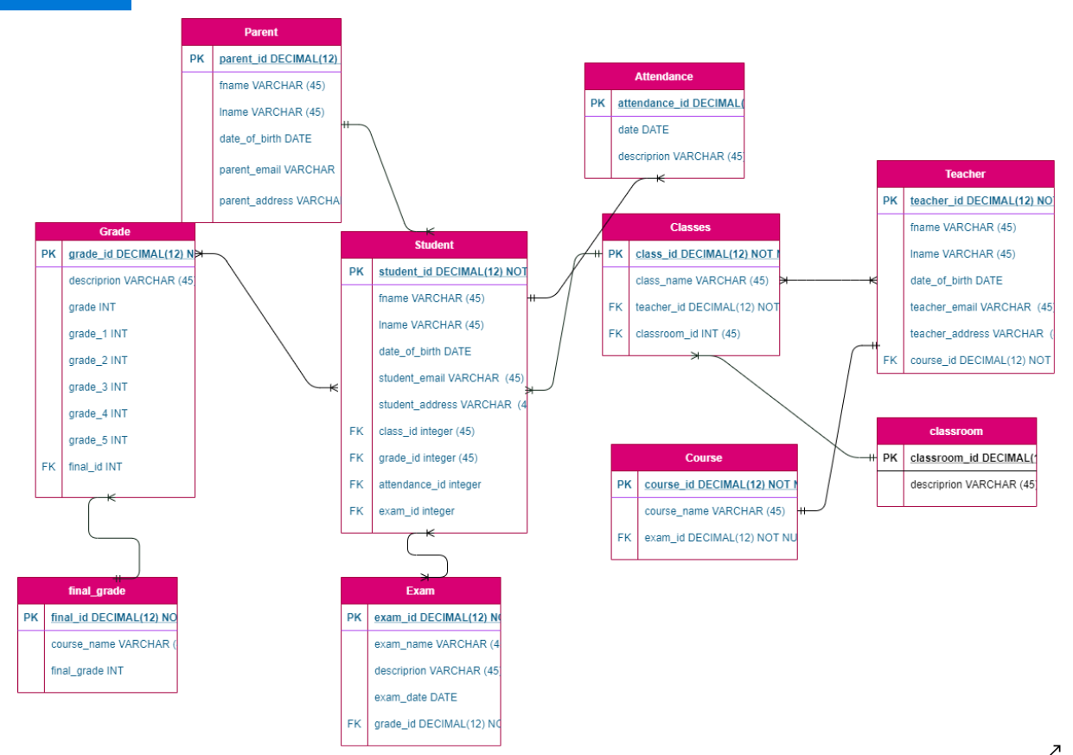
Diagram

Slide 8
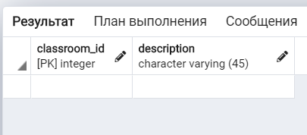
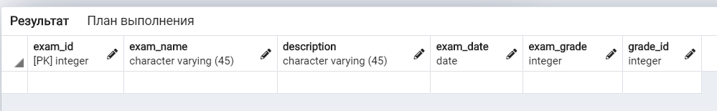
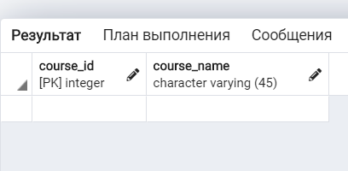
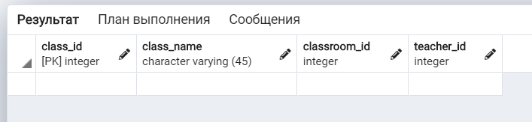
Tables in SQL
Classroom
Exam
Teacher
Course
Classes

Slide 9
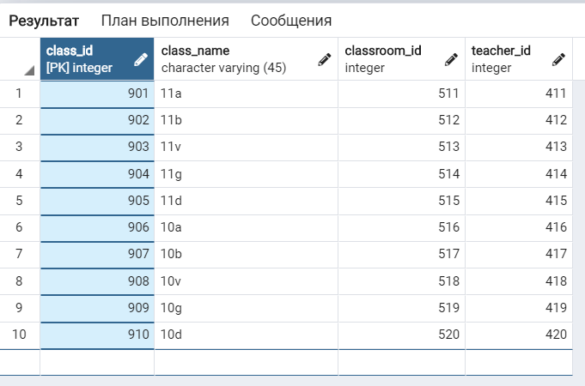
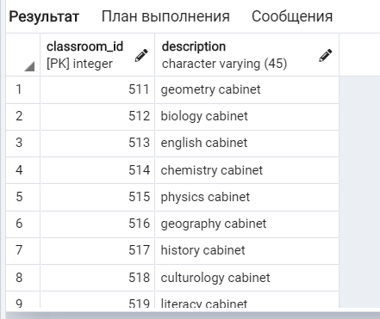
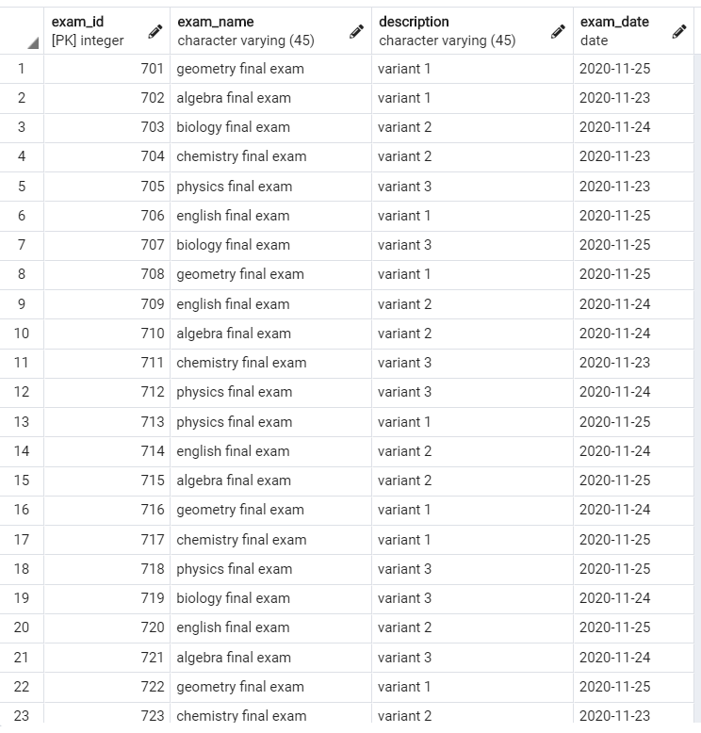
Enter data into SQL
CLASSES
TEACHER
EXAM
CLASSROOM

Slide 10
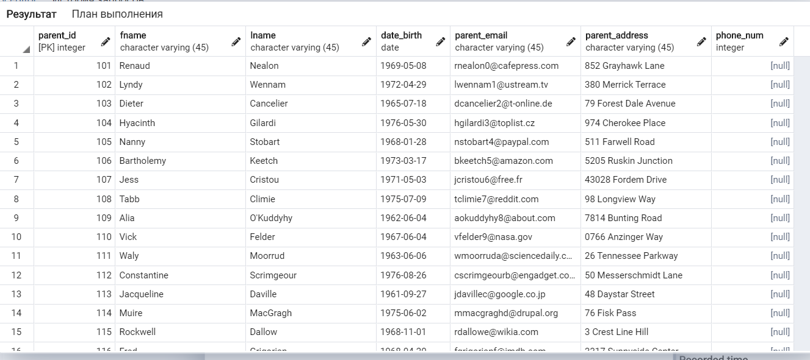
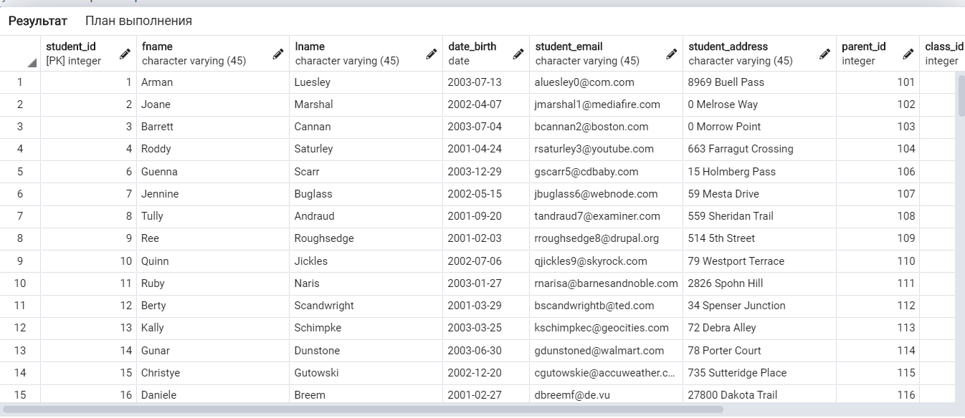
Writing queries
1) alter table parent add column phone_num INT;
2) ALTER TABLE student ALTER date_birth set NOT NULL;

Slide 11
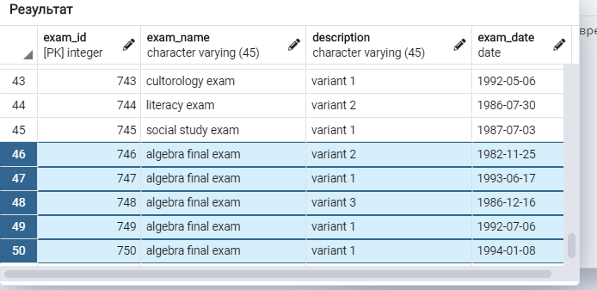
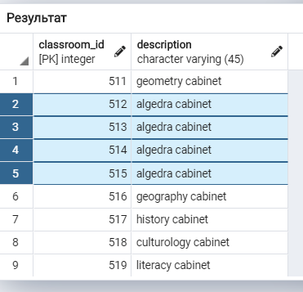
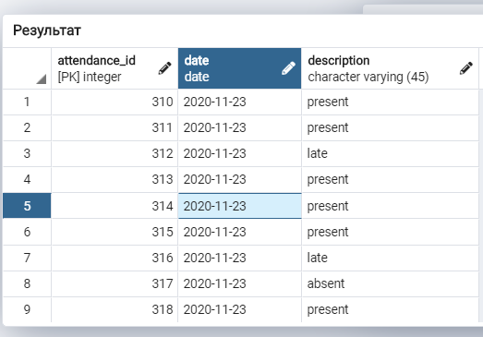
5) UPDATE classroom
SET description = 'algedra cabinet'
WHERE classroom_id > 511 and classroom_id < 516;
6) UPDATE exam
SET exam_name = 'algebra final exam'
WHERE exam_id > 745;
7) UPDATE attendance
SET date = '2020-11-23'
WHERE attendance_id = 314;

Slide 12
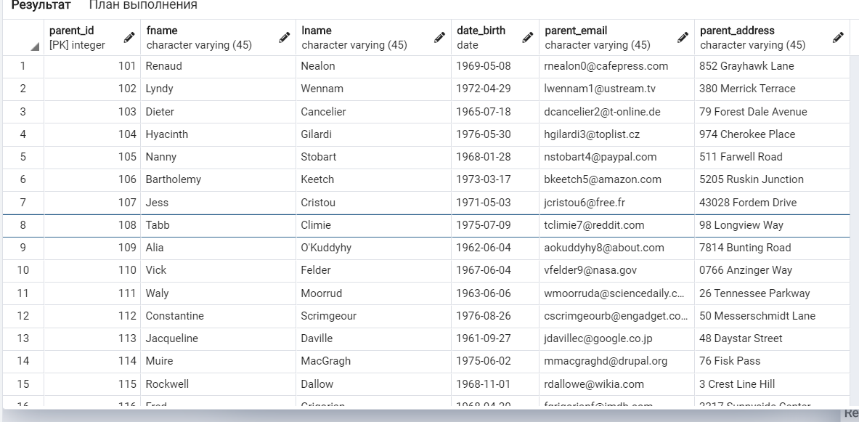
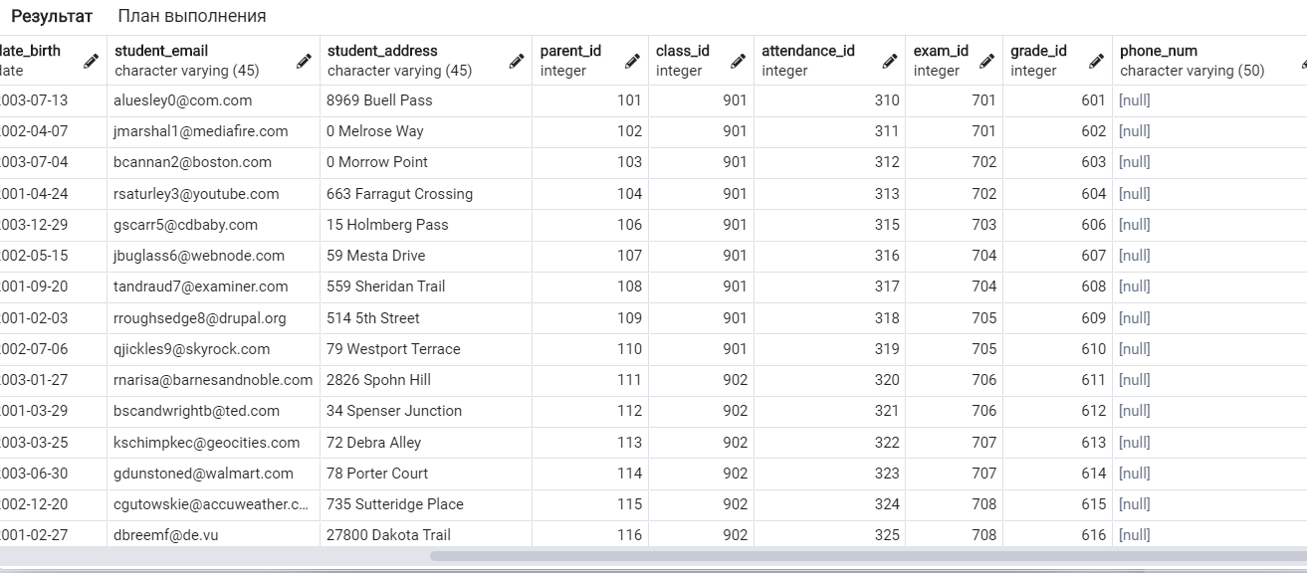
alter table parent drop column phone_num ;
4) ALTER TABLE student
ADD phone_num VARCHAR(50);

Slide 13
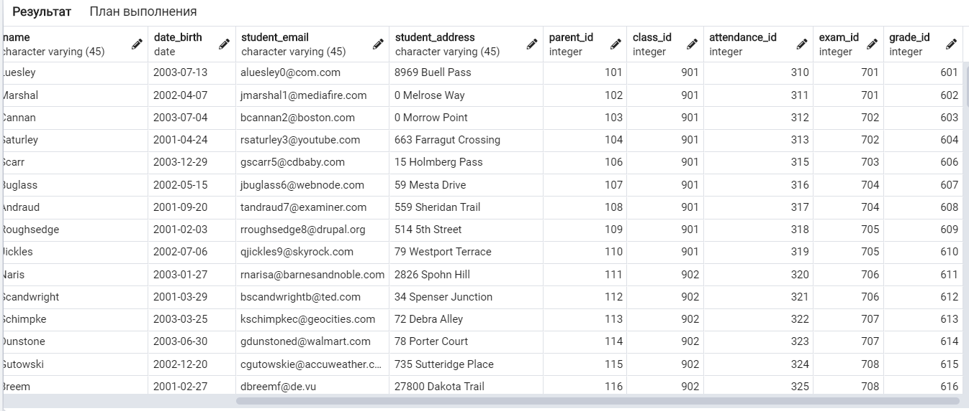
5) alter table student
drop column phone_num ;

Slide 14
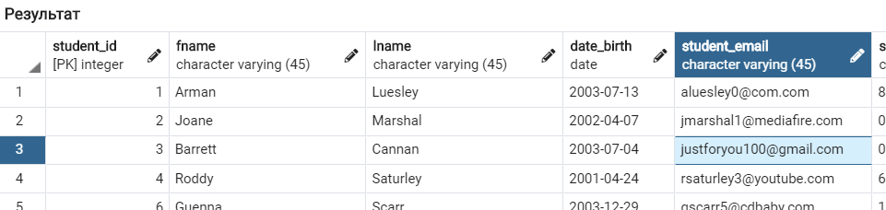
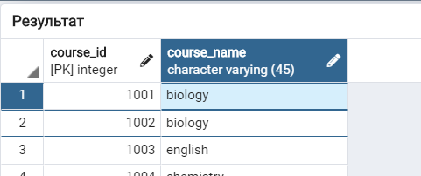
UPDATE
1)UPDATE student
SET student_email = 'justforyou100@gmail.com'
WHERE student_id = 3;
2) UPDATE course
SET course_name = 'biology'
WHERE course_id = 1001;

Slide 15
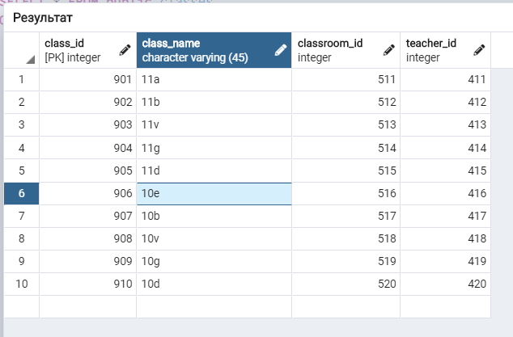
;
3) UPDATE teacher
SET fname = 'Aliyan'
WHERE teacher_id > 415 and teacher_id < 418;
4) UPDATE classes
SET class_name = '10e'
WHERE class_id =906;

Slide 16
5) UPDATE classroom
SET description = 'algedra cabinet'
WHERE classroom_id > 511 and classroom_id < 516;
6) UPDATE exam
SET exam_name = 'algebra final exam'
WHERE exam_id > 745;
7) UPDATE attendance
SET date = '2020-11-23'
WHERE attendance_id = 314;
8) UPDATE final_grade
SET course_name= 'chemistry'
WHERE final_id = 210;
9) UPDATE grade
SET description = 'bad'
WHERE grade_id> 601 and grade_id < 614;
10) UPDATE parent
SET fname = 'Dilan'
WHERE parent_id=102;

Slide 17
11) DELETE from student
WHERE student_id = 3;
19) DELETE from grade
WHERE grade_id = 609;
12) DELETE from grade
WHERE grade_id = 603;
20) DELETE from parent
WHERE parent_id = 104;
13) DELETE from attendance
WHERE attendance_id = 312;
21) DELETE from teacher
WHERE teacher_id = 411;
14) DELETE from classes
WHERE class_id = 901;
15) DELETE from classes
WHERE class_id = 517;
16) DELETE from course
WHERE course_id = 1001;
17) DELETE from exam
WHERE exam_id = 705;
18) DELETE from final_grade
WHERE final_id = 207;
21) DELETE from teacher
WHERE teacher_id = 411;

Slide 18
Thank you
for attention

