Slide 1
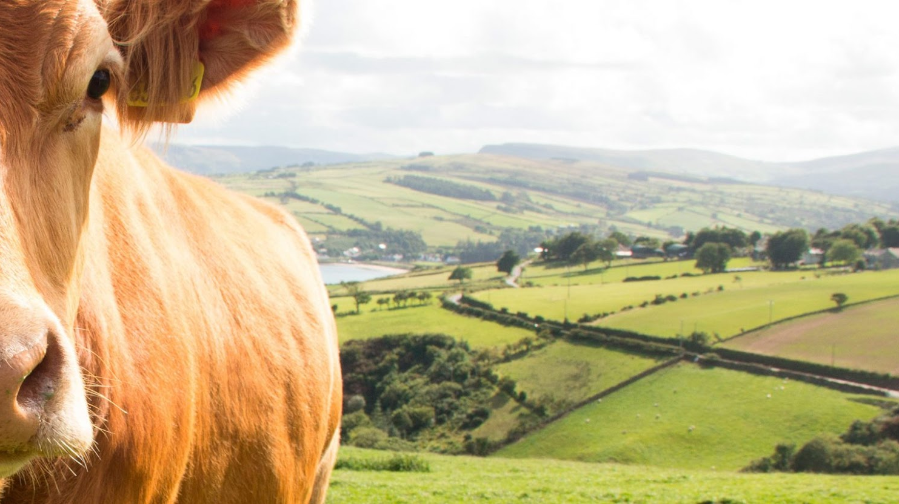

Use of algorithms to identify animal health status

Slide 2

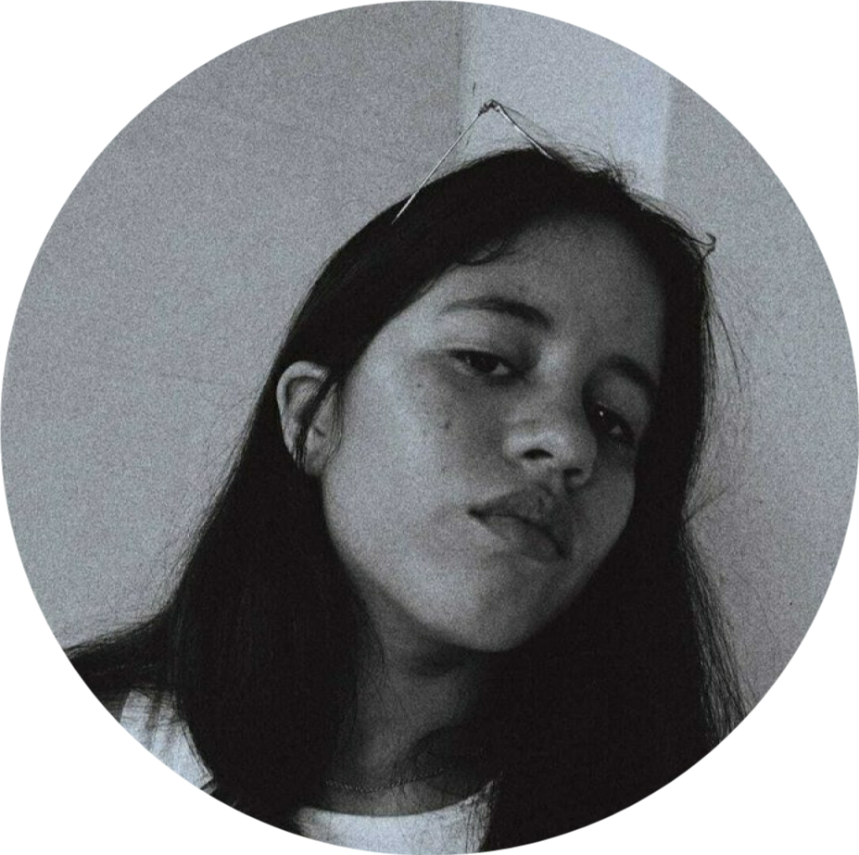
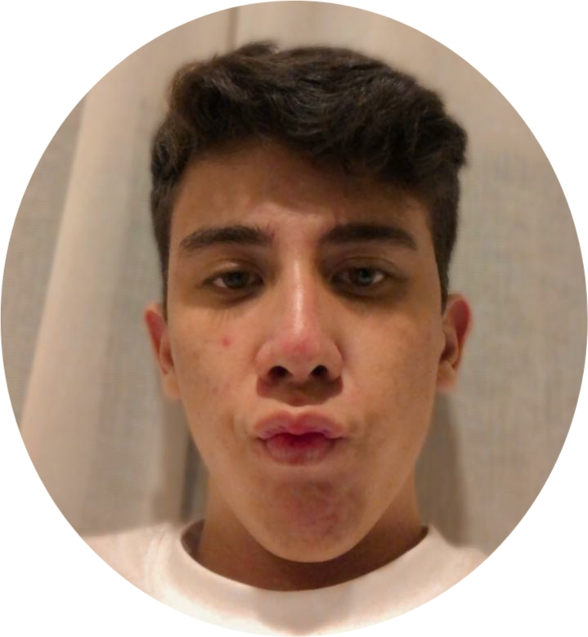
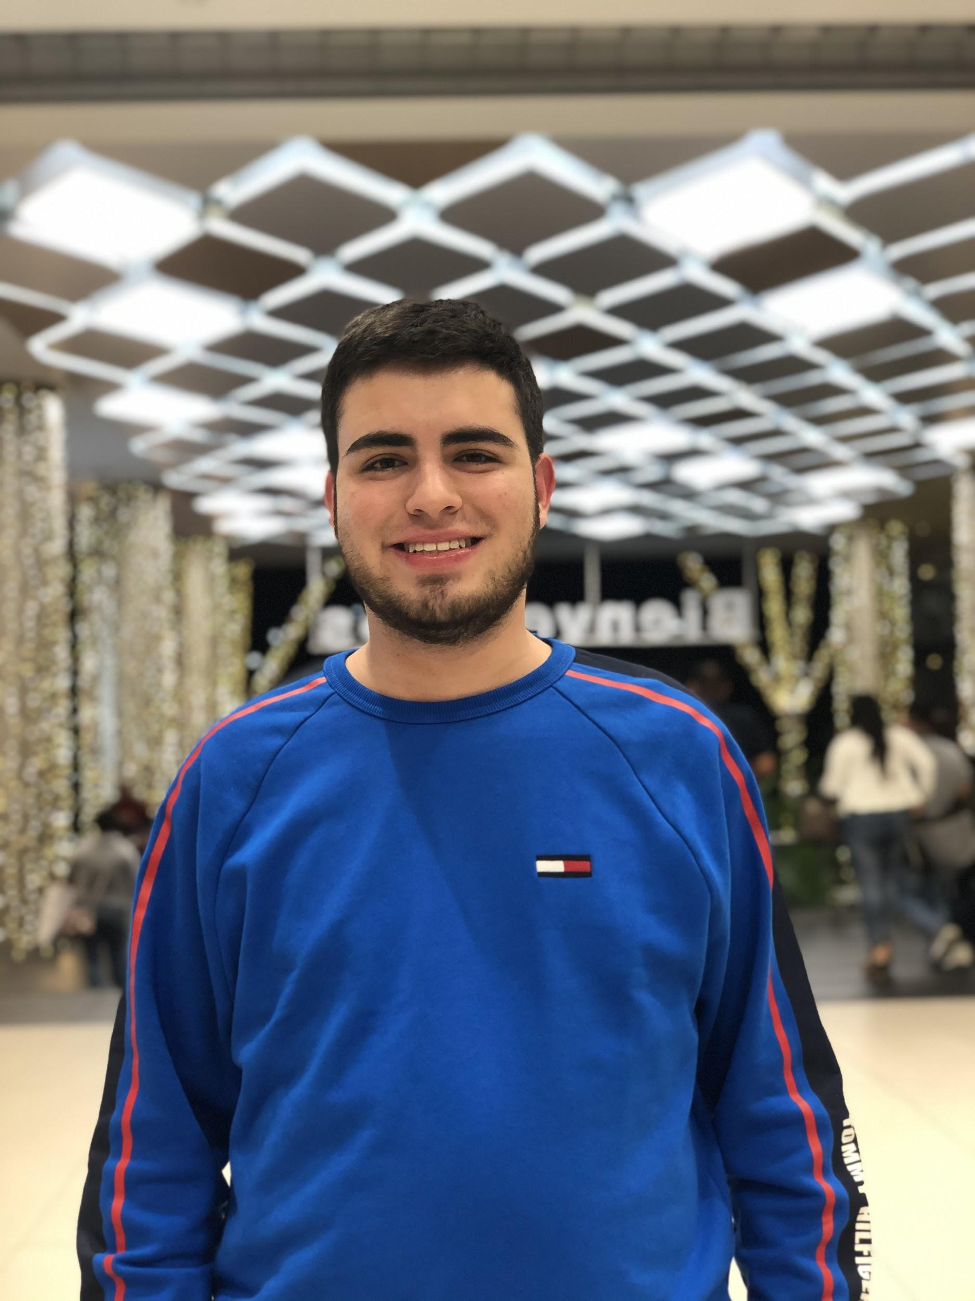
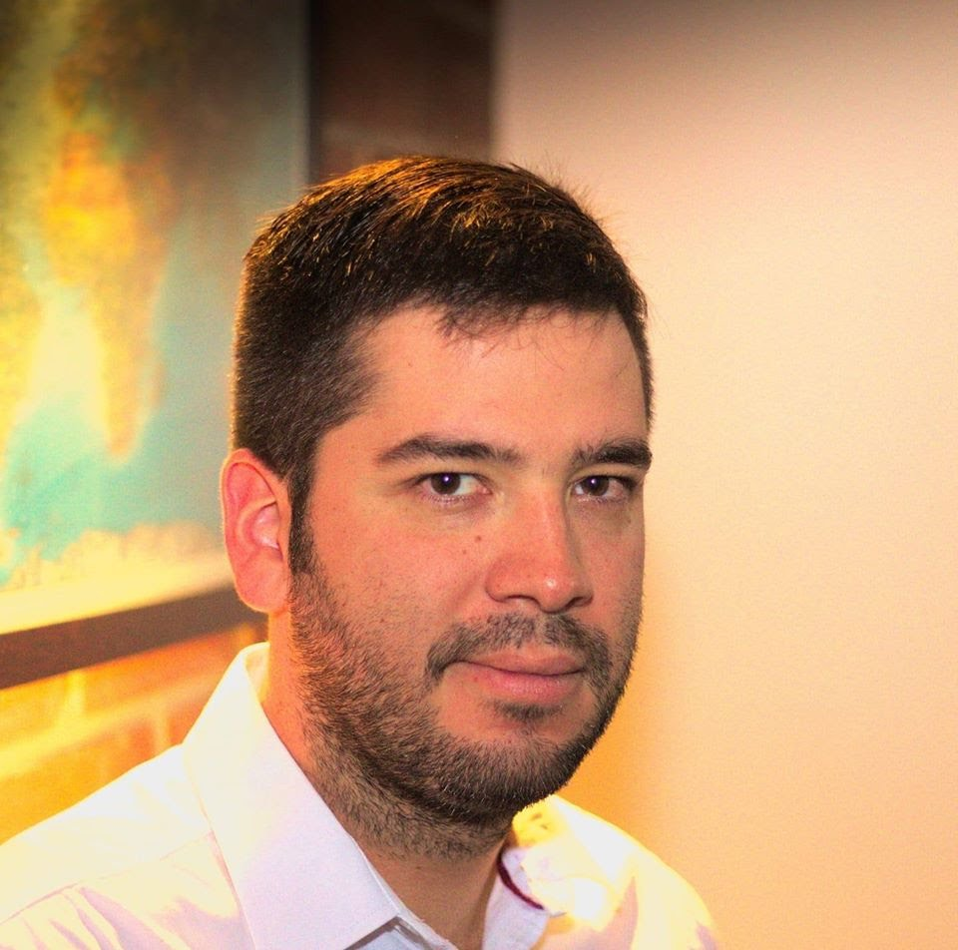

Team Presentation
Dayana
Arrieta
Juan José
Quintana
Simón Marín
Mauricio
Toro
https://github.com/dparrietar/ST0245-002/tree/master/proyecto

