Slide 1
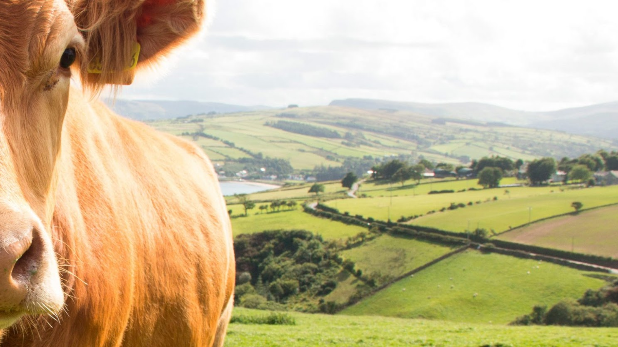

Use of algorithms to identify animal health status

Slide 2
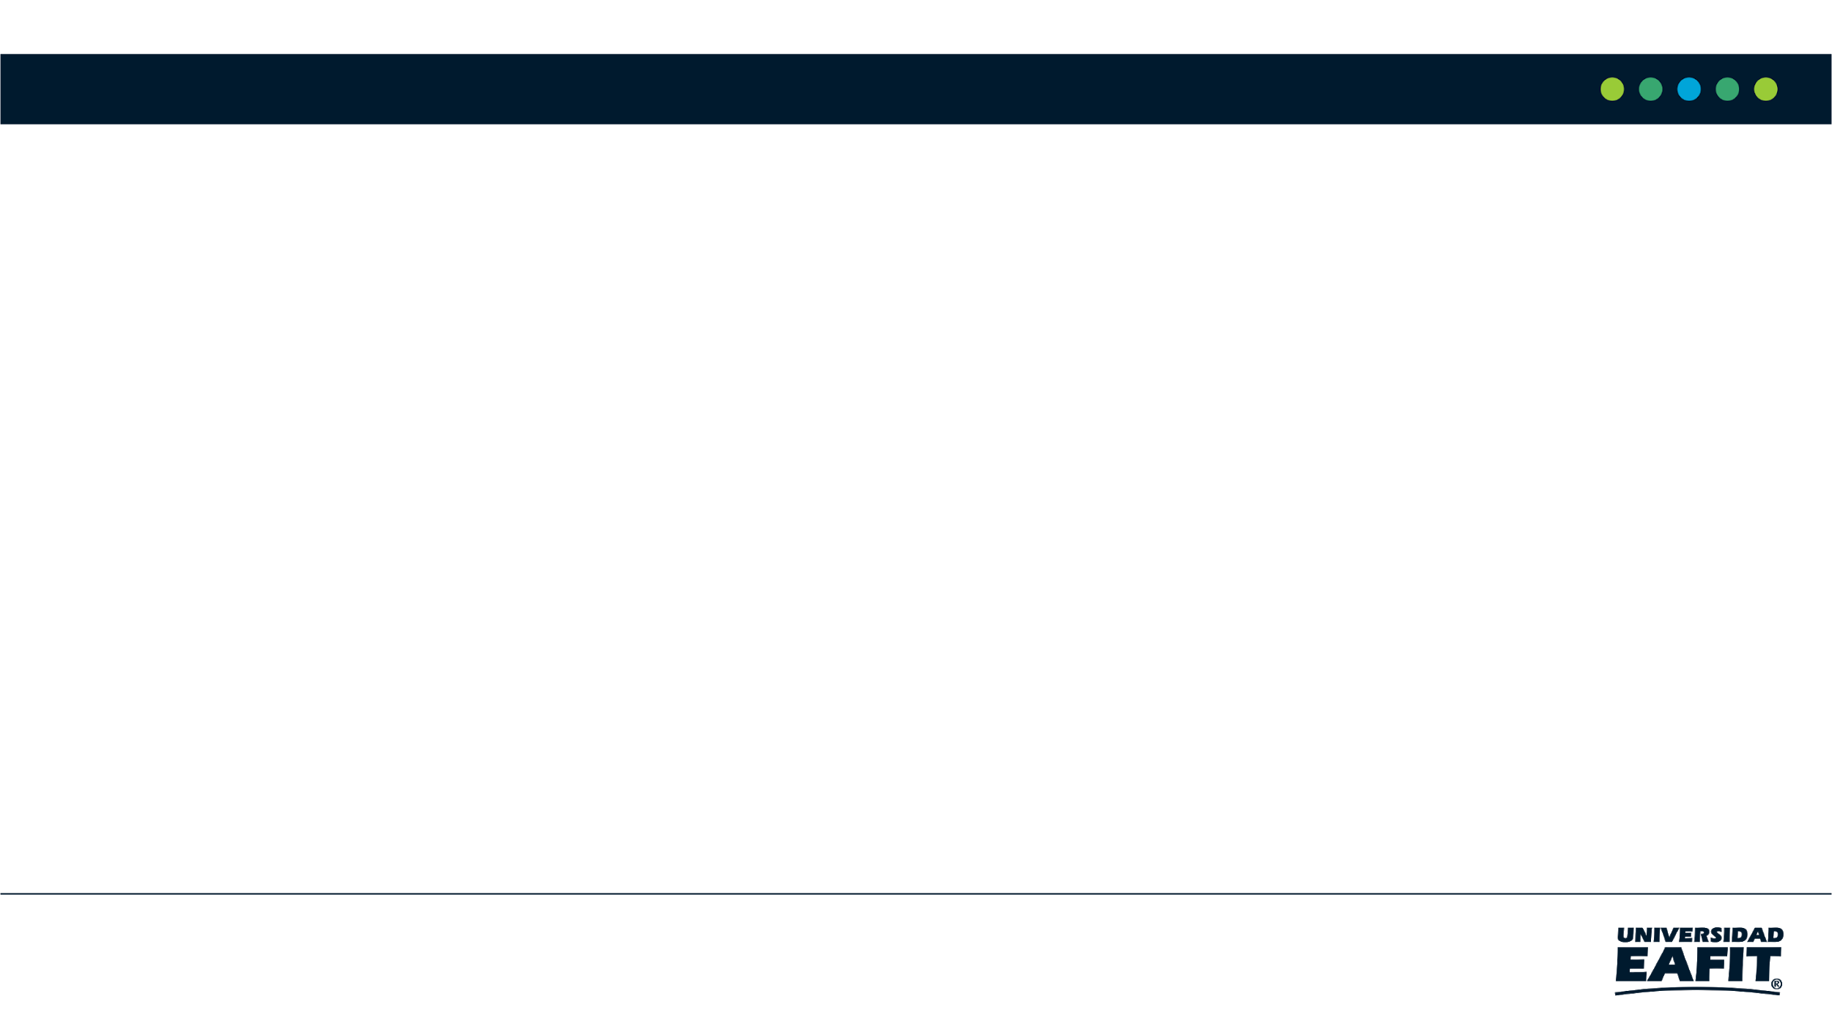





Team Presentation
Dayana
Arrieta
Juan José
Quintana
Simón Marín
Mauricio
Toro
https://github.com/dparrietar/ST0245-002/tree/master/proyecto

Slide 3
1.1 Problem
Lor that treats in this problem is delicate largely by the tall consumption so much of dairy as of meat, therefore, the good classification is paramount since if there is not good classification the product will be in bad state

Slide 4
1.2 Solution
For this solution we choose the algorithm of the nearest neighbor, this is an image scaling algorithm that effectively helps us to our image classification, which for our cattle problem is an important factor, even though it is an image loss algorithm, we believe It is the one indicated to do the compression and also the label of the cattle.

Slide 5
4.1 Data Structure
The data structure that we used was one implemented in python called numpy arrays, which basically consists of a system of vectors or arrays which have positions that can be used effectively. therefore, it helps us a lot for the problem to be solved.

Slide 6
4.2.1 Lossy Image-compression algorithm.
The first thing is to pass the csv files to a pandas dataframe, then that dataframe is used to convert it into a numpy array, when converting it into a numpy array it is read as an image and this image is compressed with the image scaling method, with the function from the nearest neighbor, when doing this, the images are resized by a smaller one, to complete the compression process and it is saved in a new image.

Slide 7
4.2.2 Lossless image-compression algorithm
In the process of decompression of images, it will be the opposite of the compression process, that is, when you have the compressed image, it passes it to a numpy array, then to the dataframe and finally to the csv file.

