Slide 1

01
LAPTOP ANALYSIS
DAYANA J A
DA&DS(TRANIEE)

Slide 2
INTRODUCTION
05
PROJECT OVERVIEW
This project aims to deliver insights that are valuable for both consumers looking to make informed purchase decisions and manufacturers aiming to stay competitive.
OBJECTIVE OF THE ANALYSIS
Analyze the relationship between laptop specifications and pricing.
Explore variations in features across different brands.
Identify trends and correlations in laptop performance and cost.
Clean and prepare the dataset for accurate analysis.
Visualize findings to reveal key market insights.

Slide 3
DATA UNDERSTANDING
06
CATEGORICAL VARIABLES NUMERICAL VARIABLES
Company
TypeName
ScreenResolution
Cpu & Gpu
Memory
OpSyS
Inches
Ram
Weight
Price
.

Slide 4
DATA CLEANING
06
Checked for unique values
Dropped the unwanted column
Replaced the ? With nan
Removed Duplicates, missing values
Used Strip functions to extract
Removed some units and converted to the appropriate data types
Handled the missing values → Mode → Median
Checked for Outliers
.

Slide 5
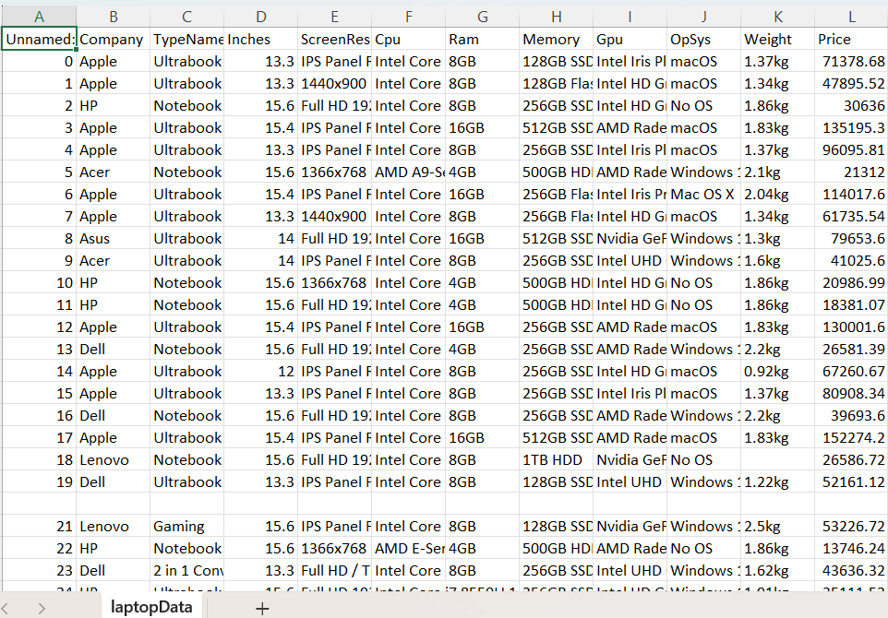
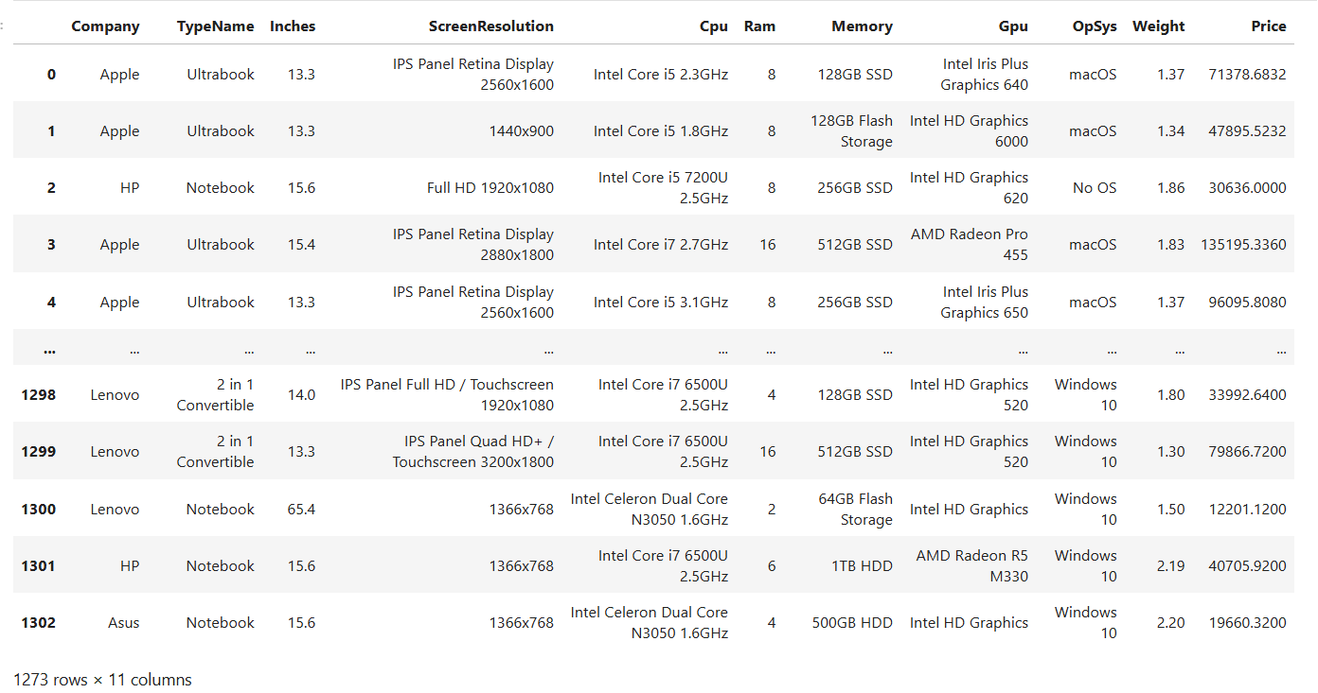
DATA CLEANING
06
RAW DATA
CLEANED DATA
.

Slide 6
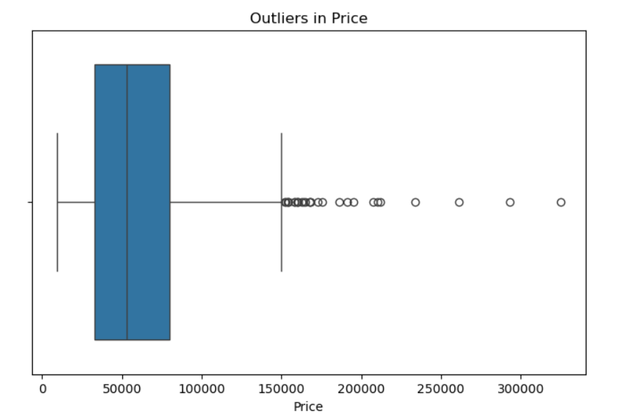
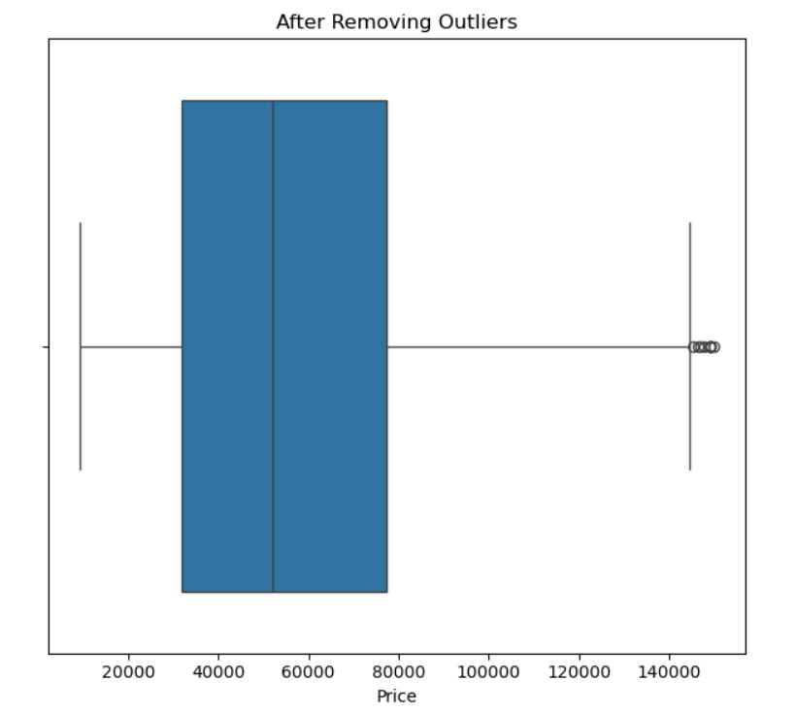
DATA CLEANING
06
OUTLIERS
AFTER REMOVING OUTLIERS
.

Slide 7
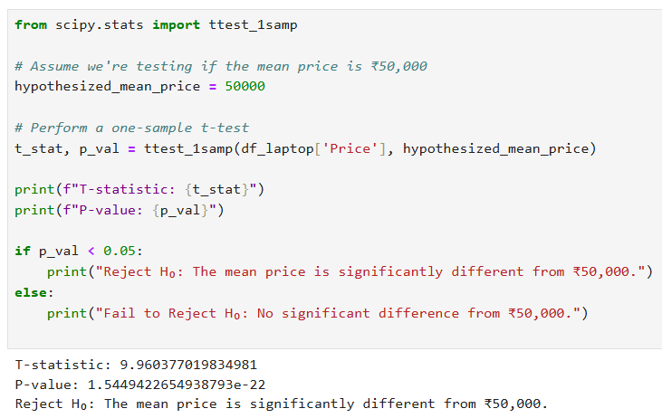
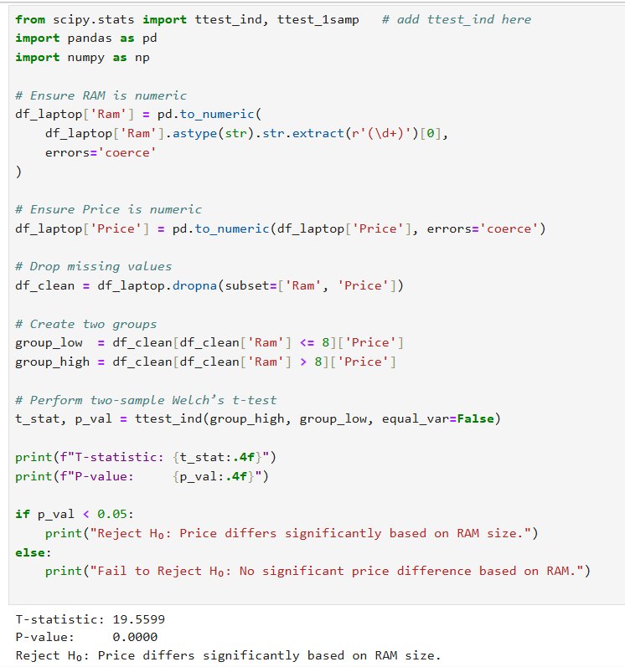
HYPOTHESIS TESITNG
06
AVERAGE PRICE
RAM Vs PRICE
.

Slide 8
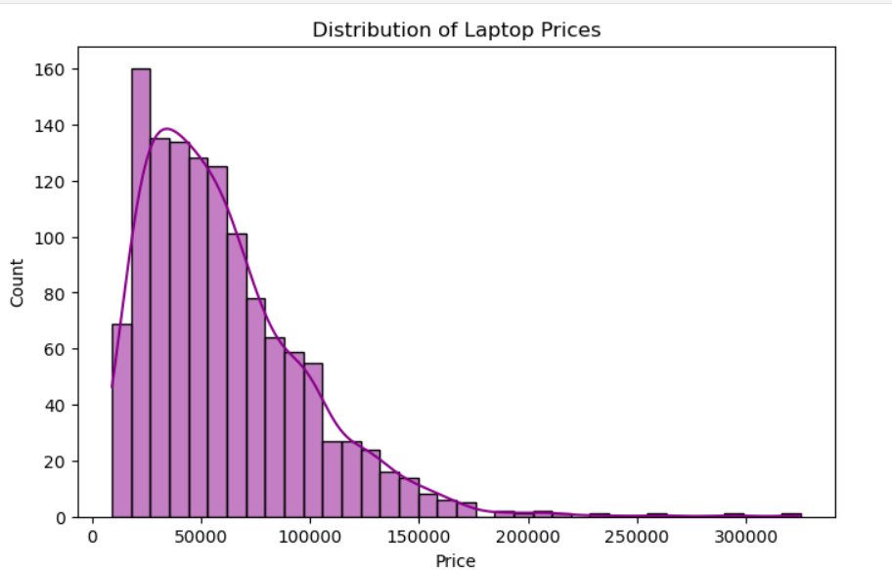
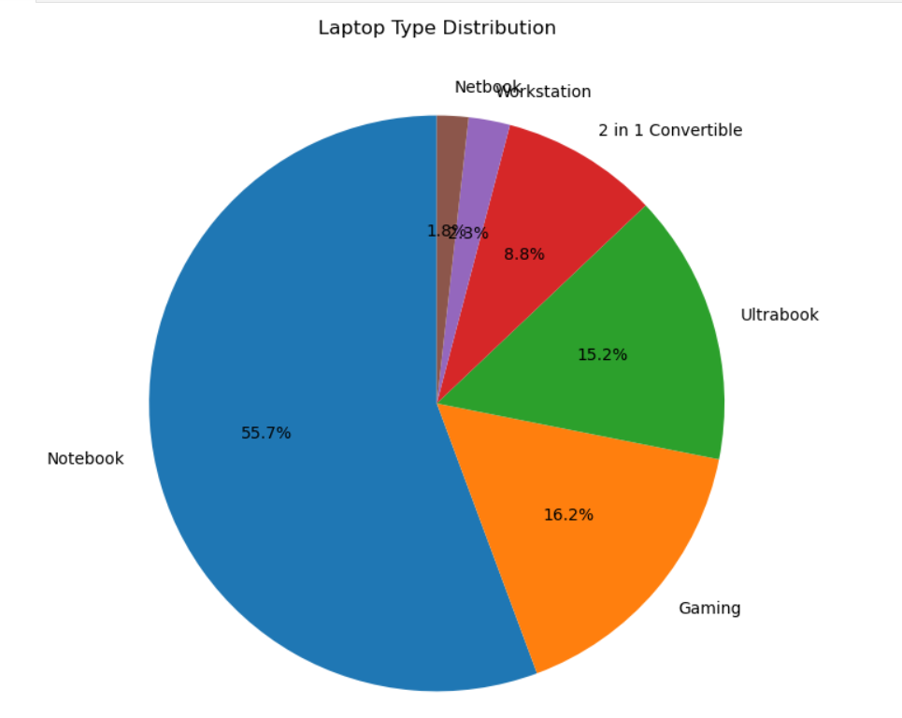
EXPLORATARY DATA ANALYSIS
06
UNIVARIANT ANALYSIS
.

Slide 9
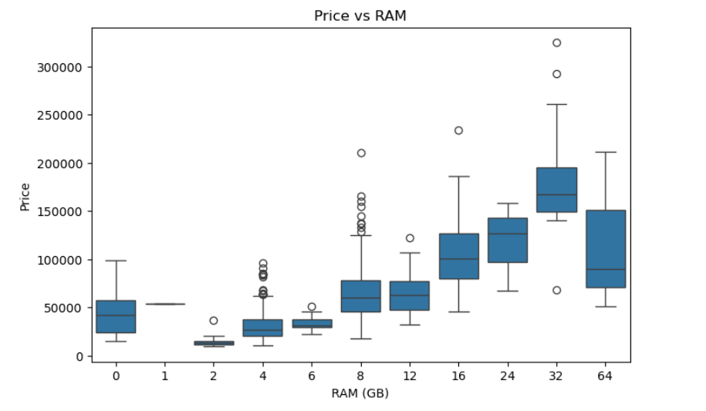
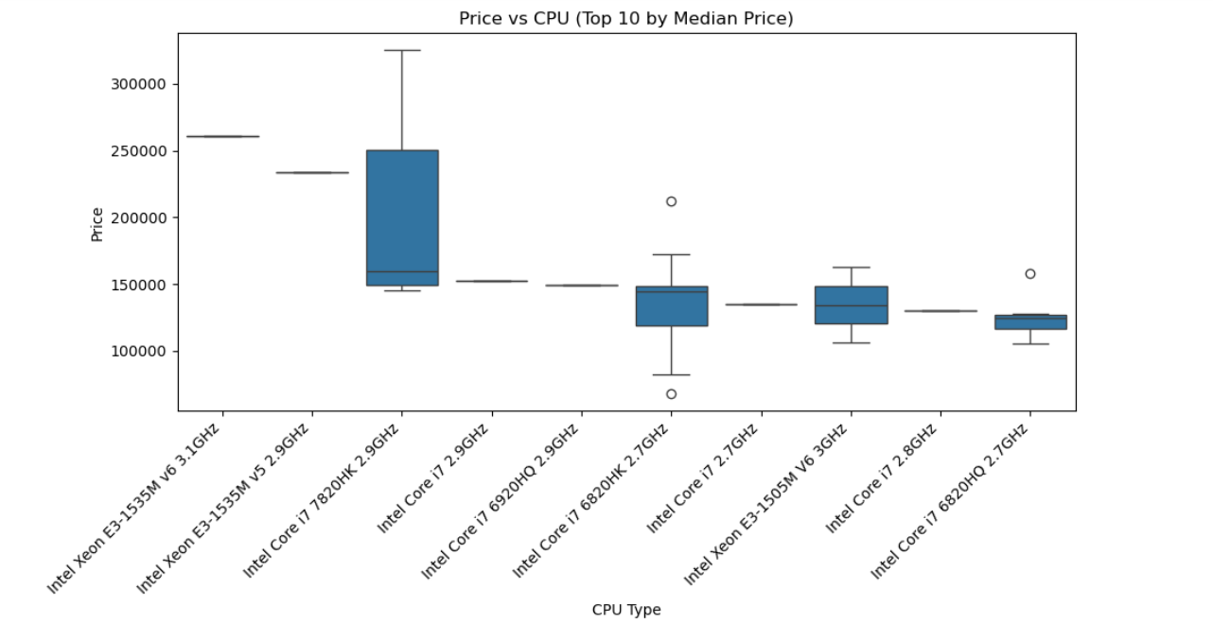
EXPLORATARY DATA ANALYSIS
06
BIVARIANT ANALYSIS
.

Slide 10
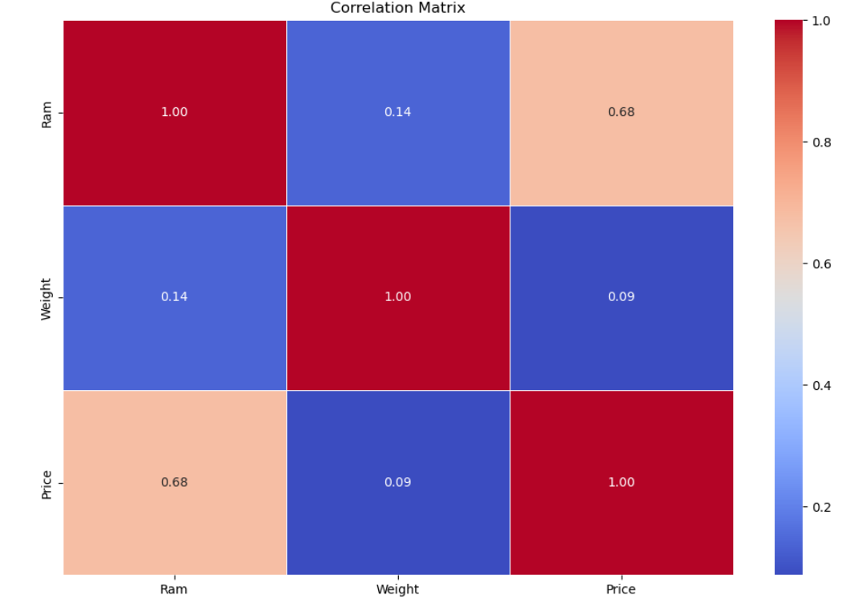
EXPLORATARY DATA ANALYSIS
06
MULTIVARIANT ANALYSIS
.

Slide 11
INSIGHTS
09
SSDs make laptops faster to use, so laptops with SSDs usually cost more.
Asus and Acer are more budget-friendly , Dell, HP, and Lenovo are mid-range.
Lighter laptops are made for portability (travel, work).
Heavier laptops are usually for gaming or heavy tasks.
Laptops with 16GB+ are for gaming or advanced work.
Higher resolution (Full HD or more) can increase the price, even if other specs are the same.
A laptop with SSD + 16GB RAM + i7 CPU + GPU is always in the higher price range.

Slide 12
RECOMMENDATION
09
Target Specific User Segments with Tailored Laptop Features
Higher RAM → larger screens for gaming or video editing → lightweight models
Improve Battery Life in Budget Laptops
Optimizing battery efficiency → Lower-cost models → Improve consumer satisfaction
→ Create a competitive edge in the market
Invest in Ultrabooks for the Premium Segment
Focusing on innovation in design → performance, and longevity
Improve Thermal Management in Gaming Laptops
Heat issues → Invest in better thermal management solutions

Slide 13

10
THANK YOU

