Slide 1

SALES DATASET ANALYSIS
DAYANA J A
DATA ANALYTICS & DATA SCIENCE
BATCH-OCTOBER-2024

Slide 2
PROJECT OVERVIEW
OVERVIEW:
To analyze sales data to identify trends, understand sales performance,& provide actionable business insights
GOAL:
To identify the high performing products and sales channel.
Analyze sales trends over time.
Determine the impact of returns, discounts, gross sales, and net sales.
Create a dynamic dashboard with key metrics

Slide 3
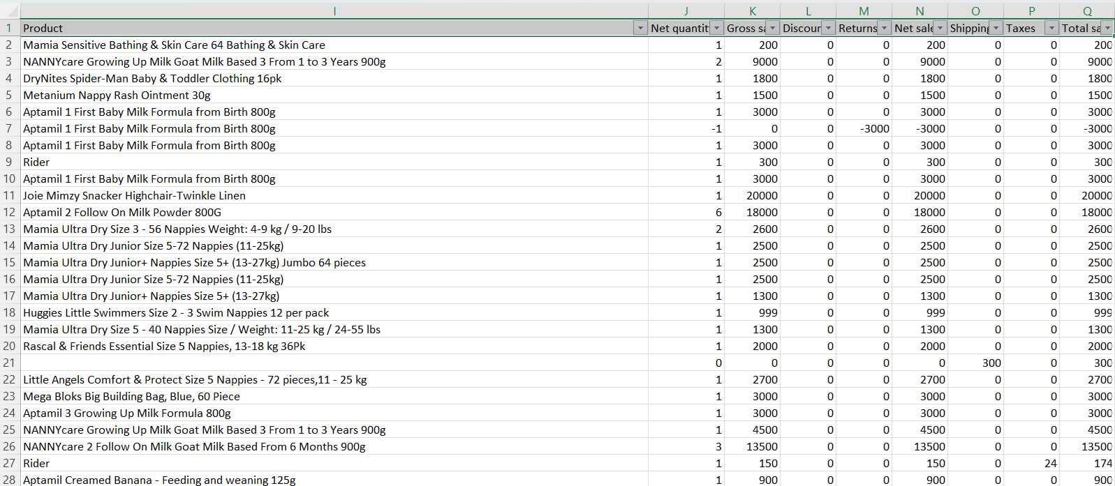
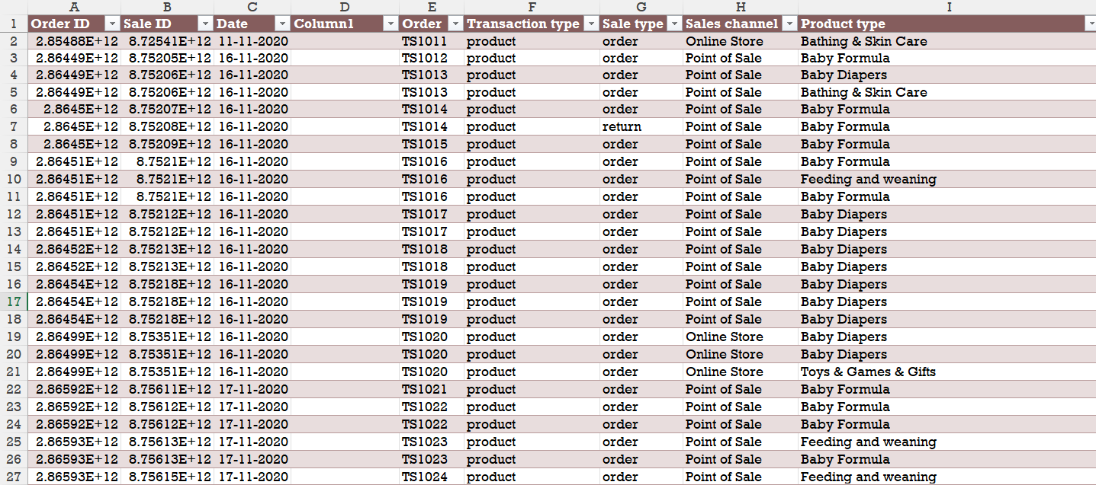
DATA DESCRIPTION AND PREPARATION
DATA SET OVERVIEW:
Dataset is about overviewing the sale of the different product which is sold offline and online over the period
DATA CLEANING PROCESS:
Dataset is cleaned using power query
Removed duplicates, split column, and removed empty rows

Slide 4
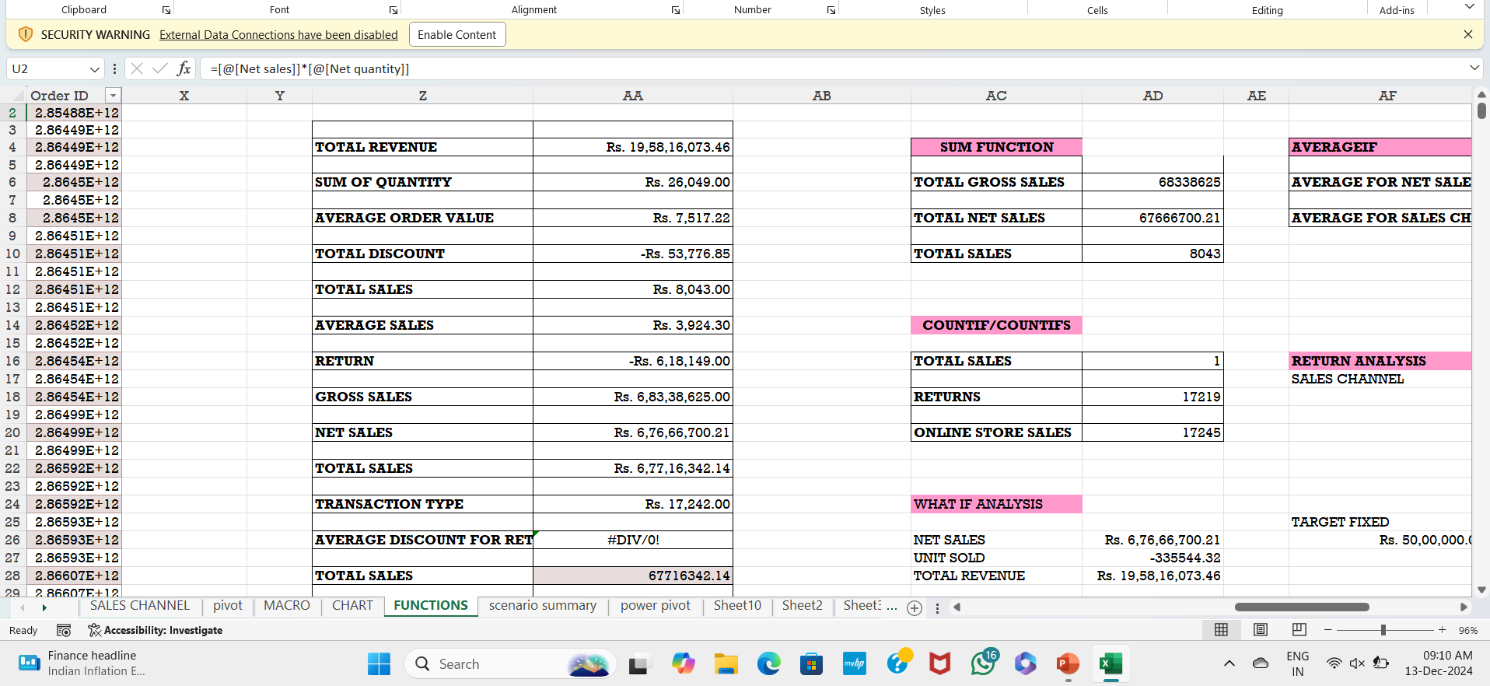
CALCULATION USING EXCEL FUNCTIONS
Total sales (Gross sales ,Net sales, Adjusted sales)
Sales by channel/ product type
Average sales per order
Discount rates, return rates

Slide 5
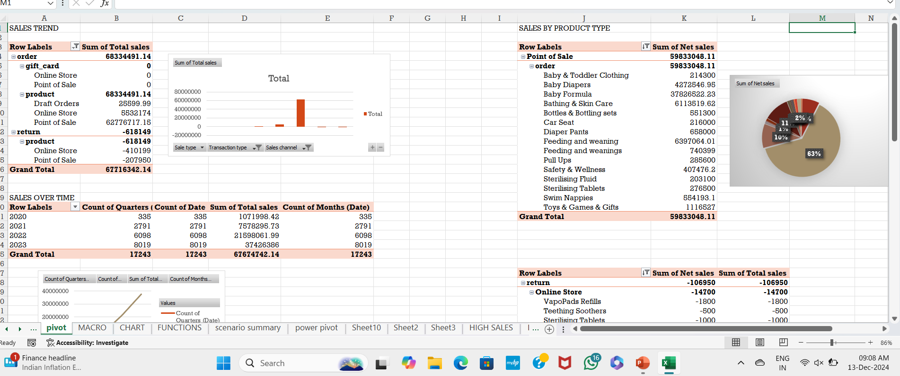
PIVOT TABLES AND PIVOT CHARTS
Used to find highest selling product
To find sales over time like (Monthly and Yearly)
To find offline and online selling product
Number of products returns and quantity

Slide 6
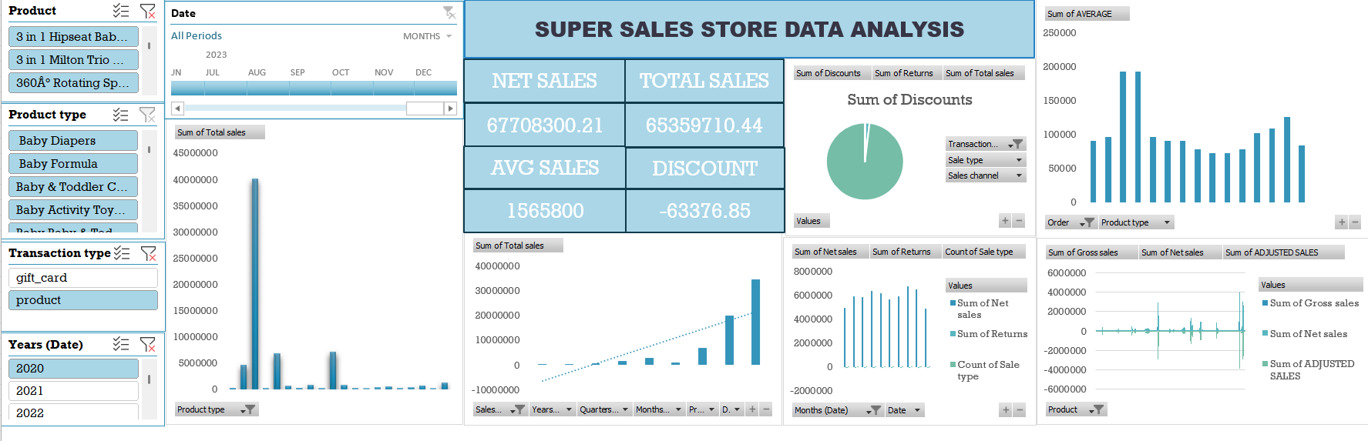
DASHBOARD OVERVIEW

Slide 7
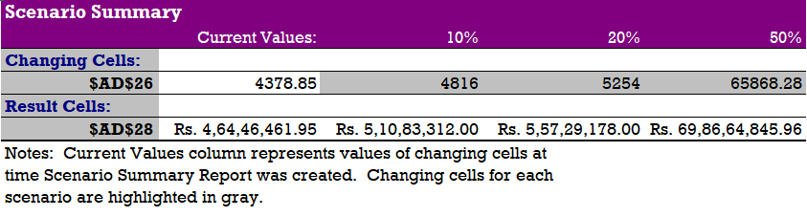
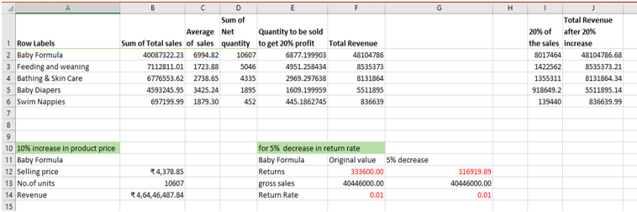
WHAT-IF ANALYSIS
To analyze how changes in sales (or) return rates impact total revenue
To find the number of units required meet a sales target

Slide 8
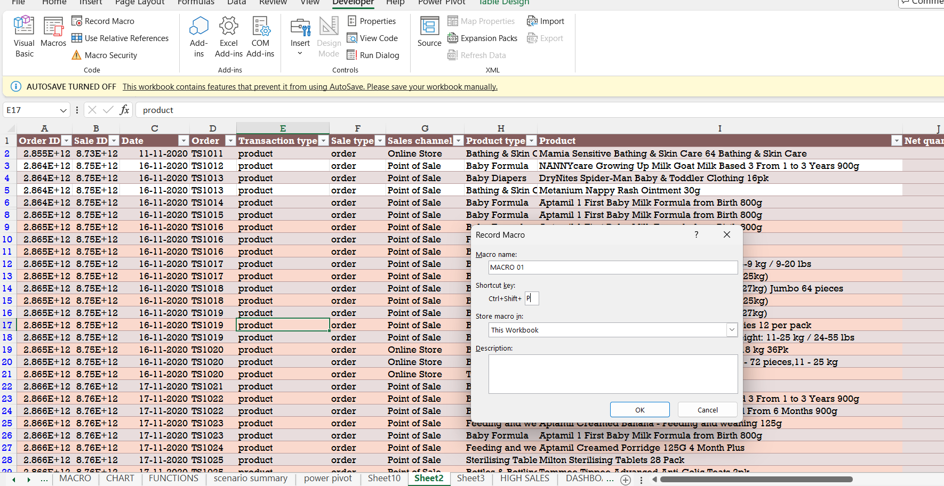
MACROS
Macro is used for formatting , generating reports and data calculations

Slide 9
INSIGHTS
By analysing this database , baby formula , feeding and weaning is the top selling products
It’s sales rate gradually increased year by year
By comparing online and offline sales increased in offline

Slide 10
CONCLUSION
This analysis shows that baby formula , feeding and weaning products sales is peaking in September and it is gradually increasing year by year
This analysis demonstrates steady annual growth highlighting for future expansion

Slide 11
THANK YOU

