Slide 1
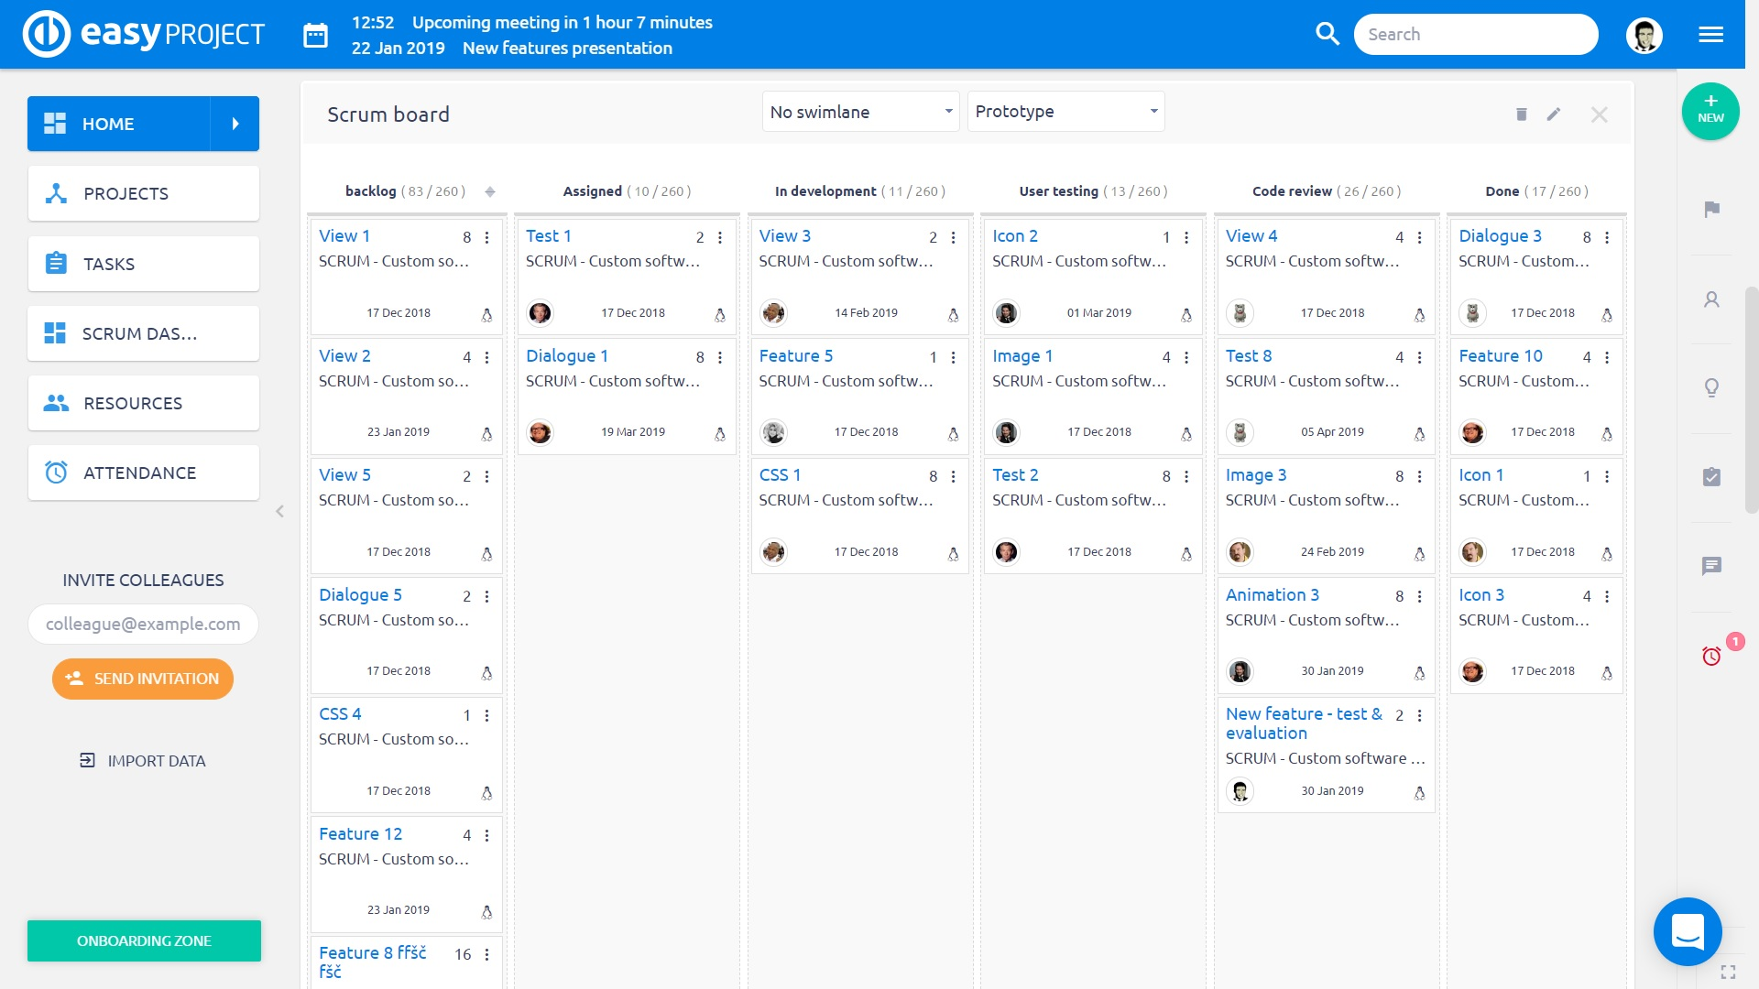


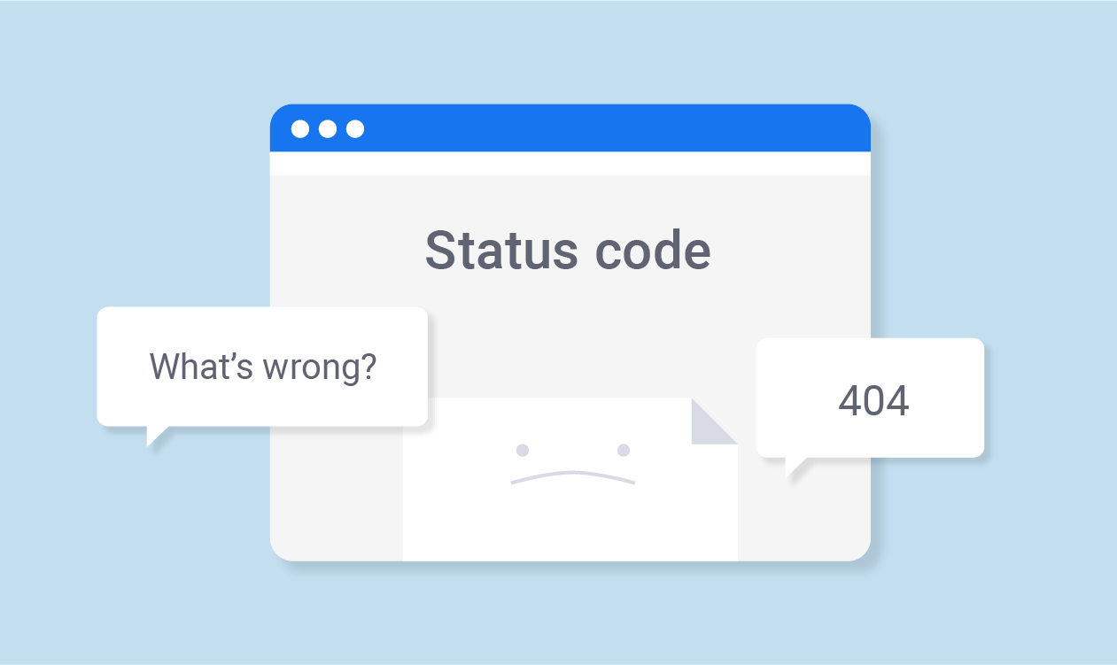



Steven Storyboard
1
I chose a new task
2
Conception/Design
3
Start coding
4
Face a problem
My days always start with a daily meeting with my team's project. After that, i chose a new task from the Dashboard.
I learned at school as well as my team advise me to start drawing the conception of my task before coding.
I now have a better vision of my task and can start the code.
While I was testing my code, I faced a problem. I never encounter this before. My team is busy and i know that i can lose a lot of time searching on the internet.
Joy
Frustration

Slide 2



Steven Storyboard
5
Searching solution on ScheduleMe
6
Complete the task
I remembered a Friday's workshop about this problem. So that, I go on ScheduleMe content section and start documenting me.
Thanks to ScheduleMe, I was able to finish my task on time without interrupting my team and wasting time on the internet
Accomplishment

