Slide 1

HIDING An IMAGE INSIDE AN IMAGE USING STEGANOGRAPHY
D.Lahari satya durga

Slide 2
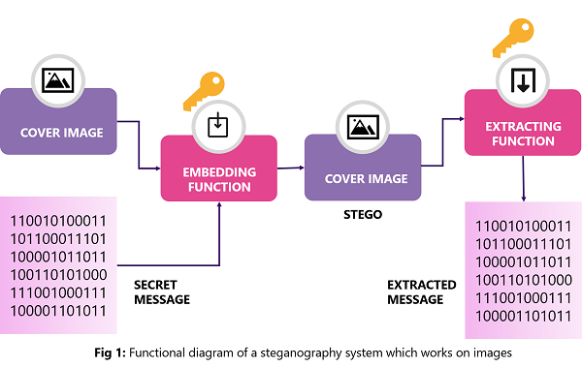
PROJECT TITLE/Problem Statement
Image Steganography is defined as a type of steganography which involves caching dispatches or secret information within digital images. It is achieved by making changes in the pixels of the image to render the information.
Malicious use of steganography can facilitate communication for criminal activities such as terrorism or illegal data exfiltration.
Embedding hidden messages within digital files can compromise data integrity, potentially leading to unauthorized alterations or corruption of sensitive information.

Slide 3
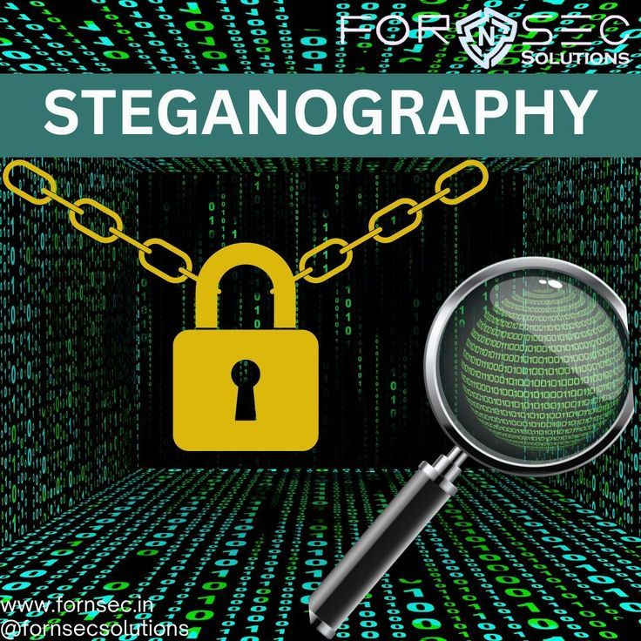
AGENDA
PROBLEM STATEMENT
INRODUCTION
PROJECT OVERVIEW
WHO ARE THE END USERS OF THIS PROJECT?
YOUR SOLUTION AND ITS VALUE PROPOSITION
HOW DID YOU CUSTOMIZE THE PROJECT AND
MAKE IT YOUR OWN
MODELLING
RESULTS
LINKS

Slide 4
INTRODUCTION
Hiding data in an image using steganography is a technique that embeds secret information within the pixels of an image in such a way that the changes are imperceptible to the human eye.
This process typically involves modifying the least significant bits of each pixel to store the hidden data without noticeably altering the image's appearance.
By doing so, the image remains visually unchanged, making it an effective method for secure and discreet communication.
This approach ensures that the presence of the hidden data goes undetected by casual observers, providing an additional layer of security.
Steganography is widely used for confidential data transmission, digital watermarking, and protecting intellectual property, showcasing its versatility and effectiveness in various applications.

Slide 5
PROJECT OVERVIEW
Steganography is the art of hiding secret information within a cover object, such as an image, audio file, or text document.
This project aims to design and implement a steganography system that can securely hide data within digital images.
Provides an additional layer of security beyond traditional encryption methods.
Allows recipients to verify the authenticity and completeness of received data. By that system can resist attacks and maintain the confidentiality of the hidden data.
Steganography develop a user-friendly interface for encoding and decoding hidden data

Slide 6
WHO ARE THE END USERS of this project?
Military and Intelligence Agencies: Securing sensitive communications and data from unauthorized access.
Law Enforcement and Intelligence Agency :Covert surveillance, monitoring suspect communications, and gathering evidence without alerting suspects.
Journalists and Whistleblowers :Safeguarding sources and sensitive information from censorship or surveillance.
Privacy Advocates and Activists:
Cybersecurity Professionals:Testing and evaluating security protocols, detecting steganographic techniques used in cyberattacks.
Individuals :Privacy concerns, protecting personal data, and communications.

Slide 7

YOUR SOLUTION AND ITS VALUE PROPOSITION
Create rules and guidelines that address how steganography can be used legally and ethically, balancing privacy rights with the need for national security.
Educate people about the risks and benefits of steganography, teaching them how to use it responsibly and understand its implications.
Strengthen cybersecurity defenses with powerful software and systems that can detect and block suspicious activities, including those using steganography.

Slide 8
How did you customize the project and make it your own
Loaded both the cover image (‘img1’) and the secret image(‘img2’).
Integrated password protection using hashing to secure access to the hidden image. This ensures that only users with the correct password can extract the hidden image.
Checks if either the cover image or the secret image is not found, and exits the program with an appropriate error message.
Iterate through each pixel of both images and extracted the corresponding pixel values from the secret image(‘img2’).
Modify the LSBs of the cover image pixels to embed the secret image pixel values.
Saved the modified cover image, which now contains the hidden data, to a new image file or display it.

Slide 9
MODELLING
Image Loading and Error Handling:
Images are loaded using 'cv2.imread()’.
Password Hashing:
Users are prompted to enter a passcode, which is then hashed using SHA-256 for security.
Steganography Process:
The script iterates through each pixel of img1 (cover image) and modifies its LSB to embed
pixels from img2 (secret image).It modifies each channel (R, G, B) of each pixel independently.
Output Image Creation:
The os.startfile() function is used to open the newly created hidden image file .

Slide 10

Results
Successfully executed a steganography project using Python.
Demonstrated proficiency in handling digital media and manipulating image data to securely embed and retrieve information.
Embedded a secret image into a cover image using steganography without perceptible changes to the cover image.
Achieved the project goal of implementing a functional steganography system capable of covertly transmitting sensitive data.
Enhanced understanding of steganography principles and their practical applications in data security.

Slide 11
links
GITHUB LINK: https://daydreamer1309.github.io/APSSDC_PROJECT/

