Slide 1
Search
1

Slide 2
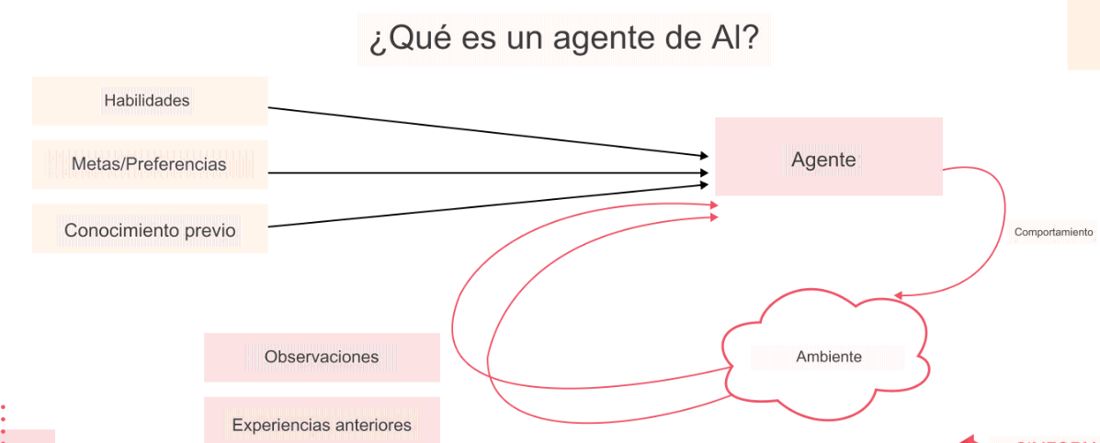

Slide 3
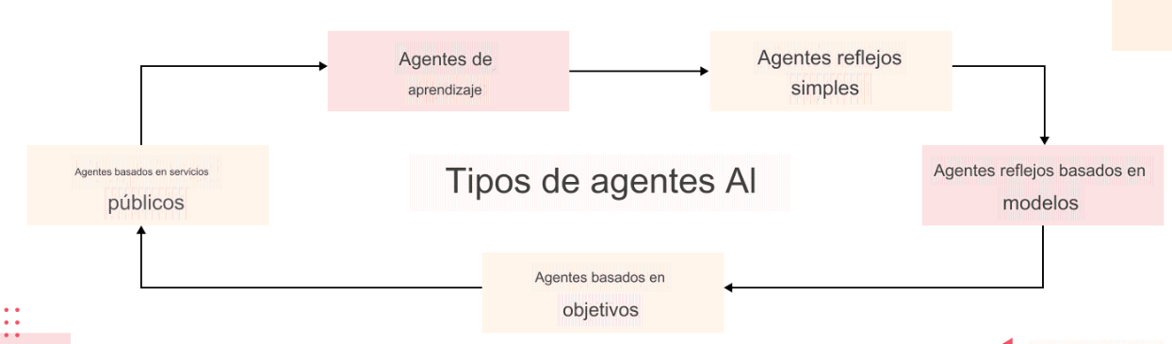

Slide 4
Introduction
2
Simple-reflex agents directly maps states to actions.
Therefore, they cannot operate well in environments where the mapping is too large to store or takes too much to learn
Goal-based agents can succeed by considering future actions and desirability of their outcomes
Problem solving agent is a goal-based agent that decides what to do by finding sequences of actions that lead to desirable states

Slide 5
Problem solving agents
5
An agent with several immediate options of unknown value can decide what to do by first examining different possible sequences of actions that lead to states of known value, and then choosing the best sequence
Looking for such a sequence is called search
A search algorithm takes a problem as input and returns a solution in the form of action sequence
One a solution is found the actions it recommends can be carried out – execution phase

Slide 6
Problem solving agents
6
“formulate, search, execute” design for the agent
After formulating a goal and a problem to solve the agent calls a search procedure to solve it
It then uses the solution to guide its actions, doing whatever the solution recommends as the next thing to do (typically the first action in the sequence)
Then removing that step from the sequence
Once the solution has been executed, the agent will formulate a new goal

Slide 7
Environment Assumptions
8
Static, formulating and solving the problem is done without paying attention to any changes that might be occurring in the environment
Initial state is known and the environment is observable
Discrete, enumerate alternative courses of actions
Deterministic, solutions to problems are single sequences of actions, so they cannot handle any unexpected events, and solutions are executed without paying attention to the percepts

Slide 8
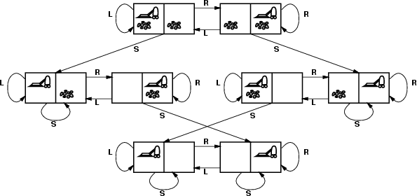
Vacuum world state space graph
13
states integer dirt and robot location.
– The agent is in one of two locations, each of which might or might not
contain dirt – 8 possible states
Initial state: any state
actions Left, Right, Suck
goal test no dirt at all locations
path cost 1 per action

Slide 9
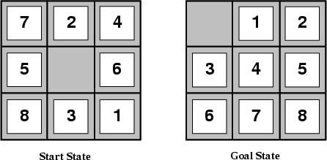
Example: The 8-puzzle
14
states: locations of tiles
Initial state: any state
actions: move blank left, right, up, down
goal test: goal state (given)
path cost: 1 per move

Slide 10
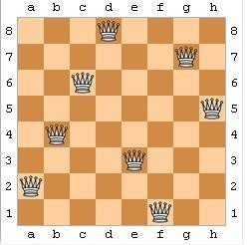
Example: 8-queens problem
15
states: any arrangement of 0-8 queens on the board is a state
Initial state: no queens on the board
actions: add a queen to any empty square
goal test: 8 queens are on the board, none attacked
64.63...57 = 1.8x10¹⁴ possible sequences

Slide 11
Example: Route finding problem
16
states: each is represented by a location (e.g. An airport) and the current time
Initial state: specified by the problem
Successor function: returns the states resulting from taking any scheduled flight, leaving later than the current time plus the within airport transit time, from the current airport to another
goal test: are we at the destination by some pre-specified time
Path cost:monetary cost, waiting time, flight time, customs and immigration procedures, seat quality, time of day, type of airplane, frequent-flyer mileage awards, etc
Route finding algorithms are used in a variety of applications, such as routing in computer networks, military operations planning, airline travel planning systems

Slide 12
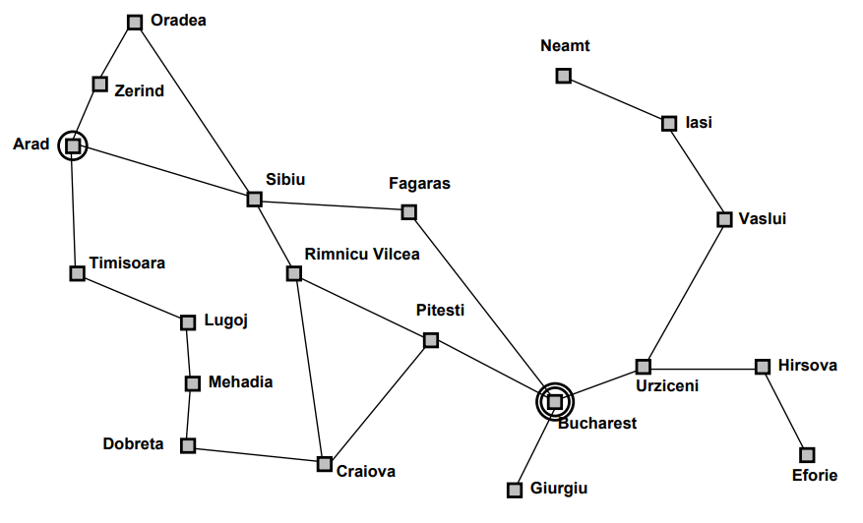
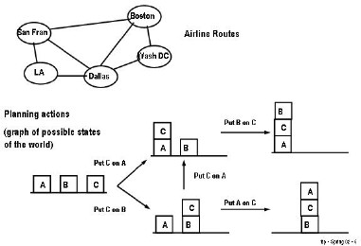
Graphs
19

Slide 13
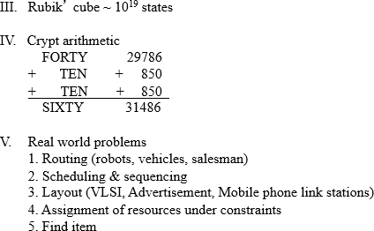
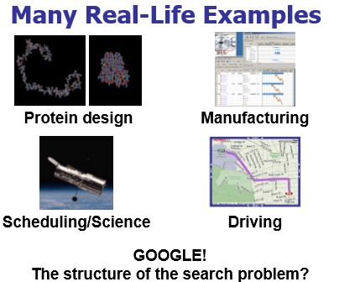
20

Slide 14
General problem:
Find a path from a start state to a goal state given:
A goal test: Tests if a given state is a goal state
A successor function (transition model): Given a state, generates its successor states
Variants:
Find any path vs. a least-cost path
Goal is completely specified, task is just to find the path
Route planning
Path doesn’t matter, only finding the goal state
8 puzzle, N queens, Rubik’s cube
6

Slide 15
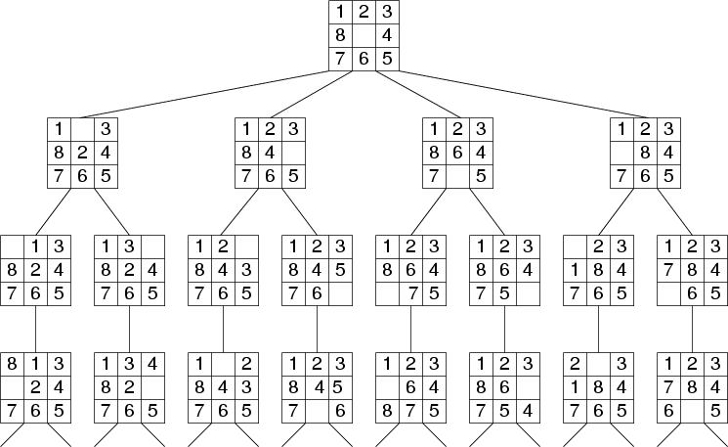
11

Slide 16
Evaluating Search Strategies
Completeness
Guarantees finding a solution whenever one exists
Time Complexity
How long (worst or average case) does it take to find a solution? Usually measured in terms of the number of nodes expanded
Space Complexity
How much space is used by the algorithm? Usually measured in terms of the maximum size that the “OPEN" list becomes during the search
Optimality/Admissibility
If a solution is found, is it guaranteed to be an optimal one? For example, is it the one with minimum cost?

Slide 17
8-PUZZLE PROBLEM SOLVING
1 | 2
4 | 5 | 3
7 | 8 | 6
Input:
Branching factor, b=2
1 |  | 2
4 | 5 | 3
7 | 8 | 6
1 | 2 | 3
4 | 5
7 | 8 | 6
b=3
b=3
1, R
2, L
5, U
3, D
5, R
6, U
1 | 2 | 3
4 | 5 | 6
7 | 8
Goal

Slide 18
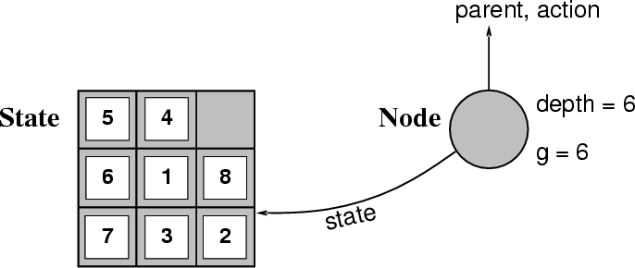
Implementation: states vs. nodes
30
A state is a (representation of) a physical configuration
A node is a data structure constituting part of a search tree includes
state, parent node, action, path cost g(x), depth

Slide 19
Implementation: Components of a node
29
State: the state in the state space to which the node corresponds
Parent-node: the node in the search tree that generated this node
Action: the action that was applied to the parent to generate the node
Path-cost: the cost, traditionally denoted by g(n), of the path from the initial state to the node, as indicated by the parent pointers
Depth: the number of steps along the path from the initial state

Slide 20
31
Implementation: general tree search
Fringe: the collection of nodes that have been generated but not yet been expanded
Each element of a fringe is a leaf node, a node with no successors
Search strategy: a function that selects the next node to be expanded from fringe
We assume that the collection of nodes is implemented as a queue
The operations on the queue are:
Make-queue(queue)
Empty?(queue)
first(queue)
remove-first(queue)
insert(element, queue)
insert-all(elements, queue)

Slide 23
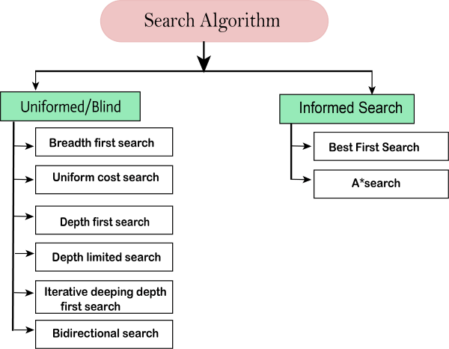

Slide 24
Uninformed search strategies
Uninformed search strategies use only the information available in the problem definition
Breadth-first search
Uniform-cost search
Depth-first search
Depth-limited search
Iterative deepening search

Slide 25
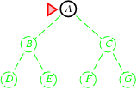
Breadth-first search
Expand shallowest unexpanded node
Implementation:
fringe is a FIFO queue, i.e., new successors go at end
A

Slide 26
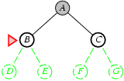
Breadth-first search
Expand shallowest unexpanded node
Implementation:
fringe is a FIFO queue, i.e., new successors go at end
A
B
C

Slide 27
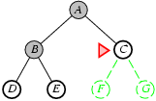
Breadth-first search
Expand shallowest unexpanded node
A
B
C
D
E

Slide 28
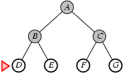
Breadth-first search
Expand shallowest unexpanded node
A
B
C
D
E
F
G

Slide 29
Properties of breadth-first search
Complete? Yes (if b is finite)
Time? 1+b+b²+b³+… +b^{d} + b(b^{d}-1) = O(b^{d+1})
Space? O(b^{d+1}) (keeps every node in memory)
Optimal? Yes (if cost = 1 per step)
Space is the bigger problem (more than time)

Slide 30
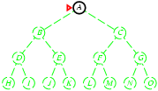
Depth-first search
Expand deepest unexpanded node
Implementation:
fringe = Stack, i.e., put successors at front
A
push A;

Slide 31
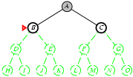
Depth-first search
Expand deepest unexpanded node
Implementation:
fringe = Stack
A
B
C
pop A;
push C;
push B;

Slide 32
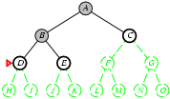
Depth-first search
Expand deepest unexpanded node
Implementation:
fringe = STACK
B
C
D
E
C
pop B;
push E;
push D;

Slide 33
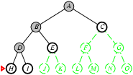
Depth-first search
Expand deepest unexpanded node
D
E
C
H
I
E
C
pop D;
push I;
push H;

Slide 34
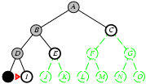
Depth-first search
Expand deepest unexpanded node
H
I
E
C
I
E
C
pop H;

Slide 35
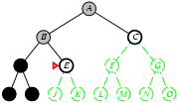
Depth-first search
Expand deepest unexpanded node
I
E
C
E
C
pop I;

Slide 36
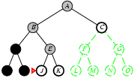
Depth-first search
Expand deepest unexpanded node
E
C
J
K
C
pop E;
push K;
push J

Slide 37
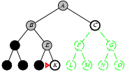
Depth-first search
Expand deepest unexpanded node
J
K
C
K
C
pop J;

Slide 38
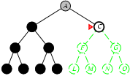
Depth-first search
Expand deepest unexpanded node
K
C
C
pop K;

Slide 39
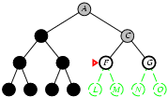
Depth-first search
Expand deepest unexpanded node
C
F
G
pop C;
push G;
push F;

Slide 40
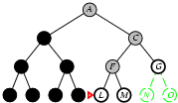
Depth-first search
Expand deepest unexpanded node
F
G
L
M
G
pop F;
push M;
push L;

Slide 41
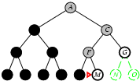
Depth-first search
Expand deepest unexpanded node
L
M
G
M
G
pop L;

Slide 42
Properties of depth-first search
Complete? No: fails in infinite-depth spaces, spaces with loops
Modify to avoid repeated states along path🡪 complete in finite spaces
Time? O(b^{m}): terrible if m is much larger than d
but if solutions are dense, may be much faster than breadth-first
Space? O(bm), i.e., linear space!
Optimal? No

Slide 43


8-puzzle problem
44

Slide 44
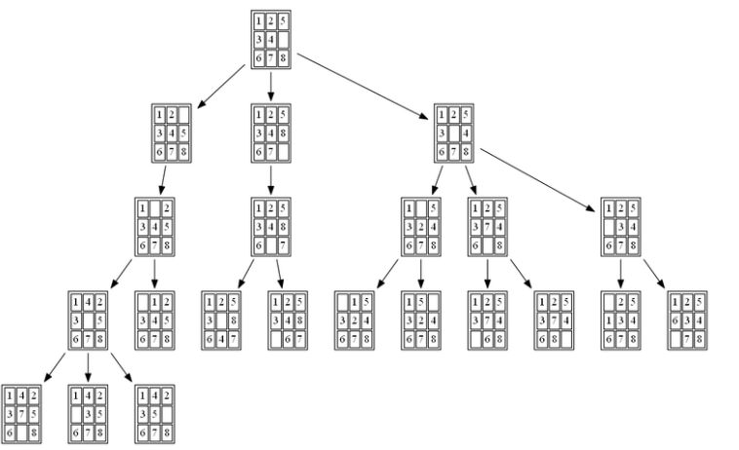
Breadth-first search of the 8-puzzle
45

Slide 45
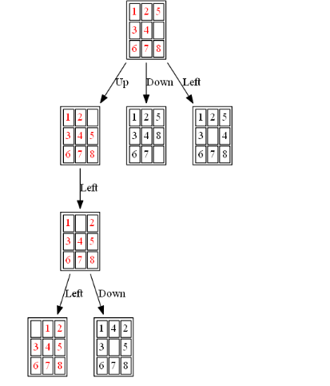
Depth-first search of the 8-puzzle

Slide 46
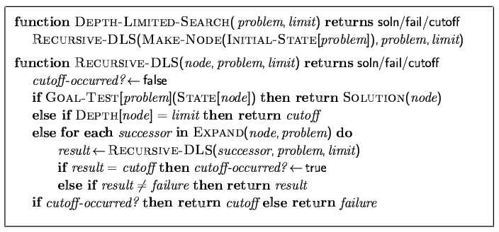
Depth-limited search
= depth-first search with depth limit l,
i.e., nodes at depth l have no successors
Recursive implementation:

Slide 47
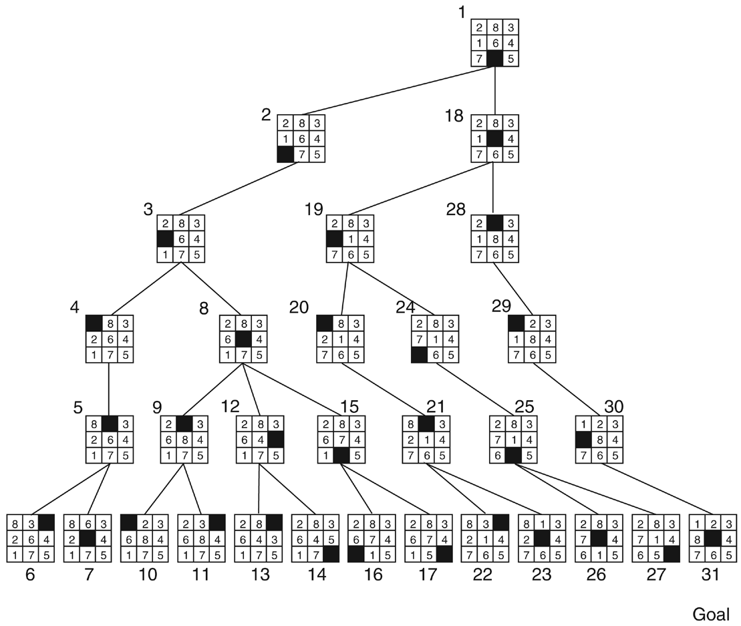
Depth-first search of the 8-puzzle with a depth
Depth limited search
bound of 5.

Slide 48
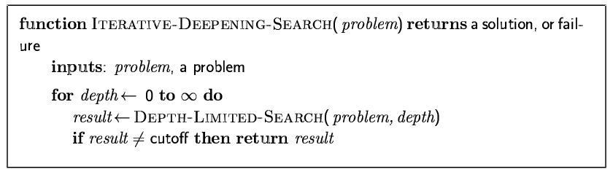
Iterative deepening search

Slide 49
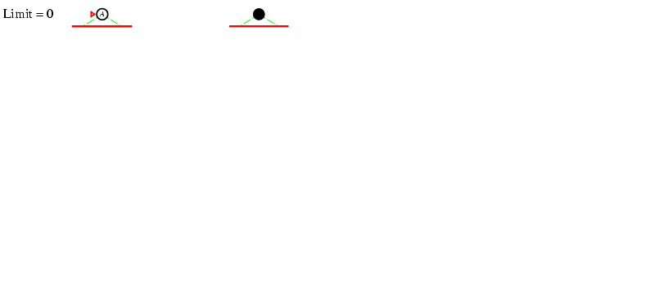
Iterative deepening search l =0

Slide 50
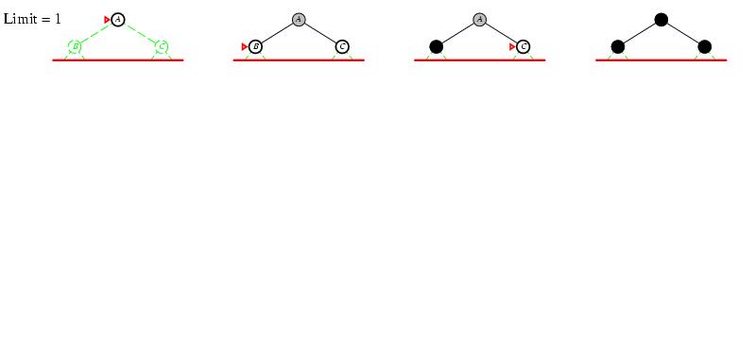
Iterative deepening search l =1

Slide 51
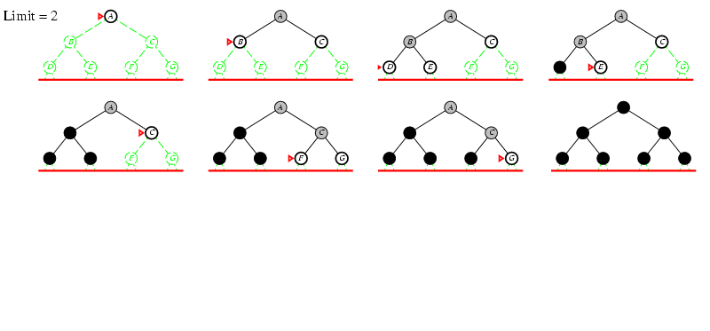
Iterative deepening search l =2

Slide 52
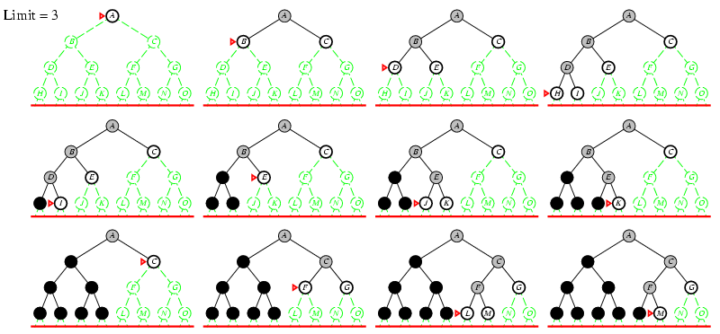
Iterative deepening search l =3

Slide 53
Properties of iterative deepening search
Complete? Yes
Time? (d+1)b⁰ + d b¹ + (d-1)b² + … + b^{d} = O(b^{d})
Space? O(bd)
Optimal? Yes, if step cost = 1

Slide 54
Uniform-cost search
Expand least-cost unexpanded node
Implementation:
fringe = priority queue
Equivalent to breadth-first if step costs all equal
Complete? Yes, if step cost ≥ ε
Time? # of nodes with g ≤ cost of optimal solution, O(b^{ceiling(C*/ ε)}) where C* is the cost of the optimal solution
Space? # of nodes with g ≤ cost of optimal solution, O(b^{ceiling(C*/ ε)})
Optimal? Yes – nodes expanded in increasing order of g(n)

Slide 55
Uniform-Cost Search
GENERAL-SEARCH(problem, ENQUEUE-BY-PATH-COST)
exp. node nodes list CLOSED list
{S(0)}
S {A(1) B(5) C(8)}
A {D(4) B(5) C(8) E(8) G(10)}
D {B(5) C(8) E(8) G(10)}
B {C(8) E(8) G’(9) G(10)}
C {E(8) G’(9) G(10) G”(13)}
E {G’(9) G(10) G”(13) }
G’ {G(10) G”(13) }
Solution path found is S B G <-- this G has cost 9, not 10
Number of nodes expanded (including goal node) = 7
S
1
8
5
A
B
C
3
9
4
5
7
D
E
G
G’
G”
Notes:
55

Slide 56
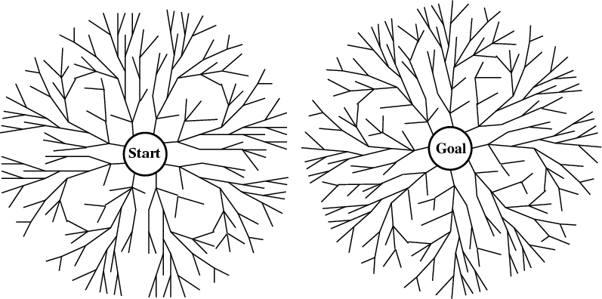
Bi-directional search
Alternate searching from the start state toward the goal and from the goal state toward the start.
Stop when the frontiers intersect.
Works well only when there are unique start and goal states and when actions are reversible
Can lead to finding a solution more quickly (but watch out for pathological situations).
Notes:
56

Slide 57
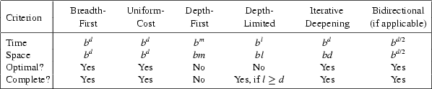
Comparing Search Strategies
Notes:
57

Slide 58
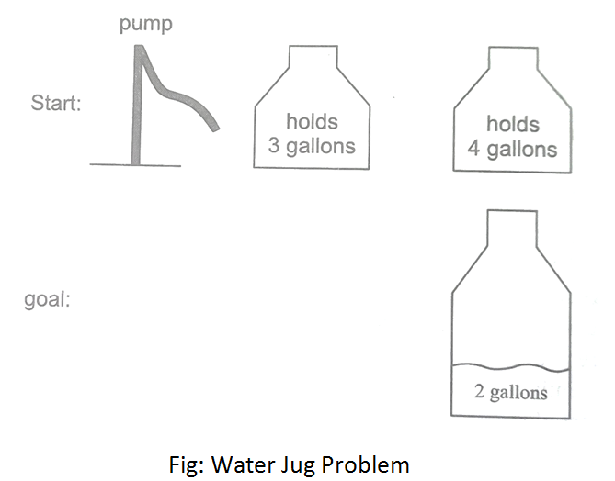
Examples: water jug problem
34
Consider the following problem: A Water Jug Problem: You are given two jugs, a 4-gallon one and a 3-gallon one, a pump which has unlimited water which you can use to fill the jug, and the ground on which water may be poured. Neither jug has any measuring markings on it. How can you get exactly 2 gallons of water in the 4-gallon jug?

Slide 59
Examples: water jug problem
34
we will represent a state of the problem as a tuple (x, y) where x represents the amount of water in the 4-gallon jug and y represents the amount of water in the 3-gallon jug. Note 0 ≤ x ≤ 4, and 0 ≤ y ≤ 3. Our initial state: (0,0) Goal Predicate – state = (2,y) where 0 ≤ y ≤ 3.

Slide 60
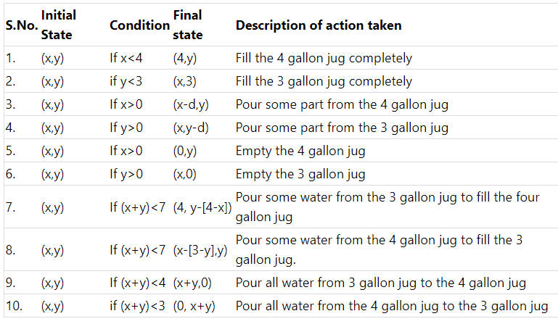

Slide 61
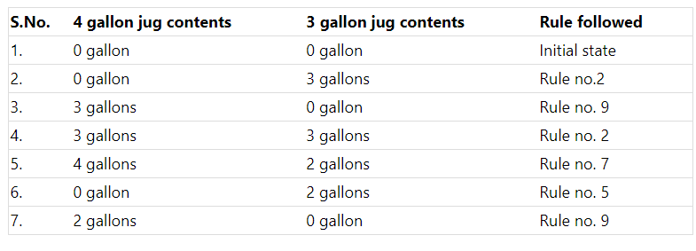

Slide 62
