Slide 1

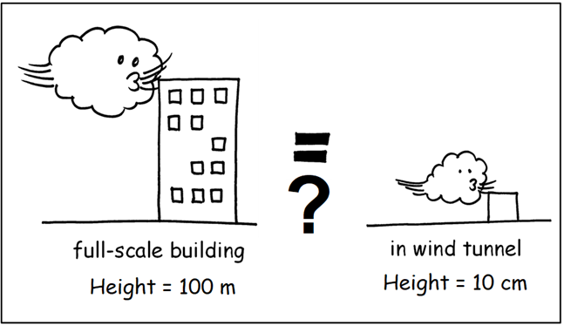
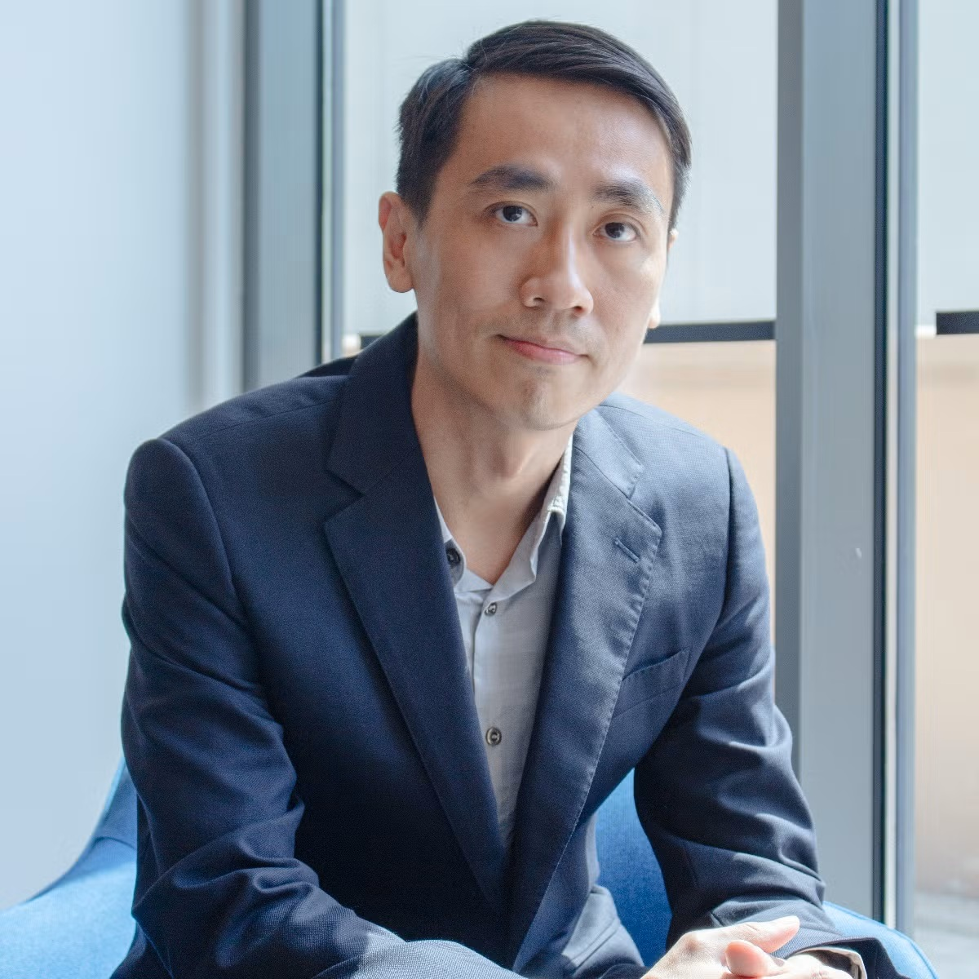

交大设计建筑学建筑技术前沿系列讲座
SJTU-ARCH LECTURE SERIES OF
BUILDING TECHNOLOGY
2026
LECTURE ABSTRACT
主讲内容
Have you ever considered how scaled-down building models (order of centimeters) can be used to analyze airflows around actual buildings (order of meters)? The answer lies in the concept of similarity - flows with similar dimensionless parameters behave the same way despite differences in scale, size, or other physical parameters. This seminar explores two errors commonly made in urban airflow modeling research. The behavior of airflows over buildings is determined by the dimensionless parameter Reynolds number, Re = UH/v, where U is a reference wind speed, H is the building height, and v is the kinematic viscosity of air. Real, full-scale buildings have H ranges from several meters to hundreds of meters, resulting in Re typically between 1,000,000 and 10,000,000. In contrast, wind tunnel experiments involve models with H measured in centimeters, resulting in Re around 1,000 to 10,000, much lower than those at full scale. This disparity in Re between scaled models and actual buildings is often circumvented using the Re-independent assumption, which enables us to study airflow patterns in wind tunnels and apply the findings to real buildings. Through experiments and computational fluid dynamics, I will demonstrate that the Re-independent assumption holds true only in simple cases, such as isothermal flows over a single building. Applying this assumption to more complex scenarios involving multiple buildings or heat transfer can lead to significant errors and incorrect predictions of the overall wind field around buildings. Some recent findings on similarity in urban airflow modeling will also be shared.
CHEW LUP WAI
个人介绍
Dr. Lup Wai Chew is an Assistant Professor in the Department of the Built Environment, College of Design and Engineering at the National University of Singapore (NUS). He is the principal investigator of the Airflow-Buildings-Cities Laboratory and CoolNUS Project. He obtained his PhD in Mechanical Engineering from Massachusetts Institute of Technology. Prior to NUS, he worked as a postdoctoral scholar at Stanford University. His specialization lies in urban airflow modelling, focusing on natural ventilation, outdoor wind field, and the physics of flows, using both experimental and numerical approaches. In his free time, he enjoys reading, painting and traveling.
Dr. Chew Lup Wai
Assistant Professor,
College of Design & Engineering,
NUS, Singapore.
缩尺模型能否用于
主办单位：
上海交通大学设计学院
城市气流研究？
时 间：
03/30 时间待定
地 点：
上海交通大学闵行校区
Can We Study Urban Airflow
主 持 人：
设计学院（具体房间待定）
with Scaled-down Models?
待定

