Slide 1

CETM46 Data Science Product Development
2022/23 Lecture 1 Module Introduction
School of Computer Science
University of Sunderland

Slide 2
Outline
Module Introduction
What is a Data Product?
What is the focus of Data Science?
What is Data Science Product Development?
How to Develop a Data Science Product?
What makes a good Data Science Product?
Real World Example

Slide 3
Module Introduction: Learning Outcomes
Knowledge
K1 Critical understanding of the use of data repositories for storage of data sets for decision making in organisations
K2 Utilisation of the state of art of data science methodologies and software tools for data analysis applications development
K3 Critical understanding of modern data science systems and their ecosystem
Skills
S1 Critical analysis, selection and evaluation of data science methodologies and software tools onto a broad range of datasets and data analysis applications
S2 Ability to design and develop data science systems using various data repositories and data models
S3 Developing data science products with modern data systems, visualisation technologies, software tools and their ecosystem

Slide 4
Module Introduction: Assignments
001 Assignment1 50%
State of the art research paper literature review (3000 Words)
K1, K3, S1
002 Assignment2
Develop a data science product prototype and technical report (3000 Words)
K2, K3, S2, S3

Slide 5
Module Introduction: Key Textbooks
Cady,F.,(2017),The Data Science Handbook, John Wileyand Sons
Deshpande,A.(2018), Artificial Intelligence for Big Data: complete guide to automating BigData
solutions using Artificial Intelligence techniques, Birmingham: Packt Publishing
Gollapudi,S.(2016),Practical Machine Learning, Birmingham: Packt Publishing
Gurin,J.,(2014),OpenDataNow: the secret to hot startups, smart investing, savvy marketing, and fast innovation, New York: McGraw-Hill, 2014
Knaffic,C.,N.,(2015)Storytelling with Data: A Data Visualization Guide for Business Professionals, John Wiley and Sons
Krishnan,K.,(2013),Data Warehousing in the Age of Big Data, Morgan Kaufmann.Kimball,R., (2013), The Data Warehouse Toolkit: The Definitive Guide to Dimensional Modelling, Wiley and Sons
Kirk,A.,(2016),Data Visualisation: A Handbook for Data Driven Design, SAGEPublicationsLtd
YauN.,(2011),Visualize This: The Flowing Data Guide to Design, Visualization, and Statistics 1st Edition, John Wiley and Sons

Slide 6
Module Introduction: Software Platforms (Details in Lecture2)
R: R Shiny + R Studio
JavaScript: Chartjs, Dj3, Three.js
Google : Google Data Studio, Google Chart Tools
Tableau Public
Jupyter Notebook
Python: Apache pySpark MLLib, TensorFlow, NLTK
Java: Deeplearning4j, Apache Mahout, Apache Spark, MALLET
C#: .NET Machine Learning + Visual Studio
Hadoop Ecosystem
Android Studio
Unity3D

Slide 7

What is a Data Product?- Definition
Is Instagram a data product?
Is Google Analytics a data product?

Slide 8
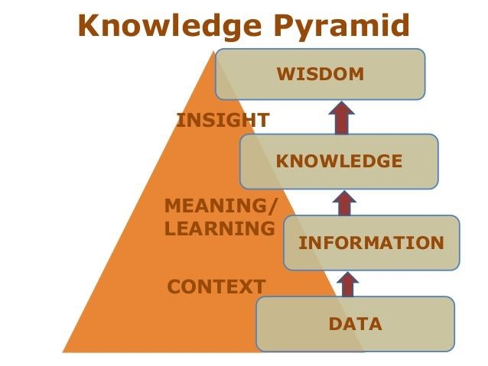
Goals
Raw Data: Source of ‘ground true’, e.g., UCI Machine Learning Repository
Derived Data: Pre-processed data source, e.g., Meta Data
Algorithms: Build models, e.g., Google Image
Decision Support: Provide Insights, e.g., Google Analytics
Automated Decision-making: AI level wisdom, e.g. Self-driving cars

Slide 9
What is the role of Data Science?
Data Science focuses on the theories and practices for data products in types of
• Algorithms: Build models, e.g., Google Image • Decision Support: Provide Insights, e.g., Google Analytics • Automated Decision-making: AI level wisdom, e.g. Self-driving cars

Slide 10
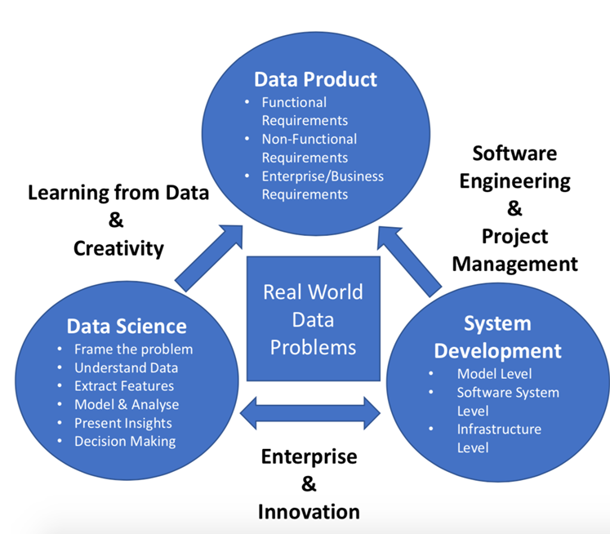
What is Data Science Product Development?
Identify decision points during the product life cycle where data science techniques are applicable
Select metrics, product instrumentation, external data sources, modelling techniques and tools for use in product management decision-making
Apply selected basic modeling (e.g. classification, clustering, time series analysis, and text analytics) to product management; critique applicability and output from more advanced techniques.
Plan and execute a data science project at realistic scale to inform product management decisions.

Slide 11
How to Develop a Data Science Product?
Understanding the requirements of a real world problem
Choosing appropriate metrics for product success
Selecting and assessing data sources
Instrumenting products for data collection
Choosing data science infrastructure
Evaluating data science models
Documenting and communicating data science results
Designing, planning, and delivering data science product projects

Slide 12
How makes a good Data Science Product?
Flexibility: Effectively incorporates newly available data and business scenarios
Deployment Simplicity: Efficiently integrates into the exiting IT system
Reducing Cost: Effectively supports business model to achieve its Key
Performance Indicators (KPI)
Increased Competitiveness: Effectively eliminates inefficiencies and human bias from business operation
Reclaiming Time: Free up time for tasks that require more human interaction

Slide 13
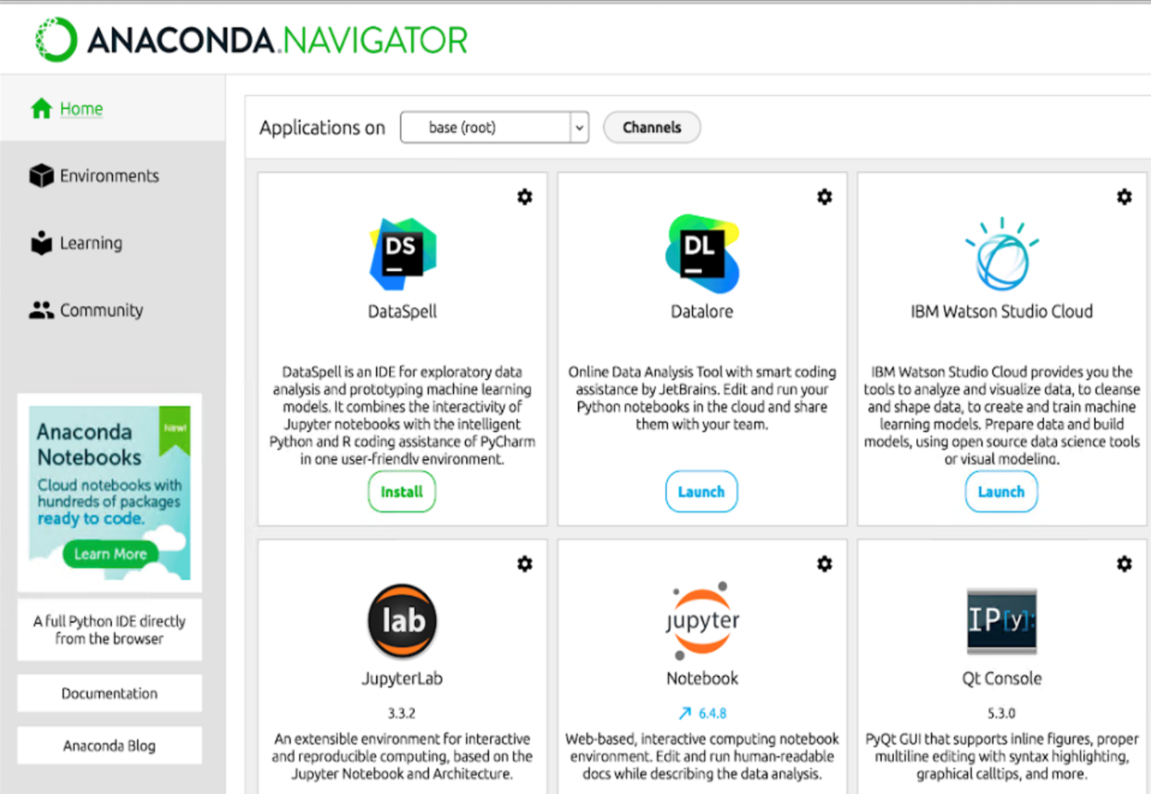
Real World Example: Anaconda Data Science Platform

Slide 14
Further Readings
Chapter1, Cady, F., (2017), The Data Science Handbook, John Wiley and Sons
https://towardsdatascience.com/designing-data-products- b6b93edf3d23

