Slide 1
Gender & Age Prediction Using Deep Learning Course Title: Deep Learning Course code: cse-459
Presented By
Dalia Sultana Dayna ID:0562210005101024
Rajiya Jahan Liza
ID:210303020014
7th Semester

Slide 2
Project Motivation
Facial image analysis plays a vital role in applications such as surveillance, smart advertising, and user personalization.
This project leverages Convolutional Neural Networks (CNNs) to automate gender classification and age estimation.
Reduces human effort in labeling & age/gender detection tasks.

Slide 3
Problem Statement
Develop a model to predict gender (classification) and age (regression) from a single face image.
Build a user-friendly web app for real-time predictions.

Slide 4
Dataset Description
UTKFace Dataset used.
Contains over 20,000 images labeled with age, gender, and ethnicity.
The full UTKFace dataset contains over 20,000 images, but for faster experimentation and model training, we selected a subset.
This reduced dataset allowed:
Shorter training time
Easier debugging & tuning
Efficient use of limited computing resources
• Images resized to 128x128 and converted to grayscale.
In future iterations, the model can be trained on the full UTKFace dataset for improved performance.

Slide 5
Preprocessing Steps
Convert images to grayscale.
Resize to 128x128 pixels.
Normalize pixel values to [0, 1]

Slide 6
Training Details
Loss Functions:
-binary_crossentropy for gender classification (binary output),
-MAE for age prediction (regression output)
Optimizer: Adam (adaptive learning rate optimization)
Batch size: 32
Epochs: 30
Train/validation split: 80% training, 20% validation
Learning Rate: Default (0.001)
Early Stopping: Not used (could be added in future work)

Slide 7
Evaluation & Results
Gender prediction accuracy: 91.3%
Age prediction MAE: 4.6 years
Model performs better on younger faces.
Slight overfitting observed after 30 epochs.
Performance could be improved further with data augmentation and larger datasets.

Slide 8
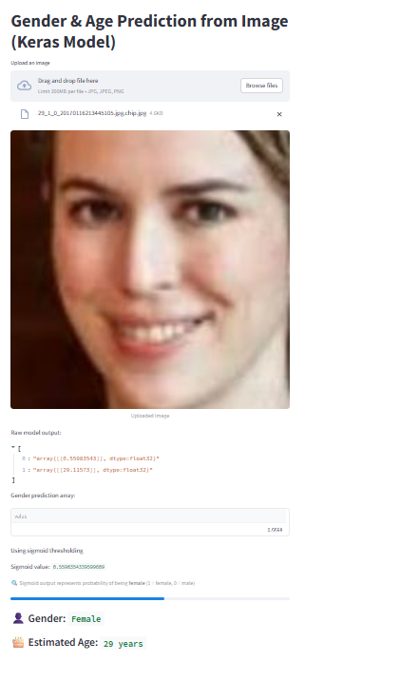
Demo Output
Streamlit web app developed.
Users can upload an image
and get predictions in real-time.
Sample Output: Gender – Female
and Age – 29 years

Slide 9
Challenges Faced
Model overfitting after 30+ epochs
Age labels in dataset are sometimes noisy
The dataset had fewer female images, leading to slight gender bias in predictions.

Slide 10
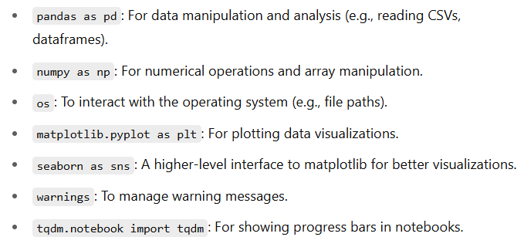
CODE EXPLANATION
# Importing Libraries:
import pandas as pd
import numpy as np
import os
import matplotlib.pyplot as plt
import seaborn as sns
import warnings
from tqdm.notebook import tqdm

Slide 11
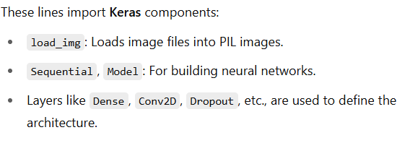
CODE EXPLANATION
# Importing Keras Components :
from tensorflow.keras.preprocessing.image import load_img
from tensorflow.keras.models import Sequential, Model
from tensorflow.keras.layers import Dense, Conv2D, Dropout, Flatten, MaxPooling2D, Input

Slide 12
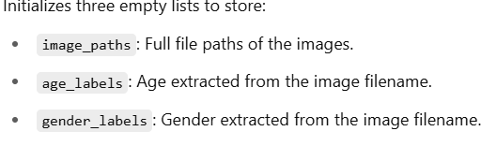
CODE EXPLANATION
# Defining Base Directory:
BASE_DIR = './UTKFace_1000_subset‘
** sets the path to the dataset folder (UTKFace_1000_subset) which contains the images for training/testing.
# Extracting Labels from Filenames:
image_paths = []
age_labels = []
gender_labels = []

Slide 13
CODE EXPLANATION
for filename in tqdm(os.listdir(BASE_DIR)):
image_path = os.path.join(BASE_DIR, filename)
temp = filename.split('_')
age = int(temp[0])
gender = int(temp[1])
image_paths.append(image_path)
age_labels.append(age)
gender_labels.append(gender)
Loops through all files in dataset directory with a progress bar (tqdm). Construct the full path of image file. Splits the filename using _ as the delimiter. Extracts and converts age and gender to integers. Appends the extracted data to the respective lists.

Slide 14
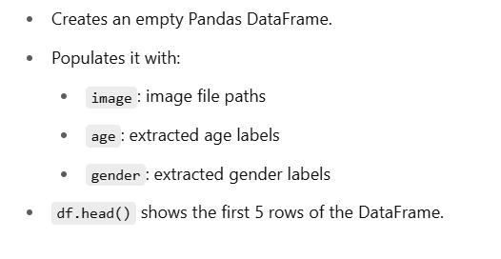
Code explanation
# Creating a DataFrame:
df = pd.DataFrame()
df['image'], df['age'], df['gender'] = image_paths, age_labels, gender_labels
df.head()

Slide 15
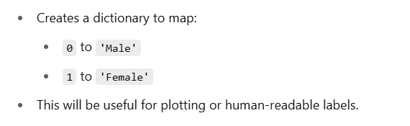
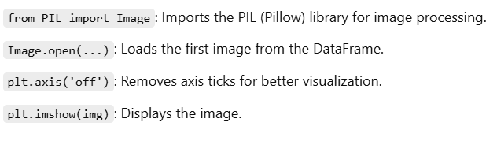
Code explanation
#Mapping Gender Labels:
gender_dict = {0: 'Male', 1: 'Female'}
# Displaying an Image:
from PIL import Image
img = Image.open(df['image'][0])
plt.axis('off')
plt.imshow(img);

Slide 16

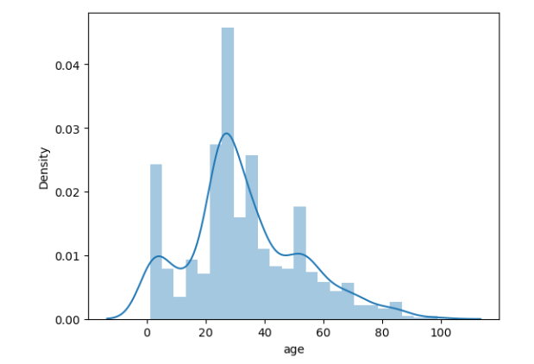
Code explanation
# Age Distribution Plot:
sns.distplot(df['age'])

Slide 17
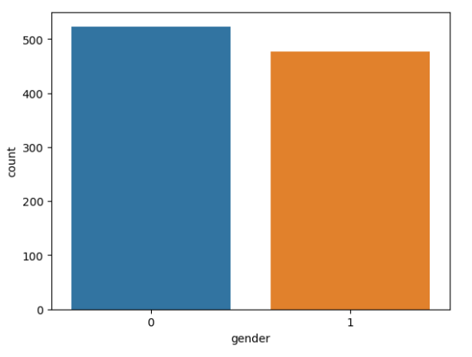
Code explanation
# Gender Count Plot:
import seaborn as sns
import matplotlib.pyplot as plt
sns.countplot(x='gender', data=df)
plt.show()
Plots a bar chart showing count of
each gender label.

Slide 18

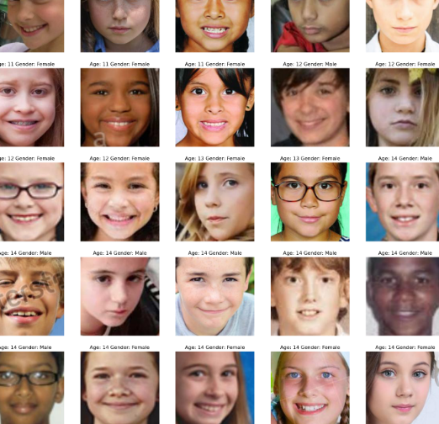
Code explanation
# Display Grid Of Images With Age And Gender
plt.figure(figsize=(20, 20))
files = df.iloc[0:25]
for index, file, age, gender in files.itertuples():
plt.subplot(5, 5, index + 1)
img = load_img(file)
img = np.array(img)
plt.imshow(img)
plt.title(f"Age: {age} Gender: {gender_dict[int(gender)]}")
plt.axis('off')

Slide 19
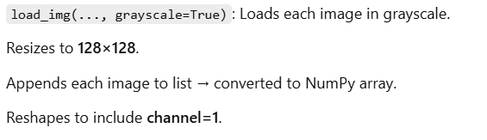
Code explanation
# Feature Extraction Function:
def extract_features(images):
features = []
for image in tqdm(images):
img = load_img(image, grayscale=True)
img = img.resize((128, 128), Image.LANCZOS)
img = np.array(img)
features.append(img)
features = np.array(features)
features = features.reshape(len(features), 128, 128, 1)
return features

Slide 20



Code explanation
# Extract image features:
X = extract_features(df['image'])
# Check Image Shape:
X.shape
#Normalize Images:
X = X / 255.0

Slide 21


Code explanation
# Prepare Labels:
y_gender = np.array(df['gender'])
y_age = np.array(df['age'])
# Define Input Shape:
input_shape = (128, 128, 1)

Slide 22
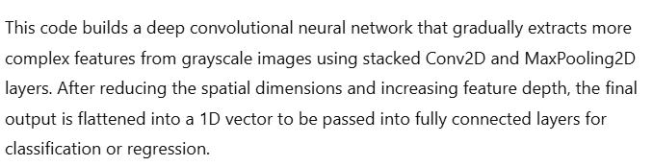
# Build the Multi-task CNN Model:
inputs = Input((input_shape))
# convolutional layers
conv_1 = Conv2D(32, kernel_size=(3, 3), activation='relu') (inputs)
maxp_1 = MaxPooling2D(pool_size=(2, 2)) (conv_1)
conv_2 = Conv2D(64, kernel_size=(3, 3), activation='relu') (maxp_1)
maxp_2 = MaxPooling2D(pool_size=(2, 2)) (conv_2)
conv_3 = Conv2D(128, kernel_size=(3, 3), activation='relu') (maxp_2)
maxp_3 = MaxPooling2D(pool_size=(2, 2)) (conv_3)
conv_4 = Conv2D(256, kernel_size=(3, 3), activation='relu') (maxp_3)
maxp_4 = MaxPooling2D(pool_size=(2, 2)) (conv_4)
flatten = Flatten() (maxp_4)

Slide 23
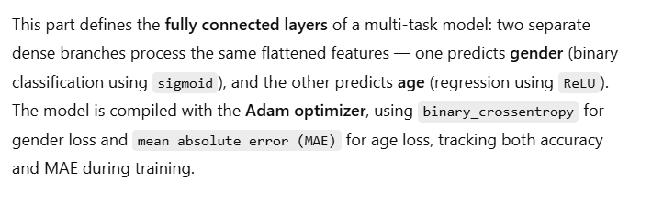
# fully connected layers
dense_1 = Dense(256, activation='relu') (flatten)
dense_2 = Dense(256, activation='relu') (flatten)
dropout_1 = Dropout(0.3) (dense_1)
dropout_2 = Dropout(0.3) (dense_2)
output_1 = Dense(1, activation='sigmoid', name='gender_out') (dropout_1)
output_2 = Dense(1, activation='relu', name='age_out') (dropout_2)
model = Model(inputs=[inputs], outputs=[output_1, output_2])
model.compile(
optimizer='adam',
loss={'gender_out': 'binary_crossentropy', 'age_out': 'mae'},
metrics={'gender_out': 'accuracy', 'age_out': 'mae'}
)

Slide 24


Code Explanation
# Plot Model Architecture:
from tensorflow.keras.utils import plot_model
plot_model(model)
# Train the Model:
history = model.fit(
x=X,
y={'gender_out': y_gender, 'age_out': y_age},
batch_size=32,
epochs=30,
validation_split=0.2
)

Slide 25
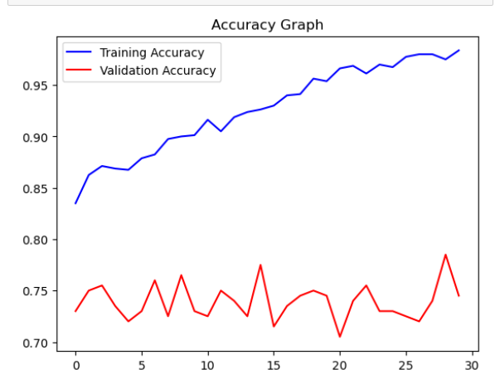
Code explanation
# Plot Gender Accuracy & Loss:
acc = history.history['gender_out_accuracy']
val_acc = history.history['val_gender_out_accuracy']
epochs = range(len(acc))
plt.plot(epochs, acc, 'b', label='Training Accuracy')
plt.plot(epochs, val_acc, 'r', label='Validation Accuracy')
plt.title('Accuracy Graph')
plt.legend()
plt.figure()

Slide 26
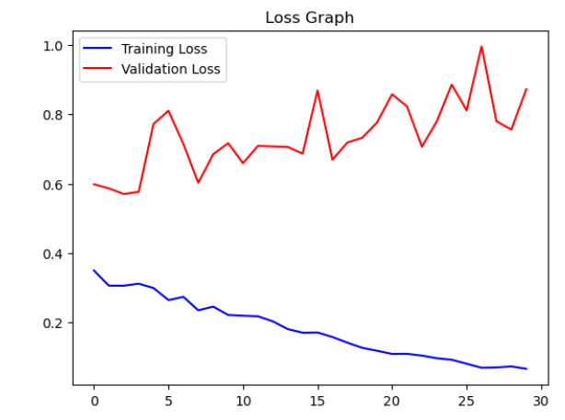

loss = history.history['gender_out_loss']
val_loss = history.history['val_gender_out_loss']
plt.plot(epochs, loss, 'b', label='Training Loss')
plt.plot(epochs, val_loss, 'r', label='Validation Loss')
plt.title('Loss Graph')
plt.legend()
plt.show()

Slide 27
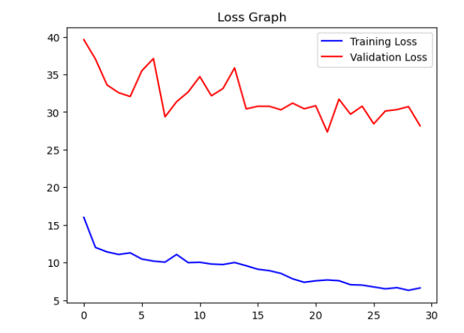
Code Explanation
# Plot Age Loss:
loss = history.history['age_out_loss']
val_loss = history.history['val_age_out_loss']
epochs = range(len(loss))
plt.plot(epochs, loss, 'b', label='Training Loss')
plt.plot(epochs, val_loss, 'r', label='Validation Loss')
plt.title('Loss Graph')
plt.legend()
plt.show()
Plots training and validation loss for age prediction.

Slide 28
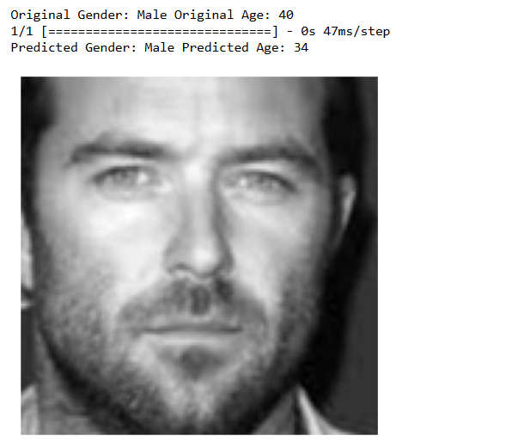

#Prediction With Test Data:
image_index = 650
print("Original Gender:", gender_dict[y_gender[image_index]], "Original Age:", y_age[image_index])
pred = model.predict(X[image_index].reshape(1, 128, 128, 1))
pred_gender = gender_dict[round(pred[0][0][0])]
pred_age = round(pred[1][0][0])
print("Predicted Gender:", pred_gender, "Predicted Age:", pred_age)
plt.axis('off')
plt.imshow(X[image_index].reshape(128, 128), cmap='gray');

Slide 29
Future Work
Use face detection before prediction
Improve accuracy with deeper models
Train on larger and cleaner datasets
Handle Imbalanced Data
Enhance Data Augmentation

Slide 30
Conclusion
Successfully built a multi-output CNN model
Achieved strong accuracy with lightweight architecture
Real-time deployment using Streamlit
Validated model on real-world face dataset (UTKFace)
Handled both classification (gender) and regression (age) tasks
Explored model performance through data visualization and evaluation metrics

Slide 31
GitHub & App Link
GitHub: https://github.com/Daynadalia/gender-age-prediction.git
Streamlit App: https://gender-age-prediction-attfkzgxlgqh9z4dewgsyp.streamlit.app/

