Slide 1
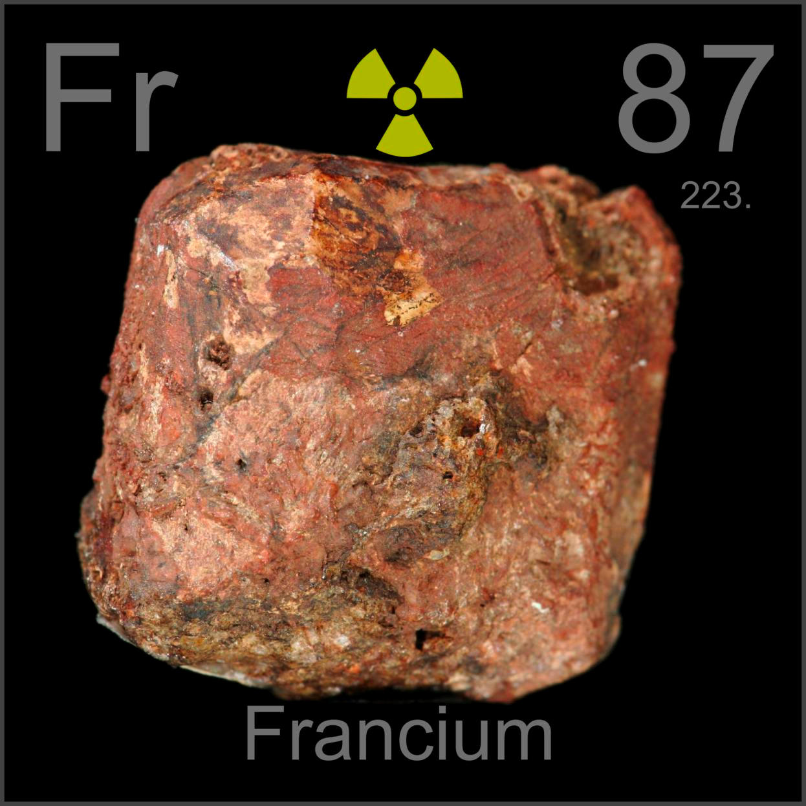
TEAM FRANCIUM
Quality code team project

Slide 2
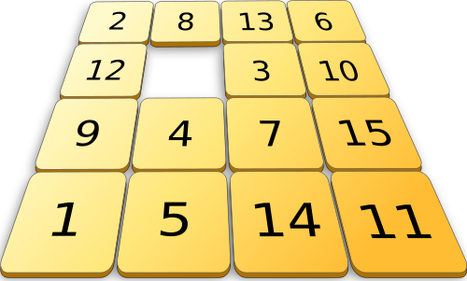
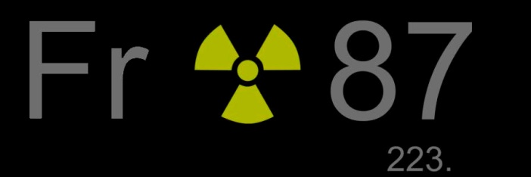
Task:
Console-based number puzzle called “Game 15”

Slide 3
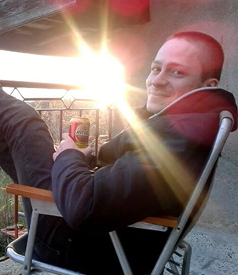
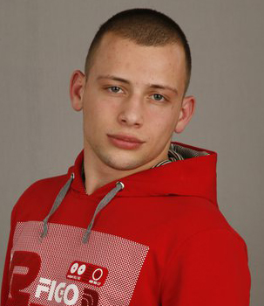
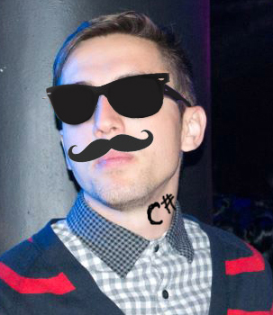
Participants:
Ivaylo Kenov
Radoslav Sholev
Zlatil Zlatilov

Slide 4
Working process:
Finding teammates
Set up a working server and initialize the project
Code refactoring and building a working solution
Unit testing and bug fixing
Documentation

Slide 5
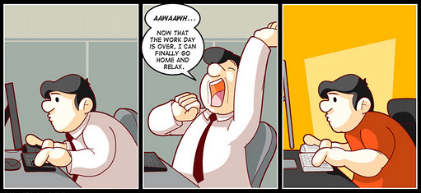
A brief resume on:
getting work done

Slide 6

Result:
https://github.com/DaysOfThePhoenix/TeamFranciumRepository

