Slide 1
CSI 402
What is the Shell?

Slide 2
The Shell
The shell is a program that takes in keyboard commands, and then passes them to the operating system to execute.
Almost all linux distros provide a shell program called bash.
Bash stands for Bourne Again SHell.
Bash is the replacement for sh, which was the original unix shell program written by Steven Bourne.
We need a terminal emulator to interact with the shell.

Slide 3
If the last character of the prompt is “#” rather than “$”, then we are in the state of one of two things: Either we are logged in the root user, or we selected a terminal emulator that provides superuser/admin privileges.
The command line remembers up to 1000 previous commands in its command history.

Slide 4
Cursor Movement
You can use the left and right arrow keys to move the cursor on the terminal. This makes editing commands much easier.
You can also highlight text on the terminal which will be maintained by X(X Window System). If you press the middle mouse button it will be pasted at the cursors’ location.

Slide 5
Simple Commands
“date” – displays the current time and date
“cal” – displays a calendar of the current month
“df” – displays the amount of current free space on your disk drives
“free” – displays the amount of free memory
“exit” – exit a terminal session

Slide 6
Chapter 2 - Navigation
Unix-like operating systems such as Linux organizes its files in a hierarchical directory structure.

Slide 7
They are organized in a tree-like pattern of directories.
The first directory is the root.
Windows has a separate file system tree for each storage device. While Unix-like systems, like Linux, have only one single file system tree.

Slide 8
Working Directories
To print the current working directory, simply type “pwd”
When you first log in to a terminal session, your current working directory is set to your home directory. The home directory is the only place a regular user is allowed to write files.
To list the files and directories in the current working directory, type “ls”.
You can also use “ls” to list the contents of any other directories, not just the current working directory.
To change the current working directory, use the ”cd” command followed by the pathname of the desired working directory.

Slide 9
Absolute vs Relative Pathnames
Absolute pathnames reference the root directory. Absolute paths contain the full path to the file. You can be in any directory on the system and be able to access the file using an absolute path.
A relative path only works if you are in the current working directory.
For example, I can provide you the full link to a website i.e: http://ansonfoong.com/documents/resume.html, this is an example of an absolute path.
Imagine I was in the directory “documents”, I could access resume.html via relative path.
The relative pathname starts from the current working directory.

Slide 10
Relative Pathnames
The “.” notation refers to the working directory, and the “..” notation refers to the parent of the working directory.
So for example, if you wanted to change the working directory to /usr/bin, you would provide the absolute pathname. i.e: cd /usr/bin
We can change the working directory to usr in two ways.
Absolute Path: cd usr
Relative Path: cd .. (This will go back one directory, aka go to the parent of the cwd)

Slide 11
Shortcuts
“cd ” – Changes the working directory to your home directory.
”cd - “ – Changes the working directory to the previous working directory.
“cd ~user_name” - Changes the working directory to the home directory of user_name. For example, cd ~bob will change the directory to the home directory of user ~bob.

Slide 12
Files
Files that begin with a dot ” . “ are hidden.
File names and commands are case sensitive in Linux.

Slide 13
Chapter 3 – Exploring the System
The “ls” command lists contents and directories of the current working directory.
We can also do “ls (name of directory in the current working directory)” to view other contents and directories in the specified directory.
For example, suppose your current working directory is the Desktop, and the Desktop contained these folders: “Projects, Documents, Pictures” you can do “ls projects” to list all of the contents and directories in projects.

Slide 14
You can also view multiple directories.
“ls ~ /usr” – This will list all of the directories in the home directory (specified with the ~ character) and the directories in /usr.
You can also do “ls –l” which will change the output to long format.
You can use the following arguments with the ls command. (See next page).

Slide 15
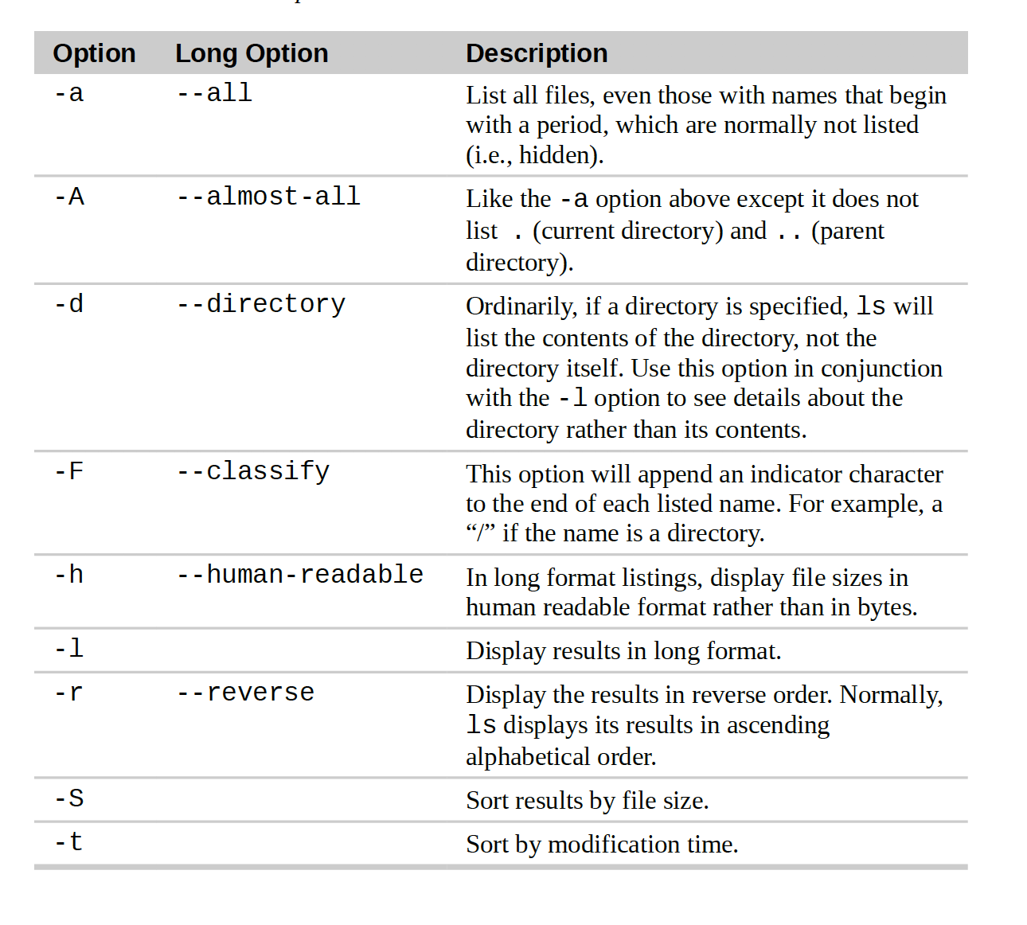

Slide 16
You can use the “file” command to determine the type of a file.
You can use the “less” command to view text file contents.
Text is a simple one-to-one mapping of characters to numbers.

Slide 17
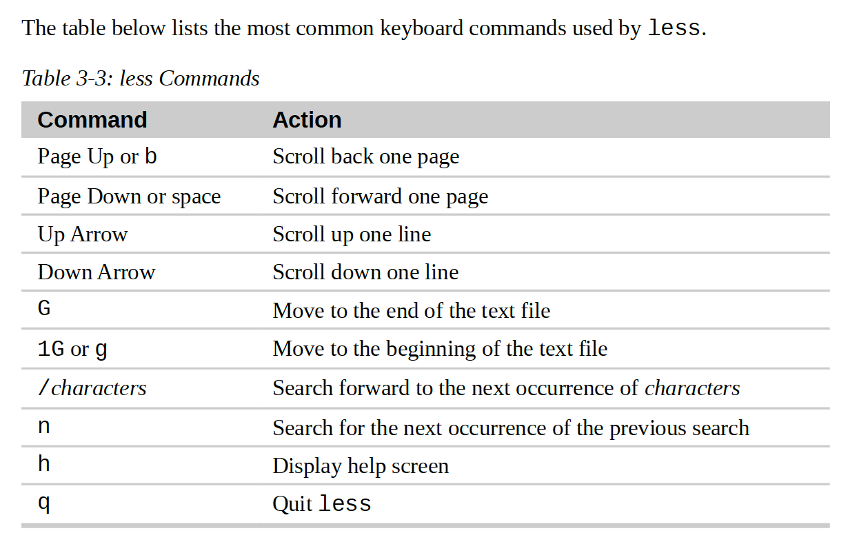
less commands

Slide 18
Chapter 4 - Manipulating Files and Directories
Wildcards allow you to specify groups of filenames. Using wildcards is also known as globbing. It allows you to select filenames based on patterns.

