Slide 1
Coding Buddy
Team Members: Danish, Zachary, Mitchell, Daryle, Abraham, Richard, Jared

Slide 2
First some of our pages

Slide 3
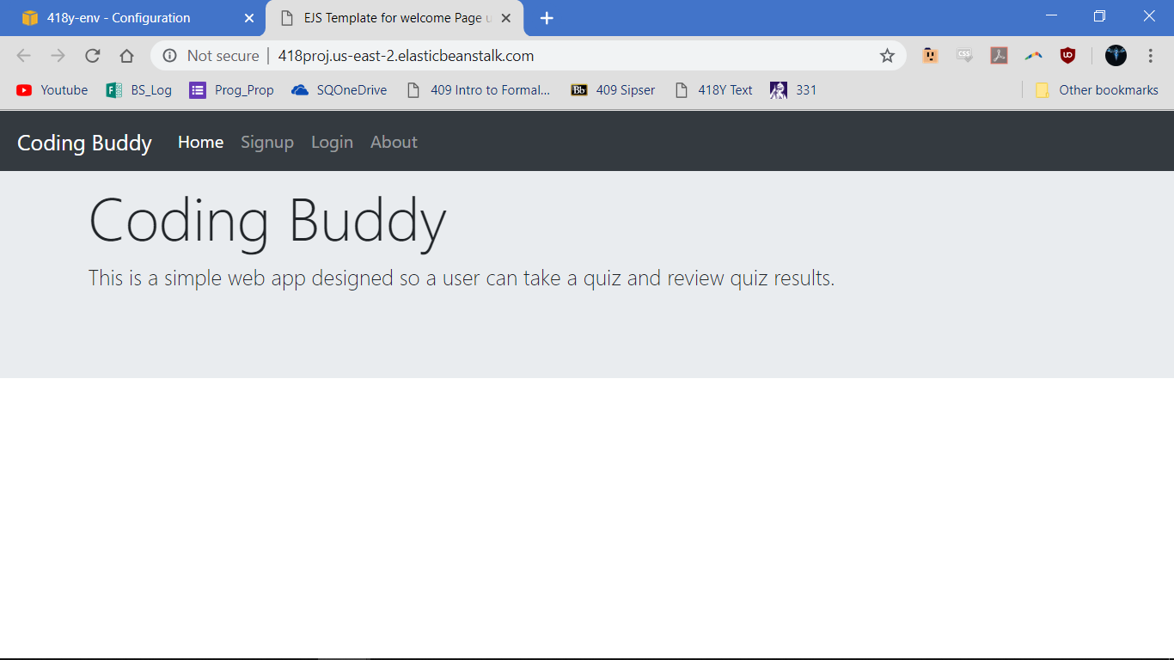

Slide 4
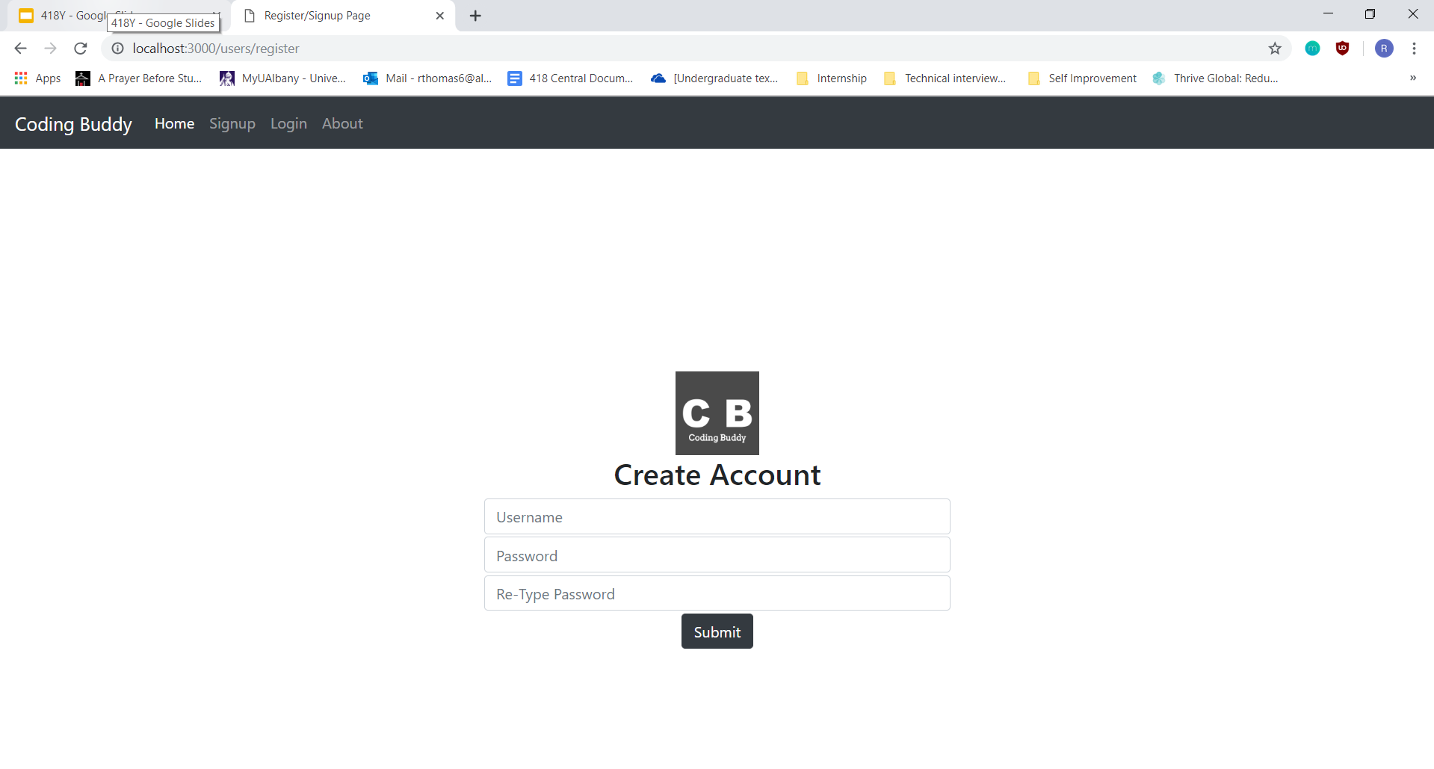

Slide 5
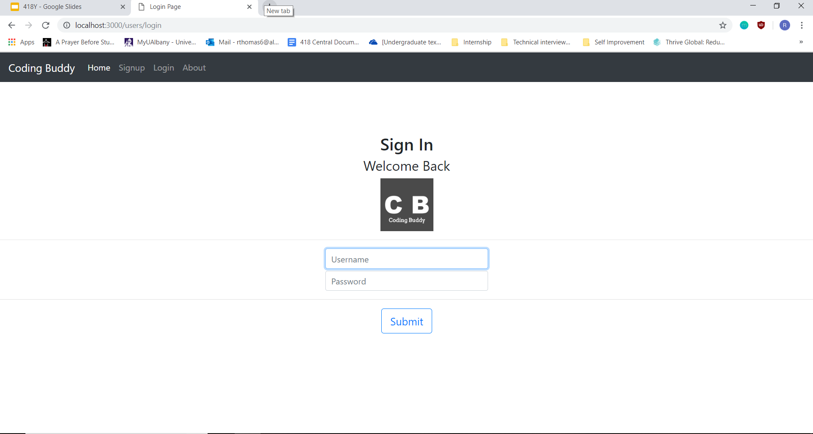

Slide 6
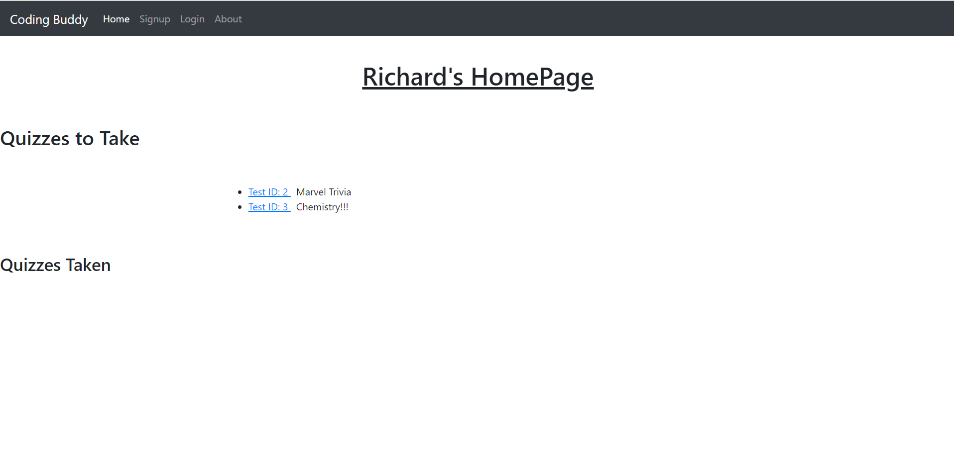

Slide 7
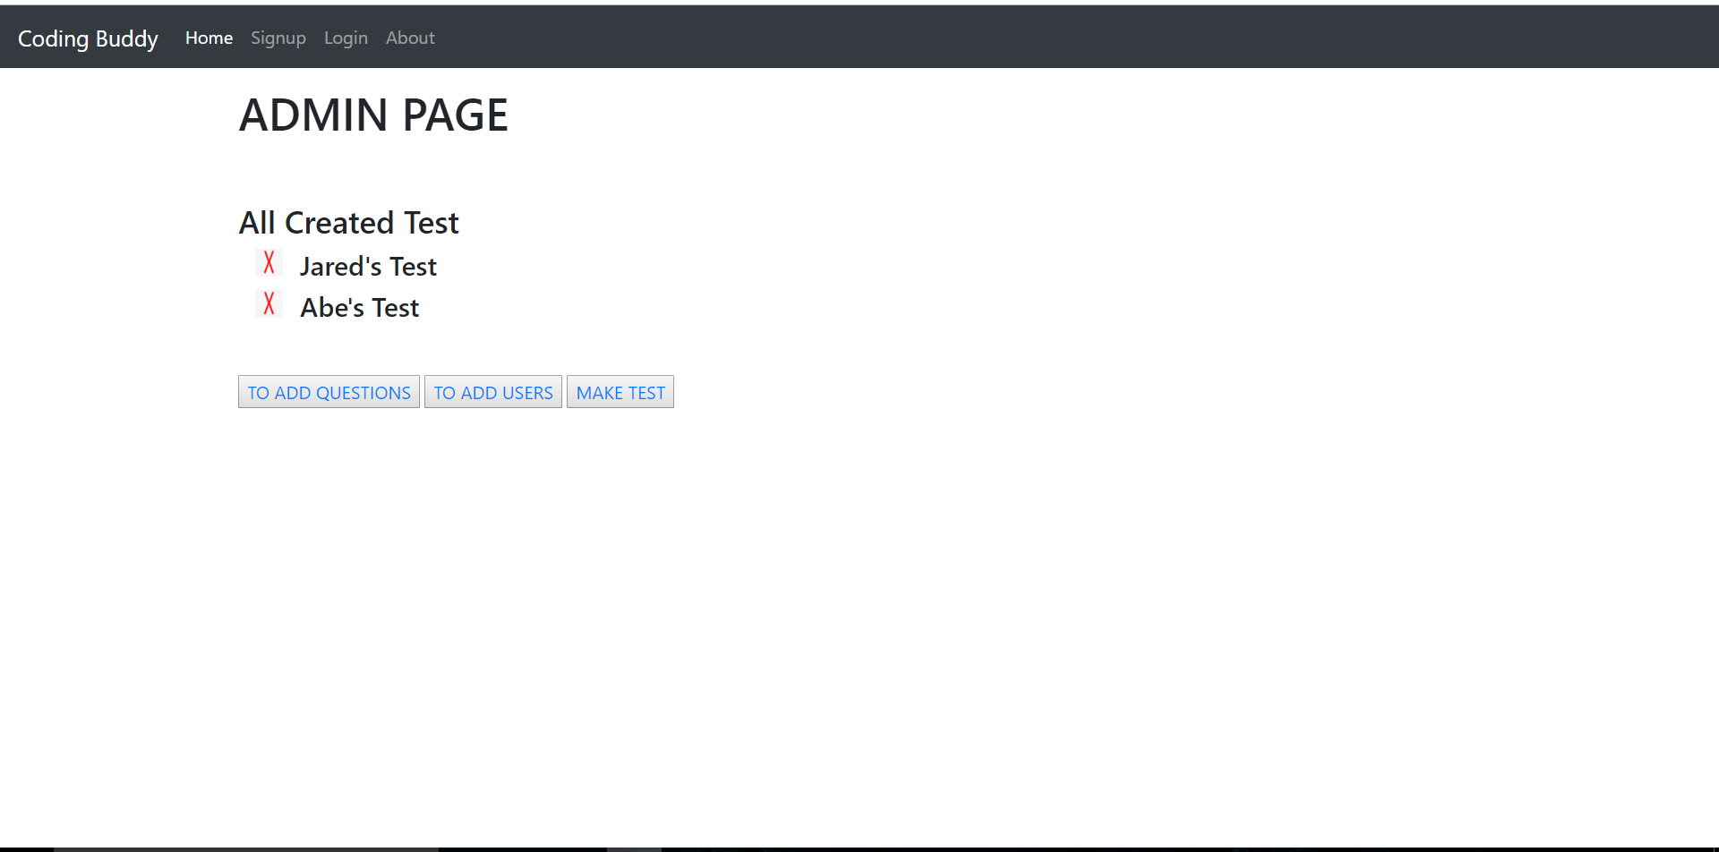

Slide 8
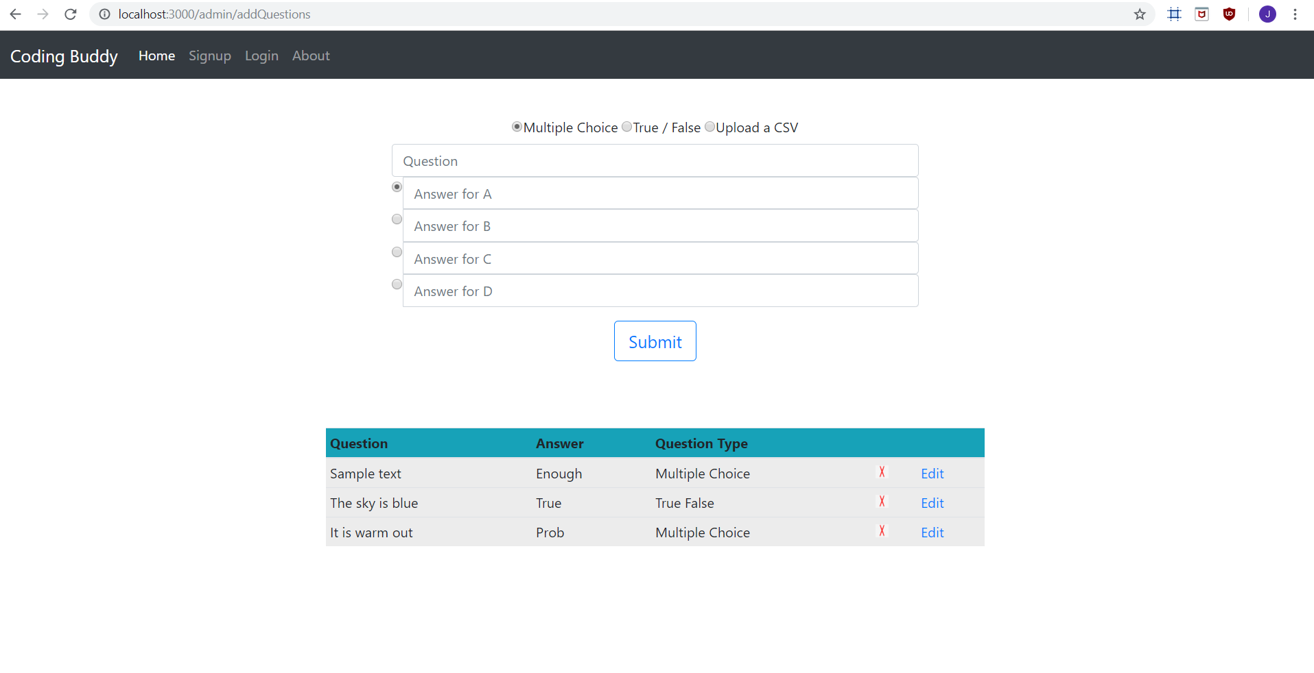

Slide 9
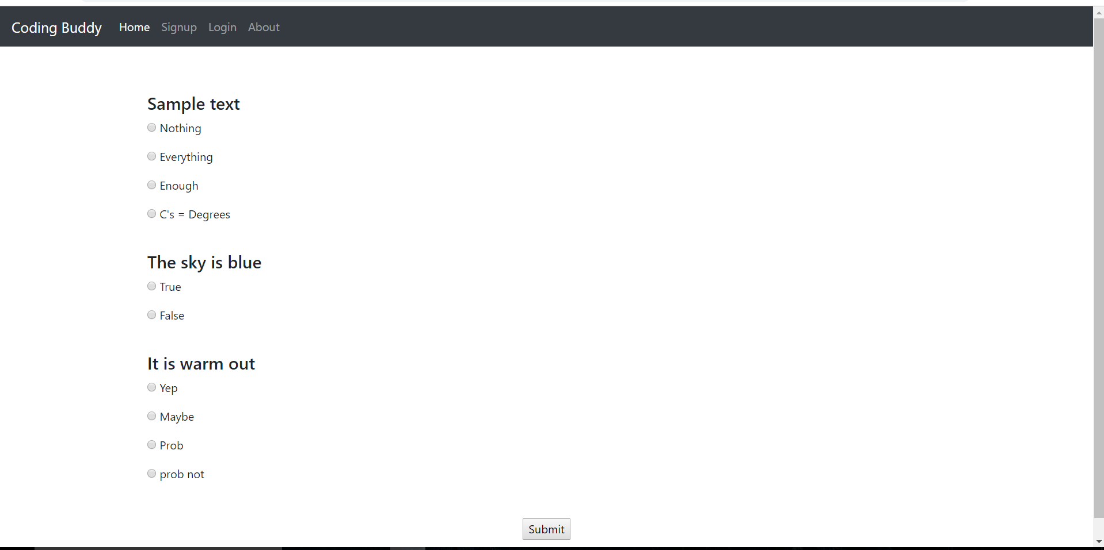

Slide 10
Statement of our Project
Our main task is to develop an MVP FullStack Blackboard clone
We wanted there to be functionality where the users are either admins or students
The admin users have the ability to create and add questions to a question bank
The admin users have the ability to then create tests from the question bank
The user has the ability to take a test, and see the results
The admin users can create userid’s for new users and also add them as admins users
Deploy the project to AWS

Slide 11
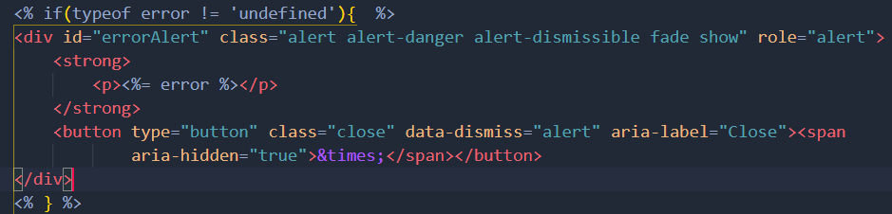
Front End Technology
View Engine Template
EJS
Fast Development Time and Rendering
Just Plain Javascript Embedded into HTML
<link href=“Bootstrap”> - CSS framework
B O O T S T R A P version 4.2.1
Functions: Navbars, links, checkboxes
Used bootstrap carousel template for our about page

Slide 12

BackEnd Technology
Used a web app framework called Express that is built on top of NodeJs
Implemented page routes that link to different EJS pages
Handled get and post HTTP requests
Deployed to Amazon Web Services with RDS Database instance
MySQL Database with XAMPP.exe (to test)
Sessions held information from the user

Slide 13
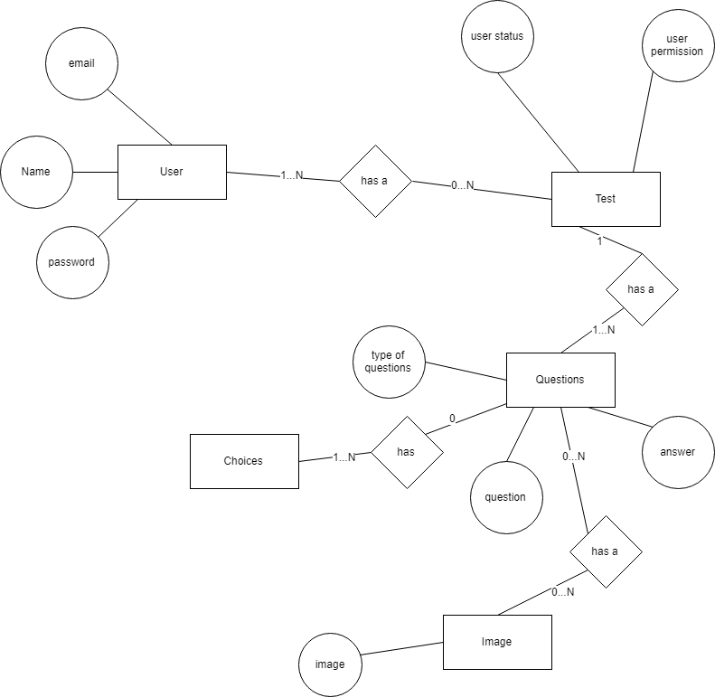
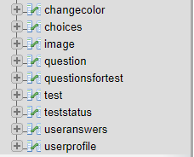
ERD
Entity-relationship diagram

Slide 14
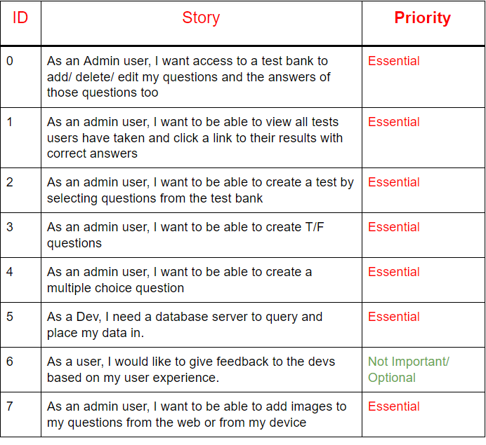
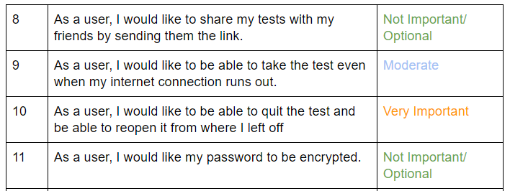
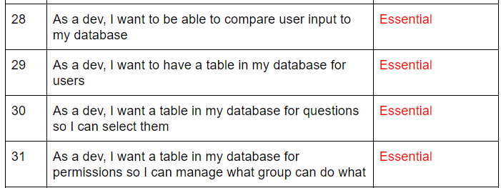
Product BackLog

Slide 15
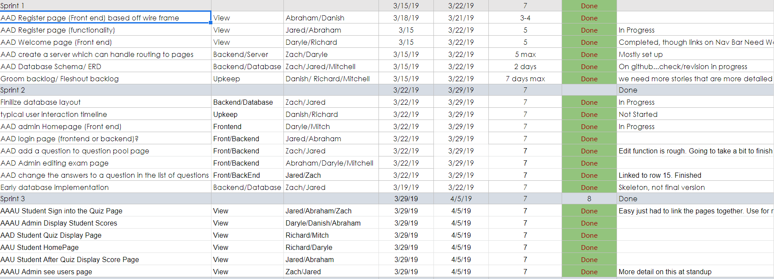
Sprint Plans

Slide 16
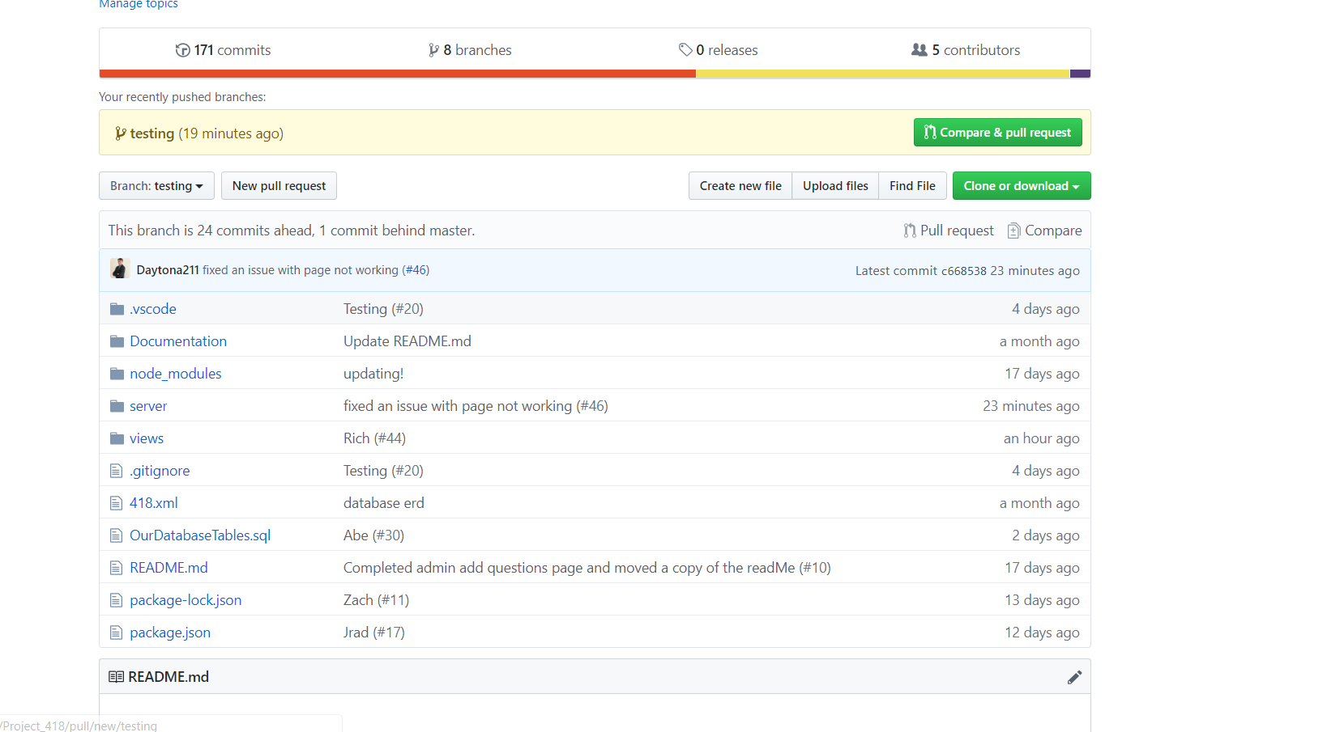
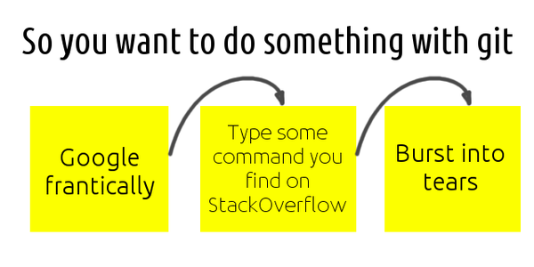
Version control - git
Like most of you we used git for version control through github
Managed branches and merged them
Mistakes were made and lessons were learned particularly resolving conflicts

Slide 17
What Went Well
Getting the team together
Learning from one another helped
Standup meetings were productive (weekly)
Inter-group collaboration helped learn the technologies

Slide 18
What we should have done differently is...
We should have started deployment earlier for testing
We should have fully understood requirements so that we did not have to make frequent changes to the Database schema
Linking different pages together made by different people

Slide 19
Lessons Learned
Keep up with your teammates to ensure quality control
Learned how to implement a Full Stack Web Application that integrates with a DataBase
Understood how to divide work into weekly springs
Understood the importance of end-user feedback during project development
Have a clear understanding of our requirements FIRST, so we make less frequent updates to the database schema
Pre-evaluate each task difficulty

Slide 20
Questions?

