Slide 1
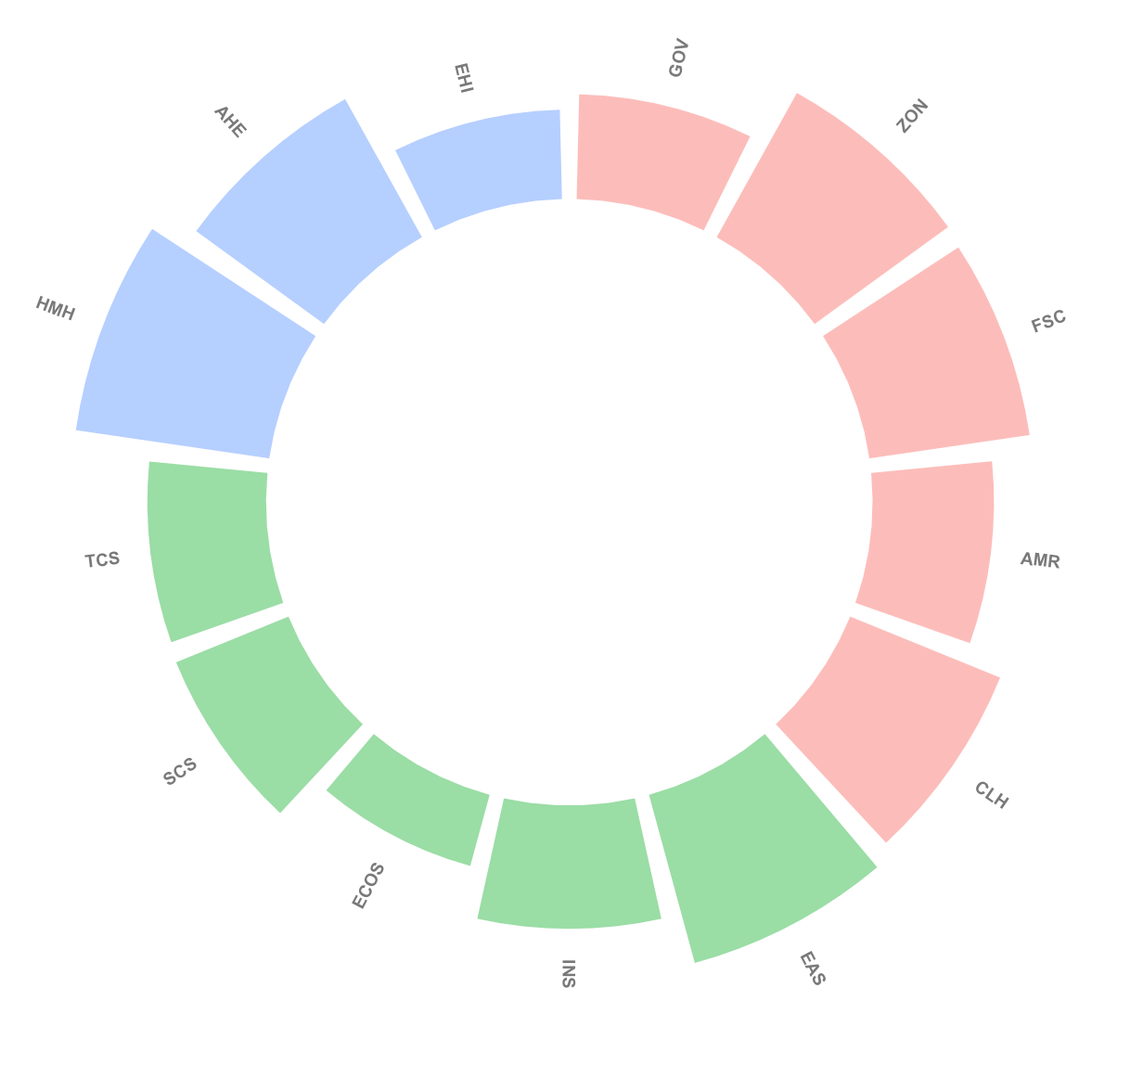
IDI
CDI
46.57
One Health Index
EDI

Slide 2
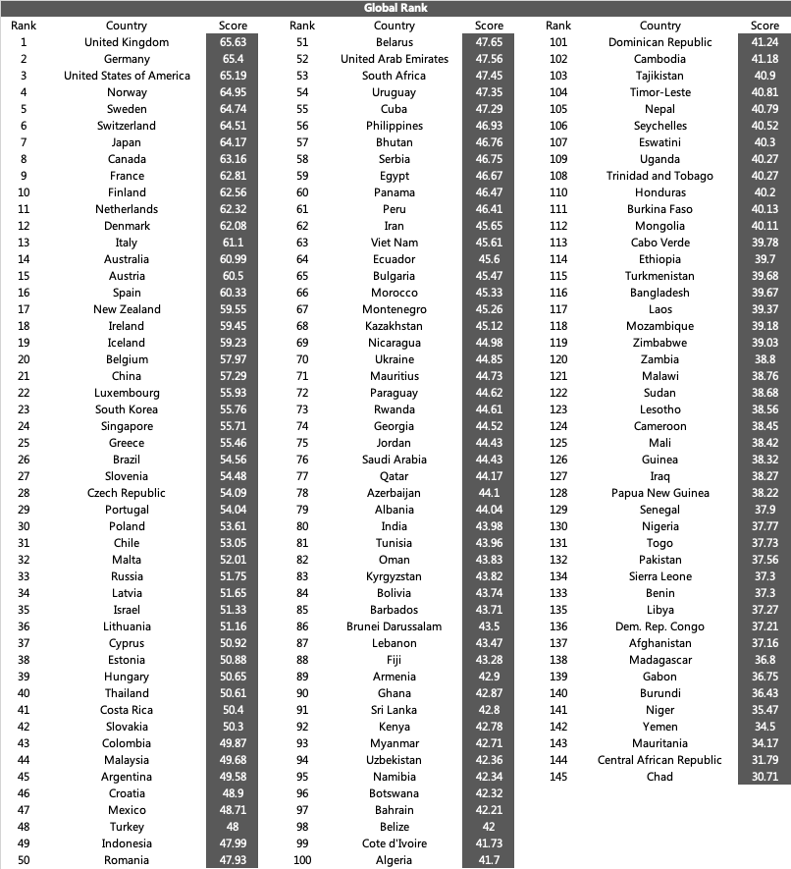

Slide 3
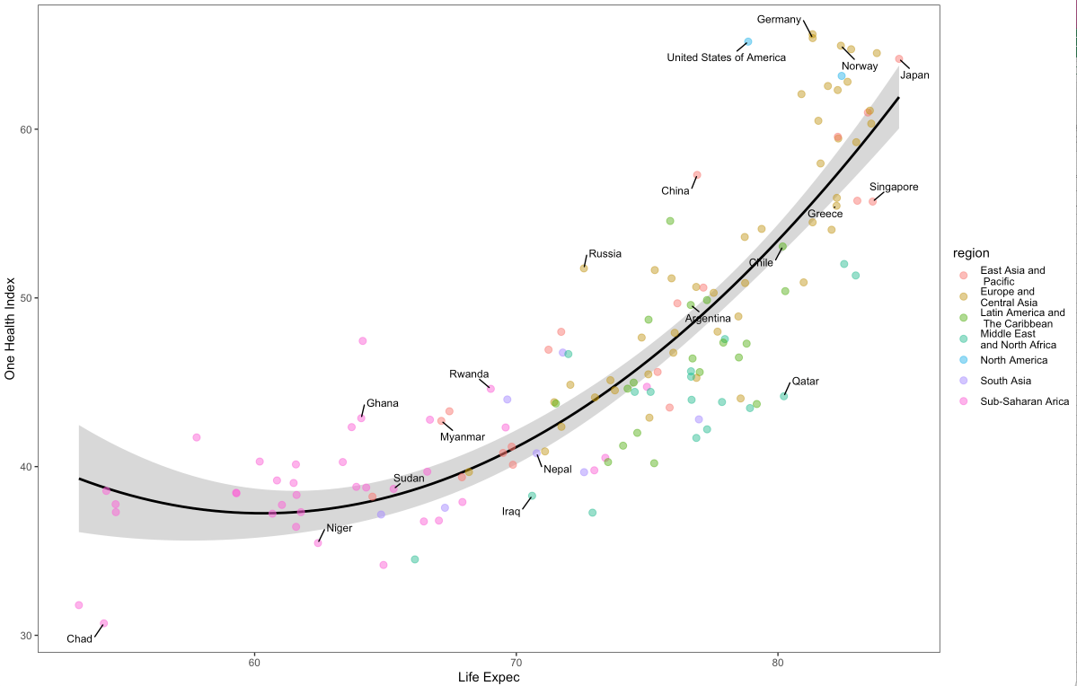
Total score = 188.91-5.03*life expectancy+0.042*(life expectancy)^2
Adjusted R-squared: 0.7446
p-value: < 2.2e-16

Slide 4
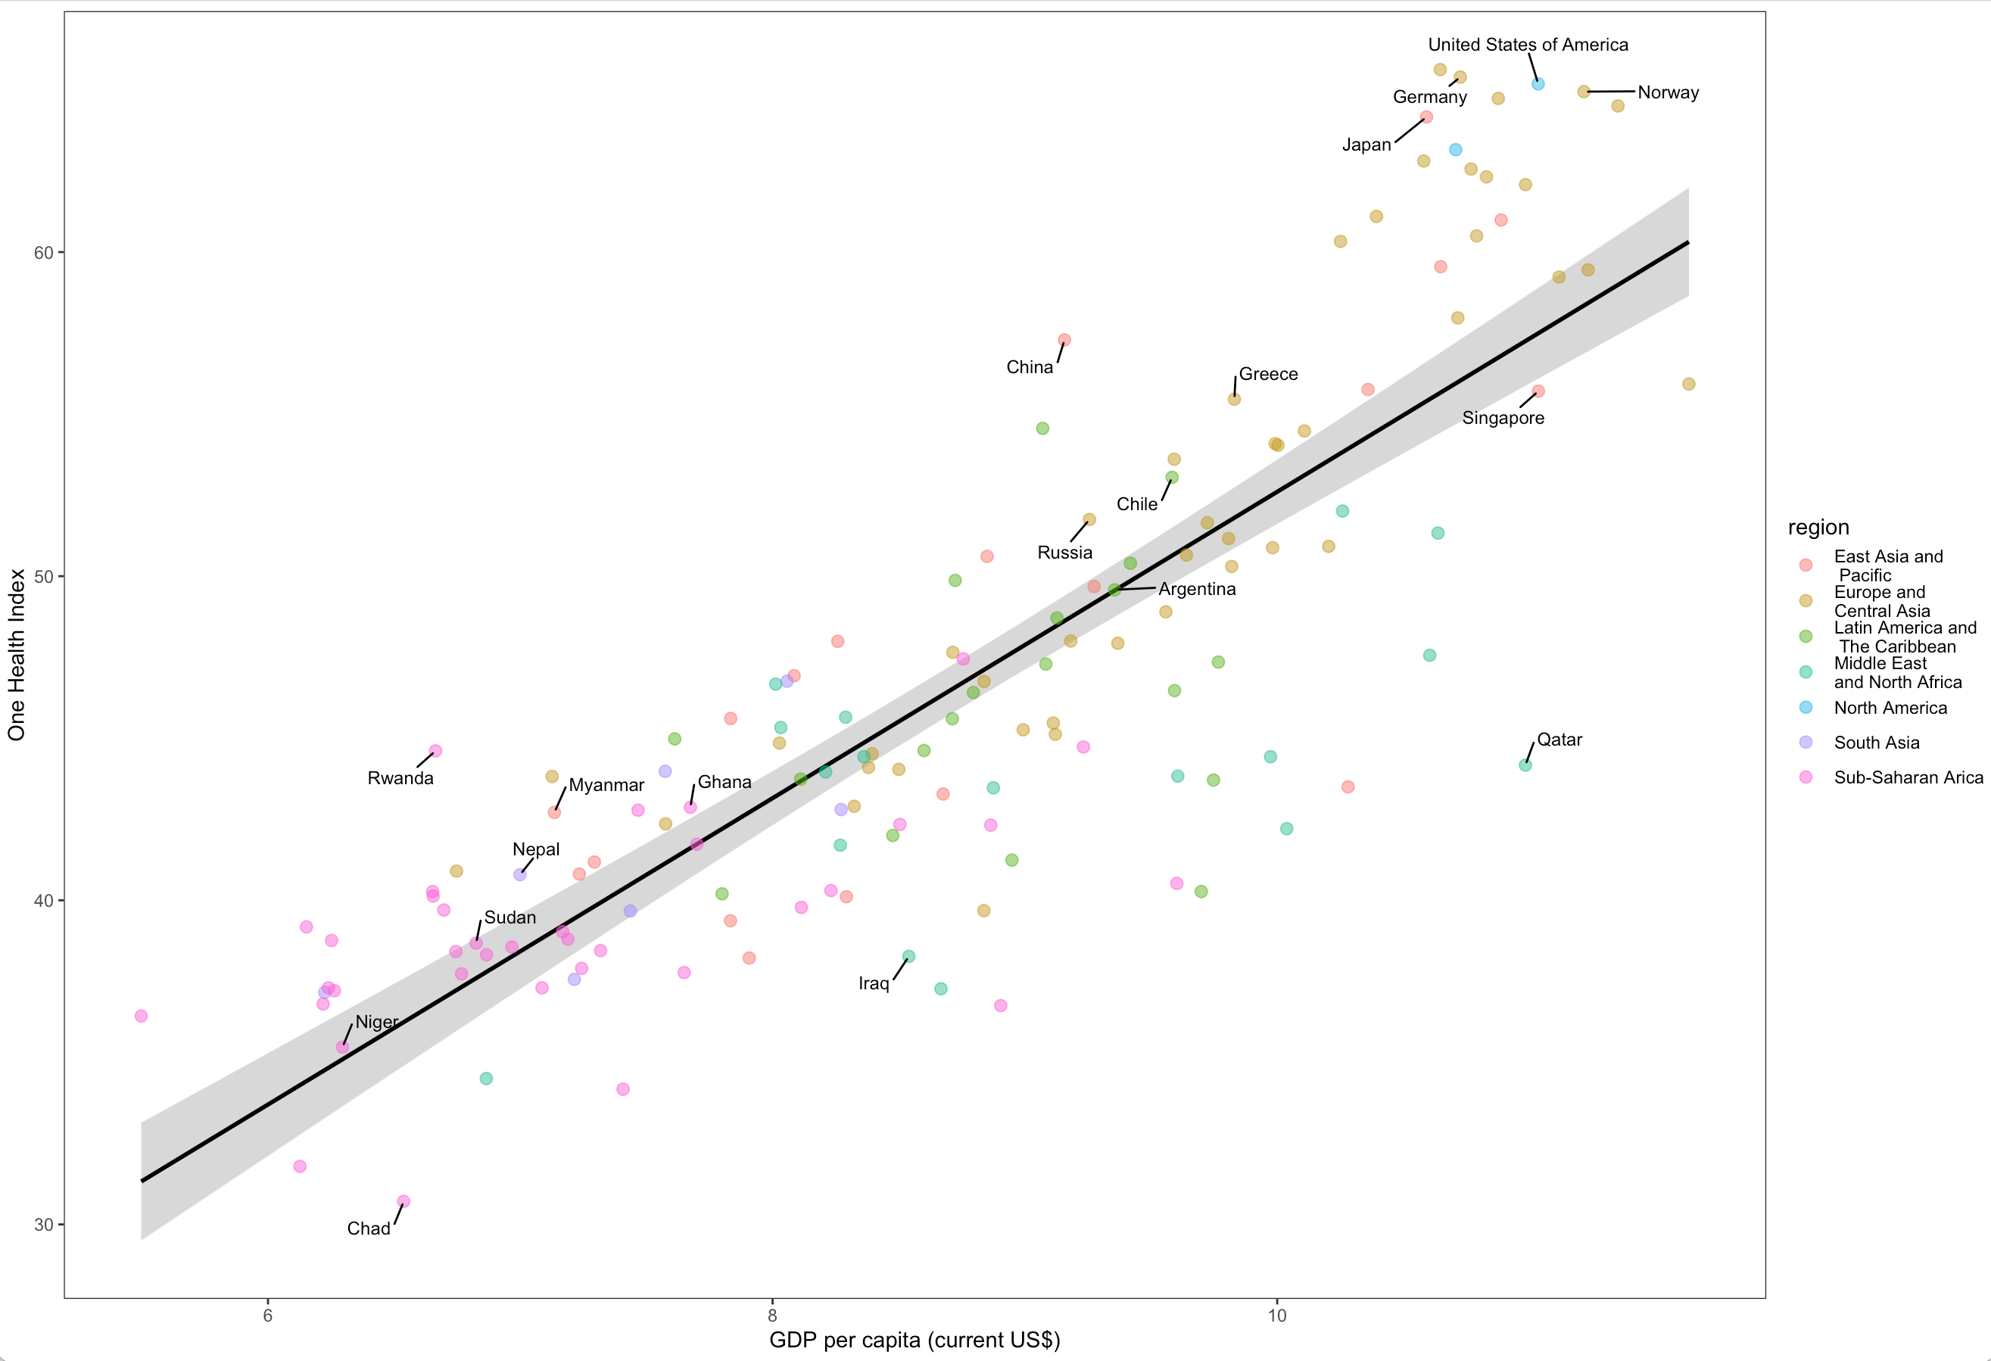
total score = 4.73*log(GDP per capita)+5.34
Adjusted R-squared: 0.6962
P-value < 0.001

Slide 5
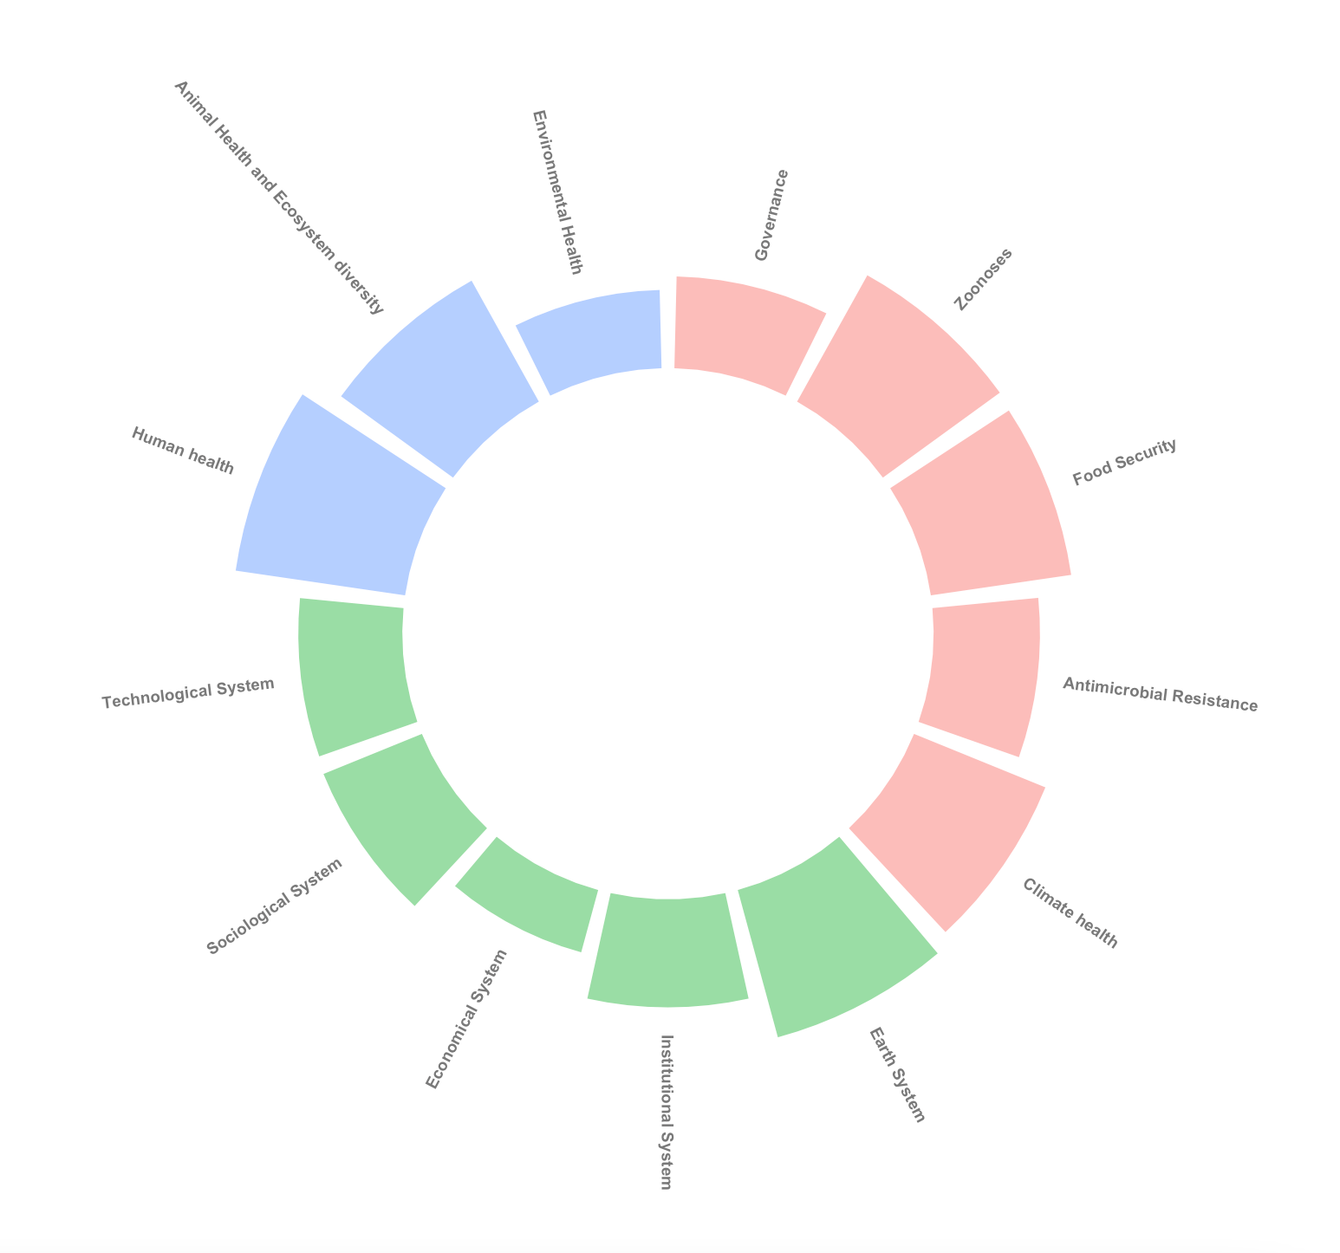
IDI
46.57
CDI
One Health Index
EDI

Slide 6
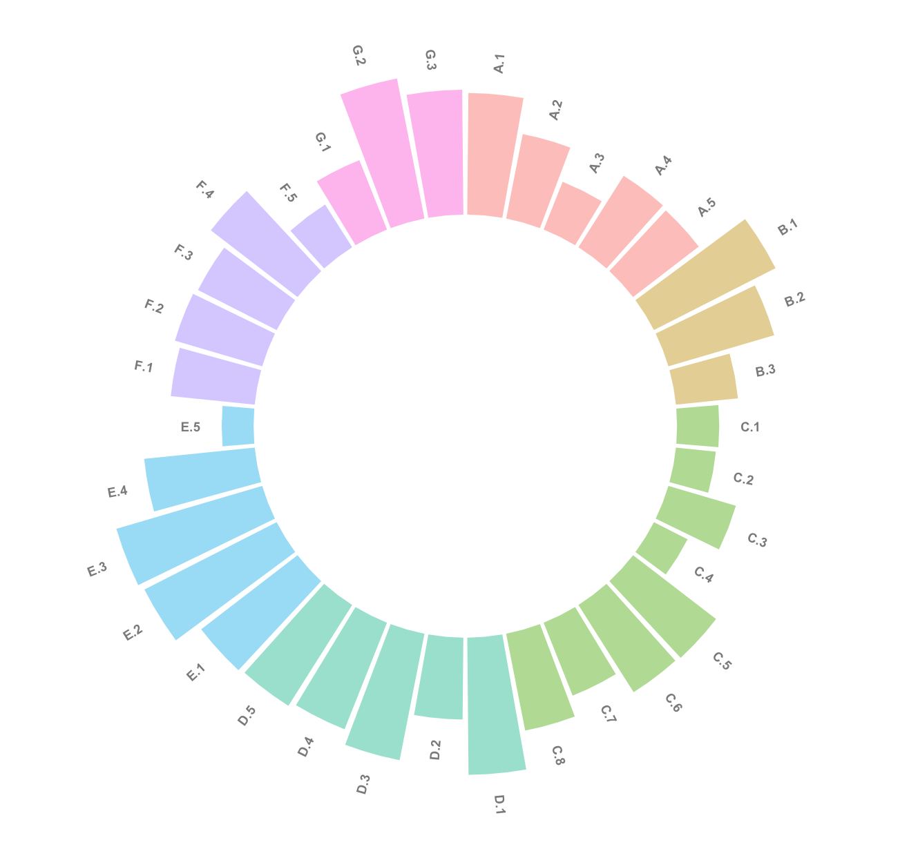
Climate Health
EDI
AMR Resistance
IDI
46.57
One Health Index
Food Security
Governance
Zoonotic Diseases

Slide 7
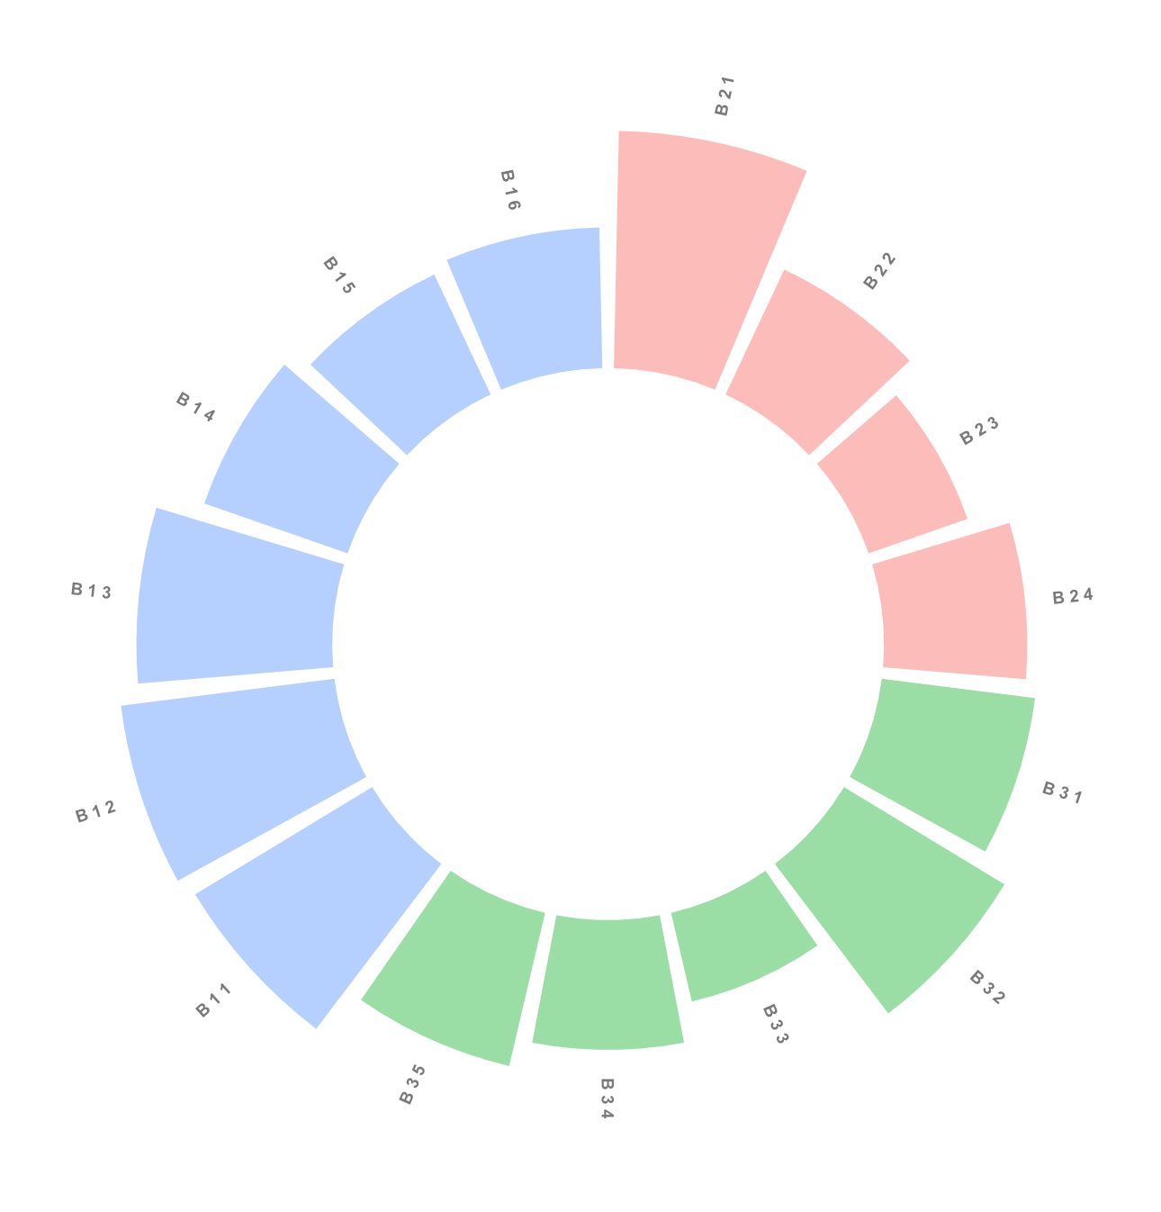
Animal Health
Human Health
53
Global Score
Environmental Health

