Slide 1
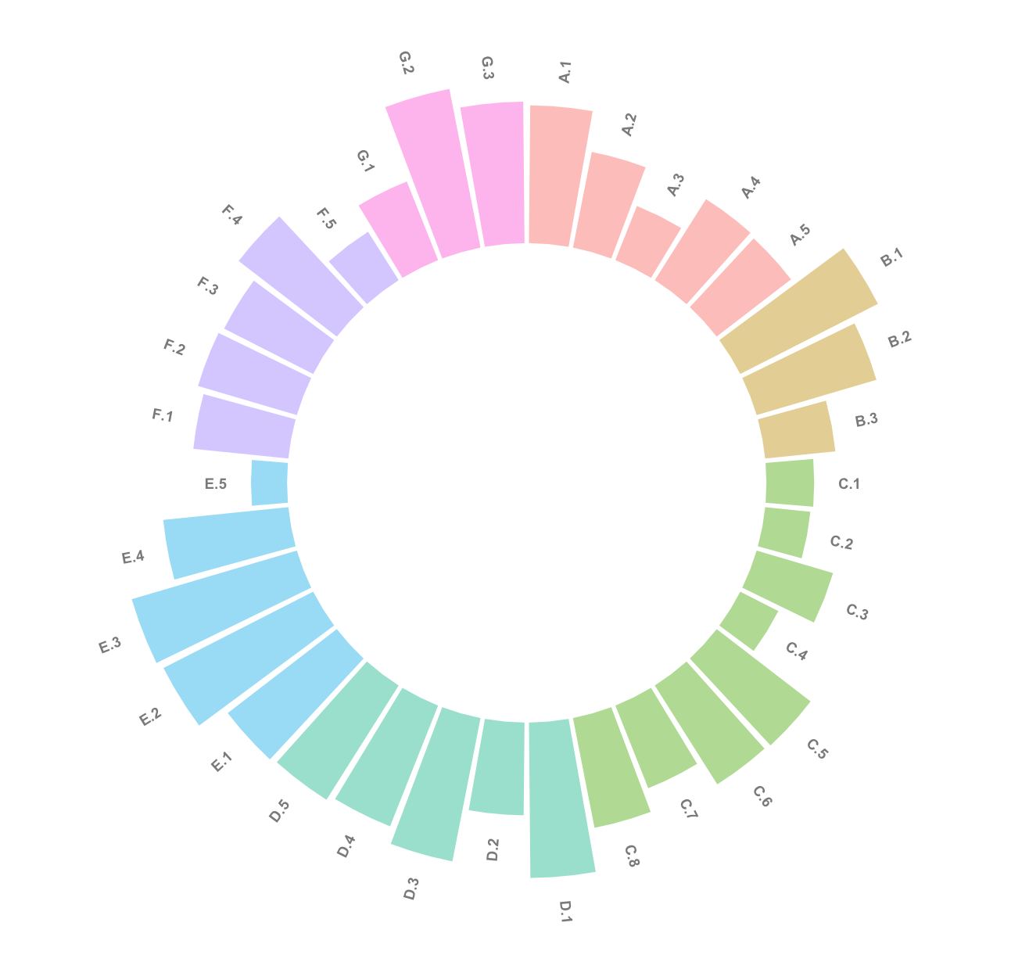
Climate Health
EDI
AMR Resistance
IDI
46.57
One Health Index
Food Security
Governance
Zoonotic Diseases

Slide 2
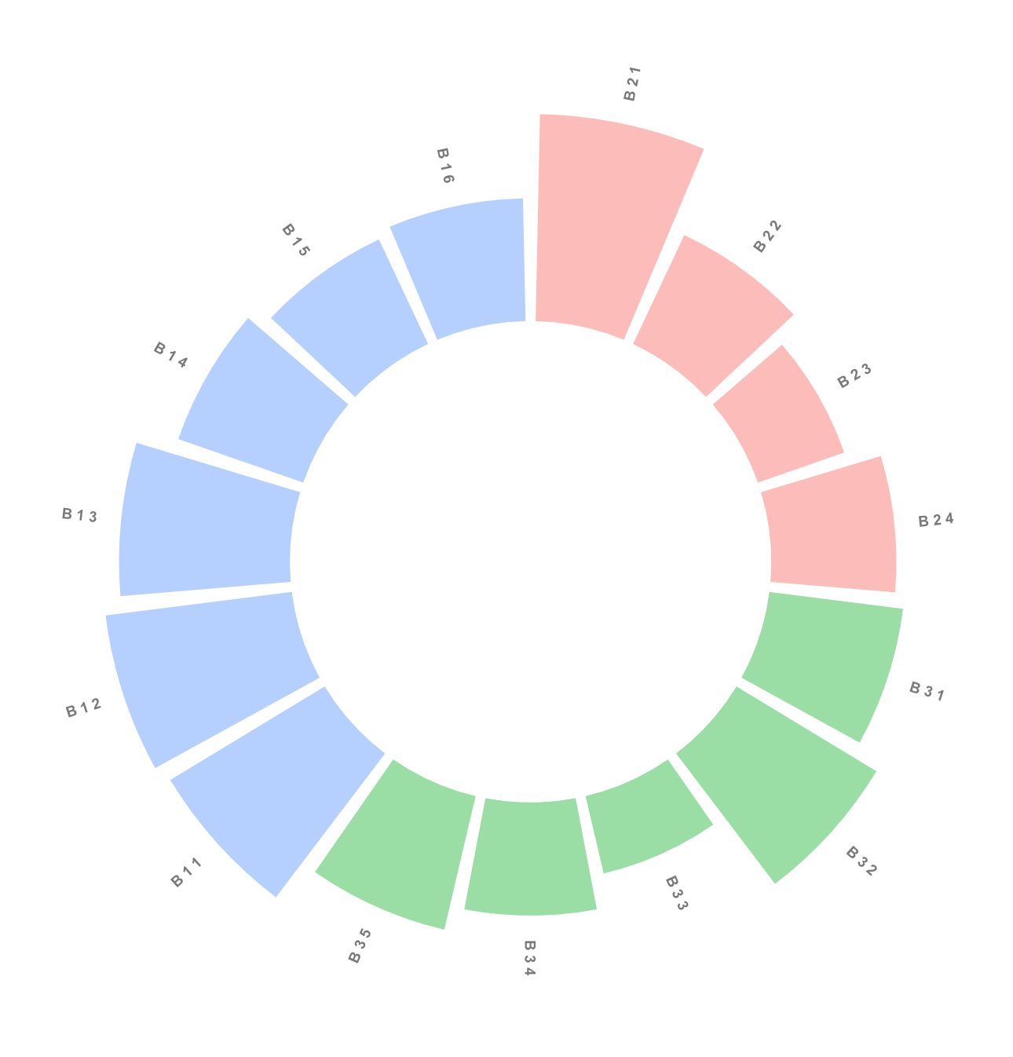
Animal Health
Human Health
53
Global Score
Environmental Health

