Slide 1
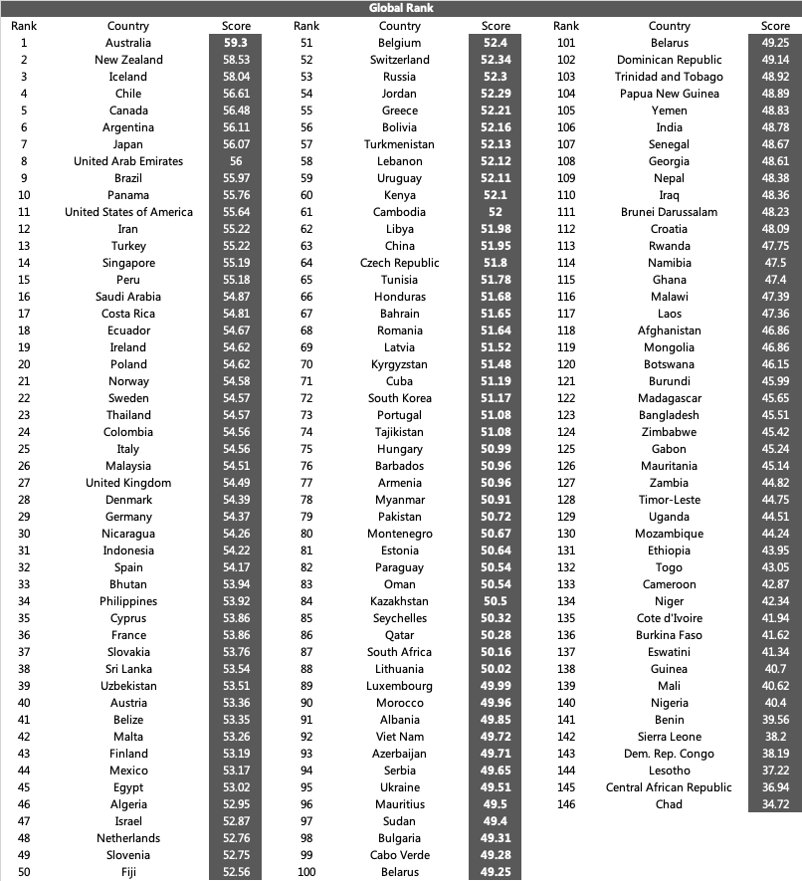

Slide 2
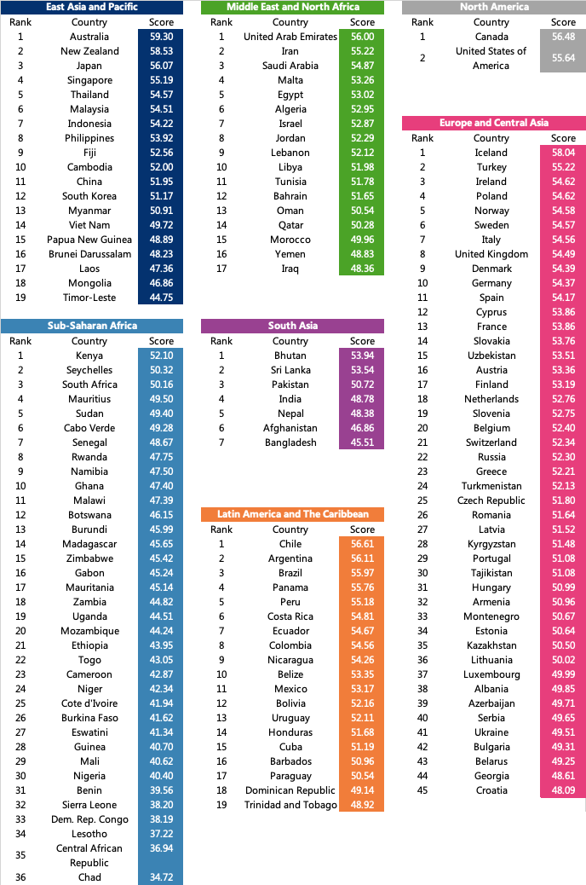

Slide 3
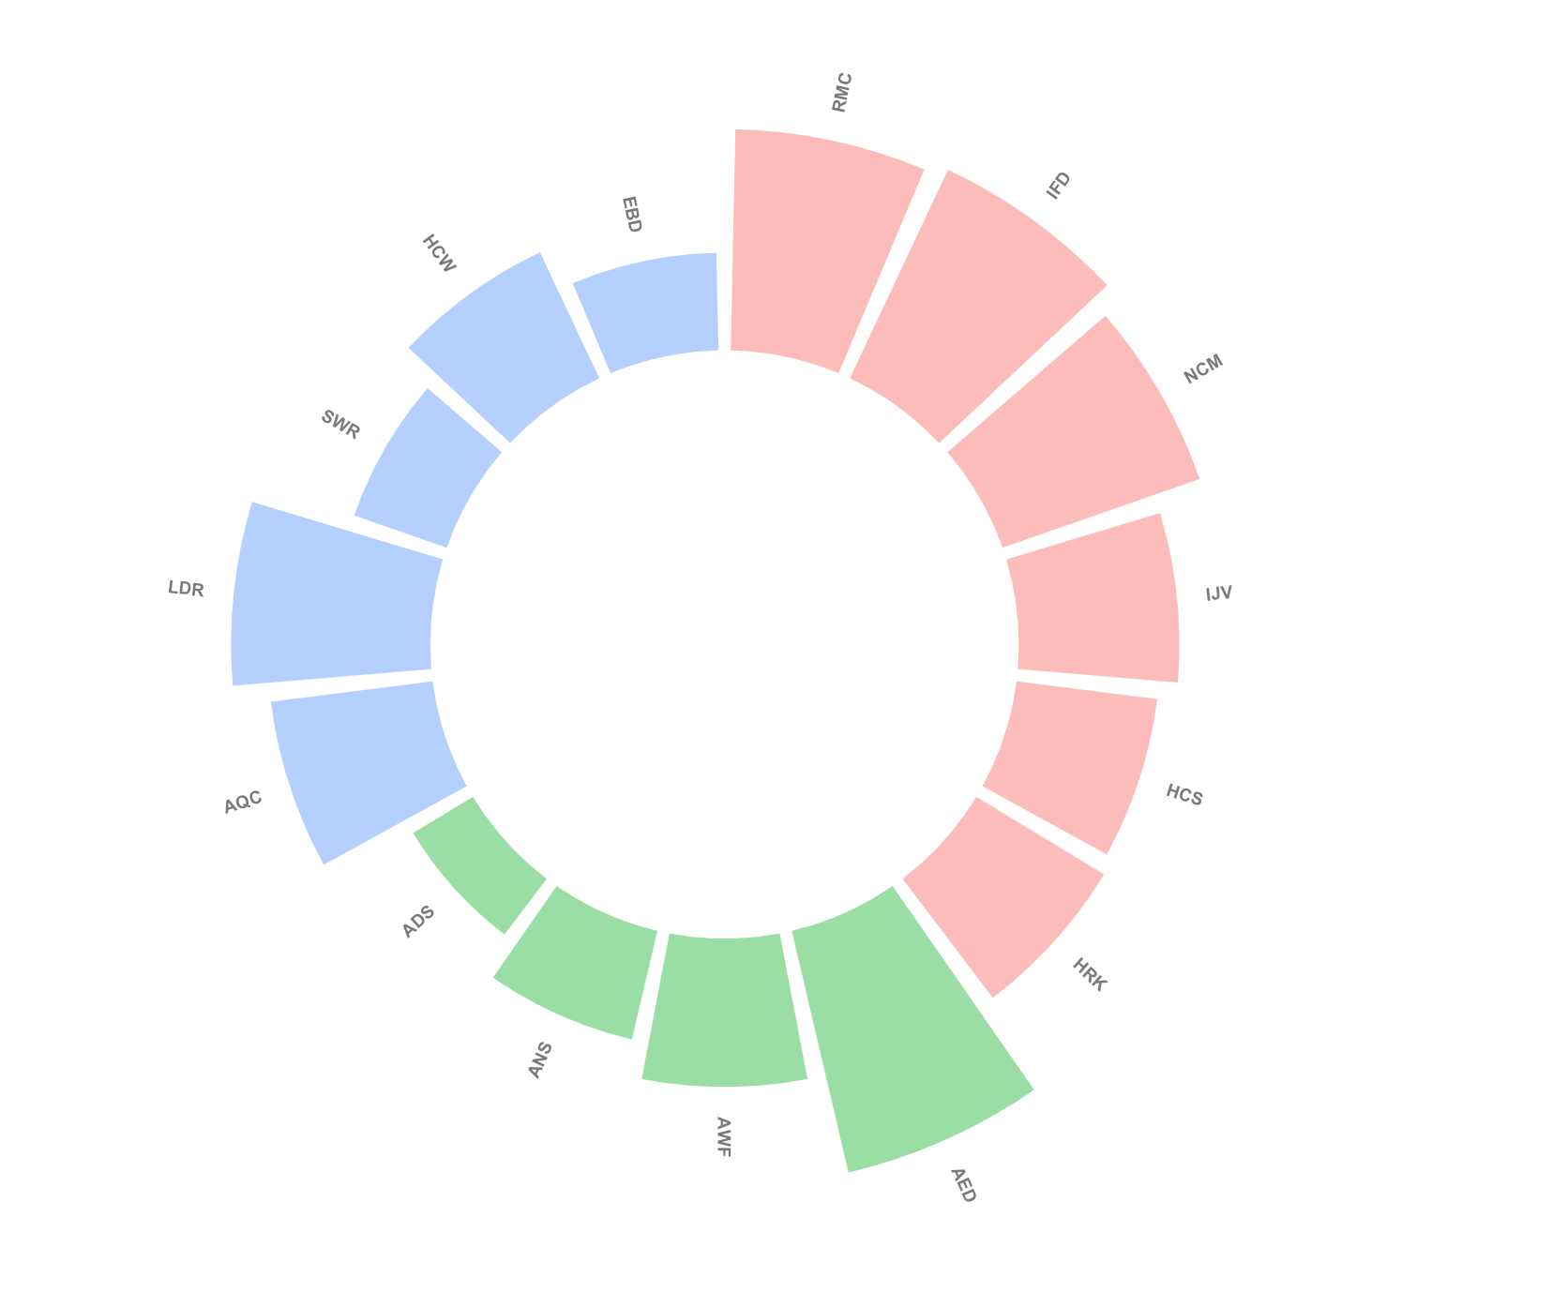
Environmental Health
50.25
Human Health
Intrinsic Driver Index
(IDI)
Animal Health

