Slide 1
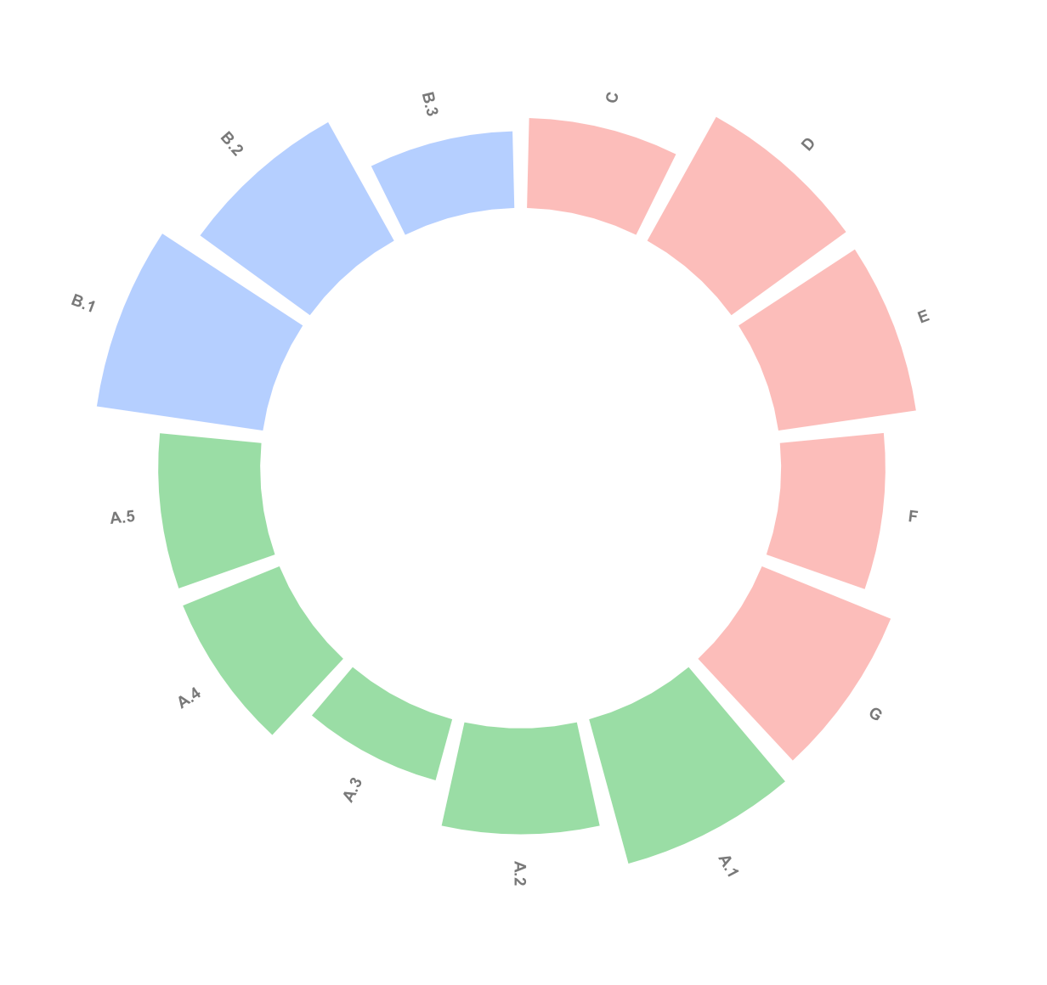
IDI
CDI
46.57
One Health Index
EDI

Slide 2
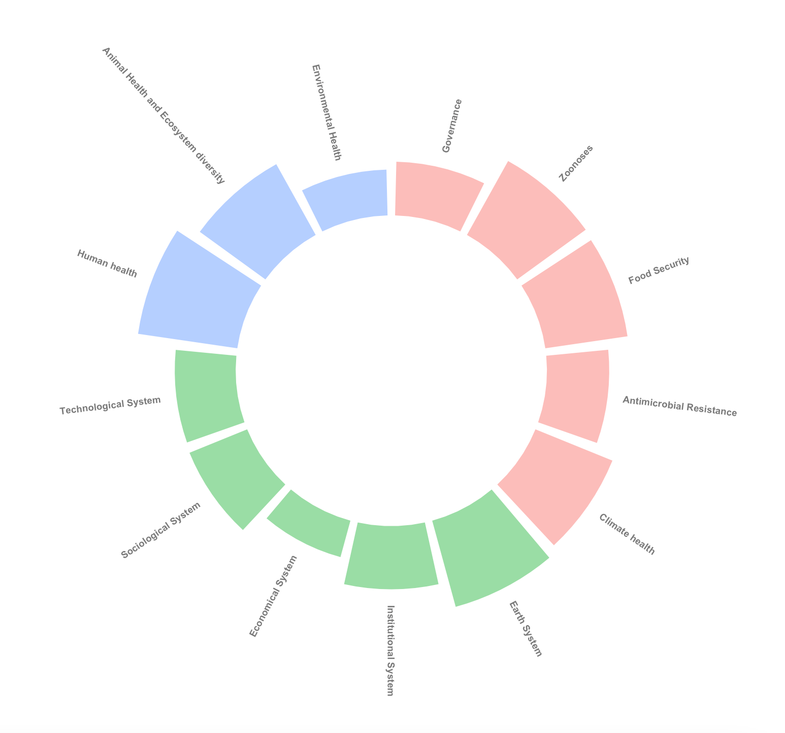
IDI
46.57
CDI
One Health Index
EDI

Slide 3
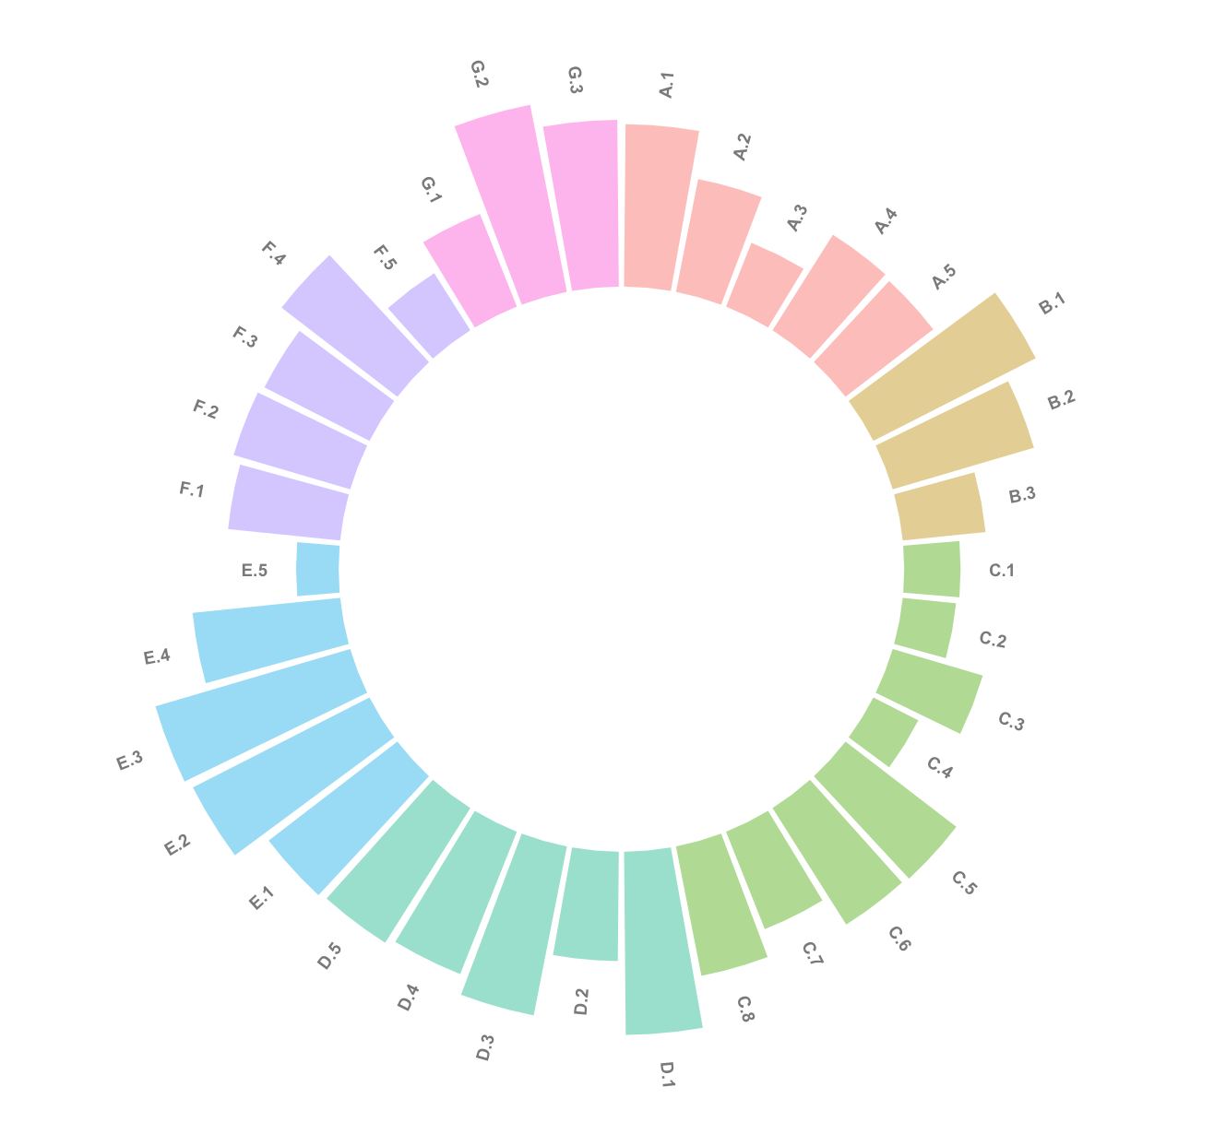
Climate Health
EDI
AMR Resistance
IDI
46.57
One Health Index
Food Security
Governance
Zoonotic Diseases

Slide 4
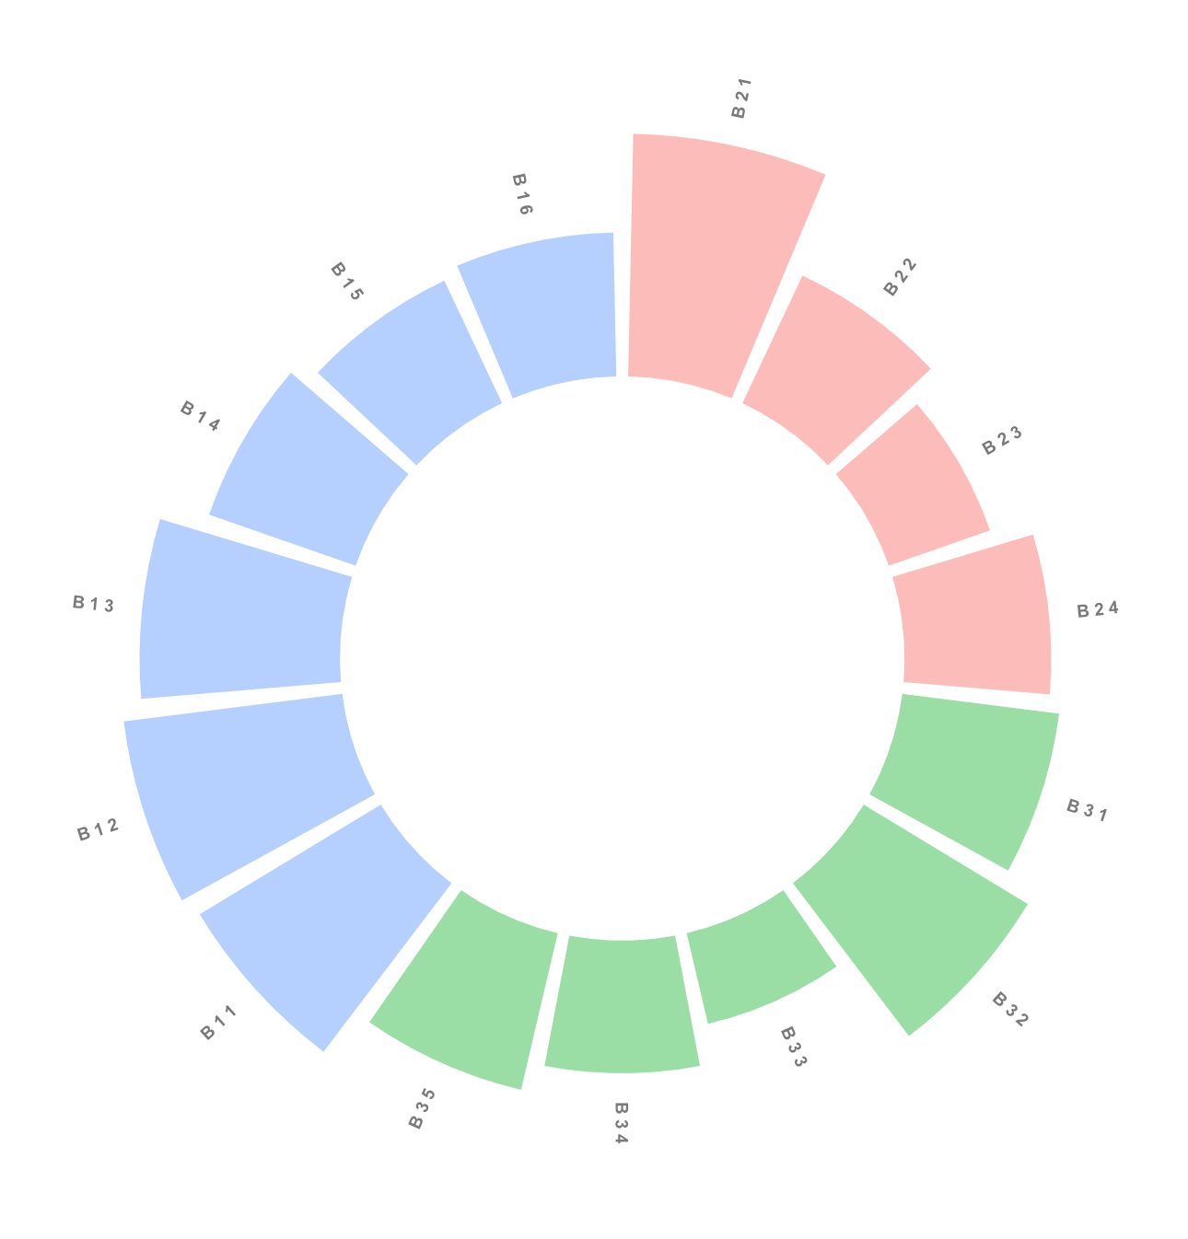
Animal Health
Human Health
53
Global Score
Environmental Health

