Slide 1
Chatterbot Application on Cryptocurrency
Qitao Xie and Dayuan Tan
CSEE, UMBC

Slide 2
What is cryptocurrency?
A cryptocurrency is a digital asset designed to work as a medium of exchange that uses cryptography
to secure its transactions,
to control the creation of additional units, and
to verify the transfer of assets. [1]

Slide 3
Why important?
As of May 6 2018 total market capitalization of cryptocurrencies is bigger than 450 billion USD and record high daily volume is larger than 25 billion USD. [2]

Slide 4
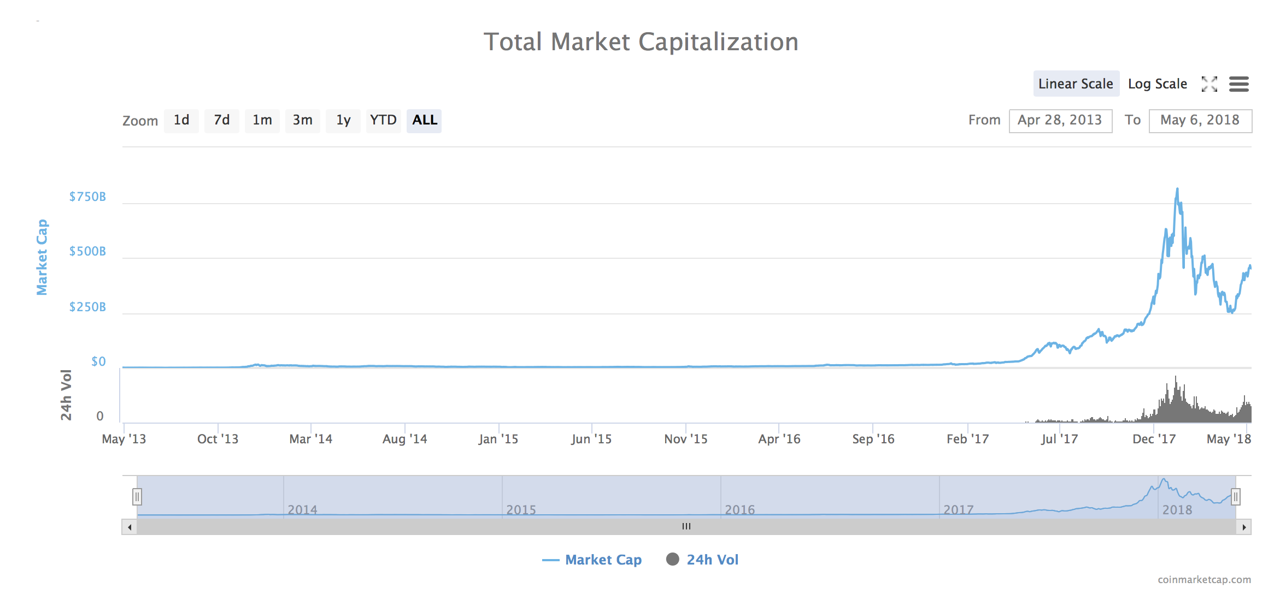
Image form https://coinmarketcap.com/charts/

Slide 5
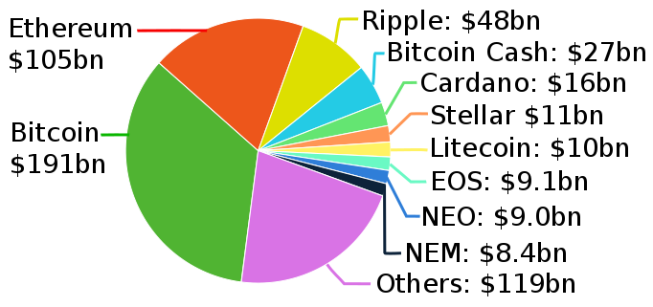
> 3000 cryptocurrencies
Image form https://www.livecoinwatch.com

Slide 6
Motivation
Problems:
Investors and interesting parties and individuals are eager to know the price and other information of cryptocurrencies.
But as new stuff, many people (beginners) aren’t familiar with them. They are confused.
There are so many kinds of cryptocurrencies.
The information is dispersive.
Approach:
One of the perfect approach to get the info automatically, quickly and accurately is through ChatterBot, a robot application.

Slide 7
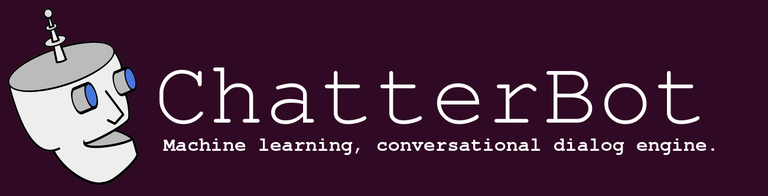
ChatterBot
A chatterbot is a brand-new conversational agent in the high-speed changing technology world. With the advance of Artificial Intelligence and machine learning, chatterbots are getting more and more popular. Essentially chatterbot is an extension of other human interface mediums other than phone and other social mediums.

Slide 8
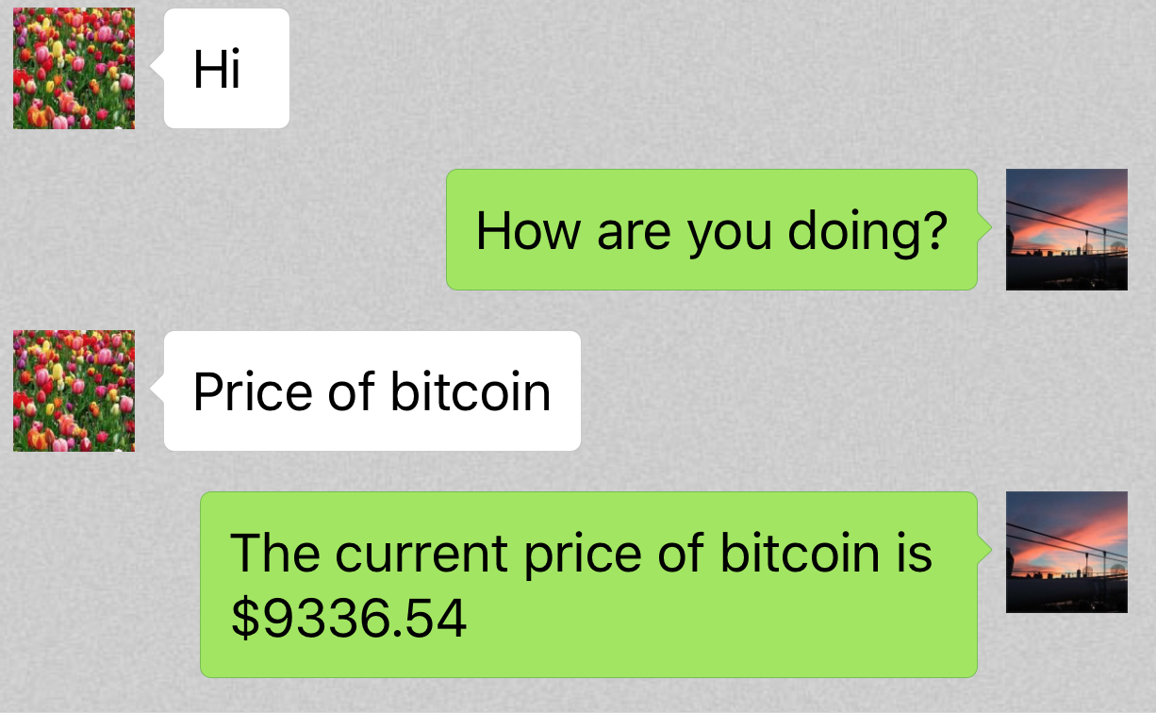
ChatterBot
Just like talking with your friend, ask your questions, and ChatterBot will give you the answer you want.

Slide 9
System Design
Collect cryptocurrency related popular questions and answers, build the dataset of Q&As.
Train the chatterbot using the datasets of the known statements and responses.
Process input in some logic ways. Using a number of machine learning methods to generate the response. Search algorithm and classification algorithm are deployed.
Return the response. It could be one of the formats such as console, API, speech synthesis, etc.

Slide 10
System Design - (1) Collect Data
Use API of coin-market to get the real time price of the top ranked 25 cryptocurrencies.
Collect some basic information of cryptocurrency to compose the basic questions about cryptocurrency and answers to each question. I.e., what is cryptocurrency?
Grab Q&As related to cryptocurrency topic on Quora using crawler to enrich our dataset.

Slide 11
System Design - (2) Train the chatterbot
The open source library Chatterbot comes with a corpus data and utility module that makes it easy to quickly train the bots to communicate. In addition, we also specify the collected data set for data training to focus on the topic of cryptocurrency.

Slide 12
System Design - (3) Process inputs
The input statement is processed by the best-matched logic method and/or some other specific logic adapters. Based on the different search algorithms, the closely matched response is returned with the highest confidence score.
Inputs will be classified into three categories:
Greetings.
Price of a certain kind of cryptocurrency. Use API to grab the real price.
Other cryptocurrency related questions. Use our pre-build dataset to obtain the best answer.

Slide 13
System Design - (4) How to generate the response?
Search algorithm
the similarity of an input statement to known statements
the frequency in which similar known responses occur
the most possible category of an input statement
Classification algorithm
naive Bayesian classification algorithms to determine if an input statement meets a particular set of criteria for a response to be generated from that logic adapter.

Slide 14
System Design - (5) Return responses
Return responses to:
website
WeChat* interface
console
*WeChat is a communication APP similar to Facebook Messenger.

Slide 15
Deployment
We built ChatterBot powered Django application and deployed it on pythonanywhere.com.
Access web: http://jackxie101.pythonanywhere.com/chatterbot/
WeChat access: running the script implementing itchat and chatterbot APIs.

Slide 16
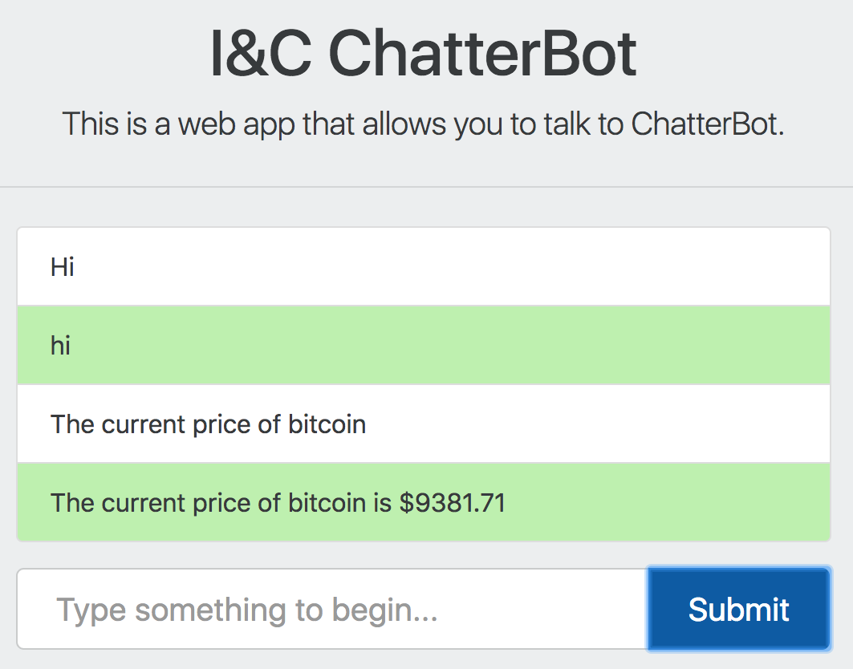
Two access ways
Through website jackxie101.pythonanywhere.com
Two access ways
Through WeChat

Slide 17
Demo

Slide 18
Conclusion
We use the open source Chatterbot and Itchat to implement the special chatterbot for the application on the field of cryptocurrency. We collect the data set for knowledge base of cryptocurrency for data training on our chatterbot. The testing shows our chatterbot is excellent to respond the certain questions related with cryptocurrency.

Slide 19
Future work
Continue improving logic adapter for response generation and enhancing the knowledge base on the cryptocurrency.

Slide 20
Roles of team members
Qitao: Write the python web application using open source chatterbot package, using the pre-built data. Write the WeChat robot application script implementing chatterbot, itchat, and cryptocurrency real-time API call.
Dayan: Crawl and collect the related info for Q&As on the topic of cryptocurrency. Based on the available info, build a database for Q&A chatbot application. Assist to develop python web application and WeChat robot application. Testing.
Write report and presentation slides together.

Slide 21
Reference
[1] https://en.wikipedia.org/wiki/Cryptocurrency
[2] https://coinmarketcap.com/charts/
[3] Ameer Rosic. “What is Cryptocurrency: Everything you need to know”. Retrieved from https://blockgeeks.com/guides/what-is-cryptocurrency. 2017.
[4] “Cryptocurrency Market capitalizations”. https://coinmarketcap.com/api/. 2017.
[5] Michael L. Mauldin. “Chatterbots, tinymuds, and the Turing test entering the Loebner prize competition”. AAAI-94 Proceedings, 1994.
[6] Gunther Cox. “ChatterBot – Machine learning, conversational dialog engine”. Retrieved from http://chatterbot.readthedocs.io/en/stable/index.html.
[7] LittleCoder, Tempdban, Chyroc. “ItChat – A complete and graceful API for Wechat” Retrieved from https://github.com/littlecodersh/ItChat.
[8] Jia, J. (2003). The Study of the Application of a Keywords-based Chatbot System on the Teaching of Foreign Languages. ArXiv preprint cs/0310018. Retrieved from https://arxiv.org/abs/cs/0310018

Slide 22


