Slide 1
Target Research
Darren Wright

Slide 2
Similar Games
Due to similarities between our game and Angry Birds. I've decided to research in to what makes these games as popular as they are. I will be looking at the majority age and gender that play these games in order to establish an audience to target with our game.

Slide 3
Angry Birds age range
Nielsen.com's research in to Android's most popular app by age, showed that the majority age range of those still playing Angry Bird's with 35% of the player base is 35-44 year old's and 29% 25-34 years old. Whereas only 22% of the player base is 18-24 years old.

Slide 4
Angry Birds platform
With my research in to which platform we should aim to target for. I first looked in the Google Play Store and discovered that Angry Birds has a total of 5.1 million players and Angry Birds 2 has a total of 2.3 million.
A survey carried out by AYTM.com who asked 1000 people which platform they played on.
It showed that 76% of the 1000 asked played on an Apple device, with only 6% of those on a Mac. 41% played on an Android device, 25% played on PC and 6% on a different device. From this it shows players played on Multiple devices with the majority of those playing on portable devices such as phones or tablets. I believe we should focus on making a game for the portable device market as this is where the majority of people that play games such as Angry Birds play their games.

Slide 5
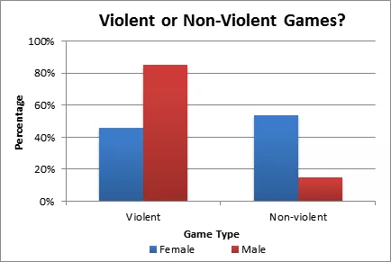
Gender
In the article by useabilty.com, "Video Games: Males Prefer Violence while Females Prefer Social" you can see that the majority of female gamers prefer to play video games that aren't as centered around violence whereas a majority of male prefer to play video game that include violence. From this, as our game is considered a puzzle game with no violence we can design our game to be centered around the female demographic.

Slide 6
Mobile gamers
From the article by Mike Mason, titled "Demographic Breakdown of Casual, Mid-Core and Hard-Core Mobile Gamers" you can see the demographic breakdown of those playing casual puzzle games such as Bejeweled or Candy Crush. From this you can see that the age groups that play these games are between the ages of 25 and 35. You can also see that the majority gender of those playing these games are female.
When watching people play these games they noticed players would play in short sessions, when commuting or laying in bed.

Slide 7
References
Mason, M. (2013) Demographic breakdown of mobile Gamers. Available at: http://developers.magmic.com/demographic-breakdown-casual-mid-core-hard-core-mobile-gamers/ (Accessed: 11 February 2017).
Mazin, L. (2012) Are you addicted to angry birds? [INFOGRAPHIC]. Available at: https://aytm.com/blog/research-junction/angry-birds-addiction/ (Accessed: 10 February 2017).
Nielsen.com (2012) App-Happy with Android the most popular Android Apps by age. Available at: http://www.nielsen.com/us/en/insights/news/2011/app-happy-with-android-the-most-popular-android-apps-by-age.html (Accessed: 11 February 2017).
Phan, M.H., Jardina, J.R. and Hoyle, W.S. (2012) Video games: Males prefer violence while females prefer social. Available at: http://usabilitynews.org/video-games-males-prefer-violence-while-females-prefer-social/ (Accessed: 11 February 2017).

