Slide 1
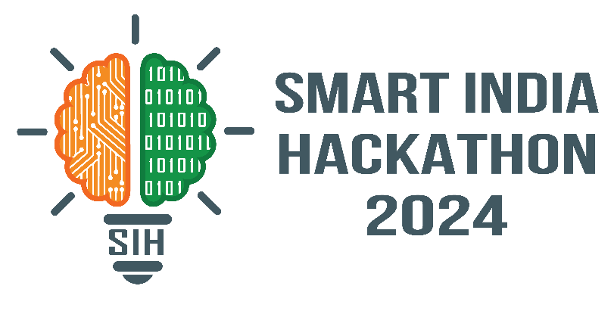
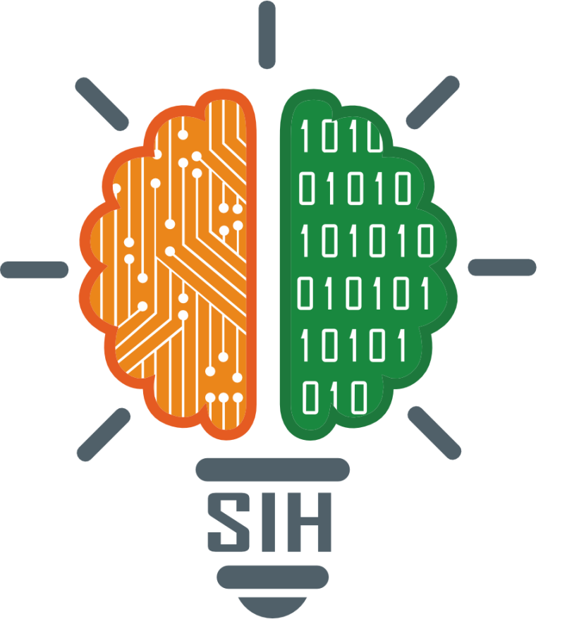
SMART INDIA HACKATHON 2024
TITLE PAGE
Problem Statement ID - 1638
Problem Statement Title- AI-Driven Crop Disease Prediction and Management System
Theme-Agriculture, FoodTech & Rural Development
PS Category- Software
Team Name- HisenBug

Slide 2

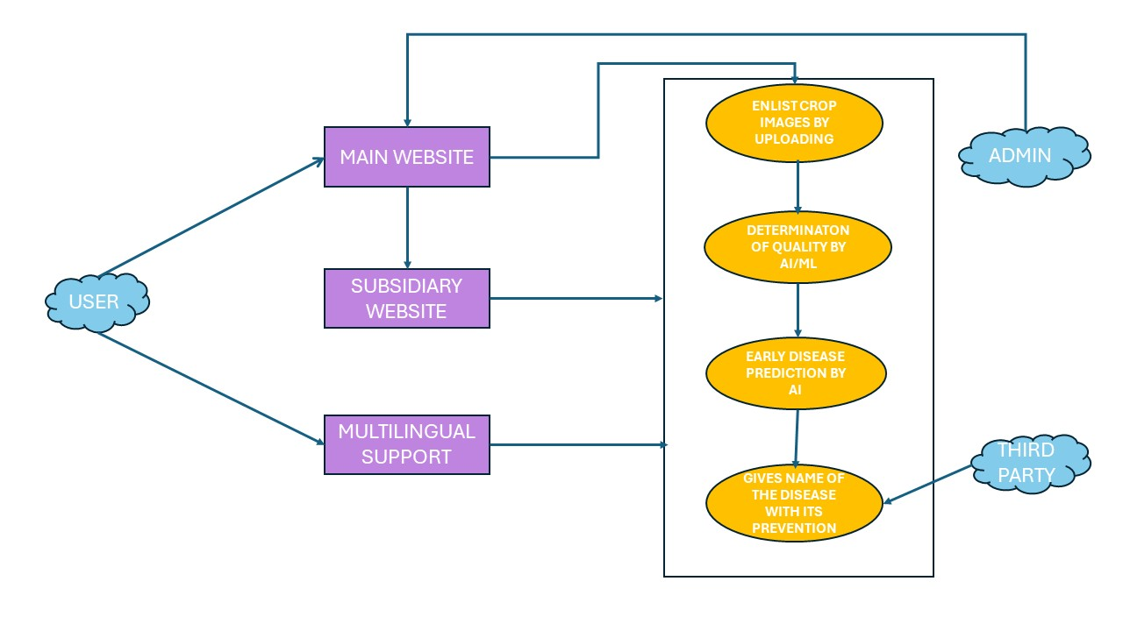
IDEA TITLE
Snap and Diagnose: Farmers can simply take a snapshot of their crop leaves and upload it to our platform to diagnose potential diseases. Our AI and ML algorithms analyze the image to identify the disease (if any) and provide insights into the crop's overall health.
USE CASES
Snap and Diagnose: Farmers can simply take a snapshot of their crop leaves and upload it to our platform to diagnose potential diseases. Our AI and ML algorithms analyze the image to identify the disease (if any) and provide insights into the crop's overall health.
Disease Prediction: Leveraging historical data and AI, the system predicts the likelihood of future disease outbreaks, enabling proactive management and improved crop yield.
Multilingual Web Application: Our web application is available in multiple local languages, making it accessible to a wide range of farmers across different regions.
Comprehensive Resource Hub: We are developing a main website that will serve as a comprehensive resource center, offering all the essential information a farmer needs, from crop care tips to market trend.

Slide 3







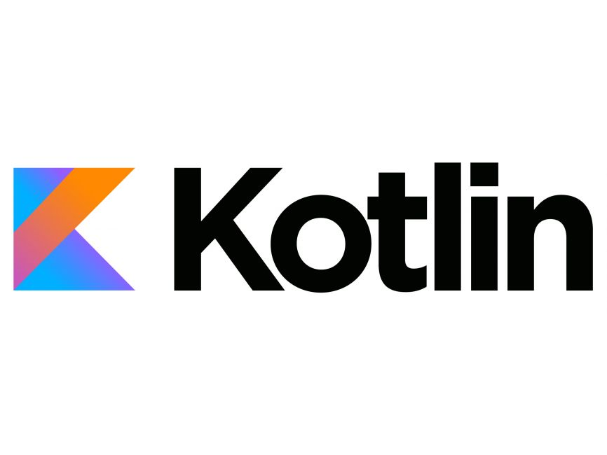
TECHNICAL APPROACH
5. Integration with Database
Integrate the web application with a SQL database to store user data, disease predictions, and crop health records. Use jQuery for dynamic data interaction.
6. Deployment
Deploy the web application on a cloud platform, making it accessible to farmers. Ensure scalability, security, and regular updates.
7. User Interaction and Feedback
Collect feedback from users and continuously improve the system. Update the model with new data and refine the algorithms.
8. Comprehensive Resource Hub
Create a centralized resource hub that provides farmers with access to crop care tips, market trends, and educational content.
1. Data Collection and Preprocessing
Collect images of crop leaves and relevant historical data. Preprocess the data by cleaning and annotating images, normalizing data, and splitting it into training, validation, and testing sets.
2. Model Training
Use Convolutional Neural Networks (CNNs) for image classification. Train the model using TensorFlow with the GPU acceleration provided by Colab’s Tesla T4. Evaluate the model using validation data.
3. Disease Prediction Module
Implement AI algorithms that use the trained model and historical data to predict potential disease outbreaks. This module provides proactive insights to the farmers.
4. Development of Multilingual Web Application
Develop a web application with a user-friendly interface that supports multiple local languages. Implement frontend using HTML, JavaScript, CSS, and backend using Node.js and Flask.
TECH-STACK

Slide 4
FEASIBILITY AND VIABILITY
Potential Challenges and Risks
1. Data Availability and Quality :
Risk : Obtaining a sufficient amount of high-quality, annotated data for training the AI model can be challenging. Inconsistent or poor-quality data could result in inaccurate predictions, reducing the system's reliability.
Strategy : Collaborate with agricultural research institutions and universities to gain access to high-quality data. Additionally, crowdsource data from farmers and provide incentives for data submission to build a more robust dataset.
2. User Adoption and Accessibility :
Risk : Farmers may be hesitant to adopt the new technology due to a lack of technical skills or distrust in AI-based solutions. Additionally, language barriers could limit the effectiveness of the platform.
Strategy : Focus on user education by providing easy-to-understand tutorials, and offering customer support in local languages. Collaborate with local agricultural cooperatives to encourage adoption and build trust within farming communities.
Strategies for Overcoming Challenges
1. Scalable Data Collection :
Strategy : Implement a scalable data collection framework that allows for continuous data gathering. Use smartphone apps and IoT devices to gather real-time data from the field, and create partnerships with agricultural organizations for ongoing data input.
2. Localization and Training :
Strategy : Develop the application in multiple local languages and dialects, and create localized content that resonates with the target audience. Additionally, offer training programs and workshops to educate farmers on how to use the application effectively, ensuring widespread adoption and proper usage.
1. Technological Feasibility :
Strength: The project leverages existing and well-established technologies like CNNs, TensorFlow, and cloud-based GPU resources like Tesla T4, which are widely used in AI-driven applications. The availability of these tools ensures that the technical implementation is feasible.
Weakness : The requirement for high-quality, annotated data for training the AI model could be a bottleneck. Collecting and processing large amounts of crop image data may require significant time and resources.
2. Market Feasibility :
Strength : The agricultural sector is increasingly adopting digital solutions, especially in regions where farming is a primary occupation. A tool that helps farmers diagnose crop diseases and predict outbreaks has strong potential for adoption, especially in developing countries.
Weakness : Farmers in remote or underdeveloped regions might have limited access to smartphones or the internet, which could reduce the reach and effectiveness of the application.

Slide 5
IMPACT AND BENEFITS
Benefits of the Solution
1. Economic Benefits :
For Farmers : Reducing crop losses through early disease detection and prevention translates to higher productivity and increased income for farmers.
For the Economy : Improved agricultural productivity can contribute to the national economy, particularly in countries where agriculture is a significant part of GDP.
2. Environmental and Social Benefits :
Environmental : By promoting proactive disease management, the solution reduces the need for excessive pesticide use, leading to more sustainable farming practices and minimizing environmental impact.
Social : The platform can foster a sense of community among farmers by providing a shared resource hub, where they can access information, share experiences, and learn from one another. This can strengthen social bonds and collective resilience in farming communities.
Potential Impact on the Target Audience
1. Empowerment of Farmers :
The solution empowers farmers by giving them direct access to advanced tools for diagnosing crop diseases and predicting potential outbreaks. This reduces their reliance on external experts, enabling them to make informed decisions quickly.
2. Improved Crop Yields and Livelihoods :
By providing timely and accurate disease predictions, the platform can help farmers prevent crop losses, leading to improved yields. This can enhance their income and overall quality of life, especially in rural and underdeveloped regions.

Slide 6
RESOURCES
https://youtu.be/chQNuV9B-Rw?si=a4zmp9B4iyU3f5mi
https://youtu.be/Pc8WdnIdXZg?si=NNXoiGxZBYa3inOJ
https://www.youtube.com/watch?v=CSEmUmkfb8Q
https://www.kaggle.com/datasets/sadmansakibmahi/plant-disease-expert?resource=download

