Slide 1
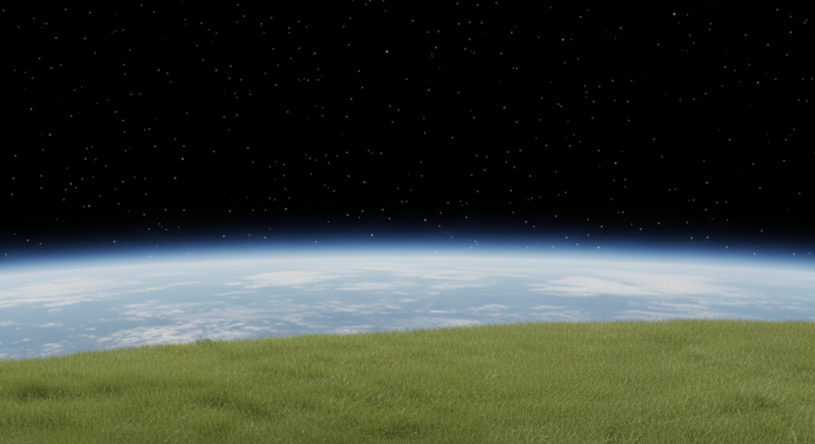
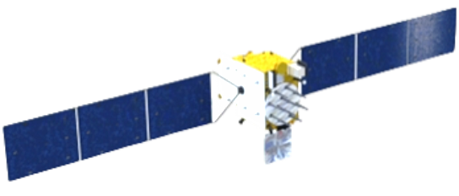
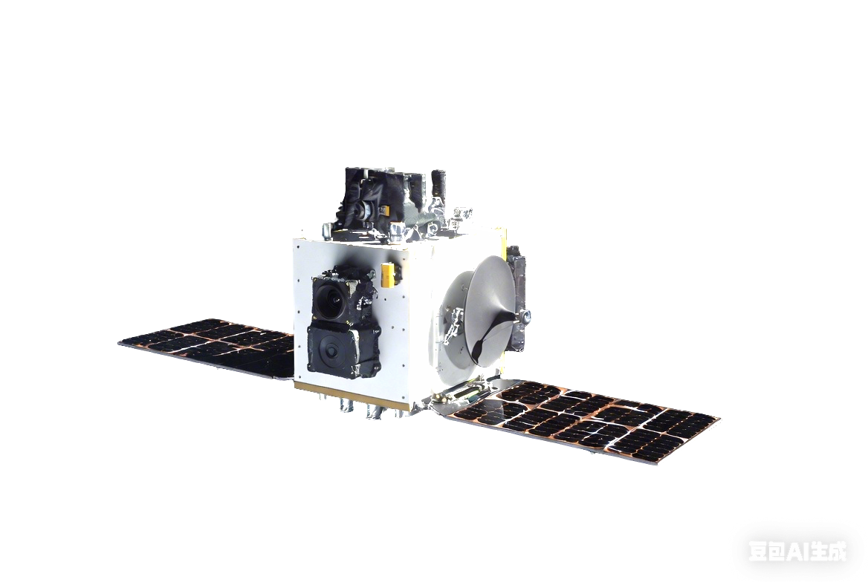
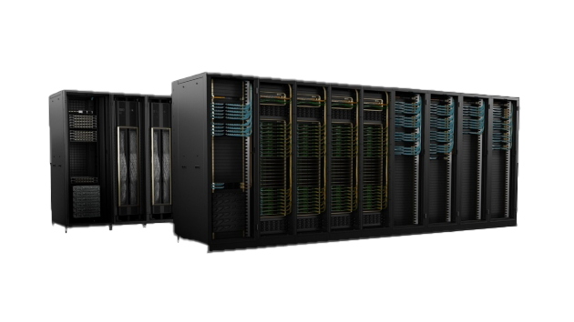
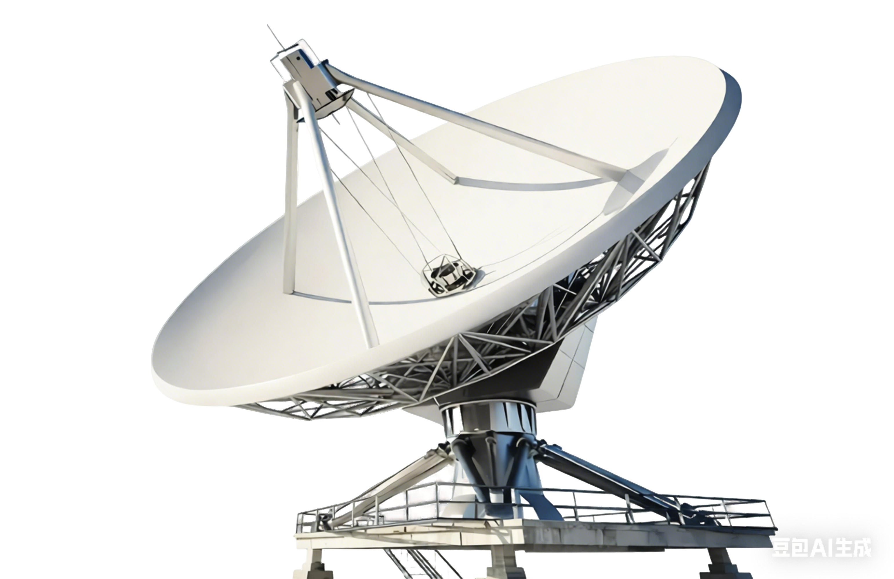
Camera
Servicer
Object
Jetson AGX Orin
85 FP16 TFLOPS
10-40 W
Capture Images
Onboard Rendering and Downstream Tasks
1
6
Antenna
2
Download Captured
Images
5
Upload Compressed Scene
Ground Station
Supercomputers
Training Scene
NVIDIA H100 Cluster
3
1,979 FP16 TFLOPS/GPU
Scene Compression
> 700 W/GPU
4

