Slide 1
MASTER'S THESIS DEFENCE
Demand Forecasting and
Inventory Optimisation
Using Machine Learning
A simulation-based evaluation on the M5-Forecasting (Walmart) dataset, with an SME-accessible Power BI dashboard
Desmond Korbla Aziega
Theresa Korlekuor Apla-Kweku
Abdul-Razak Seidu
Supervisor: Prof. Rocío González Martínez
Master in AI for Business and Data Science | 2026
Notes:
Welcome the committee, state your name and the thesis title, and give a one-sentence framing: this is a simulation-based test of whether published ML-forecasting inventory gains actually materialise at the SKU-daily level an SME would use. Keep this under 30 seconds — the agenda slide does the roadmap work.

Slide 2




ROADMAP
What This Defense Covers
01
02
03
04
The Business Problem
Methodology
Results
Recommendations
Why forecasting alone doesn't solve inventory decisions
Five model tiers, OUTL policy, and forward simulation
Forecast accuracy and the central inventory finding
A diagnostic tool for SME decision-makers
2 / 25
Notes:
Walk through the four sections in order: business problem, methodology, results, recommendations. Signal explicitly that the results section contains a correction to an earlier estimate — this primes the committee rather than surprising them cold on slide 14.

Slide 3
THE DECISION-MAKING CONTEXT
Every Retailer Faces the Same Trade-off
Too little stock
→ lost sales, eroded customer trust
Too much stock
→ tied-up cash, holding cost, spoilage risk
Published claims say:
10–25%
forecast accuracy improvement
Large retailers solve this with dedicated data-science teams and enterprise software. Small and medium-sized enterprises (SMEs) typically have neither — yet face an identical operational problem.
5–15%
inventory cost reduction — from published ML forecasting studies
3 / 25
Notes:
Anchor the stakes in plain trade-off language before any technical content. The right-hand card's 10–25% / 5–15% figures are the literature benchmarks this thesis exists to test — say so explicitly, since slide 15 revisits these exact numbers.

Slide 4


WHY THIS IS GENUINELY HARD
Four Structural Gaps in Current Practice
GAP 1
GAP 2
GAP 3
GAP 4
Forecast ≠ Decision
No Live Validation
SMEs Left Behind
Uncertainty Ignored
Most studies report accuracy and stop — they never translate forecasts into inventory outcomes.
Inventory performance is usually assumed analytically, not measured by running the policy forward.
Enterprise tools assume infrastructure and staffing SMEs simply don't have.
Textbook safety-stock formulas assume symmetric errors — real retail demand is skewed and intermittent.
4 / 25
Notes:
Each gap maps to a research objective on the next slide — Gap 1→Obj 1, Gap 2→Obj 3/4, Gap 3→Obj 5, Gap 4→Obj 3. If asked to justify the gaps: they come from the 52-source literature synthesis (slide 6), not personal opinion.

Slide 5
RESEARCH OBJECTIVES
Five Objectives Guided This Research
1
Comparatively evaluate forecasting approaches — classical, ML, deep learning, ensemble, and probabilistic — on a hierarchical retail benchmark.
2
Develop a systematic feature-engineering strategy capturing the principal drivers of retail demand.
3
Integrate the best-performing forecast with the Order-Up-To-Level (OUTL) inventory policy.
4
Test whether literature-reported gains (10–25% accuracy, 5–15% cost) transfer to SKU-daily granularity.
5
Deliver a Power BI dashboard translating outputs into an accessible tool for SME decision-makers.
5 / 25
Notes:
Read these briskly — the committee has already seen them in the written thesis. Flag Objective 4 explicitly: it was reframed, with supervisor input, from 'achieve X% gains' to 'test whether gains transfer' — this is the objective that licenses the disconfirmation finding as a valid outcome, not a failure.

Slide 6

LITERATURE REVIEW — 52 SOURCES SYNTHESISED
A Consistent Finding, With One Critical Caveat
ML and ensemble methods consistently outperform classical statistics
across retail forecasting studies — this is well replicated.
The caveat that matters most:
The published 10–25% / 5–15% benchmarks are measured on data aggregated to the weekly or category level — not the daily, individual-product level where real inventory decisions are made.
This thesis was designed to directly test whether those benchmark figures survive the move to SKU-daily granularity, using real product-store-day data and inventory outcomes measured — not assumed.
6 / 25
Notes:
This is the thesis's central research question, stated plainly: do the 10–25% / 5–15% benchmarks survive the move from weekly/category aggregation to daily/SKU granularity? Everything through slide 15 builds toward answering it — just plant the question here, don't resolve it yet.

Slide 7
THE DATA
M5-Forecasting (Walmart) Dataset
3,049
10
1,913
502
56
products
stores, 3 US states
days (2011–2016)
series stratified
subsample used
day out-of-sample
test window
Chosen for scale, hierarchical structure mirroring real SME retail operations, and status as an established academic benchmark. A stratified subsample (proportional across category × state) was used for computational tractability.
7 / 25
Notes:
Standard dataset justification. If asked why only 502 of 3,049 series: computational tractability, with the subsample stratified proportionally across category × state to preserve representativeness — not cherry-picked. If challenged on using Walmart data to make SME claims: the transferability argument is about the pipeline and data requirements, not the specific retailer — §1.2.3 specifies this concretely: three data sources (daily unit sales, calendar/promotional data, weekly pricing) that any standard POS or ERP system already produces, open-source tooling only, and one analyst with intermediate Python competency. M5 is used as a large-scale, hierarchically realistic proxy, not a claim that Walmart and a corner retailer face identical demand patterns.

Slide 8





METHODOLOGY
Five Model Tiers, Compared Head-to-Head
Tier 1
Tier 2
Tier 3
Tier 4
Tier 5
Classical
Standard ML
Deep Learning
Ensemble
Probabilistic
MA, SES, AutoARIMA,
Croston, Croston-SBA,
Seasonal Naive
Random Forest,
XGBoost, LightGBM
(Tweedie loss)
LSTM — 128/64
stacked units,
dropout 0.2
Stacking: LGBM + XGB
+ RF → Ridge
meta-learner
LightGBM quantile
regression
(P10 – P99)
Trained strictly on historical data. Evaluated exclusively on a later, entirely unseen test period.
8 / 25
Notes:
Move quickly — five tiers, all standard architectures, nothing novel claimed here. The methodological contribution is downstream in the simulation, not in model selection. If pressed on the LSTM specifically: 128/64 stacked units with dropout 0.2 was tuned via validation-set MAPE, detailed in the appendix.

Slide 9
METHODOLOGY
Translating Forecasts Into Inventory Decisions
The Order-Up-To-Level (R, s, S) Policy
Safety Stock Formulas
A periodic review policy: every R days, if the inventory position falls at or below reorder point s, an order is placed to raise stock to order-up-to level S.
SS = z · σ · √(R + L)
Gaussian (textbook) — assumes symmetric forecast-error distribution
Three policy variants compared — differing only in how safety stock is calculated:
Classical
— Gaussian formula fed by classical forecast
ML-Gaussian
— Gaussian formula fed by ML ensemble forecast
ML-Empirical-Quantile
— distribution-aware formula from quantile model
SS = (P95 − P50) · √(R + L)
Empirical quantile — reflects the true, skewed shape of retail demand
9 / 25
Notes:
Explain the (R,s,S) mechanics briefly, then land on the two safety-stock formulas — that's the crux. Gaussian assumes symmetric forecast errors; empirical-quantile does not. This distinction is exactly what the inventory experiment tests — say that explicitly before moving on.

Slide 10

THE PIVOTAL METHODOLOGICAL DECISION
Measuring Performance, Not Assuming It
Most Published Studies
This Thesis
Calculate expected cost and service level analytically — using a formula to project what should happen under an assumed stockout rate.
Runs each policy forward, day by day, against real 56-day test demand for all 502 products — genuinely tracking stock, genuinely recording every stockout.
10 / 25
Notes:
The most important methodological slide in the deck — slow down here. State plainly: an earlier draft used the left-hand (assumed/analytical) approach, produced a 21% cost-saving figure, and a supervisor review caught that this was circular — the quantile policy was assigned a higher service level by construction, then credited for 'achieving' it. The right-hand approach is what actually got measured and reported. Naming this transparently before showing the result builds credibility rather than undermining it.

Slide 11
VALIDATING THE SIMULATION ENGINE
Falsification Test: Can It Detect a Stockout?
Before trusting the simulation, it was deliberately stress-tested under conditions engineered to force stockouts.
Stress Condition
Realised SL
Stockout Cost
Real buffers (baseline)
100.0%
$0
Safety stock set to zero
74.0%
$124,338
Demand scaled ×3
94.1%
$87,691
Replenishment suppressed
0.0%
$469,556
Every stress condition correctly registered degraded service and rising cost — confirming the 100% baseline result reflects demand genuinely being met, not a counter that never fires.
11 / 25
Notes:
Before trusting a simulation that reports zero stockouts, you have to prove it CAN detect a stockout — that's this table. All three stress conditions correctly degrade service and spike cost, ruling out 'your simulator is just broken / always reports success.' This is shown before the headline number precisely to pre-empt that objection.

Slide 12
RESULTS — FORECAST ACCURACY
The Ensemble Wins, But the Margin Is Modest
+4.5%
MAE improvement vs best classical baseline
+9.5%
RMSE improvement — large-error / spike sensitivity
MAPE improvement was essentially flat — below the 10–25% literature benchmark, as anticipated (Slide 6).
12 / 25
Notes:
The ensemble modestly beats classical baselines on MAE (+4.5%) and RMSE (+9.5%), but MAPE improvement is flat — well short of the 10–25% literature benchmark. Flag this now: better forecasts existed, but as slide 14 shows, better forecasts didn't translate into better inventory outcomes in this regime. That's the whole thesis in one sentence.

Slide 13
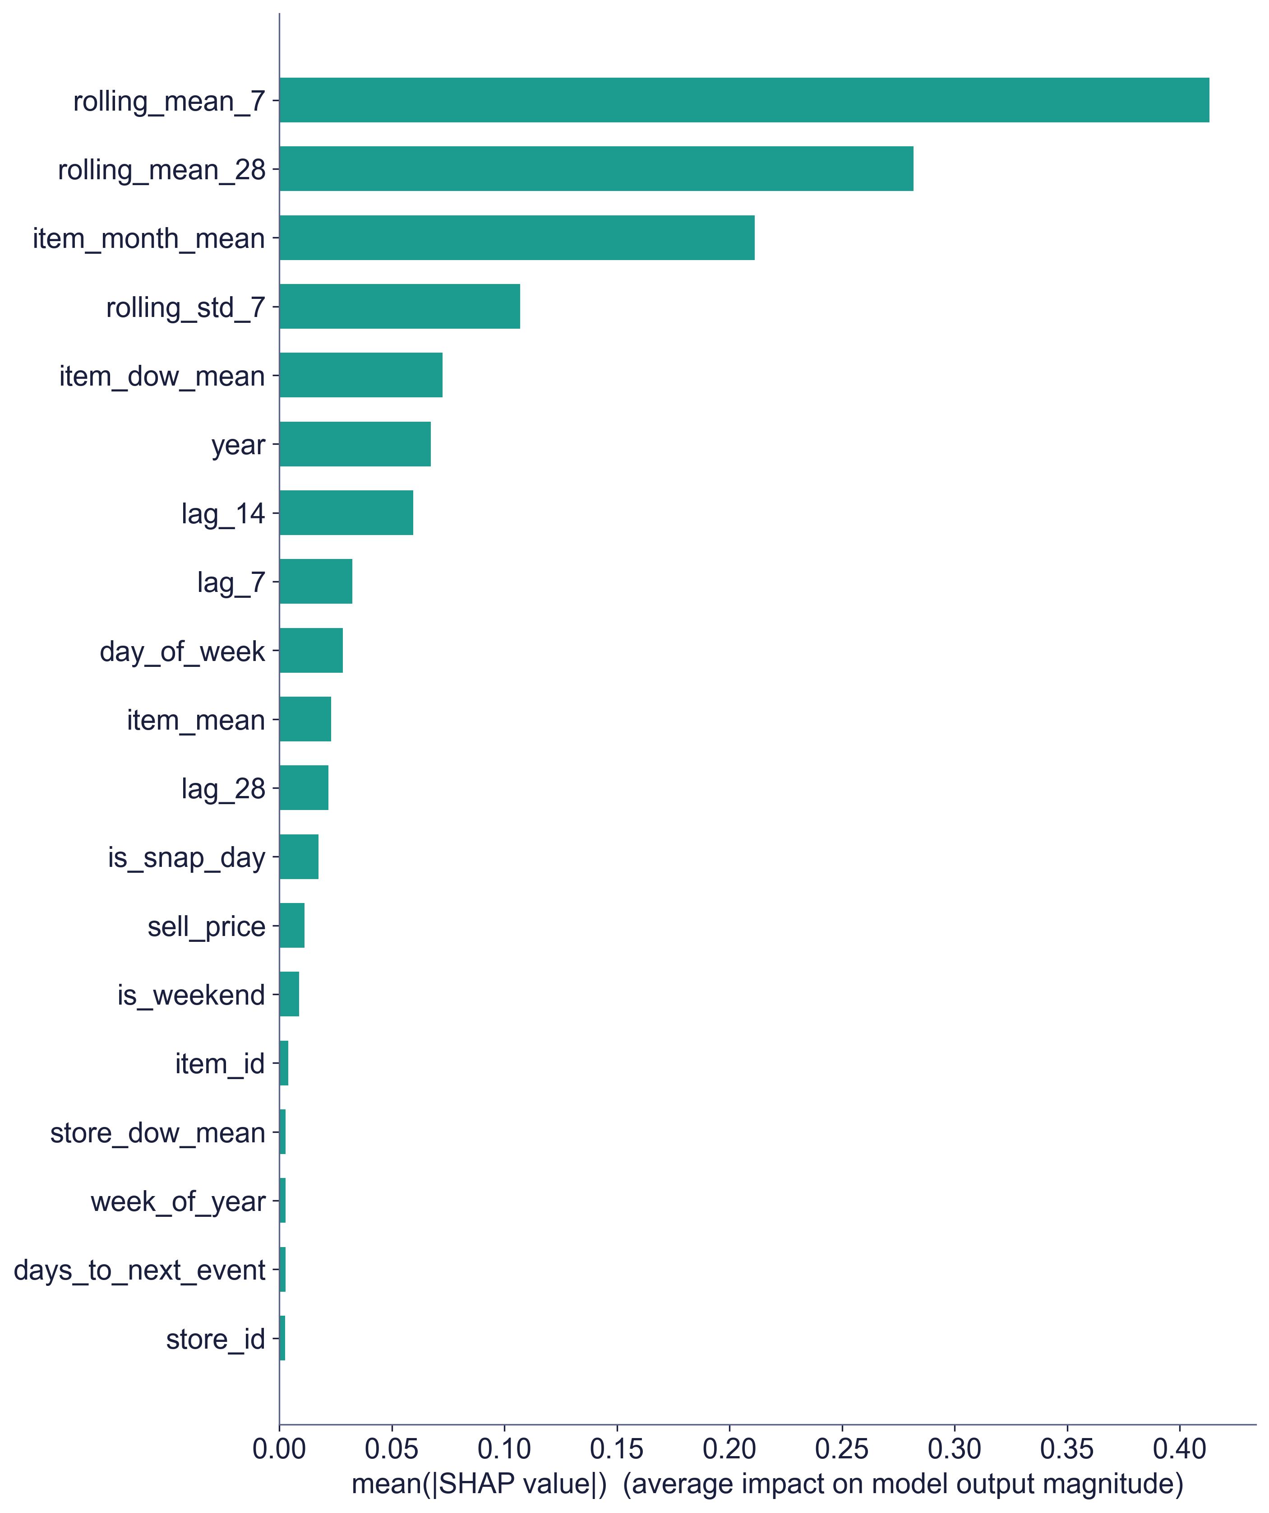
MODEL INTERPRETABILITY
What Actually Drives the Forecast
Top 5 features explain 78.6% of model behaviour — dominated by recent sales trend and item-level seasonality, not opaque signals.
13 / 25
Notes:
Quick interpretability check — recent rolling means and item-level seasonality dominate, not some opaque signal. Useful mainly to pre-empt a 'is this a black box' question; don't dwell unless asked. If asked why SHAP is run on LightGBM rather than the winning stacking ensemble: stacking ensembles combine three base learners through a meta-learner, which resists clean, single-model attribution — LightGBM is used as the standard, well-supported proxy for interpretability, consistent with how tree-based SHAP is normally applied in this literature. The ensemble's own behaviour is dominated by the same base learners LightGBM represents.

Slide 14
THE CENTRAL FINDING
100%
Consequence:
With zero stockouts, there was no stockout cost left for a smarter forecast or a smarter safety-stock formula to save.
Realised Service Level
— achieved by ALL THREE policies (Classical, ML-Gaussian, ML-Quantile) across every one of the 502 products, over the full 56-day test window. No policy ever stocked out.
ML-Quantile policy cost:
+1.5%
more than the classical baseline — unnecessary safety stock, no offsetting benefit
14 / 25
Notes:
This is the headline slide. Pause here. Emphasise: this was measured, not assumed — the simulation was independently validated (falsification results, slide 11). If asked why this contradicts the abstract's framing: it doesn't — it IS the framing. The abstract explicitly states the apparent saving does not survive measurement.

Slide 15
AN HONEST CORRECTION
Why the Earlier 21% Estimate Did Not Survive
Earlier (Analytical) Draft
This Thesis (Simulated)
21%
−1.5%
Assumed the Gaussian policy achieved ~83% service and the quantile policy ~95% "by calibration," then computed cost from that gap.
Both policies actually achieve 100% service — the quantile buffer protects against stockouts that never occur.
The quantile policy won by construction — before any simulation ran.
The Ch1 5–15% inventory-cost target is not achieved on this dataset — treated as a finding, not a failure.
15 / 25
Notes:
If asked 'so was the thesis a failure?' — No. Disconfirmation of a specific hypothesis under specific conditions is a valid and valuable research outcome, especially when it corrects a methodological flaw (assumed vs measured performance) common across the literature this thesis reviewed. This slide names the correction directly rather than burying it.

Slide 16
RESULTS — COST DECOMPOSITION
Holding Cost Dominates; Stockout Cost Is Zero
Bars start at $0 — the ML-Quantile difference is a genuine but small ~1.5% increase, not the large gap a truncated axis would suggest.
16 / 25
Notes:
This chart is the mechanical explanation for slides 14–15: holding cost is ~99.5% of total cost and nearly identical across all three policies; ordering cost is a rounding error; stockout cost is exactly zero for all three. There is structurally no room for a safety-stock formula to differentiate cost when the thing it protects against never happens.

Slide 17

SENSITIVITY ANALYSIS
The Finding Is Robust — Not a One-Off Result
Across Lead Time (7–21 days)
Across Stockout Multiplier (0.4×–2.0×)
−1.3% to −1.7%
No change
Quantile policy consistently more expensive, never favourable
Multiplier never engages — zero stockouts to price at any level
A threefold demand-shock stress test (Slide 11) shows even that is not enough, on this dataset, to make the quantile policy clearly superior.
17 / 25
Notes:
Anticipate the 'is this just a fluke of your parameter choices' question — walk through both sensitivity axes actually reported in Chapter 5 §5.7 (lead time and stockout multiplier) and note neither flips the conclusion. The stockout-multiplier result is the strongest point: even inflating stockout cost up to 2× doesn't matter, because the multiplier never engages against a real stockout. If asked about forecast-accuracy (MAPE) sensitivity specifically: that sweep belonged to the earlier, retracted analytical methodology and was not reproduced under simulation — say so directly rather than implying it was tested. If pushed on why one 56-day window is enough to generalise a boundary condition: it isn't, on its own — that's exactly why the deliverable is a diagnostic tool rather than a universal percentage. The claim isn't 'this window proves ML forecasting never helps'; it's 'here is a validated way to test your own window, your own data, before investing.' Window-dependence is a limitation of this specific measurement, not of the method being offered.

Slide 18
THE REAL CONTRIBUTION
A Boundary Condition, Not a Blanket Claim
The value of ML forecasting and distributional safety stock is conditional on the demand regime:
Genuine stockout risk exists
Service is already saturated
→ the larger, empirically calibrated buffer earns back its holding cost by preventing real stockouts.
→ the buffer protects against stockouts that don't occur — pure added cost, no benefit. (The M5 test regime.)
18 / 25
Notes:
This is the actual contribution: not a cost-saving percentage, but a boundary condition and a reusable diagnostic. Committee may ask for the mechanism — explain via the two-card comparison on this slide if asked to elaborate.

Slide 19
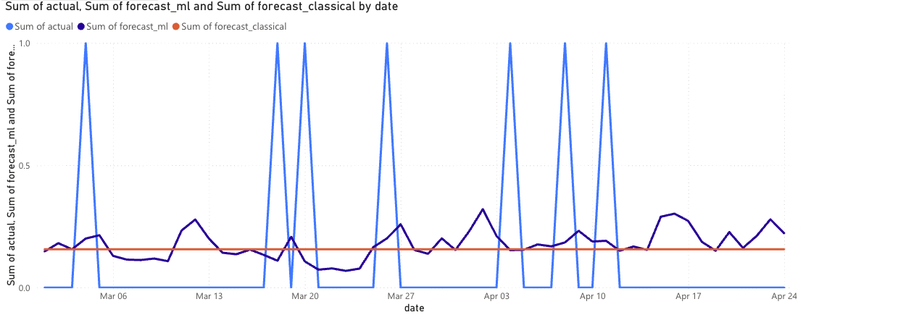
THE PRACTICAL DELIVERABLE
An Accessible Power BI Dashboard for SMEs
0.952
100.0%
−1.5%
MAE Ensemble
SL Quantile
Cost Chg. Quantile
Forecast Overview — actual vs. ML-ensemble vs. classical forecast, with KPI tiles and per-SKU drilldown
19 / 25
Notes:
Pivot tone here — from 'here's what we found' to 'here's what we built regardless.' The dashboard has value independent of which policy wins, because visibility into forecast-vs-actual is useful to an SME manager either way. Mention it runs on Power BI's free tier.

Slide 20
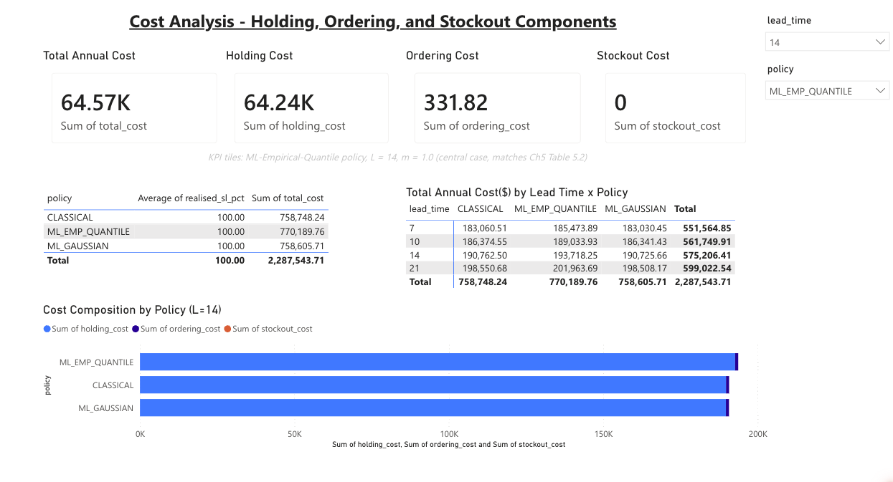
THE PRACTICAL DELIVERABLE
Cost Analysis — The Finding, Made Visible
Free (Power BI free tier). Runs on a standard laptop. Requires only data a typical POS system already produces.
20 / 25
Notes:
This page makes the finding SME-legible without requiring anyone to read the thesis — the cost breakdown by policy, visually, is slide 16's chart made operational. Reiterate: free, laptop-grade, uses data a typical POS system already produces.

Slide 21
CONTRIBUTIONS
Theoretical and Practical Contributions
Theoretical
Practical
First simulation-based measurement of the Gaussian-vs-empirical safety-stock choice on M5
End-to-end, reproducible, free-and-open-source pipeline (< 3 hrs on a laptop)
Demonstrates ML forecasting's inventory value is regime-conditional, not automatic
A forward-simulation engine usable as a pre-investment diagnostic
Shows the inventory comparison is robust to the stockout-cost multiplier (zero stockouts at 0.4×–2.0×)
An interactive Power BI dashboard for non-technical SME managers
21 / 25
Notes:
Two distinct audiences, two columns — don't let the committee conflate them. The theoretical contribution is the finding itself (regime-conditionality); the practical contribution is the reusable diagnostic tool. Both stand on their own even though the headline number didn't survive.

Slide 22
RECOMMENDATIONS
For SMEs: Diagnose Before You Invest
1
Don't trust published % claims alone
Ask: at what data granularity, and was cost measured or assumed?
2
Run the diagnostic on your own data first
The delivered simulation engine tells you if you face real stockout risk
3
Invest where the diagnostic says risk is real
High-margin, fast-moving, or highly seasonal categories are the best candidates
4
Deploy the dashboard regardless
Free, low-risk visibility — independent of which forecasting method feeds it
22 / 25
Notes:
This is the advice an SME owner would actually walk away with. Step 2 is the operational core: run the diagnostic on your OWN data before spending on either better forecasting or better safety-stock formulas, because the answer is regime-dependent, not universal. If asked how technical a team needs to be to actually run this: §1.2.3 is specific — one analyst with roughly 12-18 months of Python scripting experience, using only free and open-source libraries, on a standard laptop. No dedicated data science hire or paid infrastructure is required, which is the whole point of the SME-accessibility claim.

Slide 23
LIMITATIONS & FUTURE WORK
What This Study Does Not Claim
Limitations
Future Work
Single 56-day test window — a longer or differently-timed window could expose real stockouts
Re-test on retail benchmarks with more volatile demand (Rossmann, Favorita)
LSTM evaluated at one architecture only — more elaborate sequence models untested
Validate the boundary condition in a live SME deployment with genuine stockout exposure
Stockout cost modelled as linear — real-world costs (e.g. churn) may be non-linear
Extend the simulation engine to non-linear stockout costs and lead-time uncertainty
23 / 25
Notes:
Be candid and unhurried here — a 56-day single test window is the most defensible line of questioning to expect, and 'a longer or differently-timed window could expose real stockouts' is the honest answer, not a hedge. Each limitation is paired row-by-row with its future-work fix.

Slide 24
CONCLUSION
The Value of ML Forecasting Is Real —
But Conditional, Not Automatic
This thesis delivers both the evidence for that conclusion and a practical, free, open-source tool that lets any organisation test which side of that condition it falls on — using its own data, before spending anything further.
The barrier this research removes is not financial. It is informational.
24 / 25
Notes:
Land on the reframe, not the retracted number: ML forecasting's inventory value is real but conditional, and the contribution is a way to test which condition you're in before investing. The closing line — 'the barrier is informational, not financial' — is the sentence to leave the committee with.

Slide 25
Thank You
Questions & Discussion
Desmond Korbla Aziega • Theresa Korlekuor Apla-Kweku • Abdul-Razak Seidu
Supervisor: Prof. Rocío González Martínez
Notes:
Stop talking. Invite questions. If the committee opens with a challenge to the 21%→−1.5% reversal, don't get defensive — point back to slide 10 (the methodological pivot) and slide 11 (falsification validation) as the two slides that pre-empt it.

