Slide 1
MASTER'S THESIS DEFENSE
Demand Forecasting and
Inventory Optimisation
Using Machine Learning
A simulation-based evaluation on the M5-Forecasting (Walmart) dataset, with an SME-accessible Power BI dashboard
Desmond Korbla Aziega
Theresa Korlekuor Apla-Kweku
Abdul-Razak Seidu
Supervisor: Prof. Rocío González Martínez
Master's Programme in Data Science | 2026
Notes:
SAY THIS: Good [morning/afternoon], committee members. My name is Desmond Korbla Aziega, and together with my co-authors Theresa Korlekuor Apla-Kweku and Abdul-Razak Seidu, under the supervision of Professor Rocío González Martínez, we present our thesis: Demand Forecasting and Inventory Optimisation Using Machine Learning. This is a simulation-based evaluation on the M5-Forecasting Walmart dataset, concluding with an SME-accessible Power BI dashboard. In one sentence: we set out to test whether machine-learning forecasting actually saves retailers money once you measure the result properly, rather than assume it. SPEAKER TIPS: Keep this under 30 seconds — the agenda slide does the roadmap work.

Slide 2




ROADMAP
What This Defense Covers
01
02
03
04
The Business Problem
Methodology
Results
Recommendations
Why forecasting alone doesn't solve inventory decisions
Five model tiers, OUTL policy, and forward simulation
Forecast accuracy and the central inventory finding
A diagnostic tool for SME decision-makers
2 / 26
Notes:
SAY THIS: This defense covers four parts. First, the business problem — why a forecast alone doesn't solve an inventory decision. Second, our methodology — five model tiers, an Order-Up-To-Level inventory policy, and, critically, a forward simulation that measures real outcomes instead of assuming them. Third, our results — forecast accuracy, and the central inventory finding, which includes a correction to an earlier estimate. Fourth, our recommendations — a practical diagnostic tool any SME can use before investing. SPEAKER TIPS: Naming the correction here primes the committee rather than surprising them cold on slide 14.

Slide 3
THE DECISION-MAKING CONTEXT
Every Retailer Faces the Same Trade-off
Too little stock
→ lost sales, eroded customer trust
Too much stock
→ tied-up cash, holding cost, spoilage risk
Published claims say:
10–25%
forecast accuracy improvement
Large retailers solve this with dedicated data-science teams and enterprise software. Small and medium-sized enterprises (SMEs) typically have neither — yet face an identical operational problem.
5–15%
inventory cost reduction — from published ML forecasting studies
Source: Barghi (2025); Seyedan, Mafakheri & Wang (2023)
3 / 26
Notes:
SAY THIS: Every retailer faces the same trade-off. Too little stock costs you sales and customer trust; too much stock ties up cash and adds holding cost. Large retailers solve this with dedicated data-science teams. SMEs typically have neither the budget nor the staff, yet they face an identical operational problem. Published studies claim the answer is machine learning: 10 to 25 percent improvements in forecast accuracy, 5 to 15 percent reductions in inventory cost. Our thesis asks: is that true for a business like this, or only true under the specific conditions those studies happened to measure? SPEAKER TIPS: These are the literature benchmarks this thesis exists to test — say so explicitly, since slide 15 revisits these exact numbers.

Slide 4


WHY THIS IS GENUINELY HARD
Four Structural Gaps in Current Practice
GAP 1
GAP 2
GAP 3
GAP 4
Forecast ≠ Decision
No Live Validation
SMEs Left Behind
Uncertainty Ignored
Most studies report accuracy and stop — they never translate forecasts into inventory outcomes.
Inventory performance is usually assumed analytically, not measured by running the policy forward.
Enterprise tools assume infrastructure and staffing SMEs simply don't have.
Textbook safety-stock formulas assume symmetric errors — real retail demand is skewed and intermittent.
4 / 26
Notes:
SAY THIS: We identified four structural gaps in how this question gets answered in the existing literature. First, forecast and decision are treated separately — most studies report accuracy and stop, never checking whether a better forecast changes what happens on the warehouse floor. Second, there's no live validation — inventory performance is calculated from a formula, never measured by running the policy forward. Third, SMEs are left behind — the tools assume infrastructure a small business doesn't have. Fourth, uncertainty is ignored — textbook safety-stock formulas assume symmetric errors, but real retail demand is skewed and intermittent. SPEAKER TIPS: Each gap maps to a research objective on the next slide — Gap 1→Obj 1, Gap 2→Obj 3/4, Gap 3→Obj 5, Gap 4→Obj 3. If asked to justify the gaps: they come from the 52-source literature synthesis (slide 6), not personal opinion.

Slide 5
RESEARCH OBJECTIVES
Five Objectives Guided This Research
1
Comparatively evaluate forecasting approaches — classical, ML, deep learning, ensemble, and probabilistic — on a hierarchical retail benchmark.
2
Develop a systematic feature-engineering strategy capturing the principal drivers of retail demand.
3
Integrate the best-performing forecast with the Order-Up-To-Level (OUTL) inventory policy.
4
Test whether literature-reported gains (10–25% accuracy, 5–15% cost) transfer to SKU-daily granularity.
5
Deliver a Power BI dashboard translating outputs into an accessible tool for SME decision-makers.
5 / 26
Notes:
SAY THIS: These four gaps translate into five research objectives: comparatively evaluate forecasting approaches across five tiers; develop a systematic feature-engineering strategy; integrate the best-performing forecast with the Order-Up-To-Level policy; explicitly test whether the literature's 10 to 25 percent accuracy and 5 to 15 percent cost gains transfer to SKU-daily granularity; and deliver it all as an accessible Power BI dashboard for SME decision-makers. I want to flag Objective 4 specifically — with our supervisor's input, we deliberately framed it as testing whether the literature's gains transfer, not as a target we promised to hit. SPEAKER TIPS: That reframing is what licenses the disconfirmation finding later as a valid outcome, not a failure. Read this slide briskly — the committee has already seen it in the written thesis.

Slide 6

LITERATURE REVIEW — 52 SOURCES SYNTHESISED
A Consistent Finding, With One Critical Caveat
ML and ensemble methods consistently outperform classical statistics
across retail forecasting studies — this is well replicated.
Barghi (2025); Nasseri et al. (2023); Razzak et al. (2025) — 72-study systematic review
The caveat that matters most:
The published 10–25% / 5–15% benchmarks are measured on data aggregated to the weekly or category level — not the daily, individual-product level where real inventory decisions are made.
Benchmark source: Barghi (2025); Seyedan, Mafakheri & Wang (2023)
This thesis was designed to directly test whether those benchmark figures survive the move to SKU-daily granularity, using real product-store-day data and inventory outcomes measured — not assumed.
6 / 26
Notes:
SAY THIS: We reviewed 52 academic sources. The consensus is clear and not in dispute: ensemble machine-learning methods consistently outperform classical statistical forecasting — moving averages, exponential smoothing, ARIMA — across retail datasets, per Barghi 2025, Nasseri et al. 2023, and a 72-study systematic review by Razzak et al. 2025. But here is the caveat that matters most: the published 10 to 25 percent and 5 to 15 percent benchmark figures, from Barghi 2025 and Seyedan, Mafakheri and Wang 2023, are measured on data aggregated to the weekly or category level — not the daily, individual-product level where a real inventory decision actually gets made. This thesis was designed to directly test whether those benchmarks survive that move to SKU-daily granularity. SPEAKER TIPS: This is the thesis's central research question. Everything through slide 15 builds toward answering it — just plant the question here, don't resolve it yet.

Slide 7
THE DATA
M5-Forecasting (Walmart) Dataset
3,049
10
1,913
502
56
products
stores, 3 US states
days (2011–2016)
series stratified
subsample used
day out-of-sample
test window
Chosen for scale, hierarchical structure mirroring real SME retail operations, and status as an established academic benchmark. A stratified subsample (proportional across category × state) was used for computational tractability.
7 / 26
Notes:
SAY THIS: We used the M5-Forecasting Walmart dataset: 3,049 products across 10 stores in three US states, spanning 1,913 days from January 2011 to April 2016. For computational tractability, we drew a stratified subsample of 502 product-store series, proportional across category and state, and tested on the final 56 days as a genuinely out-of-sample window. We chose this dataset for its scale, its hierarchical structure — which mirrors real SME retail operations — and its status as an established academic benchmark that lets us compare directly against published results. SPEAKER TIPS: If challenged on using Walmart data to make SME claims: the transferability argument is about the pipeline and data requirements, not the specific retailer — §1.2.3 specifies three data sources any standard POS or ERP system already produces, open-source tooling only, and one analyst with intermediate Python competency. M5 is a large-scale, hierarchically realistic proxy, not a claim that Walmart and a corner retailer face identical demand patterns.

Slide 8
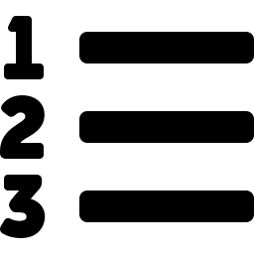




METHODOLOGY
Five Model Tiers, Compared Head-to-Head
Tier 1
Tier 2
Tier 3
Tier 4
Tier 5
Classical
Standard ML
Deep Learning
Ensemble
Probabilistic
MA, SES, AutoARIMA,
Croston, Croston-SBA,
Seasonal Naive
Random Forest,
XGBoost, LightGBM
(Tweedie loss)
LSTM — 128/64
stacked units,
dropout 0.2
Stacking: LGBM + XGB
+ RF → Ridge
meta-learner
LightGBM quantile
regression
(P10 – P99)
Trained strictly on historical data. Evaluated exclusively on a later, entirely unseen test period.
Croston / Croston-SBA for intermittent demand: Croston (1972); Syntetos & Boylan (2005).
8 / 26
Notes:
SAY THIS: We built five tiers of forecasting models, deliberately structured as a ladder so every more complex model has to earn its place. Tier 1 is classical statistics — moving average, exponential smoothing, AutoARIMA, and Croston's method, introduced by Croston in 1972 specifically for intermittent demand and refined by Syntetos and Boylan in 2005. Tier 2 is standard machine learning — Random Forest, XGBoost, and LightGBM, using a Tweedie loss suited to sparse, zero-heavy sales data. Tier 3 is an LSTM network with 128 and 64 stacked units. Tier 4 is our stacking ensemble — it blends the three Tier 2 models through a Ridge regression meta-learner, and it's our best-performing model. Tier 5 is quantile regression — the same LightGBM algorithm, retrained to predict a full range of outcomes, from the 10th to the 99th percentile, instead of one number. Every model was trained strictly on historical data and evaluated only on the later, entirely unseen test period. SPEAKER TIPS: Move quickly — nothing novel is claimed in model selection itself; the methodological contribution is downstream in the simulation. If pressed on the LSTM: 128/64 stacked units, dropout 0.2, tuned via validation-set MAPE, detailed in the appendix.

Slide 9
METHODOLOGY
Translating Forecasts Into Inventory Decisions
The Order-Up-To-Level (R, s, S) Policy
Safety Stock Formulas
A periodic review policy: every R days, if the inventory position falls at or below reorder point s, an order is placed to raise stock to order-up-to level S.
SS = z · σ · √(R + L)
Gaussian (textbook) — assumes symmetric forecast-error distribution
Three policy variants compared — differing only in how safety stock is calculated:
Classical
— Gaussian formula fed by classical forecast
ML-Gaussian
— Gaussian formula fed by ML ensemble forecast
ML-Empirical-Quantile
— distribution-aware formula from quantile model
SS = (P95 − P50) · √(R + L)
Empirical quantile — reflects the true, skewed shape of retail demand
(R, s, S) / OUTL framework: Silver, Pyke & Thomas (2017)
9 / 26
Notes:
SAY THIS: We translate forecasts into inventory decisions using the Order-Up-To-Level policy — a standard periodic-review framework from Silver, Pyke and Thomas's 2017 textbook. Every R days, if stock falls to or below a reorder point s, we place an order to bring it back up to a target level S. We compare three variants that differ only in how they calculate safety stock. Classical and ML-Gaussian use the textbook formula — z times sigma times the square root of R plus L — which assumes forecast errors are symmetric and bell-shaped. ML-Empirical-Quantile instead reads the buffer directly from the 95th percentile of our quantile model, reflecting the true, skewed shape of real retail demand. SPEAKER TIPS: The Gaussian-versus-empirical distinction is the crux of the whole inventory experiment — say that explicitly before moving on.

Slide 10

THE PIVOTAL METHODOLOGICAL DECISION
Measuring Performance, Not Assuming It
Most Published Studies
This Thesis
Calculate expected cost and service level analytically — using a formula to project what should happen under an assumed stockout rate.
Runs each policy forward, day by day, against real 56-day test demand for all 502 products — genuinely tracking stock, genuinely recording every stockout.
10 / 26
Notes:
SAY THIS: This is the single most important methodological decision in this thesis. Most published studies calculate expected inventory cost and service level analytically — using a formula to project what should happen under an assumed stockout rate. On the advice of our supervisor, we replaced that with something more rigorous: we run each policy forward, day by day, against the real 56-day test demand for all 502 products, genuinely tracking stock levels and genuinely recording every stockout that occurs. This distinction — assuming performance versus measuring it — is exactly what produces this thesis's central finding. SPEAKER TIPS: Slow down here. An earlier draft used the assumed/analytical approach, produced a 21% cost-saving figure, and a supervisor review caught that this was circular — the quantile policy was assigned a higher service level by construction, then credited for 'achieving' it. Naming this transparently before showing the result builds credibility rather than undermining it.

Slide 11
VALIDATING THE SIMULATION ENGINE
Falsification Test: Can It Detect a Stockout?
Before trusting the simulation, it was deliberately stress-tested under conditions engineered to force stockouts.
Stress Condition
Realised SL
Stockout Cost
Real buffers (baseline)
100.0%
$0
Safety stock set to zero
74.0%
$124,338
Demand scaled ×3
94.1%
$87,691
Replenishment suppressed
0.0%
$469,556
Every stress condition correctly registered degraded service and rising cost — confirming the 100% baseline result reflects demand genuinely being met, not a counter that never fires.
11 / 26
Notes:
SAY THIS: Before trusting a simulation that reports zero stockouts, we had to prove it could actually detect a stockout if one occurred. So we deliberately broke it. With safety stock set to zero, realised service level dropped to 74.0 percent and stockout cost rose to $124,338. Scaling demand up threefold dropped service to 94.1 percent, with $87,691 in stockout cost. Suppressing replenishment entirely collapsed service to 0.0 percent, with $469,556 in stockout cost. Every stress condition correctly registered degraded service and rising cost — confirming our headline 100 percent result reflects demand genuinely being met, not a counter that never fires. SPEAKER TIPS: This table is shown before the headline number precisely to pre-empt the objection 'your simulator is just broken / always reports success.'

Slide 12
RESULTS — FORECAST ACCURACY
The Ensemble Wins, But the Margin Is Modest
+4.5%
MAE improvement vs best classical baseline
+9.5%
RMSE improvement — large-error / spike sensitivity
MAPE improvement was essentially flat — below the 10–25% literature benchmark (Barghi, 2025; Seyedan et al., 2023), as anticipated (Slide 6).
12 / 26
Notes:
SAY THIS: The stacking ensemble is the best-performing model across all twelve we tested, with an MAE of 0.952. It improves on the strongest classical baseline, AutoARIMA at 0.997, by 4.5 percent on MAE and 9.5 percent on RMSE. But on MAPE — the metric most of the marketing literature quotes — the improvement is essentially flat, well below the 10-25 percent benchmark from Barghi 2025 and Seyedan et al. 2023. This isn't a failure — it's our first direct evidence that those benchmarks, measured on aggregated data, don't automatically transfer to the SKU-daily granularity where real inventory decisions are made. SPEAKER TIPS: Flag this now: better forecasts existed, but as slide 14 shows, better forecasts didn't translate into better inventory outcomes in this regime. That's the whole thesis in one sentence.

Slide 13
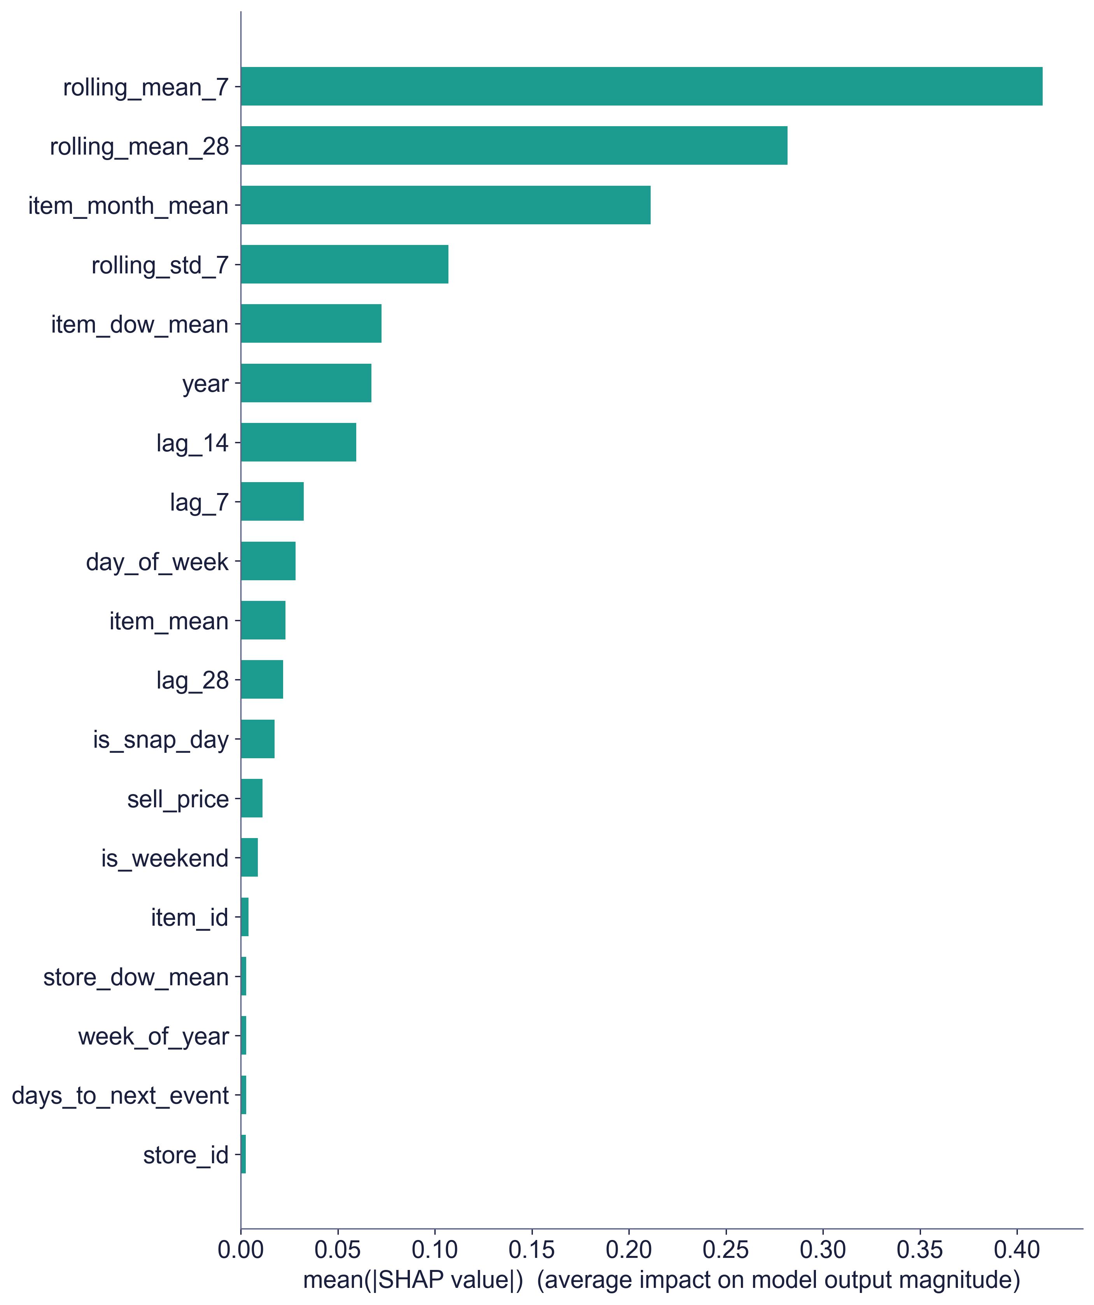
MODEL INTERPRETABILITY
What Actually Drives the Forecast
Top 5 features explain 78.6% of model behaviour — dominated by recent sales trend and item-level seasonality, not opaque signals.
13 / 26
Notes:
SAY THIS: We used SHAP analysis to check what's actually driving the model's forecasts. The top five features account for 78.6 percent of the model's behaviour, dominated by recent sales trend and item-level seasonality — not some opaque, unexplainable signal. This is essentially a more systematic version of what an experienced store manager already intuitively tracks. SPEAKER TIPS: Useful mainly to pre-empt an 'is this a black box' question; don't dwell unless asked. If asked why SHAP runs on LightGBM rather than the winning stacking ensemble: stacking ensembles combine three base learners through a meta-learner, which resists clean, single-model attribution — LightGBM is the standard, well-supported proxy here, and the ensemble's own behaviour is dominated by the same base learners it represents.

Slide 14
THE CENTRAL FINDING
100%
Consequence:
With zero stockouts, there was no stockout cost left for a smarter forecast or a smarter safety-stock formula to save.
Realised Service Level
— achieved by ALL THREE policies (Classical, ML-Gaussian, ML-Quantile) across every one of the 502 products, over the full 56-day test window. No policy ever stocked out.
ML-Quantile policy cost:
+1.5%
more than the classical baseline — unnecessary safety stock, no offsetting benefit
14 / 26
Notes:
SAY THIS: Here is the central finding of this thesis. When we ran all three inventory policies forward through real demand, all three achieved a 100 percent realised service level. Not once, across 502 products, over the full eight-week window, did any policy run out of stock. The consequence is direct: with zero stockouts, there was no stockout cost left for a smarter forecast or a smarter safety-stock formula to save. The ML-Gaussian policy costs essentially the same as Classical — a $12 difference, statistical noise. The ML-Quantile policy actually costs 1.5 percent more, because it holds a larger safety-stock buffer — 6,287 units against the Gaussian policies' 4,572 — that protects against stockouts which, in this regime, simply never happen. SPEAKER TIPS: Pause here. Emphasise: this was measured, not assumed — independently validated by the falsification results on slide 11. If asked whether this contradicts the abstract's framing: it doesn't — it IS the framing. The abstract explicitly states the apparent saving does not survive measurement.

Slide 15
AN HONEST CORRECTION
Why the Earlier 21% Estimate Did Not Survive
Earlier (Analytical) Draft
This Thesis (Simulated)
21%
−1.5%
Assumed the Gaussian policy achieved ~83% service and the quantile policy ~95% "by calibration," then computed cost from that gap.
Both policies actually achieve 100% service — the quantile buffer protects against stockouts that never occur.
The quantile policy won by construction — before any simulation ran.
The Ch1 5–15% inventory-cost target is not achieved on this dataset — treated as a finding, not a failure.
5–15% target sourced from Barghi (2025); Seyedan, Mafakheri & Wang (2023)
15 / 26
Notes:
SAY THIS: I want to be transparent about something. An earlier draft of this analysis, using the conventional analytical approach, estimated a 21 percent cost saving. That number assumed the Gaussian policy achieved only 83 percent service and the quantile policy 95 percent 'by calibration,' then computed cost from that assumed gap — in other words, the quantile policy won by construction, before any simulation ever ran. Once we actually measured service level through simulation, both policies achieved 100 percent service, and the 21 percent evaporated. The corrected number is a 1.5 percent cost increase, not a decrease. The Chapter 1 target of a 5 to 15 percent inventory cost reduction, sourced from Barghi 2025 and Seyedan et al. 2023, is therefore not achieved on this dataset. We treat that as a finding, not a failure. SPEAKER TIPS: If asked 'so was the thesis a failure?' — No. Disconfirmation of a specific hypothesis under specific conditions is a valid, valuable research outcome, especially when it corrects a methodological flaw common across the literature this thesis reviewed.

Slide 16
RESULTS — COST DECOMPOSITION
Holding Cost Dominates; Stockout Cost Is Zero
Bars start at $0 — the ML-Quantile difference is a genuine but small ~1.5% increase, not the large gap a truncated axis would suggest.
16 / 26
Notes:
SAY THIS: This chart shows why. Holding cost dominates total annual cost across all three policies and is nearly identical between them — around $63,256 for Classical versus $64,241 for the quantile policy. Ordering cost is negligible, about $332 for all three. And stockout cost is exactly zero for all three policies. There is structurally no room for a safety-stock formula to differentiate cost when the thing it protects against never happens. SPEAKER TIPS: This is the mechanical explanation for slides 14–15 — holding cost is roughly 99.5% of total cost. Keep this brief; it's confirmation, not new information.

Slide 17

SENSITIVITY ANALYSIS
The Finding Is Robust — Not a One-Off Result
Across Lead Time (7–21 days)
Across Stockout Multiplier (0.4×–2.0×)
−1.3% to −1.7%
No change
Quantile policy consistently more expensive, never favourable
Multiplier never engages — zero stockouts to price at any level
A threefold demand-shock stress test (Slide 11) shows even that is not enough, on this dataset, to make the quantile policy clearly superior.
17 / 26
Notes:
SAY THIS: We tested whether this result is a fluke of our specific assumptions. Across lead times from 7 to 21 days, the quantile policy is consistently between 1.3 and 1.7 percent more expensive than classical — never favourable. Across a stockout-cost multiplier from 0.4 times to 2.0 times, nothing changes at all, because the multiplier scales a stockout cost that is already zero. Even our threefold demand-shock stress test from slide 11 wasn't enough, on this dataset, to make the quantile policy clearly superior. SPEAKER TIPS: The stockout-multiplier result is the strongest point — even inflating stockout cost up to 2× doesn't matter, because the multiplier never engages against a real stockout. If asked about forecast-accuracy (MAPE) sensitivity specifically: that sweep belonged to the earlier, retracted analytical methodology and was not reproduced under simulation — say so directly. If pushed on why one 56-day window is enough to generalise a boundary condition: it isn't, on its own — that's exactly why the deliverable is a diagnostic tool rather than a universal percentage. The claim isn't 'this window proves ML forecasting never helps'; it's 'here is a validated way to test your own window, your own data, before investing.'

Slide 18
THE REAL CONTRIBUTION
A Boundary Condition, Not a Blanket Claim
The value of ML forecasting and distributional safety stock is conditional on the demand regime:
Genuine stockout risk exists
Service is already saturated
→ the larger, empirically calibrated buffer earns back its holding cost by preventing real stockouts.
→ the buffer protects against stockouts that don't occur — pure added cost, no benefit. (The M5 test regime.)
18 / 26
Notes:
SAY THIS: So what is the actual contribution here? Not a blanket claim, but a boundary condition. Where a business's baseline policy faces genuine stockout risk, the larger, empirically calibrated buffer earns back its holding cost by preventing real stockouts. Where service is already saturated — which is the regime we found on this M5 test window — that same buffer simply adds cost with nothing to show for it. The value of ML forecasting and distributional safety stock is conditional on which of these two regimes a business is actually in. SPEAKER TIPS: Committee may ask for the mechanism — walk through the two-card comparison on this slide if asked to elaborate.

Slide 19
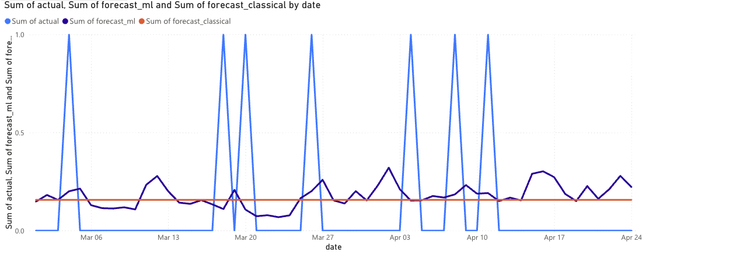
THE PRACTICAL DELIVERABLE
An Accessible Power BI Dashboard for SMEs
0.952
100.0%
−1.5%
MAE Ensemble
SL Quantile
Cost Chg. Quantile
Forecast Overview — actual vs. ML-ensemble vs. classical forecast, with KPI tiles and per-SKU drilldown
19 / 26
Notes:
SAY THIS: All of this is delivered through an interactive Power BI dashboard, designed to be accessible to a non-technical SME manager. This is the Forecast Overview page — actual versus ML-ensemble versus classical forecast, with KPI tiles and per-SKU drilldown. SPEAKER TIPS: Pivot tone here — from 'here's what we found' to 'here's what we built regardless.' The dashboard has value independent of which policy wins, because visibility into forecast-vs-actual is useful to an SME manager either way. Mention it runs on Power BI's free tier.

Slide 20
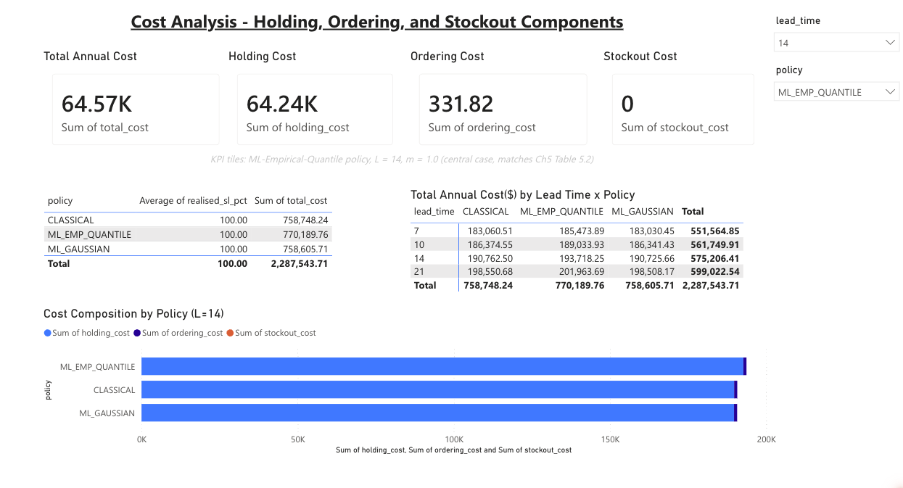
THE PRACTICAL DELIVERABLE
Cost Analysis — The Finding, Made Visible
Free (Power BI free tier). Runs on a standard laptop. Requires only data a typical POS system already produces.
20 / 26
Notes:
SAY THIS: And this is the Cost Analysis page — it makes our central finding visible directly, without requiring anyone to read the thesis. It's free, on Power BI's free tier, runs on a standard laptop, and needs only the data a typical point-of-sale system already produces. SPEAKER TIPS: This page is slide 16's chart made operational and SME-legible.

Slide 21
CONTRIBUTIONS
Theoretical and Practical Contributions
Theoretical
Practical
First simulation-based measurement of the Gaussian-vs-empirical safety-stock choice on M5
End-to-end, reproducible, free-and-open-source pipeline (< 3 hrs on a laptop)
Demonstrates ML forecasting's inventory value is regime-conditional, not automatic
A forward-simulation engine usable as a pre-investment diagnostic
Shows the inventory comparison is robust to the stockout-cost multiplier (zero stockouts at 0.4×–2.0×)
An interactive Power BI dashboard for non-technical SME managers
21 / 26
Notes:
SAY THIS: Our contributions split into two categories. Theoretically: this is the first simulation-based measurement of the Gaussian-versus-empirical safety-stock choice on the M5 benchmark, and it demonstrates that ML forecasting's inventory value is regime-conditional, not automatic. We also show the comparison is robust to the stockout-cost multiplier across the full 0.4 to 2.0 times range. Practically: we deliver an end-to-end, reproducible, free and open-source pipeline that runs in under three hours on a laptop; a forward-simulation engine usable as a pre-investment diagnostic; and an interactive dashboard for non-technical managers. SPEAKER TIPS: Two distinct audiences, two columns — don't let the committee conflate them. Both contributions stand on their own even though the headline cost-saving number didn't survive.

Slide 22
RECOMMENDATIONS
For SMEs: Diagnose Before You Invest
1
Don't trust published % claims alone
Ask: at what data granularity, and was cost measured or assumed?
2
Run the diagnostic on your own data first
The delivered simulation engine tells you if you face real stockout risk
3
Invest where the diagnostic says risk is real
High-margin, fast-moving, or highly seasonal categories are the best candidates
4
Deploy the dashboard regardless
Free, low-risk visibility — independent of which forecasting method feeds it
22 / 26
Notes:
SAY THIS: For SMEs specifically, here is our advice. Don't trust a published percentage claim alone — ask at what data granularity it was measured, and whether cost was measured or assumed. Run our diagnostic on your own data first — it tells you directly whether you face real stockout risk. Invest where the diagnostic says the risk is real — typically high-margin, fast-moving, or highly seasonal categories. And deploy the dashboard regardless of which forecasting method feeds it, because visibility alone is valuable and free. SPEAKER TIPS: Step 2 is the operational core — say it plainly. If asked how technical a team needs to be: §1.2.3 specifies one analyst with roughly 12-18 months of Python scripting experience, free and open-source libraries only, on a standard laptop. No dedicated data-science hire or paid infrastructure required.

Slide 23
LIMITATIONS & FUTURE WORK
What This Study Does Not Claim
Limitations
Future Work
Single 56-day test window — a longer or differently-timed window could expose real stockouts
Re-test on retail benchmarks with more volatile demand (Rossmann, Favorita)
LSTM evaluated at one architecture only — more elaborate sequence models untested
Validate the boundary condition in a live SME deployment with genuine stockout exposure
Stockout cost modelled as linear — real-world costs (e.g. churn) may be non-linear
Extend the simulation engine to non-linear stockout costs and lead-time uncertainty
23 / 26
Notes:
SAY THIS: We want to be upfront about the limits of this study. We tested a single 56-day window — a longer or differently-timed window could expose real stockouts. We evaluated only one LSTM architecture. And we modelled stockout cost as linear, when real-world costs like customer churn may not be. For future work, we'd like to re-test on more volatile retail benchmarks like Rossmann or Favorita, validate this boundary condition in a live SME deployment with genuine stockout exposure, and extend the simulation engine to non-linear stockout costs. SPEAKER TIPS: Be candid and unhurried — the 56-day window is the most defensible line of questioning to expect, and 'a longer window could expose real stockouts' is the honest answer, not a hedge.

Slide 24
CONCLUSION
The Value of ML Forecasting Is Real —
But Conditional, Not Automatic
This thesis delivers both the evidence for that conclusion and a practical, free, open-source tool that lets any organisation test which side of that condition it falls on — using its own data, before spending anything further.
The barrier this research removes is not financial. It is informational.
24 / 26
Notes:
SAY THIS: So, in conclusion: the value of ML forecasting is real, but it is conditional, not automatic. This thesis delivers both the evidence for that conclusion and a practical, free, open-source tool that lets any organisation test which side of that condition it falls on, using its own data, before spending anything further. The barrier this research removes is not financial. It is informational. SPEAKER TIPS: Land on the reframe, not the retracted 21% number. 'The barrier is informational, not financial' is the sentence to leave the committee with.

Slide 25
KEY SOURCES CITED
The Benchmark Figures and Frameworks Referenced Tonight
Highlighted subset of the 52 sources reviewed — full reference list is in the written thesis.
Barghi, S. (2025).
Demand forecasting and inventory improvement in supply chain management using hybrid boosting ensemble techniques. Master's thesis, École de Technologie Supérieure, Université du Québec.
10–25% / 5–15% benchmark figures
Seyedan, M., Mafakheri, F., & Wang, C. (2023).
Order-up-to-level inventory optimization model using time-series demand forecasting with ensemble deep learning. Supply Chain Analytics, 3, 100024.
10–25% / 5–15% benchmark figures
Nasseri, M., Falatouri, T., Brandtner, P., & Darbanian, F. (2023).
Applying machine learning in retail demand prediction — A comparison of tree-based ensembles and long short-term memory-based deep learning. Applied Sciences, 13(19), 11112.
ML-vs-classical consensus; LSTM underperformance
Razzak, A., Paul, R., & Rozony. (2025).
Demand forecasting in retail e-commerce: A systematic review. International Journal of Scientific Interdisciplinary Research, 6(1), 1–27.
72-study systematic review, ML-vs-classical consensus
Silver, E. A., Pyke, D. F., & Thomas, D. J. (2017).
Inventory and production management in supply chains (4th ed.). CRC Press.
(R, s, S) / OUTL policy; Gaussian safety-stock formula
Croston, J. D. (1972); Syntetos, A. A., & Boylan, J. E. (2005).
Forecasting and stock control for intermittent demands / The accuracy of intermittent demand estimates.
Croston's method and SBA for intermittent demand
25 / 26
Notes:
SAY THIS: For reference, here are the key sources behind the benchmark figures and frameworks I've cited tonight — happy to speak to any of them in more detail during questions. SPEAKER TIPS: Only needed if a panellist asks 'which studies?' Barghi (2025) and Seyedan et al. (2023) are the source of every 10–25% / 5–15% figure quoted tonight (slides 3, 6, 12, 15); Nasseri et al. (2023) and Razzak et al. (2025) back the broader 'ML beats classical' consensus on slide 6; Silver, Pyke & Thomas (2017) is the textbook source for the (R,s,S) policy and Gaussian formula on slide 9. Move through this quickly or skip straight to Q&A if no one asks.

Slide 26
Thank You
Questions & Discussion
Desmond Korbla Aziega • Theresa Korlekuor Apla-Kweku • Abdul-Razak Seidu
Supervisor: Prof. Rocío González Martínez
Notes:
SAY THIS: Thank you. We're glad to take your questions. SPEAKER TIPS: Stop talking. Invite questions. If the committee opens with a challenge to the 21%→−1.5% reversal, don't get defensive — point back to slide 10 (the methodological pivot) and slide 11 (falsification validation) as the two slides that pre-empt it.

