Slide 1

Neural Style Transfer with TensorFlow

Slide 2
Objectives
Understand the Neural Style Transfer
Implement the project for Neural Style Transfer with TensorFlow

Slide 3
Introduction
Neural style transfer is an optimization technique used to take two images, a content image and a style reference image (such as an artwork by a famous painter)—and blend them together so the output image looks like the content image, but “painted” in the style of the style reference image

Slide 4
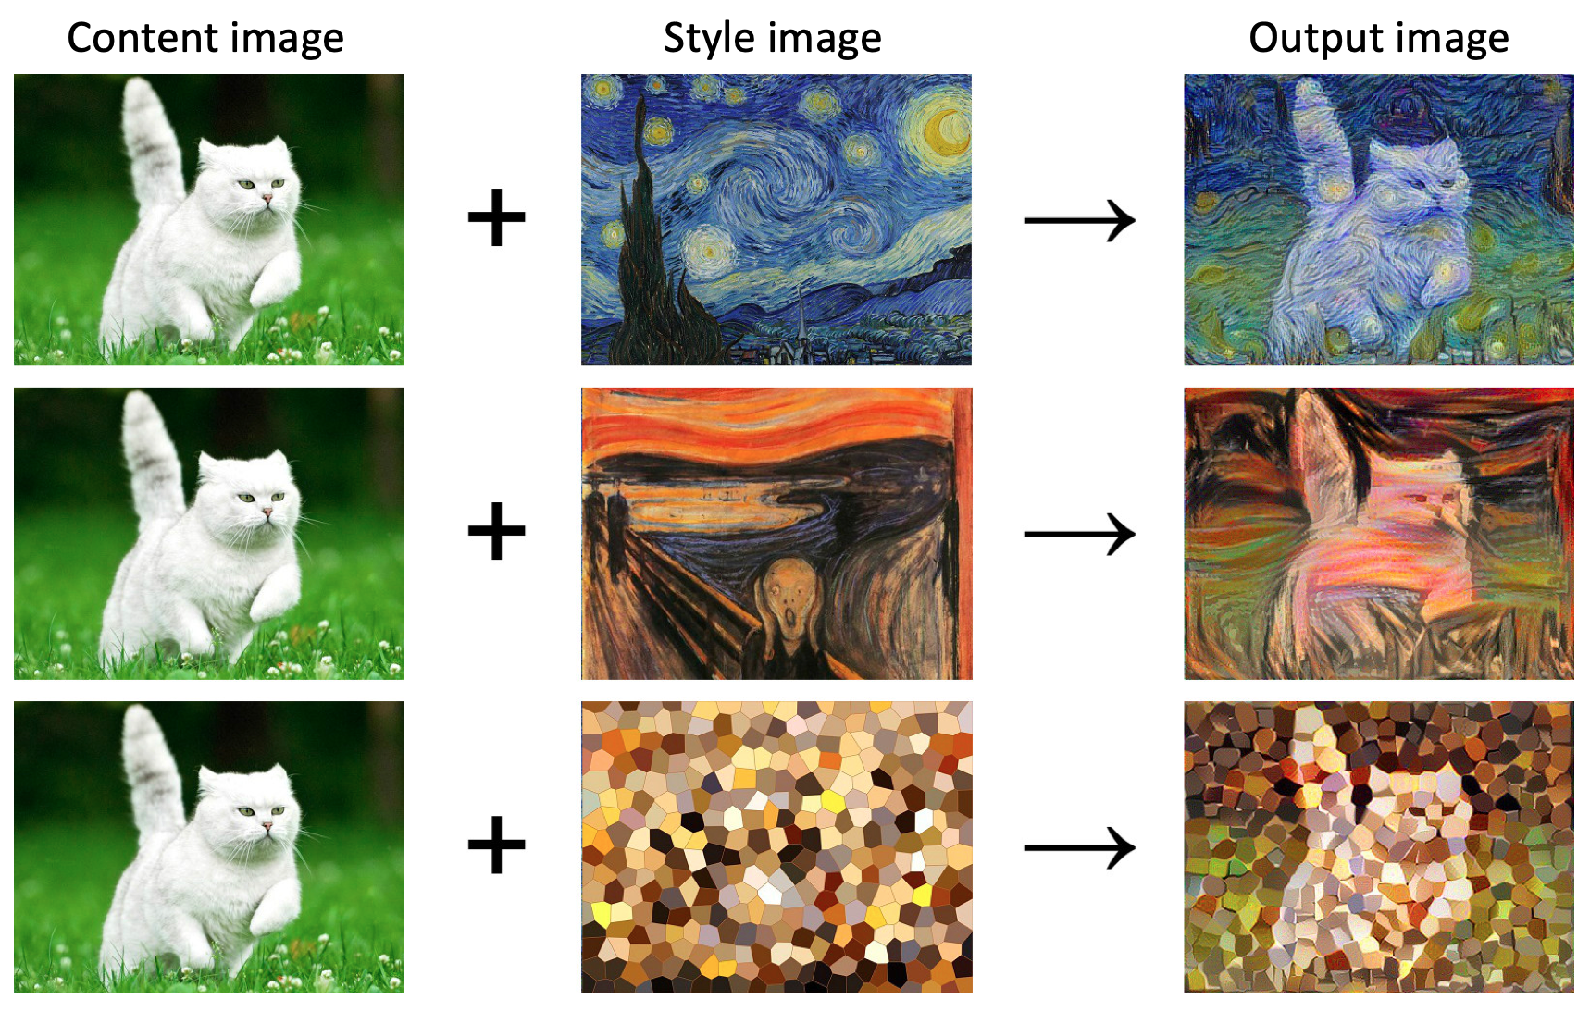
Introduction

Slide 5
Q & A

