Slide 1
Oracle for the SQL Server Data Pro
Kellyn Gorman
Multiplatform and AI Advocate

Slide 2
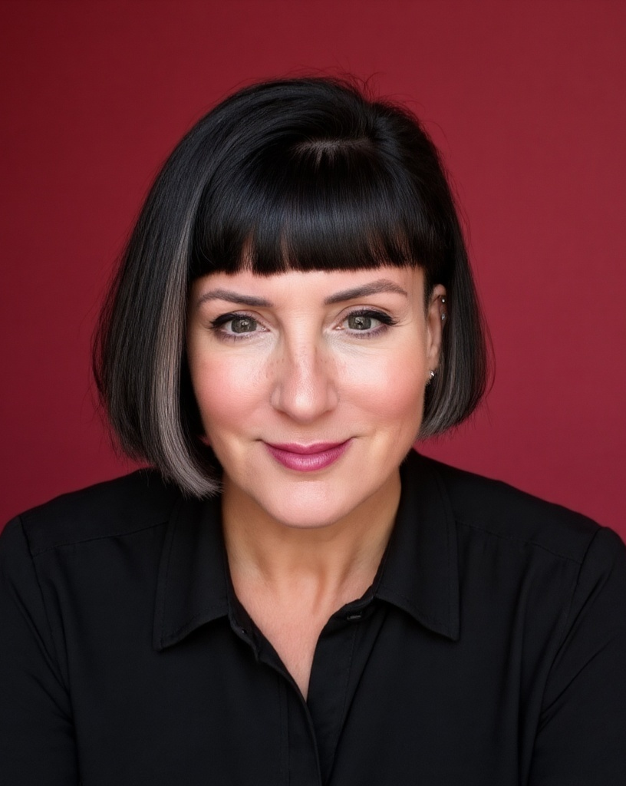


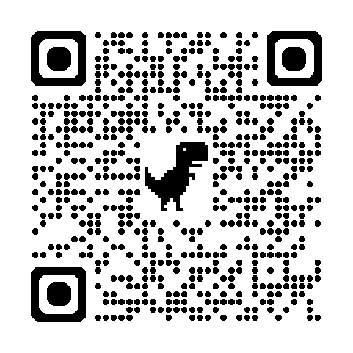

About me
Kellyn Gorman
Engineer and Advocate
Kellyn.Gorman@red-gate.com
https://linkedin.com/in/kellyngorman
https://dbakevlar.com

Slide 3
Breakfast Agenda
Conversation
Interactive
Value Positive

Slide 4
Oracle Peanut Butter in my SQL Server Chocolate

Slide 5
A Quick Poll
Experience Level with Oracle?
New to Oracle
1-5 years
5-8 years
8+ years

Slide 6
Daily Focus Poll
My daily focus is…
Development
Production
End User
Leadership

Slide 7
The Oracle Ecosystem

Slide 8
Oracle – Key Facts
📌 Founded – 1977 by Larry Ellison, Bob Miner, and Ed Oates 📌 Headquarters – Austin, Texas, but soon to be - Nashville, Tennessee 📌 Global Presence – Operates in 175+ countries 📌 Revenue – $50B+ annually 📌 Employees – 140,000+ worldwide 📌 Major Customers – Fortune 500 companies, governments, and enterprises 📌 Innovation Focus – AI-driven automation, multi-cloud, security

Slide 9
Oracle, is Everywhere
Database, software, hardware, cloud
Fortune 500 enterprise and large organizations
Mostly on-premises, but more running in the cloud
Database environments can be TB or PB in size!

Slide 10
Oracle Database Versioning
No Man’s Land: Oracle 8, 8i, 9i, 10g and 11g
Still Holding on: Oracle 12.1 and 12.2(extended support)
Non-terminal Release, but supported: Oracle 18c, 21c (AWS RDS)
Oracle Terminal Release, Full Supported: Oracle 19c
Exceptionally buggy version!
Should run latest release.
Best on Oracle Enterprise Linux, (OEL or EL, followed by Red Hat)
Oracle 23ai: Bleeding Edge, but GA!!

Slide 11
“I thought Oracle was a Database Platform??”
Hardware Vendor?
Application Suites?
Storage Management System?
Cloud Vendor?
Coding Language?

Slide 12
Oracle Hardware
Oracle purchased Sun Microsystems in 2010.
Zettabyte File System(ZFS) for inexpensive storage solution
Zero Data Loss Recovery Appliance (ZDLRA) for backup and recovery
Oracle Data Appliance (ODA) aka “Poor man’s Exadata)
*We’ll cover Exadata separately as it is an engineered system.

Slide 13
Oracle Application Suites
E-business Suite- Accounts Receivable, Order Entry, Customer Orders, etc. Multi-tier system with Concurrent Manager for job management.
Peoplesoft- HR software suite
Hyperion/EPM – Financial and Operation performance Software
JD Edwards – Financial System
Primavera – Project Management Software
Opera – Hotel and Resort Management
APEX – Application Express, Web application creation suite

Slide 14
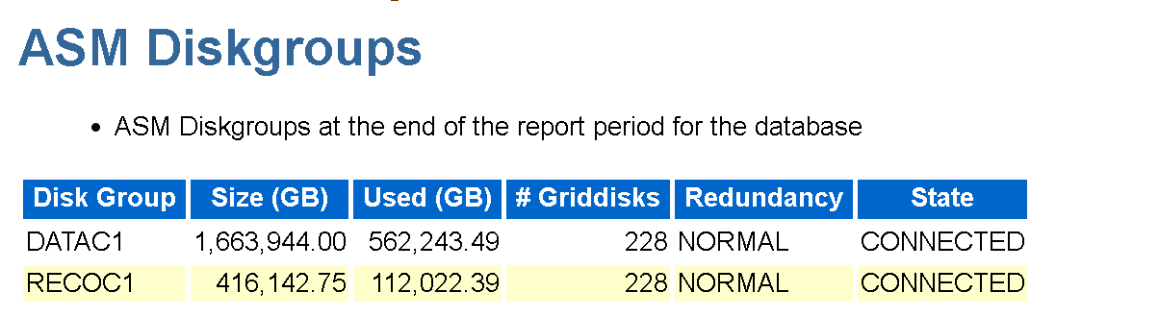
Storage Management
Automatic Storage Management, ASM
Like NFTS or FAT32 in Windows
Very similar to Linux Volume Manager(LVM) and UDEV in Linux/Unix
Possesses its own Oracle instance that is running and managing the storage layer for Oracle.
Removes the secondary layer at the OS level and is optimized for Oracle databases
Has its own syntax, utilities, views and command line reference.

Slide 15
Oracle and the Cloud Vendor
Oracle Cloud Infrastructure (OCI)
This is Oracle’s 5th public cloud offering.
PaaS and SaaS offerings built out of 4th cloud, Oracle Bare Metal.
Free tier of Oracle cloud is 3rd public cloud “repurposed”.
Made up mostly of Oracle Data Appliances (for SaaS offerings) and significantly now offers Oracle Exadata solutions with the PaaS database.
Oracle’s PaaS database is called the Autonomous Database or Oracle Autonomous DB, (ADB).
Exadata@Cloud are Exadata in other cloud datacenters (Azure and GCP, recently in AWS.)

Slide 16
Oracle as Software
PL/SQL – Flavor of SQL with incredibly robust packages to simplify development work. Can be found in Oracle, DB2 and extension for PostgreSQL.
Want the most from Oracle? Use PL/SQL, not “vanilla” SQL.
Java – Java is one of the most popular coding languages in the world and incredibly robust. Oracle receives royalties off of most Java implementations in vendor code.
Oracle also owns the trademark for Javascript.

Slide 17

Real Oracle Licensing Auditors

Slide 18
Oracle License Contracts are Unique
Oracle licensing costs are commonly the most expensive part of any database project.
Oracle is licensed by CORE, management pack.
There are unlimited licensing agreements (EULAs) with large customers.
Customer’s rarely pay list price- often large discounts in end.
Annual support cost on top of licensing.

Slide 19
Oracle Specialists Are Focused
Database Administrator
Development DBA
Production DBA
Application DBA
Developer
PL/SQL Developer
Application Developer
Web Developer

Slide 20
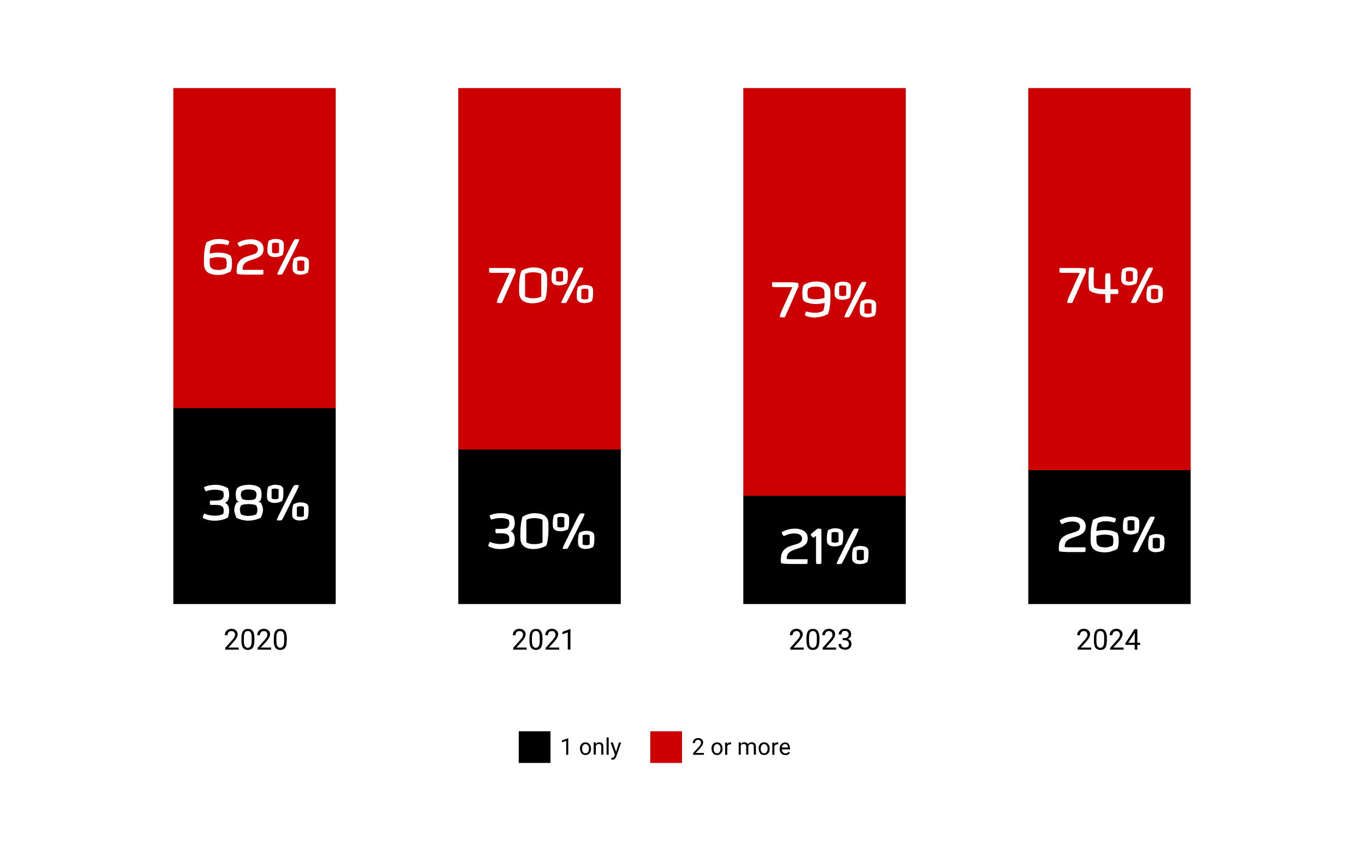
Multi-platform is the norm
NEW Redgate State of Database Landscape Report 2025
Notes:
Single-platform is a myth, discuss my own history
The State of Database Landscape survey shows how many of us are multiplatform.
26% of respondents claim one platform is unrealistic
Data security is a major concern
Dig into the report

Slide 21
After 27 years, I still have challenges “switching”
Same terms, different definitions
Different tools
Different uses for different platforms
Little understanding, “A database is a database…”

Slide 22


Increasing data volume and platform type
of IT teams are now using more than one database platform
74%
25%
of respondents using more than four database platforms
NEW Redgate State of Database Landscape Report 2025
Notes:
Kellyn: complexity in most IT organizations have contributed to additional challenges.
Organizations are incorporating more database platforms and environments through new technology, acquisitions and the cloud.
survey showed that three quarters (74%) of IT teams are now using more than one database platform
over a quarter of respondents are using more than four
Many organizations are using a mix of on-premise and cloud.
for DB professionals starting their day in SQL Server, then Oracle, PostgreSQL
Along with demands, add AI and ML as part of technology stack.
Natural life of a db is growth, so reaching multi-PB sizes, requiring us to evolve.

Slide 23
The Oracle Database

Slide 24
Terms to Clarify
Instance
Database
Locking
Buckets
Process/Session
Logs, (redo, archive, transaction)
Schema/DBO
Role/Group
Cluster
Packages
Before Triggers/Complex Rules
Synonyms
Sequences/Identity Columns
https://docs.oracle.com/cd/E10405_01/appdev.120/e10379/ss_oracle_compared.htm

Slide 25

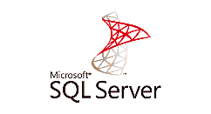
Oracle Compared to SQL Server, (Database Level)
*non multi-tenant, RAC or ASM
*non MSFC, AG configuration
Instance
Database
User Process
Shared Pool
SGA
Buffer Cache
User Process
Relational Engine
Protocol Layer
Plan Cache
________________
Data Cache
_______________
Buffer Pool
Shared Cache
Redo Log Buffer
Optimizer
SNI
Server Process
Server Process
Cmd Parser
Library Cache
Query Executer
PGA
PMON
SMON
QMNC
CKPT
OLEDB
Transaction Mgr
Buffer Mgr
LGWR
RECO
MMON
DBWR
SQL Server service
Access Methods
Data files
Master
Archive Log Files
Other DB Processes
Transaction Log
Data files
Instance
Transaction Log
Database
Redo Logs
Control file
SP, (Param) file
SQL Server, (BIN) Software
MSDB
Oracle Home
Transaction Log
Redo Logs
Control file
Transaction Log
Oracle Software
TEMP
Redo Logs
Control file
Password file

Slide 26
Memory: Oracle SGA
Oracle Instance
System Global Area (SGA)
Buffer Cache
Default
Least Recently Used
(LRU) List
Non-Default Pools
Keep
2 K
4 K
Cold
Hot
Recycle
32 K
16 K
Checkpoint Queue
Flash Buffer Area
RBA Order

Slide 27
Memory: Oracle PGA
PGA
SQL Work Area
Server
Process
Session Memory
Private SQL Area
SQL Work Area
Server
Process
Bitmap Merge
Area
Session Memory
Private SQL Area
Sort Area
Hash Area
Persistent
Area
Runtime
Area
Session Memory
SQL Work Area
Server
Process
Session Memory
Private SQL Area

Slide 28
Oracle Processes
Upwards of 30+ background processes
LGWR, DBWR and J*** (jobs) can have numerous number of processes.
Each user spawns a process on the host in Linux/Unix.

Slide 29
What is an Oracle Instance?
Background processes and memory allocation
From SQLPlus, SQLcl or other utility-
export|set ORACLE_SID=ORCL, ORACLE_HOME, ORACLE_BASE
>sqlplus / as sysdba
Staged opening of an Oracle Database:
>startup nomount|mount|open

Slide 30
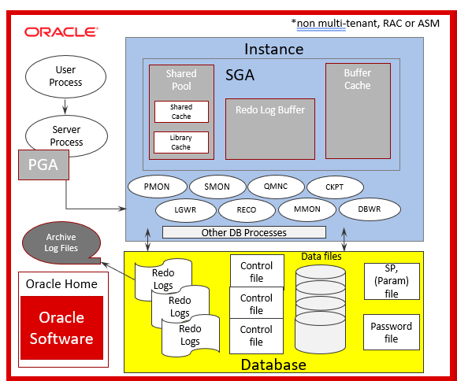
Aspects of the Startup
NoMount
Mount
Open
Memory and processes open, control files and parameters initialized.
Everything from NOMOUNT and all datafiles, redo logs, etc. are mounted, but the database is NOT open
The database is not open after performing all previous steps.

Slide 31
Network Connectivity
Listener Service/Utility listens for connections
Listener.ora file contains listener configuration
Tnsnames.ora contains service names connections
Sqlnet.ora contains network configuration information

Slide 32
Users, Schemas and Object Storage
User databases are broken up by schemas
Each schema will have objects isolated by their own logical tablespaces, made up of 1 or more datafiles, (common).

Slide 33
Storage
Byte→ Block→ Extent→ Segment→ Tablespace→ Database
Every datafile(s) belong to a tablespace.
A minimum of 3 redo log groups with a minimum 1 redo log each.
UNDO tablespace can’t be used for anything but internal UNDO processing
All undo is also written to the REDO logs for recovery purposes.

Slide 34
Unique Objects
Package and Package Bodies- groups of procedures, functions, variables, cursors, etc.
User Defined Objects types
Nested tables and VARRAYS, aka collections
Sequences are the default for sequence generation.
The DUAL table: SELECT 8*6 from DUAL;

Slide 35
Sessions and Processes
User log into, no logins, (changes a bit with multitenant architecture with c## global users)
Each session spawns a new process on the OS, (vs. threads in SQL Server)
How has this changed with multitenant?

Slide 36
Security
Built in roles and privileges
Deeply complex row level security, encryption and isolation.
All processes owned by a designated ORACLE user
Advanced auditing, (revamped in release 19c)

Slide 37
Interacting with Oracle Data
Application Interface
Development and Query Tools
SQL Developer
VS Code
PL/SQL Developer
SQL*Plus
SQLcl

Slide 38
Connection Information
Info Required:
Host Name or IP Address
Port
Connection Type, (TCP, EZ Connect, TCPS, Bequeath, Wallet)
SID, Service Name

Slide 39
Connection Strings and Connecting to Oracle
Bequeath connection as DBA:
>sqlplus / as sysdba
Standard user connection to a multitenant PDB using SQLcl:
>sql –s -L jdoe@//dbhost:1521/orclpdb1
EZConnect:
>sqlplus jdoe@host.com:1521:ORCL

Slide 40
Oracle Architecture

Slide 41
The Oracle Evolution

Slide 42
Monitoring the Behemoth
Our teams discovered the long runway of identifying the architectures that would be required.
Built these out and how different the roadmap for Oracle was vs. other database platforms, (even SQL Server!)

Slide 43
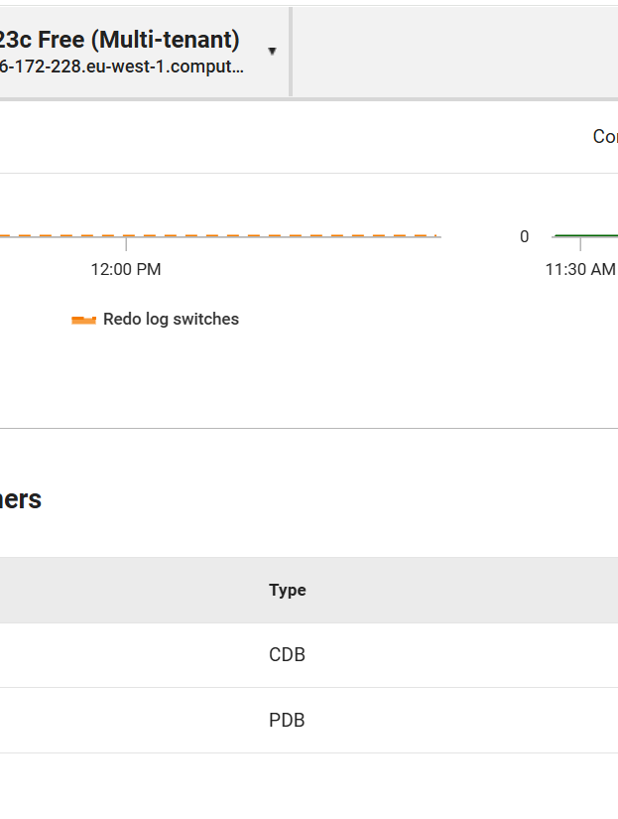
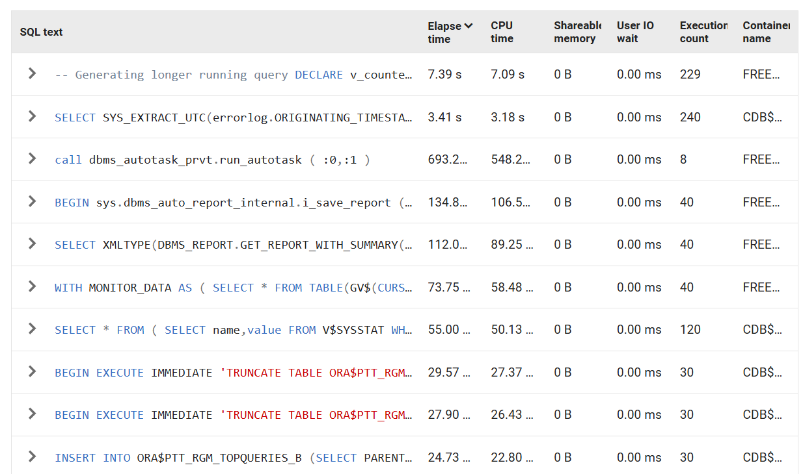
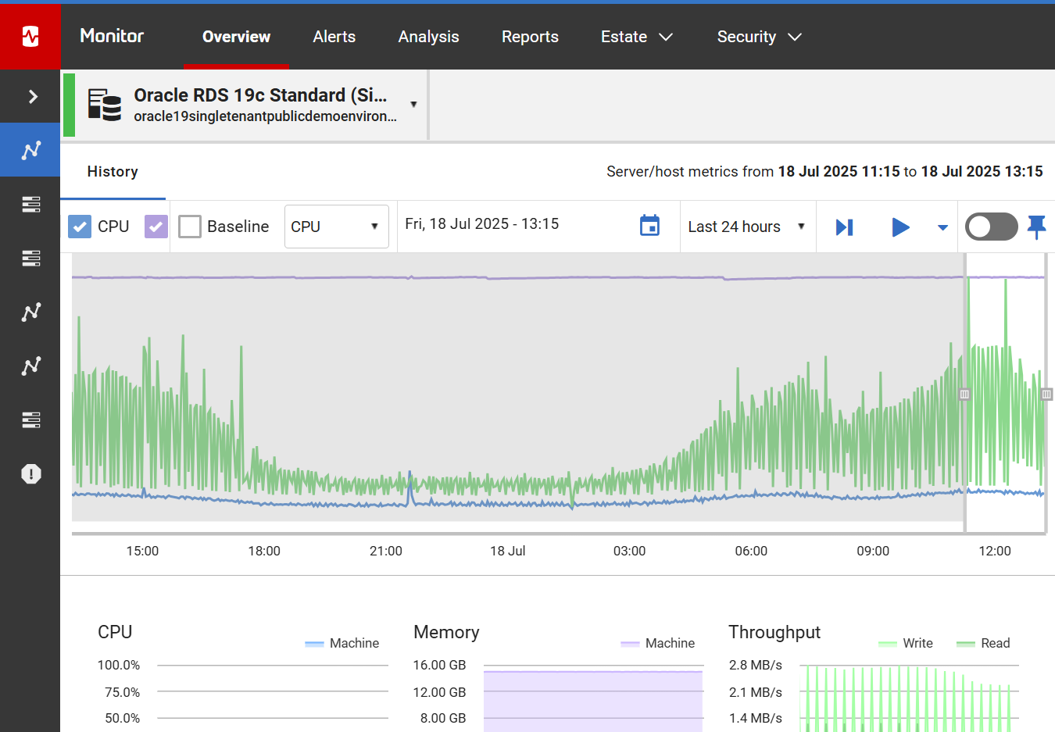
Long Runway of Architectures

Slide 44

Historical Single Instance Oracle
Owns all background processes.
Requires more resources to run a database, pushing for larger monolith systems.
Limits the ability to migrate to the cloud.
More difficult backup/recovery and high availability solutions.
No longer available in Oracle 23ai

Slide 45


Traditional Oracle Single Instance (Non-23ai)
Database Host/VM/Container
Single Instance
PMON
SMON
RECO
DBWx
Listener receives requests
Oracle Listener
Others
Others
Redo Logs
Others
Redo Logs
Others
User Sessions Connect via Service Name
Redo Logs
Datafile
Datafile
Datafile
Validates Service via TNS, Broker or Wallet
Undo
Datafile
Archived Logs
TEMP
Archived Logs
Archived Logs
Sqlnet.ora
Undo
Original Oracle Single Database Instance – 10g to 21c
Tnsnames.ora
Oracle Database

Slide 46
Multi Tenant is Introduced in Oracle 12c
Container Database
Like Master Database in SQL Server
Own majority of background processes, manages “containers”.
Pluggable databases
Like user databases in SQL Server
Simplifies management, migration and uses significantly less resources.
Seed Database
Template database to ease cloning and database creation.
Like Model database in SQL Server
*A MULTITENANT license is not the same as MULTITENANT architecture

Slide 47
High Level Oracle Multitenant(Container)
Database Host/VM/Container
CDB
PMON
SMON
RECO
DBWx
Others
Others
Others
Datafile
Others
TEMP
Others
Listener receives requests
Undo
Oracle Listener
Redo Logs
Redo Logs
PMON
Redo Logs
PDB
User Sessions Connect via Service Name
Archived Logs
Datafile
Archived Logs
SMON
Datafile
Archived Logs
Datafile
Datafile
TEMP
Undo
Validates Service via TNS, Broker or Wallet
Undo (Global Architecture)
PDB
PMON
Sqlnet.ora
Datafile
Datafile
SMON
Datafile
Multitenant, share system processes architecture – 12c+ default for 23ai
Datafile
Tnsnames.ora
TEMP
Undo
Oracle Database Container

Slide 48
What is RAC?
Like Windows Failover Clustering, (WFCS)
Instance resiliency and scalability, but often sold as HIGH AVAILABILITY, (respect the propaganda on this one! ☺)
Shared storage and unable to span multiple datacenters, (why it fails HA 101).
Can scale 32+ nodes, as long as database design and code can also scale!
RAC One-node offers an active/passive solution for failover in single datacenter.

Slide 49


Real Application Clusters
(RAC)
RAC DB Instance
RAC Database Node 1
PMON
SMON
RECO
DBWx
Listener receives requests
RAC Shared Storage
Others
Others
Locally
received
Redo Logs
Others
User Sessions Connect via Service Name
Redo Logs
Others
Redo Logs
bknd
Datafile
Undo
Archived Logs
Archived Logs
Sqlnet.ora
Archived Logs
Datafile
Tnsnames.ora
Shared Global Cache
Datafile
Oracle SCAN Listener
RAC DB Instance
RAC Database Node 2
Datafile
PMON
SMON
RECO
DBWx
Listener receives requests
Others
TEMP
Others
Locally
received
Redo Logs
Others
Redo Logs
Others
Validates and directs session to an available node
Redo Logs
Bknd
Undo
Undo
Archived Logs
2-Node RAC, non-Multi tenant Architecture – 10g- 21c
Archived Logs
Sqlnet.ora
Archived Logs
Voting Disk
Voting Disk
Tnsnames.ora
Voting Disk

Slide 50
Oracle RAC vs. SQL Server Always-on
Unlike SQL Server Always-on Availability Groups, there isn’t a replica of the database- single database, shared between multiple DB servers. Transactional processing is “shipped” between the nodes, (servers) to keep them in sync.
No write BETWEEN nodes on AG. In Oracle RAC, there is a share everything design.
There is a significant overhead to this, global cache, (gc waits)- CPU, memory and network, although there are some similar waits in AG on SQL Server.
AG is built for failover, where RAC is built for scalability.

Slide 51

Scaling (RAC)
RAC DB Instance
PMON
SMON
RECO
DBWx
RAC Database Node 1
Locally
received
Redo Logs
RAC Shared Storage
Redo
Redo Logs
User Sessions Connect via Service Name
Undo
Archived Logs
Archived Logs
Archived Logs
Datafile
Shared Global Cache
Datafile
RAC DB Instance
PMON
RECO
DBWx
RAC Database Node 2
SMON
Locally
received
Redo Logs
Datafile
Redo
Redo Logs
Undo
Archived Logs
Oracle SCAN Listener
Archived Logs
Archived Logs
Datafile
Shared Global Cache
TEMP
Validates and directs session to an available node
RAC DB Instance
RAC Database Node 3
PMON
SMON
RECO
DBWx
Locally
received
Undo
Redo Logs
Redo
Redo Logs
Undo
Archived Logs
Voting Disk
Archived Logs
Voting Disk
Archived Logs
Voting Disk
Scaled from 2 nodes to 3

Slide 52
Data Guard
Like Always-on Availability Groups in SQL Server
Active/Passive or Active/Read-only solutions
Uses terms “Primary” and “Secondaries”
Can have many secondaries and set up with failover hierarchy.
Has Fast-start failover, (FSFO) use a Far Sync host to manage data replication between long distances or multi-cloud.
Incredibly flexible and resilient.

Slide 53

Oracle Data Guard
Primary Node
Primary
PMON
SMON
RECO
DBWx
Listener receives requests
Others
Others
User Sessions Connect via Service Name
Redo Logs
Others
Redo Logs
Others
Local Listener
Redo Logs
Others
Datafile
Datafile
Undo
Datafile
Archived Logs
Datafile
Archived Logs
Sqlnet.ora
TEMP
Archived Logs
Undo
Tnsnames.ora
Secondary Node
Secondary
PMON
SMON
RECO
DBWx
Data Guard secondaries can be passive, (failover only) or active (read only)
Others
Others
Redo Logs
Others
Local Listener
Redo Logs
Others
Redo Logs
Others
Data Guard can be used on Single instance, Multitenant and RAC – 10g- 23ai
Datafile
Datafile
Archived Logs
Undo
Datafile
Archived Logs
Datafile
Archived Logs
Sqlnet.ora
TEMP
Undo
Tnsnames.ora

Slide 54
Oracle Golden Gate
Highly Configurable Replication Software.
Can be used for Oracle and numerous other platforms.
Uses redo log data to stream changes, logs changes to trail files.
Easy to set up, difficult to troubleshoot when problems arise.
Expensive, but flexible, with ability to do all, partial, transform, migration, etc.
Can even create an Active/Active GG environment, synchronizing changes between the two databases.

Slide 55
The Oracle Engineered System- Exadata

Slide 56
What is Oracle Exadata?
An Engineered hardware and software solution specifically designed to run Oracle workloads
Consists of database and cell nodes, (servers), fast internal network, PDU, (power) in a rack configuration.
Proprietary features:
Offloading, (using cell nodes to perform high IO processing instead of the primary database nodes.
Storage indexes, (indexes in memory, along with advanced features.)
Flash cache and Flash Logging for faster buffer results, elimination of log latency
HCC, (Hybrid Columnar Compression) for faster scans of compressed data
Secondary features depending on the version of Exadata(X5-2L through X11-M versions are available, depending on the location of OCI, Exadata@customer [ on-premises] or Exadata@cloud).
Can use Oracle RAC or RAC single node, (active/passive)
Software intelligence installed to know when to use Exadata features to benefit the workload

Slide 57
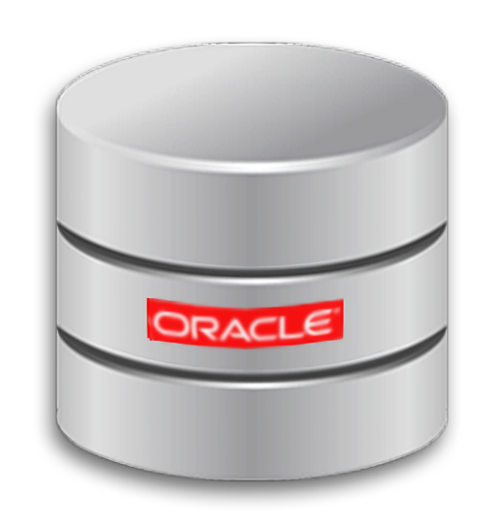
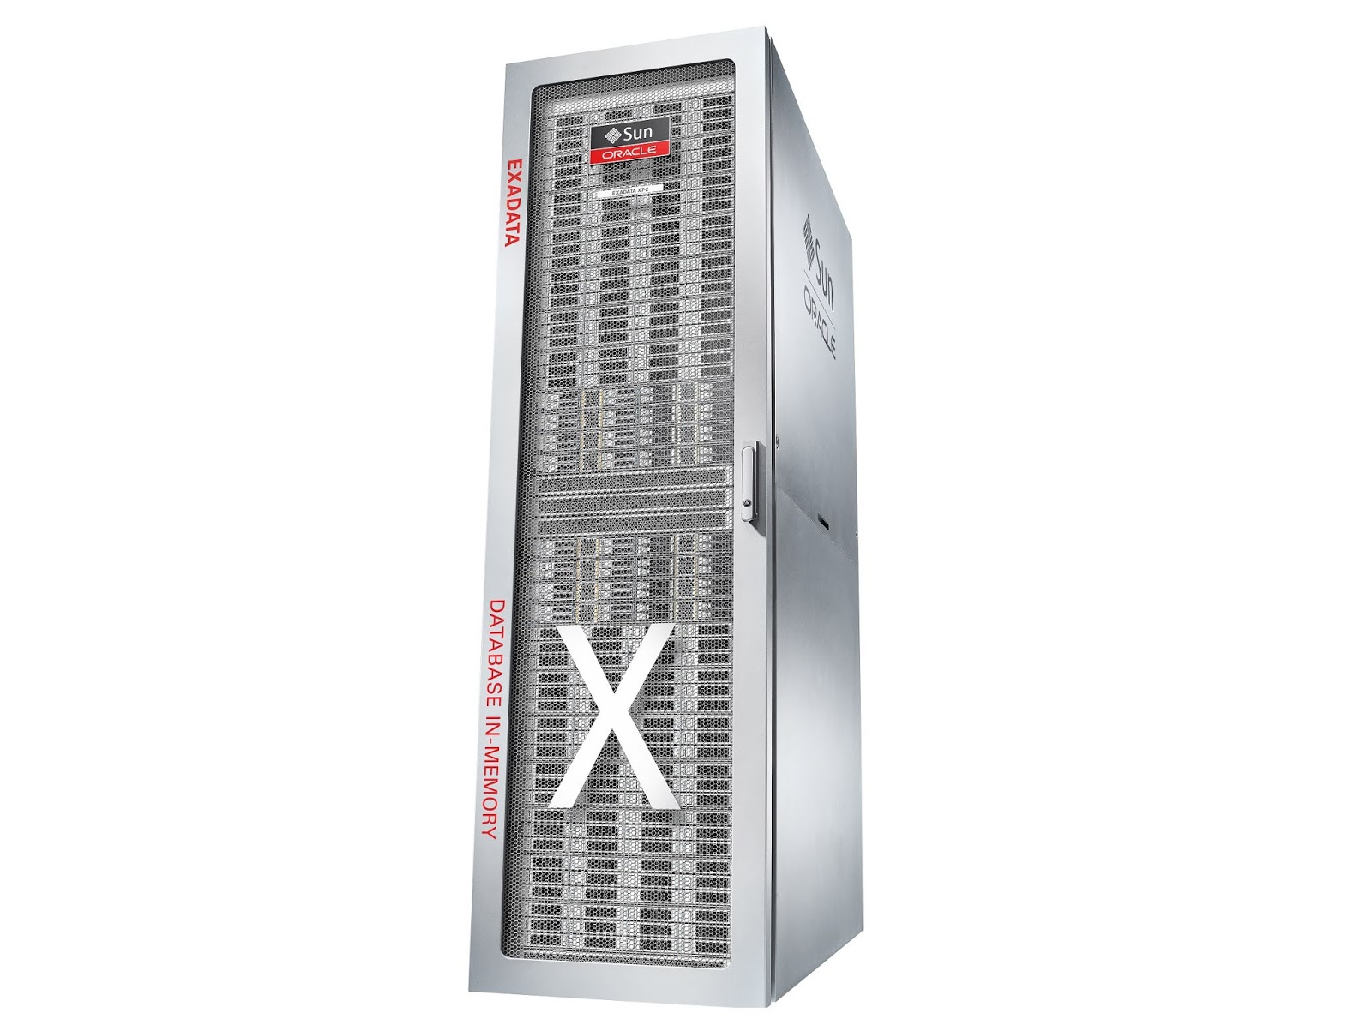







Oracle Exadata- A cloud in a box
Purchase of Exadata was most likely made due to 1-2 large databases.
Rest of databases were consolidated to make the most of the investment.
Most databases heavily dependent on the infrastructure, not Exadata features.
Can have upwards of
2990 CPU cores
33TB of memory
21TB of RDMA memory
3-7 cell nodes for offloading
462TB of flash capacity
4.2PB of SSD storage

Slide 58
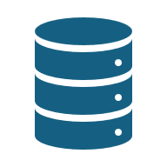
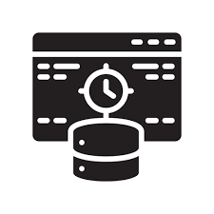
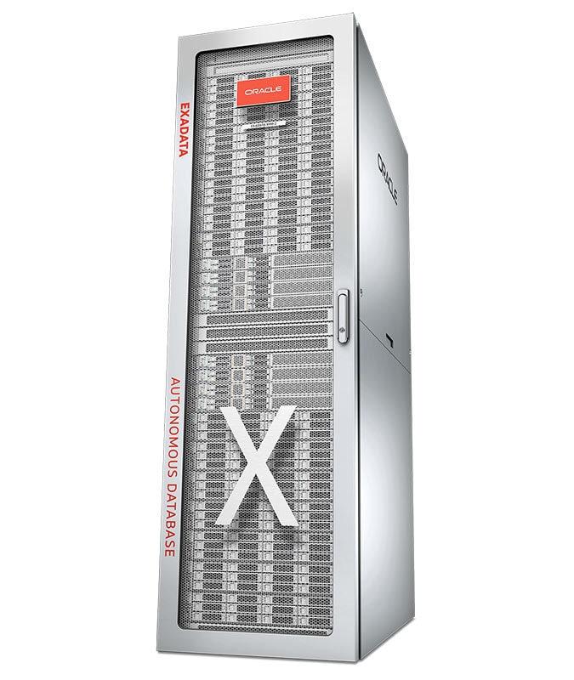




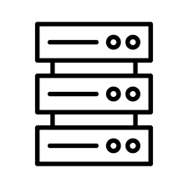
Oracle Enterprise Linux OS
Exadata
RAC Databases
100Gb/sec RDMA Network Fabric
Large Memory
Extensive Flash Cache
Storage Servers/Cell Nodes for Offloading
Redundant Power
Fast Flash Storage

Slide 59
Why Oracle has Lock-in

Slide 60
Oracle Modernization Failures
Uses PL/SQL
Dependent upon internal PL/SQL packages (collection of procs, functions, etc.) to limit demands on developers.
Schema migration of objects is easy, recoding of PL/SQL is NOT.

Slide 61
In Summary

Slide 62
Oracle is…
Much more than a database platform
Is expensive but has lock-in around it’s PL/SQL, internal packages, instance resiliency and scalability that other platforms will have challenges in the modernization game.
Greenfield projects rarely make sense to choose Oracle.

Slide 63
Oracle requires knowledgeable resources
As it’s part of 100% of fortune 500+ companies.
Requires deep database, infrastructure, development and command line skills.
Has advanced architectures differing greatly from other database platforms.
Has differing definitions of common terms.

Slide 64
The End
Thank you for attending
Please reach out if you have questions.

Slide 65

Interested in a live demo of Redgate Tools?
Discover how Redgate can add value to your DevOps processes through live demo today with a Redgate Solution Engineer. Head to the demo area or ask a friendly Redgate representative.
Networking and drinks reception
Join us for an opportunity to network during our drinks reception from 4:30 – 5:30pm.
Scan the QR code to leave your feedback:
Please leave us your feedback to be in with a chance to win a complimentary 3-Day Ticket to PASS Summit 2025 and other giveaways !
Winner drawn during the drinks reception, you have to be present to win!

Slide 66
Navigating the database landscape

