Slide 1

Optimizing CI/CD for Hybrid and Cloud Environments with DevOps and AI
Building scalable, secure, and AI-enhanced CI/CD pipelines

Slide 2


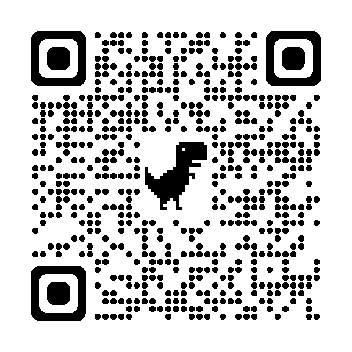
About me
Kellyn Gorman
Multiplatform and AI Advocate
https:dbakevlar.com

Slide 3

Agenda
Foundations of Modern CI/CD
Leveraging AI in CI/CD Pipelines
Security and Governance
Key Practices and Patterns
Demo and Walkthrough
Q&A and Takeaways

Slide 4
Discussion vs. Demo
Enterprise is EXPECTED
Policy and governance first, solutions and tools later
Cost is what I hear about most often, so…
This is a VIBE CODE – seriously…

Slide 5
Foundations of Modern CI/CD
Principles: Continuous Integration and Delivery
Key tools for SCM, CI/CD, Testing, and Observability
Automation as the backbone of modern pipelines
Notes:
Foundations of Modern CI/CD
Continuous Integration (CI): Frequent integration of code changes to a shared repository, enabling early detection of issues.
Continuous Delivery/Deployment (CD): Automated build, test, and release pipelines ensure rapid, reliable deployments to staging or production.
Shift-Left Mindset: Testing, security, and compliance integrated earlier in the development lifecycle.
Feedback Loops: Fast feedback to developers for quick remediation and improvement.
Key Tools Across the Pipeline
Source Code Management (SCM)
Git-based platforms: GitHub, GitLab, Bitbucket, Azure Repos
CI/CD Orchestration
Jenkins, GitHub Actions, GitLab CI/CD, Azure DevOps Pipelines, CircleCI, Argo CD, Tekton
Testing & Quality
Unit & Integration: JUnit, NUnit, PyTest
API Testing: Postman, Karate, RestAssured
Security & Compliance: Snyk, SonarQube, Checkmarx
Load & Performance: JMeter, Locust
Observability & Monitoring
Prometheus + Grafana, Datadog, PGNow, New Relic, Splunk, Redgate Monitor
Tracing & Metrics: OpenTelemetry, Jaeger
Automation as the Backbone
Automated builds, tests, and deployments minimize human error.
Infrastructure as Code (IaC) with Terraform, Pulumi, Ansible standardizes environments.
Policy-as-Code ensures compliance guardrails are embedded in pipelines.
AI-driven anomaly detection enhances proactive monitoring and pipeline optimization.

Slide 6
On-premises / Hybrid / Cloud
Cloud services are not alike (Infra vs. Services)
One solution may not be possible
Take network latency and cloud limitations into consideration
Track additional cloud costs (egress/ingress, scaling) into consideration.
Services will add simplicity and UI solutions for easier innovation.

Slide 7
Leveraging AI in CI/CD Pipelines
Predictive build and test optimization
AI-assisted code review and recommendations
Anomaly detection in pipelines and deployments
Smarter rollbacks and deployment decisions
Notes:
Predictive Build & Test Optimization
Use AI to analyze historical build/test data and predict which components need testing.
Reduce pipeline time by prioritizing high-risk changes instead of full-suite testing.
Enable parallelization and resource optimization to speed up delivery cycles.
AI-Assisted Code Review & Recommendations
Automated static analysis and code quality suggestions using AI models. ******
Context-aware recommendations for refactoring, security, or performance improvements. ****
Adaptive learning from past reviews to align with team-specific coding standards.
Anomaly Detection in Pipelines & Deployments
AI-driven monitoring to detect unusual patterns in build, test, or deployment metrics.
Real-time alerts for performance regressions, security risks, or pipeline failures.
Predictive failure analysis to proactively prevent production incidents.
Smarter Rollbacks & Deployment Decisions
Risk scoring based on historical failure patterns and telemetry data.
AI-driven canary or blue/green deployment recommendations for safer rollouts. ******
Automated rollback triggers when KPIs or error rates exceed learned thresholds. *****

Slide 8
Security and Governance
Ensure that AI governance and policy is in place BEFORE integration of AI into platforms/software.
Mitigating AI-related vulnerabilities
Ensuring model integrity and compliance
Zero Trust pipelines
Policy-as-Code and automated compliance checks
https://dev.to/tylerauerbeck/using-open-policy-agent-and-conftest-to-validate-your-openshift-4-ipi-configuration-3n6o
Notes:
Mitigating AI-Related Vulnerabilities
Scan AI models and dependencies for known vulnerabilities and malicious code.
Secure training data to prevent poisoning attacks or leakage of sensitive information.
Monitor AI pipelines for shadow AI or unauthorized model usage.
Ensuring Model Integrity & Compliance
Implement version control for models and datasets to track changes and provenance.
Use checksums, signatures, and attestation for model artifacts to ensure authenticity. ****this is more workflow, current capabilities, not so much AI
Maintain auditable logs for training, validation, and deployment events to meet regulatory requirements.
Zero-Trust Pipelines
Enforce strict identity and access controls for every step in the pipeline. ***this is a hard one
Require multi-factor authentication (MFA) and least-privilege roles for CI/CD access.
Isolate workloads and secrets using vaults and secure service mesh frameworks.
Policy as Code & Automated Compliance
Codify security and governance rules with tools like OPA (Open Policy Agent) or Conftest.
Run automated compliance checks during builds and deployments to enforce policies in real time.
Continuously validate regulatory adherence (GDPR, SOX, HIPAA, etc.) through automated audits and reports.

Slide 9
Key Practices and Patterns
GitOps for declarative pipelines
Infrastructure as Code with Terraform, Pulumi, Bicep or scripting solutions.
Progressive delivery: Canary and blue-green deployments
Feature flag strategies are beneficial.
https://learn.microsoft.com/en-us/devops/deliver/what-is-infrastructure-as-code
Notes:
GitOps Foundations
Single Source of Truth: Store application code, pipeline definitions, and infrastructure configs in Git.
Declarative Pipelines: Ensure every environment state is described in version-controlled manifests.
Automated Reconciliation: Use tools like Argo CD or Flux to continuously sync the desired state.
Auditability: Every change is tracked via commits, enabling full traceability and rollback.
Infrastructure as Code (IaC)
Use IaC frameworks like Terraform, Pulumi, or Bicep to provision cloud, hybrid, or on-prem environments.
Modular templates allow consistent, reusable infrastructure deployments.
Validation and linting integrated into pipelines to catch misconfigurations early.
Apply policy-as-code to enforce compliance and security guardrails.
Progressive Delivery Strategies
Canary Deployments: Gradually release changes to a small percentage of users to validate stability.
Blue-Green Deployments: Maintain parallel production environments for seamless rollbacks.
Use automated metrics monitoring (via Prometheus, Datadog, etc.) to decide when to promote or roll back releases.
Feature Flag Strategies
Implement feature toggles for controlled, incremental releases without redeploying.
Enable A/B testing and dark launches to validate functionality before full rollout.
Integrate feature flags with CI/CD pipelines to decouple feature deployment from code release.
Use platforms like LaunchDarkly, Unleash, or Flipt for governance and analytics.

Slide 10
The Challenges of Incorporating AI
Capability Understanding
Goals
Cost
Trust
Notes:
Everyone has an AI option
Is it the right one?
Foundation of AI governance and policy
Differences between shadow AI and authorized AI

Slide 11
New AI POV…

Slide 12
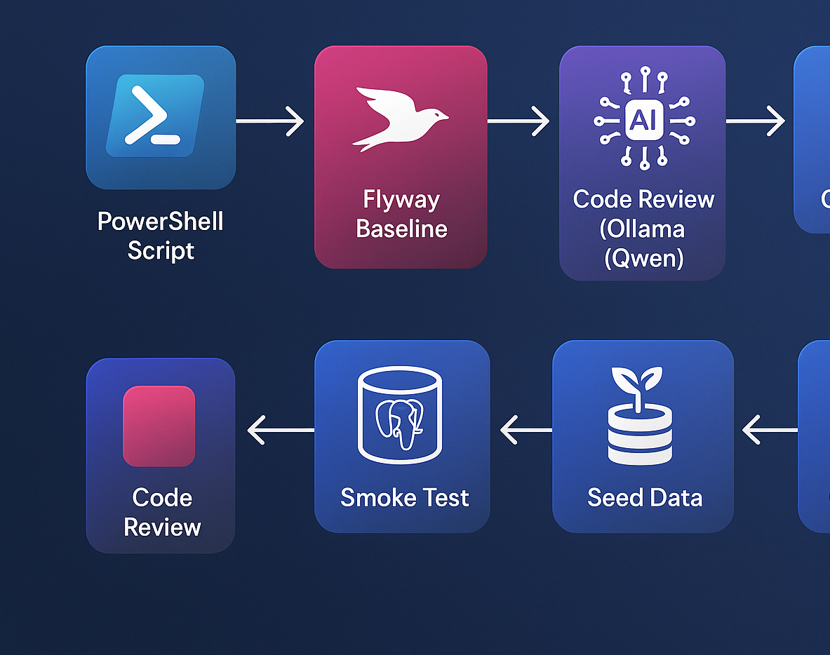
Example Workflow
Notes:
Source code retained in Github or other Git repository.
AI checks code and reviews, only promoting those to build & test which meet requirements.
From the build and test, anomaly detection, if detected, will alert and release will fail and rollback.
For my demo, I did all scripting in Powershell and SQL.

Slide 13
Demo Walkthrough
Baseline DB → AI-assisted code review → Automated testing
AI anomaly detection → Smoke Test → Review Code Review/Output
No cloud, terraform, OpenAI but could be easily adapted.

Slide 14
Demo Environment
Ollama on Windows 11 Laptop
Qwen 2.5 Coder LLM
Postgres 17.5 on laptop
Flyway Teams and CLI
Powershell and SQL scripts
Only CPU laptop- No GPU, tokens, etc.

Slide 15

Demo
Scripts and Demo Sheet Available at: http://github.com/Dbakevlar/Presentations2025/

Slide 16
So What Did I Do for the Demo?
This is stand alone- The LLM is downloaded and once downloaded, it is being run “offline” mode.
Removes many concerns around risking critical data unintentionally.
Demonstrates AI can be done quite efficiently and with little resources.
It addressed a problem that existed vs. trying to find a solution for AI.

Slide 17
Key Takeaways
Automate everything, with governance baked in
Balance AI innovation with security and compliance
Use observability for smarter, safer decisions
Start small, scale responsibly

Slide 18
Q&A
Kellyn Gorman
Engineer and Advocate, Redgate
Kellyn.Gorman@redgate.com
https://dbakevlar.com

Slide 19
References
Ollama for Windows: https://ollama.com/download/windows
Flyway Teams and CLI: https://www.red-gate.com/hub/product-learning/flyway/automating-flyway-desktop-development
Postgres on Windows: https://www.postgresql.org/download/windows/
The qwen LLM (I use 2.5 to keep it very lightweight): https://huggingface.co/Qwen
Optimizing Ollama with Windows 11: https://www.sqlservercentral.com/editorials/using-ollama-on-windows-11-as-an-alternative-to-public-llms
All code can be found here: https://github.com/Dbakevlar/Presentations2025

