Slide 1

Coffee Sales: A
Comprehensive
Dashboard
Optimizing coffee sales involves understanding market trends and consumer preferences. This presentation will explore a comprehensive dashboard analysis to enhance sales strategies. We will focus on key metrics, customer insights, and actionable recommendations to drive profitability

Slide 2
Introduction
Analyzing market trends is crucial for identifying opportunities. Key factors include consumer behavior and coffee varieties.
Understanding these trends allows businesses to adapt their strategies and meet customer demands effectively.

Slide 3

Key
Performance
Indicators
To measure success, we must track Key Performance Indicators (KPIs) such as total sales value over the years, coffee types and their sales over time, and loyalty card customers who are the main contributors to sales.
These metrics provide insights into business performance and help identify areas for improvement.

Slide 4
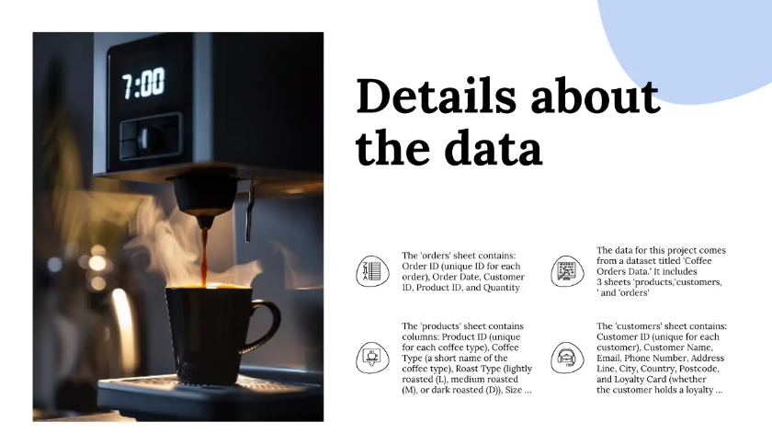
Key
Performance
Indicators
To measure success, we must track Key Performance Indicators (KPIs) such as total sales value over the years, coffee types and their sales over time, and loyalty card customers who are the main contributors to sales. These metrics provide insights into business performance and help identify areas for improvement

Slide 5
The Dashboard

Slide 6
Interactivity and the main file
The interactive dashboard includes several controls to enhance data exploration and analysis: 1) Timeline: A timeline filter allows users to examine sales data over specific periods, enabling trend analysis over time.
2) Slicers: Three slicers are incorporated into the dashboard:
a) Size of Coffee Packages: Filter data based on different coffee package sizes.
b) Different Coffee Types: Narrow down the data to specific coffee types to compare their performance.
c) Loyalty Card Holders: Distinguish between sales data from loyalty card holders and non-holders.
All these controls dynamically adjust the visuals on the dashboard, providing a comprehensive and user-friendly experience for deeper insights into coffee sales trends and customer preferences. The main file with the dashboard -

Slide 7
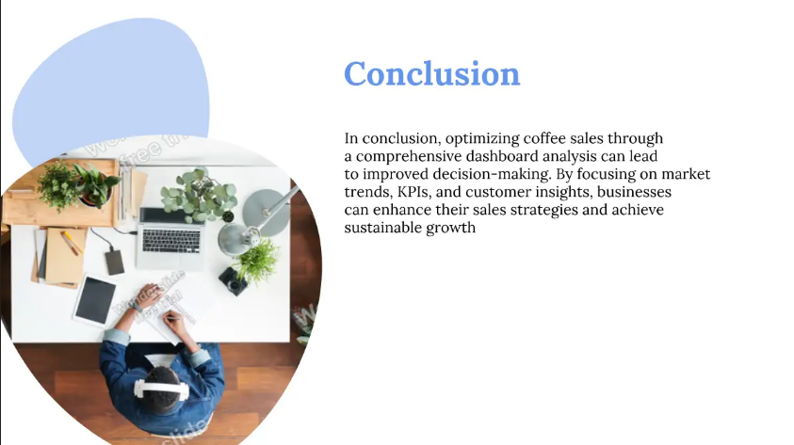

Key
Performance
Indicators
To measure success, we must track Key Performance Indicators (KPIs) such as total sales value over the years, coffee types and their sales over time, and loyalty card customers who are the main contributors to sales. These metrics provide insights into business performance and help identify areas for improvement

Slide 8
Thank you!
Debojyoti Balial
dbalial@yahoo.com
9073395920
www.linkedin.com/in/debojyoti-balial

