Slide 1
Unit 4
RESOURCE MANAGEMENT AND SECURITY IN CLOUD
Inter Cloud Resource Management – Resource Provisioning and Resource Provisioning Methods – Global Exchange of Cloud Resources – Security Overview – Cloud Security Challenges –Software-as-a-Service Security – Security Governance – Virtual Machine Security – IAM –Security Standards.

Slide 2
INTER-CLOUD RESOURCE MANAGEMENT

Slide 3
Intercloud or 'cloud of clouds' is a term refer to a theoretical model for cloud computing services based on the idea of combining many different individual clouds into one seamless mass in terms of on-demand operations.
The Intercloud would simply make sure that a cloud could use resources beyond its reach, by taking advantage of pre-existing contracts with other cloud providers.
The Intercloud scenario is based on the key concept that each single cloud does not have infinite physical resources or ubiquitous geographic footprint. If a cloud saturates the computational and storage resources of its infrastructure, or is requested to use resources in a geography where it has no footprint, it would still be ableto satisfy such requests for service allocations sent from its clients.

Slide 4
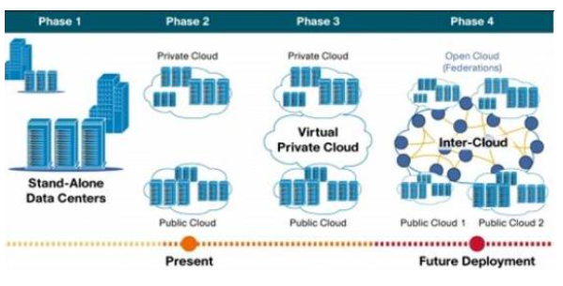

Slide 5
The Intercloud scenario would address such situations where each cloud would use the computational, storage, or any kind of resource (through semantic resource descriptions, and open federation) of the infrastructures of other clouds.
This is analogous to the way the Internet works, in that a service provider, to which an endpoint is attached, will access or deliver traffic from/to source/destination addresses outside of its service area by using Internet routing protocols with other service providers with whom it has a pre-arranged exchange or peering relationship.
It is also analogous to the way mobile operators implement roaming and inter-carrier interoperability. Such forms of cloud exchange, peering, or roaming may introduce new business opportunities among cloud providers if they manage to go beyond the theoretical framework.

Slide 6
Real time Example
IBM researchers are working on a solution that they claim can seamlessly store and move data across multiple cloud platforms in real time. The firm thinks that the technology will help enterprises with service reliability concerns. On top of this, they hope to “cloud-enable” almost any digital storage product.
Researchers at IBM have developed a “drag-and-drop” toolkit that allows users to move file storage across almost any cloud platform. The company cloud would host identity authentication and encryption technologies as well as other security systems on an external cloud platform (the ‘InterCloud Store’) to keep each cloud autonomous, while also keeping them synced together.

Slide 7
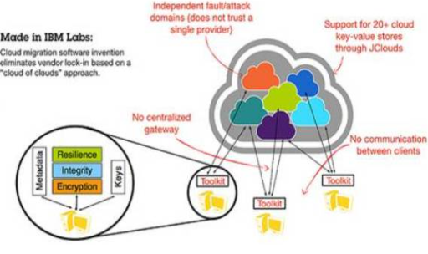

Slide 8
cloud-of-clouds invention can help avoid service outrages due to the fact it can tolerate crashes of any number of clients. It would do this using the independence of multiple clouds linked together to increase overall reliability.
Storage services don’t communicate directly with each other but instead go through the larger cloud for authentication. Data is encrypted as it leaves one station and decrypted before it reaches the next. If one cloud happens to fail, a back-up cloud responds immediately.
The cloud-of-clouds is also intrinsically more secure: “If one provider gets hacked there is little chance they will penetrate other systems at the same time using the same vulnerability.” Alessandro Sorniotti, cloud storage scientist at IBM and one of the researchers, says. “From the client perspective, we will have the most available and secure storage system.”

Slide 9
Resource Provisioning and Resource Provisioning Methods

Slide 10
Resource Provisioning and Platform Deployment
The emergence of computing clouds suggests fundamental changes in software and hardware architecture. Cloud architecture puts more emphasis on the number of processor cores or VM instances. Parallelism is exploited at the cluster node level.
Here they describing
The techniques to provision computer resources or VMs.
Storage allocation schemes to interconnect distributed computing infrastructures by harnessing the VMs dynamically.

Slide 11
Provisioning of Compute Resources (VMs)
Providers supply cloud services by signing SLAs with end users.
The SLAs must commit sufficient resources such as CPU, memory, and bandwidth that the user can use for a preset period.
Under provisioning of resources will lead to broken SLAs and penalties.
Over provisioning of resources will lead to resource underutilization, and consequently, a decrease in revenue for the provider.
Deploying an autonomous system to efficiently provision resources to users is a challenging problem.
The difficulty comes from the unpredictability of consumer demand, software and hardware failures, heterogeneity of services, power management, and conflicts in signed SLAs between consumers and service providers.

Slide 12
Efficient VM provisioning depends on the cloud architecture and management of cloud infrastructures.
Resource provisioning schemes also demand fast discovery of services and data in cloud computing infrastructures.
In a virtualized cluster of servers, this demands efficient installation of VMs, live VM migration, and fast recovery from failures.
To deploy VMs, users treat them as physical hosts with customized operating systems for specific applications. For example, Amazon’s EC2 uses Xen as the virtual machine monitor (VMM). The same VMM is used in IBM’s Blue Cloud.

Slide 13
In the EC2 platform, some predefined VM templates are also provided. Users can choose different kinds of VMs from the templates.
IBM’s Blue Cloud does not provide any VM templates. In general, any type of VM can run on top of Xen.
Microsoft also applies virtualization in its Azure cloud platform. The provider should offer resource-economic services.
Power-efficient schemes for caching, query pro-cessing, and thermal management are mandatory due to increasing energy waste by heat dissipation from data centers.
Public or private clouds promise to streamline the on-demand provisioning of soft-ware, hardware, and data as a service, achieving economies of scale in IT deployment and operation.

Slide 14
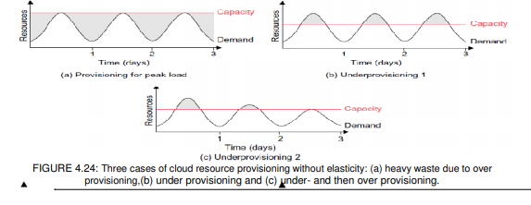
Resource Provisioning Methods

Slide 15
Figure shows three cases of static cloud resource provisioning policies.
In case (a), over provisioning with the peak load causes heavy resource waste (shaded area).
In case (b), under provisioning (along the capacity line) of resources results in losses by both user and provider in that paid demand by the users (the shaded area above the capacity) is not served and wasted resources still exist for those demanded areas below the provisioned capacity.
In case (c), the constant provisioning of resources with fixed capacity to a declining user demand could result in even worse resource waste. The user may give up the service by canceling the demand, resulting in reduced revenue for the provider. Both the user and provider may be losers in resource provisioning without elasticity

Slide 16
Three resource-provisioning methods are presented in the following sections.
The demand-driven method provides static resources and has been used in grid computing for many years.
The event driven method is based on predicted workload by time.
The popularity-driven method is based on Internet traffic monitored.

Slide 17
Demand-Driven Resource Provisioning
This method adds or removes computing instances based on the current utilization level of the allocated resources.
The demand-driven method automatically allocates two Xeon processors for the user application, when the user was using one Xeon processor more than 60 percent of the time for an extended period.
In general, when a resource has surpassed a threshold for a certain amount of time, the scheme increases that resource based on demand. When a resource is below a threshold for a certain amount of time, that resource could be decreased accordingly.
Amazon implements such an auto-scale feature in its EC2 platform. This method is easy to implement. The scheme does not work out right if the workload changes abruptly.

Slide 18
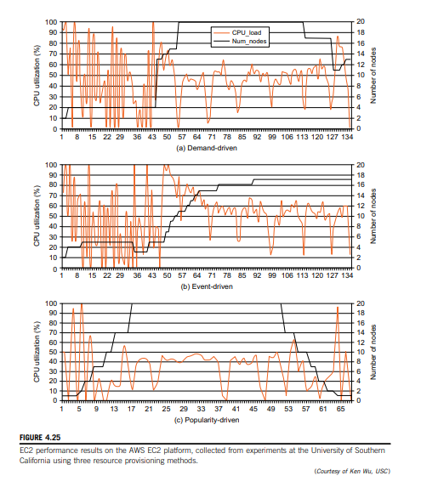

Slide 19
The x-axis in Figure 4.25 is the time scale in milliseconds. In the beginning, heavy fluctuations of CPU load are encountered.
All three methods have demanded a few VM instances initially.
Gradually, the utilization rate becomes more stabilized with a maximum of 20 VMs (100 percent utilization) provided for demand-driven provisioning in Figure 4.25(a).
However, the event-driven method reaches a stable peak of 17 VMs toward the end of the event and drops quickly in Figure 4.25(b).
The popularity provisioning shown in Figure 4.25(c) leads to a similar fluctuation with peak VM utilization in the middle of the plot

Slide 20
Event-Driven Resource Provisioning
This scheme adds or removes machine instances based on a specific time event.
The scheme works better for seasonal or predicted events such as Christmastime in the West and the Lunar New Year in the East.
During these events, the number of users grows before the event period and then decreases during the event period.
This scheme anticipates peak traffic before it happens. The method results in a minimal loss of QoS, if the event is predicted correctly. Otherwise, wasted resources are even greater due to events that do not follow a fixed pattern.

Slide 21
Popularity-Driven Resource Provisioning
In this method, the Internet searches for popularity of certain applications and creates the instances by popularity demand.
The scheme anticipates increased traffic with popularity. Again, the scheme has a minimal loss of QoS, if the predicted popularity is correct.
Resources may be wasted if traffic does not occur as expected. In Figure 4.25(c), EC2 performance by CPU utilization rate (the dark curve with the percentage scale shown on the left) is plotted against the number of VMs provisioned (the light curves with scale shown on the right, with a maximum of 20 VMs provisioned).

Slide 22
Dynamic Resource Deployment
The cloud uses VMs as building blocks to create an execution environment across multiple resource sites.
The Inter-Grid-managed infrastructure was developed by a Melbourne University group. Dynamic resource deployment can be implemented to achieve scalability in performance.
The Inter-Grid is a Java-implemented software system that lets users create execution cloud environments on top of all participating grid resources.
Peering arrangements established between gateways enable the allocation of resources from multiple grids to establish the execution environment

Slide 23
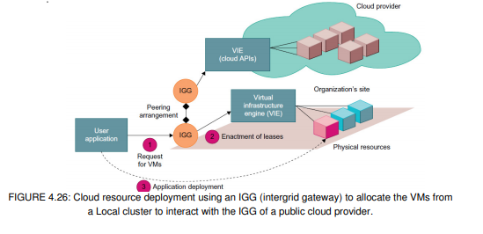

Slide 24
In Figure 4.26, a scenario is illustrated by which an inter-grid gateway (IGG) allocates resources from a local cluster to deploy applications in three steps:
(1) requesting the VMs,
(2) enacting the leases, and
(3) deploying the VMs as requested. Under peak demand, this IGG interacts with another IGG that can allocate resources from a cloud computing provider

Slide 25
A grid has predefined peering arrangements with other grids, which the IGG manages. Through multiple IGGs, the system coordinates the use of InterGrid resources.
An IGG is aware of the peering terms with other grids, selects suitable grids that can provide the required resources, and replies to requests from other IGGs.
Request redirection policies determine which peering grid InterGrid selects to process a request and a price for which that grid will perform the task.
An IGG can also allocate 40 resources from a cloud provider.
The cloud system creates a virtual environment to help users deploy their applications. These applications use the distributed grid resources.

Slide 26
The InterGrid allocates and provides a distributed virtual environment (DVE).
This is a virtual cluster of VMs that runs isolated from other virtual clusters.
A component called the DVE manager performs resource allocation and management on behalf of specific user applications.
The core component of the IGG is a scheduler for implementing provisioning policies and peering with other gateways.
The communication component provides an asynchronous message-passing mechanism.
Received messages are handled in parallel by a thread pool.

Slide 27
Provisioning of Storage Resources
The data storage layer is built on top of the physical or virtual servers.
As the cloud computing applications often provide service to users, it is unavoidable that the data is stored in the clusters of the cloud provider.
The service can be accessed anywhere in the world.
One example is e-mail systems. A typical large e-mail system might have millions of users and each user can have thousands of e-mails and consume multiple gigabytes of disk space.
Another example is a web searching application.
In storage technologies, hard disk drives may be augmented with solid-state drives in the future. This will provide reliable and high-performance data storage. The biggest barriers to adopting flash memory in data centers have been price, capacity, and, to some extent, a lack of sophisticated query-processing techniques. However, this is about to change as the I/O bandwidth of solid-state drives becomes too impressive to ignore.

Slide 28
A distributed file system is very important for storing large-scale data.
However, other forms of data storage also exist. Some data does not need the namespace of a tree structure file system, and instead, databases are built with stored data files.
In cloud computing, another form of data storage is (Key, Value) pairs. Amazon S3 service uses SOAP to access the objects stored in the cloud.

Slide 29
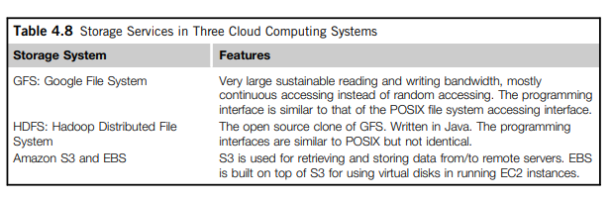
Table 4.8 outlines three cloud storage services provided by Google, Hadoop, and Amazon.

Slide 30
Many cloud computing companies have developed large-scale data storage systems to keep huge amount of data collected every day.
For example, Google’s GFS stores web data and some other data, such as geographic data for Google Earth.
A similar system from the open source community is the Hadoop Distributed File System (HDFS) for Apache. Hadoop is the open source implementation of Google’s cloud computing infrastructure.
Similar systems include Microsoft’s Cosmos file system for the cloud.

Slide 31
Despite the fact that the storage service or distributed file system can be accessed directly, similar to traditional databases, cloud computing does provide some forms of structure or semi-structure database processing capability.
For example, applications might want to process the information contained in a web page. Web pages are an example of semi-structural data in HTML format.
If some forms of database capability can be used, application developers will construct their application logic more easily.
Another reason to build a database-like service in cloud computing is that it will be quite convenient for traditional application developers to code for the cloud platform.
Databases are quite common as the underlying storage device for many applications.

Slide 32
Thus, such developers can think in the same way they do for traditional software development.
Hence, in cloud computing, it is necessary to build databases like large-scale systems based on data storage or distributed file systems.
The scale of such a database might be quite large for processing huge amounts of data.
The main purpose is to store the data in structural or semi-structural ways so that application developers can use it easily and build their applications rapidly.
Traditional databases will meet the performance bottleneck while the system is expanded to a larger scale. How-ever, some real applications do not need such strong consistency. The scale of such databases can be quite large.
Typical cloud databases include BigTable from Google, SimpleDB from Amazon, and the SQL service from Microsoft Azure

Slide 33
Global Exchange of Cloud Resources

Slide 34
In order to support a large number of application service consumers from around the world, cloud infrastructure providers (i.e., IaaS providers) have established data centers in multiple geographical locations to provide redundancy and ensure reliability in case of site failures.
For example, Amazon has data centers in the United States (e.g., one on the East Coast and another on the West Coast) and Europe. However, currently Amazon expects its cloud customers (i.e., SaaS providers) to express a preference regarding where they want their application services to be hosted.
Amazon does not provide seamless/automatic mechanisms for scaling its hosted services across multiple geographically distributed data centers.

Slide 35
This approach has many shortcomings.
First, it is difficult for cloud customers to determine in advance the best location for hosting their services as they may not know the origin of consumers of their services.
Second, SaaS providers may not be able to meet the QoS expectations of their ser-vice consumers originating from multiple geographical locations.
This necessitates building mechan-isms for seamless federation of data centers of a cloud provider or providers supporting dynamic scaling of applications across multiple domains in order to meet QoS targets of cloud customers

Slide 36
In addition, no single cloud infrastructure provider will be able to establish its data centers at all possible locations throughout the world.
As a result, cloud application service (SaaS) providers will have difficulty in meeting QoS expectations for all their consumers.
Hence, they would like to make use of services of multiple cloud infrastructure service providers who can provide better support for their specific consumer needs.
This kind of requirement often arises in enterprises with global operations and applications such as Internet services, media hosting, and Web 2.0 applications.
This necessitates federation of cloud infrastructure service providers for seamless provisioning of services across different cloud providers.
To realize this, the Cloudbus Project at the University of Melbourne has proposed InterCloud architecture sup-porting brokering and exchange of cloud resources for scaling applications across multiple clouds.

Slide 37
By realizing InterCloud architectural principles in mechanisms in their offering, cloud providers will be able to dynamically expand or resize their provisioning capability based on sudden spikes in workload demands by leasing available computational and storage capabilities from other cloud service providers; operate as part of a market-driven resource leasing federation, where application service providers such as Salesforce.com host their services based on negotiated SLA contracts driven by competitive market prices; and deliver on-demand, reliable, cost-effective, and QoS-aware services based on virtualization technologies while ensuring high QoS standards and minimizing service costs.
They need to be able to utilize market based utility models as the basis for provisioning of virtualized software services and federated hardware infrastructure among users with heterogeneous applications.

Slide 38
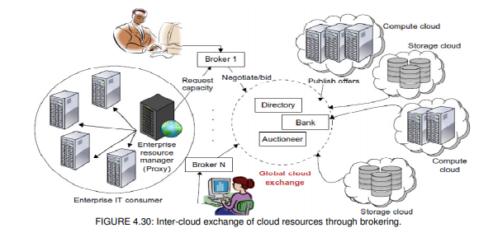

Slide 39
They consist of client brokering and coordinator services that support utility-driven federation of clouds: application scheduling, resource allocation, and migration of workloads.
The architecture cohesively couples the administratively and topologically distributed storage and compute capabilities of clouds as part of a single resource leasing abstraction.
The system will ease the crossdomain capability integration for on-demand, flexible, energy-efficient, and reliable access to the infrastructure based on virtualization technology.
The Cloud Exchange (CEx) acts as a market maker for bringing together service producers and consumers. It aggregates the infrastructure demands from application brokers and evaluates them against the available supply currently published by the cloud coordinators.

Slide 40
It supports trading of cloud services based on competitive economic models such as commodity markets and auctions.
CEx allows participants to locate providers and consumers with fitting offers. Such markets enable services to be commoditized, and thus will pave the way for creation of dynamic market infrastructure for trading based on SLAs.
An SLA specifies the details of the service to be provided in terms of metrics agreed upon by all parties, and incentives and penalties for meeting and violating the expectations, respectively.
The availability of a banking system within the market ensures that financial transactions pertaining to SLAs between participants are carried out in a secure and dependable environment

Slide 41
Security overview

Slide 42
cloud service providers are leveraging virtualization technologies combined with self-service capabilities for computing resources via the Internet.
In these service provider environments, virtual machines from multiple organizations have to be co-located on the same physical server in order to maximize the efficiencies of virtualization.
Cloud service providers must learn from the managed service provider (MSP) model and ensure that their customers’ applications and data are secure if they hope to retain their customer base and competitiveness.
Today, enterprises are looking toward cloud computing horizons to expand their on-premises infrastructure, but most cannot afford the risk of compromising the security of their applications and data

Slide 43
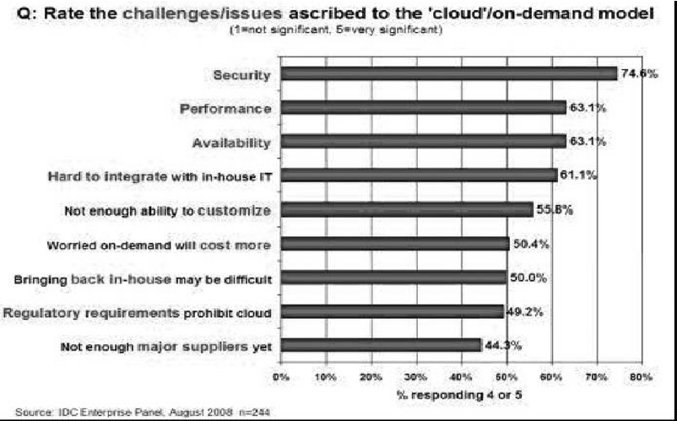
For example, IDC recently conducted a survey1 (see Figure 6.1) of 244 IT executives/CIOs and their line-of-business (LOB) colleagues to gauge their opinions and understand their companies’ use of IT cloud services. Security ranked first as the greatest challenge or issue of cloud computing.

Slide 44
Cloud Security Challenges

Slide 45
Lack of Visibility and Control
Relating to both public and hybrid cloud environments, the loss of overall service visibility and the associated lack of control can be a problem.
Whether you’re dealing with public or hybrid cloud environments, a loss of visibility in the cloud can mean a loss of control over several aspects of IT management and data security. Where legacy style in-house infrastructure was entirely under the control of the company, cloud services delivered by third-party providers don’t offer the same level of granularity with regards to administration and management.
When it comes to visualizing potential security vulnerabilities, this lack of visibility can lead to a business failing to identify potential risks. In some sectors, such as media, cloud adoption is as low as 17%, which has been blamed on this lack of visibility and control.

Slide 46
Data Breaches and Downtime
Despite the fact that generally speaking, enterprise-grade cloud services are more secure than legacy architecture, there is still a potential cost in the form of data breaches and downtime. With public and private cloud offerings, resolving these types of problems is in the hands of the third-party provider. Consequently, the business has very little control over how long critical business systems may be offline, as well as how well the breach is managed.
In the 12th annual Cost of Data Breach Study, sponsored by IBM, it was found that the global cost of data breaches amounted to $3.62 million, so we can see how this particular issue is a major one with regard to cloud adoption.

Slide 47
Vendor Lock-In
For companies that come to rely heavily on public and hybrid cloud platforms, there is a danger that they become forced to continue with a specific third-party vendor simply to retain operational capacity. If critical business applications are locked into a single vendor, it can be very difficult to make tactical decisions such as moving to a new vendor. In effect, the vendor is being provided with the leverage it needs to force the customer into an unfavourable contract.
Logicworks recently performed a survey that found showed that some 78% of IT decision makers blame the fear of vendor lock-in as a primary reason for their organization failing to gain maximum value from cloud computing.

Slide 48
Compliance Complexity
In sectors such as healthcare and finance, where legislative requirements with regard to storage of private data are heavy, achieving full compliance whilst using public or private cloud offerings can be more complex.
Many enterprises attempt to gain compliance by using a cloud vendor that is deemed fully compliant. Indeed, data shows that some 51% of firms in the USA rely on nothing more than a statement of compliance from their cloud vendor as confirmation that all legislative requirements have been met.
But what happens when at a later stage, it is found that the vendor is not actually fully compliant? The client company could find itself facing non-compliance, with very little control over how the problem can be resolved.

Slide 49
A Lack of Transparency
When a business buys in third-party cloud services as either a public or hybrid cloud offering, it is likely they will not be provided with a full service description, detailing exactly how the platform works, and the security processes the vendor operates.
This lack of service transparency makes it hard for customers to intelligently evaluate whether their data is being stored and processed securely at all times. Surveys have shown that around 75% of IT managers are only marginally confident that company data is being stored securely by their cloud vendor.

Slide 50
Insecure Interfaces and APIs
Cloud vendors provide their customers with a range of Application Programming Interfaces (APIs), which the customer uses to manage the cloud service.
Unfortunately, not every API is entirely secure. They may have been deemed to be initially, and then at a later stage be found to be insecure in some way. This problem is compounded when the client company has built its own application layer on top of these APIs. The security vulnerability will then exist in the customer’s own application. This could be an internal application, or even a public facing application potentially exposing private data.

Slide 51
Insufficient Due Diligence
For companies that lack the internal resources to fully evaluate the implications of cloud adoption, then the risk of deploying a platform that is ineffective and even insecure is real.
Responsibility for specific issues of data security needs to be fully defined before any deployment. Failing to do so could lead to a situation where there is no clearly defined way to deal with potential risks and solve current security vulnerabilities.
Shared Technology Vulnerabilities
Using public or hybrid cloud offerings can expose a business to security vulnerabilities caused by other users of the same cloud infrastructure.
The onus is upon the cloud vendor to see that this does not happen, yet no vendor is perfect. It is always possible that a security vulnerability caused by another user in the same cloud will affect every user.

Slide 52
Other Potential Threats
Alongside the potential security vulnerabilities relating directly to the cloud service, there are also a number of external threats which could cause an issue. Some of these are:
Man in the Middle attacks – where a third party manages to become a relay of data between a source and a destination. If this is achieved, the data being transmitted can be altered.
Distributed Denial of Service – a DDoS attack attempts to knock a resource offline by flooding it with too much traffic.
Account or Service Traffic Hijacking – a successful attack of this kind could provide an intruder with passwords or other access keys which allow them access to secure data.

Slide 53
Software-as-a-Service Security

Slide 54
Cloud computing models of the future will likely combine the use of SaaS (and other XaaS’s as appropriate), utility computing, and Web 2.0 collaboration technologies to leverage the Internet to satisfy their customers’ needs.
New business models being developed as a result of the move to cloud computing are creating not only new technologies and business operational processes but also new security requirements and challenges as described previously.

Slide 55
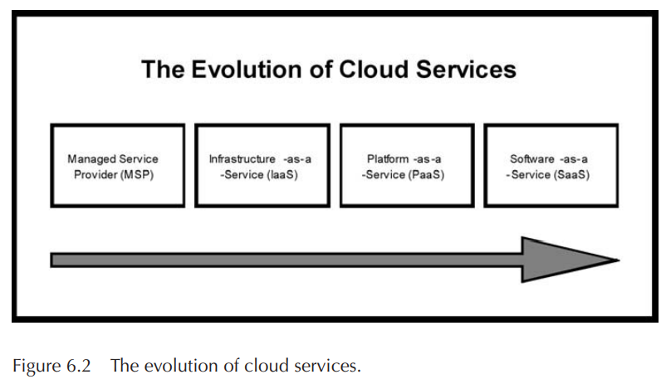
As the most recent evolutionary step in the cloud service model (see Figure 6.2), SaaS will likely remain the dominant cloud service model for the foreseeable future and the area where the most critical need for security practices and oversight will reside.

Slide 56
Just as with an managed service provider, corporations or end users will need to research vendors’ policies on data security before using vendor services to avoid losing or not being able to access their data.
The technology analyst and consulting firm Gartner lists seven security issues which one should discuss with a cloud-computing vendor:
Privileged user access—Inquire about who has specialized access to data, and about the hiring and management of such administrators.
Regulatory compliance—Make sure that the vendor is willing to undergo external audits and/or security certifications.
Data location—Does the provider allow for any control over the location of data?

Slide 57
Data segregation—Make sure that encryption is available at all stages, and that these encryption schemes were designed and tested by experienced professionals.
Recovery—Find out what will happen to data in the case of a disaster. Do they offer complete restoration? If so, how long would that take?
Investigative support—Does the vendor have the ability to investigate any inappropriate or illegal activity?
Long-term viability—What will happen to data if the company goes out of business? How will data be returned, and in what format?

Slide 58
Determining data security is harder today, so data security functions have become more critical than they have been in the past.
A tactic not covered by Gartner is to encrypt the data yourself. If you encrypt the data using a trusted algorithm, then regardless of the service provider’s security and encryption policies, the data will only be accessible with the decryption keys.
Of course, this leads to a follow-on problem: How do you manage private keys in a pay-on-demand computing infrastructure?
To address the security issues listed above along with others mentioned earlier in the chapter, SaaS providers will need to incorporate and enhance security practices used by the managed service providers and develop new ones as the cloud computing environment evolves

Slide 59
Security Governance

Slide 60
What Is Cloud Security Governance?
Cloud security governance refers to the management model that facilitates effective and efficient security management and operations in the cloud environment so that an enterprise’s business targets are achieved. This model incorporates a hierarchy of executive mandates, performance expectations, operational practices, structures, and metrics that, when implemented, result in the optimization of business value for an enterprise.
Cloud security governance helps answer leadership questions such as:
Are our security investments yielding the desired returns?
Do we know our security risks and their business impact ?
Are we progressively reducing security risks to acceptable levels?
Have we established a security-conscious culture within the enterprise?

Slide 61
Key Objectives for Cloud Security Governance
Building a cloud security governance model for an enterprise requires strategic-level security management competencies in combination with the use of appropriate security standards and frameworks (e.g., NIST, ISO, CSA) and the adoption of a governance framework (e.g., COBIT).
The first step is to visualize the overall governance structure, inherent components, and to direct its effective design and implementation.
The use of appropriate security standards and frameworks allow for a minimum standard of security controls to be implemented in the cloud, while also meeting customer and regulatory compliance obligations where applicable.
A governance framework provides referential guidance and best practices for establishing the governance model for security in the cloud.

Slide 62
The following represents key objectives to pursue in establishing a governance model for security in the cloud. These objectives assume that appropriate security standards and a governance framework have been chosen based on the enterprise’s business targets, customer profile, and obligations for protecting data and other information assets in the cloud environment.
Strategic Alignment
Enterprises should mandate that security investments, services, and projects in the cloud are executed to achieve established business goals (e.g., market competitiveness, financial, or operational performance).
Value Delivery
Enterprises should define, operationalize, and maintain an appropriate security function/organization with appropriate strategic and tactical representation, and charged with the responsibility to maximize the business value (Key Goal Indicators, ROI) from the pursuit of security initiatives in the cloud.

Slide 63
Risk Mitigation
Security initiatives in the cloud should be subject to measurements that gauge effectiveness in mitigating risk to the enterprise (Key Risk Indicators). These initiatives should also yield results that progressively demonstrate a reduction in these risks over time.
Effective Use of Resources
It is important for enterprises to establish a practical operating model for managing and performing security operations in the cloud, including the proper definition and operationalization of due processes, the institution of appropriate roles and responsibilities, and use of relevant tools for overall efficiency and effectiveness.
Sustained Performance
Security initiatives in the cloud should be measurable in terms of performance, value and risk to the enterprise (Key Performance Indicators, Key Risk Indicators), and yield results that demonstrate attainment of desired targets (Key Goal Indicators) over time.

Slide 64
Virtual Machine Security

Slide 65
Virtual Environment Security Mechanisms
The security of VM-based services rests on the assumption that the underlying trusted computing base (TCB) is also secure. If the TCB is compromised, then all bets are for the VM-based

Slide 66
Security of Virtual Machines
In a Type I virtual machine, the trusted computing base is the virtual machine monitor. Some services also need to include the dedicated secure VM as part of TCB. The TCB is considered to be secure because “It is so simple that its implementation can be reasonably expected to be correct” Virtual machine monitors are only responsible for virtualizing the physical machine’s hardware and partitioning it into logically separate virtual machines
Compared to a full operating system, which may have several million lines of code, VMMs have around 30,000 lines of code. Also, the secure VM typically has a reduced mini-OS without any unneeded services or components.
In addition to having a small code base, the interfaces to VMM and the dedicated security VM are much simpler, more constrained, and better specified than a standard operating system. This helps reduce the risk of security vulnerabilities.

Slide 67
Consider the following to provide VM security
a) Mandatory access control:
MAC component runs in a separate VM and administrator
can modify the security policy
b) Para-virtualization:.
the interface executed by the guest OS consist of three components: “memory management, CPU, and device I/O” and the guest OS is responsible for managing these resources.
c) Policy considerations
it is better to have proper guidelines and security policies which can be implemented dynamically in accordance with the change in the virtual environment.

Slide 68
d) Virtual Layer Vulnerabilities: Here the author Michael Price
[4] discusses about the layered architecture of a virtual
environment and how it play a major role in security issues.
The fact that lower level layers can have control over the upper level layers if there is any malicious code or worm infected in the upper layer of the VM environment then those can be easily removed from the lower layers. But it becomes difficult to remove the malicious code if it infects the lower layer of the VM environment.

Slide 69
Benefits
Security: An important feature of virtualization is isolation. That is software running in one VM will not interact with another VM running is the same machine This gives a lot of security benefits.
f) Intrusion protection: Here the author Michael Price [4] brings the concept of clones. He talks about Signature based intrusion detection. Here the state of a system is determined by monitoring the system activity. Here he suggests that instead of looking for the patterns on the original machines, clones can be created and the events can be monitored [4]. Clones can be run in standby mode and then can be synchronized with the real machine and then the pattern of the clone activity can be monitored [4, 15].In this manner one need not compromise the real system

Slide 70
Identity Access Management (IAM)

Slide 71
What is Identity Access Management in Cloud Computing
The concept of identity in the cloud can refer to many things, but for the purpose of this discussion, we will focus on two main entities:
users
cloud resources.
IAM policies are sets of permission policies that can be attached to either users or cloud resources to authorize what they access and what they can do with it.

Slide 72
Roles of Identity Access Management in Cloud Security
IAM is crucial to protecting sensitive enterprise systems, assets, and information from unauthorized access or use. This represents the systematic management of any single identity and provides authentication, authorization, privileges, and roles of the enterprise boundaries.
The primary goal is to upgrade security and productivity by decreasing the total cost, repetitive tasks, and system downtime. Identity access management in cloud computing covers all types of users who can work with defined devices under unlike circumstances.

Slide 73
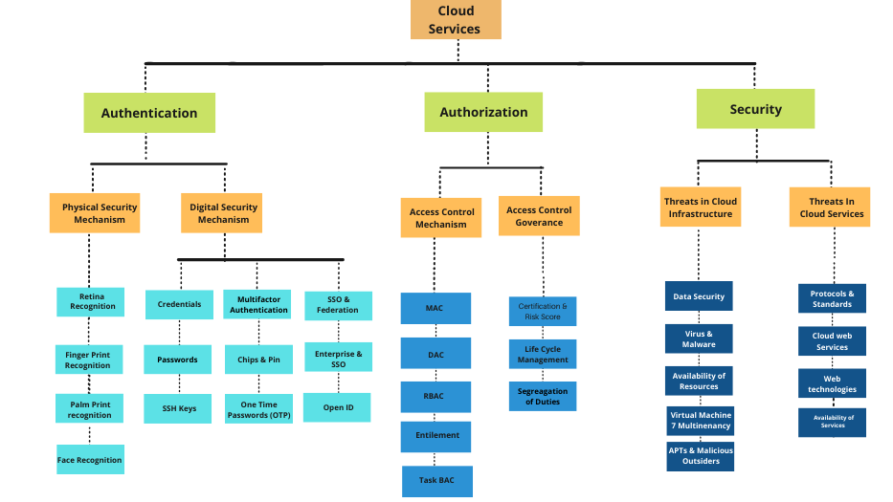

Slide 74
In a cloud system, the storage and processing of data are performed by organizations or with the help of third-party vendors. The service provider has to ensure that data and applications stored in the cloud are protected as well as the infrastructure is an insecure environment. Further, users need to verify that their credentials for authentication are secure.
There are many security issues that compromise data in the process of data access and storage in the cloud environment, especially in the case of data storage with the help of third-party vendors who themselves may be a malicious attacker. Though standards and best practices are available for overcoming such security problems, cloud service providers are reluctant in securing their network with the updated set of security standards.

Slide 75
Identity and access management is one of the best practices to measure cloud services. Presently, Identity and Access Management (IAM) provides effective security for cloud systems. IAM systems perform different operations for providing security in the cloud environment that includes authentication, authorization, and provisioning of storage and verification. IAM system guarantees the security of identities and attributes of cloud users by ensuring that the right persons are allowed in the cloud systems. IAM systems also help to manage access rights by checking if the right person with the right privileges is accessing information that is stored in cloud systems.
Currently, many organizations use Identity and Access Management systems to provide more security for sensitive information that is stored in the cloud environment.

Slide 76
How Identity Access Management can control Interactions with Data and Systems
IAM can move beyond simply allowing or blocking access to data and systems.
For example, IAM can:
Restrict access to data: Specific roles can access only necessary parts of systems, databases, and information.
Only allow view access: Users with such roles can only view data, they cannot add, update, or amend it.
Only permit access on certain platforms: Users may have access to operational systems, but not on development, testing, or PROD platforms.
Only allow access to create, amend, or delete data, not to transmit it: Some roles may not be able to send or receive data outside the system, meaning it cannot be exposed to other third parties and applications.
Based on a company’s specific requirements, there are many ways to implement IAM policies to define and enforce exactly how individual roles can access systems and data.

Slide 77
Why Identity Access Management is a Vital IT Enablement & Security Layer
IAM offers several advantages over all other traditional products. Below is the list to understand the few benefits of identity management in cloud computing:
Enhanced Network Abilities: Identity access management (IAM) makes it simple in sharing the network capabilities with a complete grid of users who were connected with it.
Support On-demand improvement: 24*7 hours support and monitoring can be provided based on need.
Increase Overall Productivity: Cloud-based services are configured and hosted by service providers. As a result, many organizations can improve their overall productivity instead of worrying about the infrastructure.
Centralized Management System: Clients can be able to manage all their services and programs at one place with the cloud-based services. Identity access management can be done with one click on a single dashboard.

Slide 78
Security Standards.

Slide 79

Cloud Security Standards: Benefits
Standards promote interoperability, reducing vendor lock-in
Standards facilitate hybrid cloud computing by making it easier to integrate on-premises security technologies with those of cloud service providers (CSPs)
Standards provide assurance that best practices are being followed both internally within an enterprise and by CSPs
Standards support provides an effective means by which cloud service customers can compare and contrast CSPs
Standards support enables an easier path to regulatory compliance
79

Slide 80
Cloud Security Standards: Current Landscape
Cloud security standards - maturing
Different types of standards need to be considered
Formal standards specific to cloud security already published
General IT security standards applicable to cloud computing
Insist that cloud service providers support these
Cloud service customers: insist on security certifications from providers
Cloud specific security certifications available today (emerging)
Existing general security certifications are applicable
Advisory Standards
Interpreted and applied to all types and sizes of organizations Flexibility: latitude to adopt information security controls that make sense to users Unsuitable for compliance testing
Examples
ISO 27002, ISO 38500, COBIT
Security Frameworks
Define specific policies, controls, checklists, procedures Define processes for examining support - auditors use to assess & measure CSP conformance Suitable for compliance testing
Examples
ISO/IEC 27001, ISO/IEC 27017, ISO/IEC 27018
Standards Specifications
Define APIs and protocols Extensibility - optional functions that go beyond those defined in standard Formal certifications not provided - compliance and interoperability test suites may be available
Examples
OAuth 2.0, SAML 2.0, SSL/TLS, X.509
6

Slide 81












10 Steps to Evaluate Cloud Security
10 Steps to Evaluate Cloud Security
Ensure effective governance, risk & compliance
Audit operational & business processes
Manage people, roles & identities
4.
5.
6.
7.
8.
9.
10.
Ensure proper protection of data & information
Enforce privacy policies
Assess the security provisions for cloud applications
Ensure cloud networks & connections are secure
Evaluate security controls on physical infrastructure & facilities
Manage security terms in the cloud service agreement
Understand the security requirements of the exit process

Slide 82




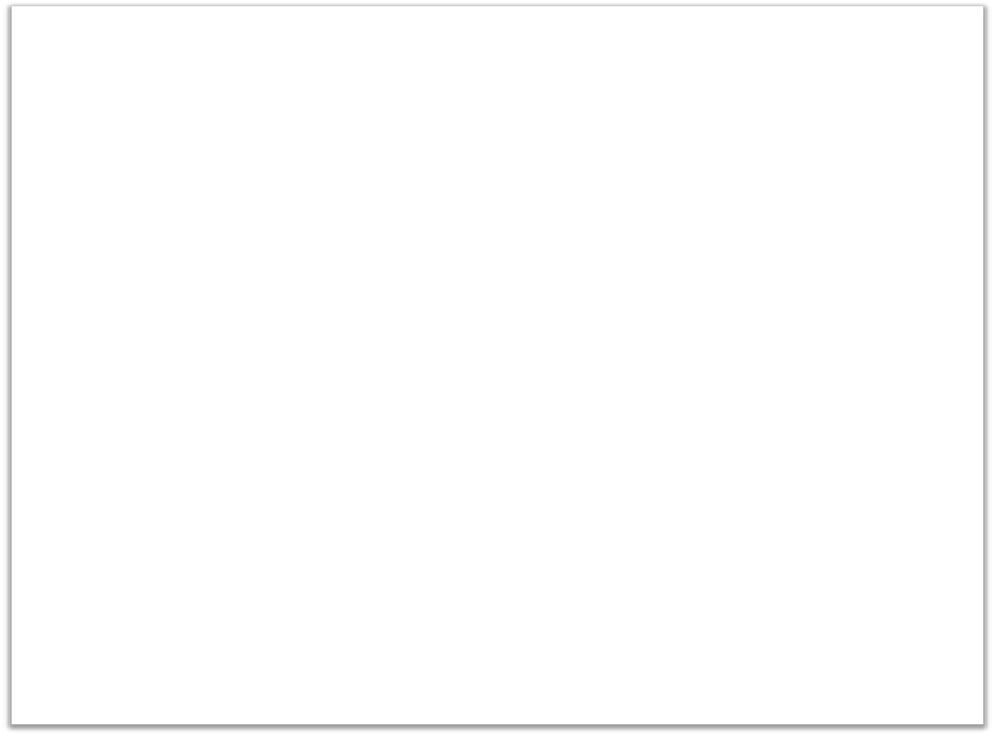


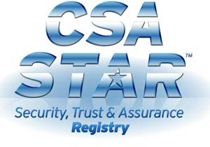
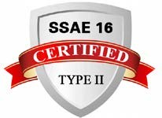





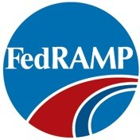

Step 1: Ensure effective governance, risk and compliance
GRC Requirements
General IT Governance Standards
Cloud computing presents different risks than traditional IT solutions
Customers must understand their risk tolerance and must focus on mitigating the risks that are most crucial to the organization
Customers must fully understand specific laws or regulations that apply to the services (data retention, privacy requirements, etc.)
Customers should be notified if any breach occurs regardless if the customer is directly impacted
CSF
Primary means to ensure application and data security is through Cloud Service Agreement
Country / Industry Standards
General IT governance standards apply to cloud
Country & industry specific governance standards also apply

Slide 83


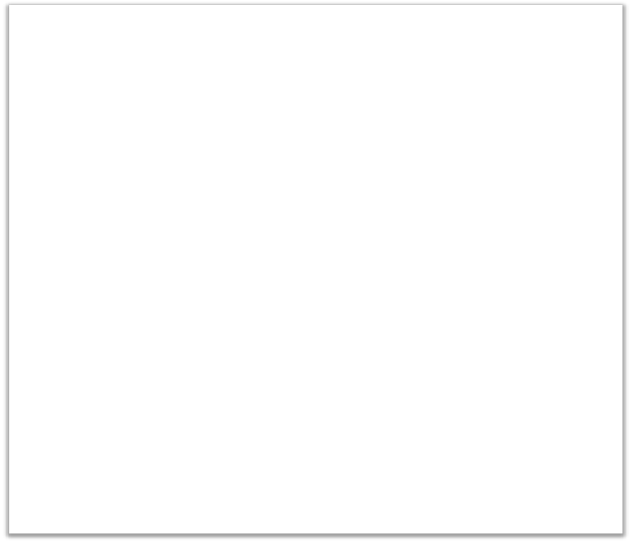
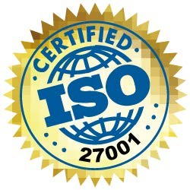
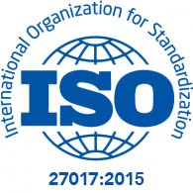
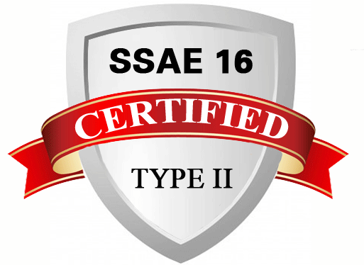
Step 2: Audit operational & business processes
Audit Requirements
Security audit of cloud service providers is essential
Security audits should be carried out by appropriately skilled staff
Security audits should leverage an established standard for security controls
Typically done as part of a formal certification process
Insist on ISO/IEC 27001 and ISO/IEC 27017 or equivalent certification
For cloud services with impact on financial activities seek SSAE 16 certification

Slide 84


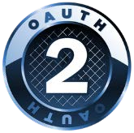
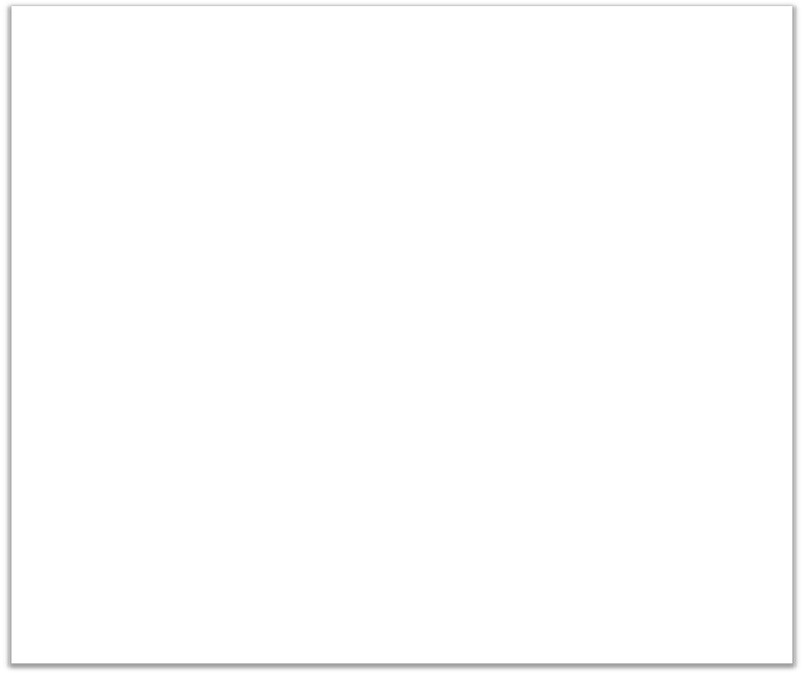
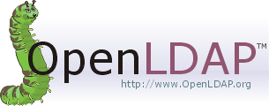



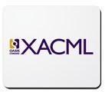

Step 3: Manage people, roles & identities
Considerations
Cloud service provider should support:
Federated identity management
Delegated user administration
Single sign-on
Strong, multi-factor, mutual and/or even biometric authentication
Role, entitlement and policy management
Identity & Access audit
Any access to the provider’s management platform should be monitored and logged
Several standards available for federated IDs, single sign-on and access control
WS-Federation

Slide 85


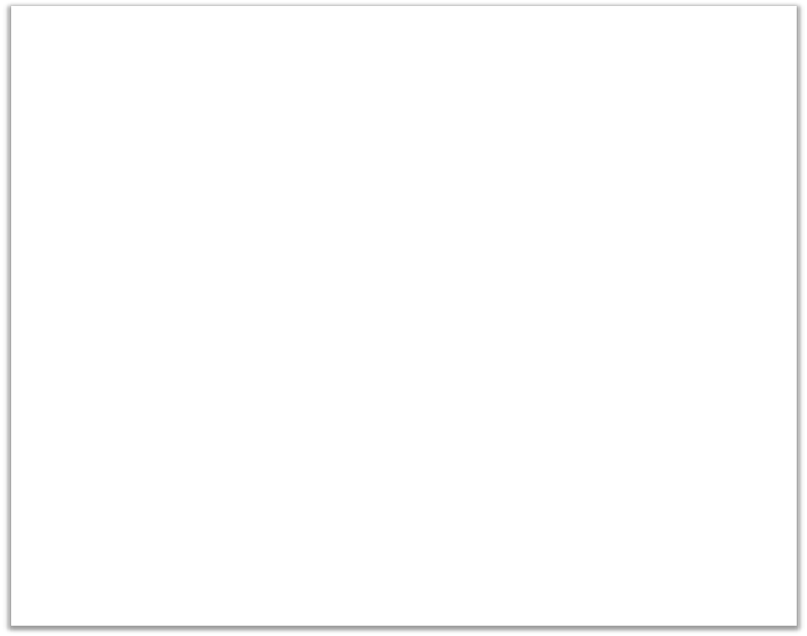


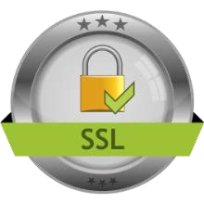
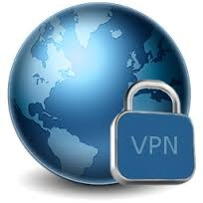
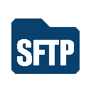
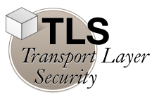


Step 4: Ensure proper protection of data & information
Control Standards
Considerations
Security considerations apply to data at rest as well as data in motion
Controls for securing data in the cloud:
Create a data asset catalog
Consider all forms of data
Consider privacy requirements
Apply confidentiality, integrity and availability principles
Apply identify and access management
Data In Motion Standards
Data Encryption Standards
Seek security standards for control framework, data in motion and data encryption
KMIP

Slide 86

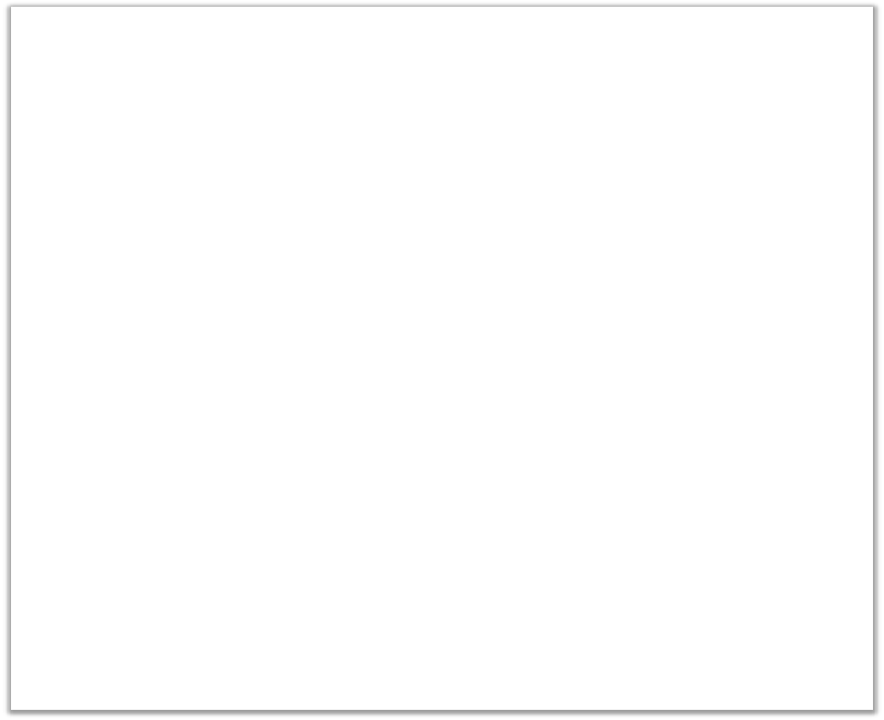




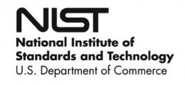
Step 5: Enforce policies for Protection of Personal Data
Considerations
“Privacy”: acquisition, storage, use of personally identifiable information (PII)
EU-US Privacy Shield
Gaining importance
Law and regulations usually apply
Privacy requirements include:
Limitations on use of and access to PII
Tagging PII data correctly
Securing storage of PII
Limiting access to authorized users
Specific types of PII require special treatment
Health data: HIPAA
Credit card data: PCI-DSS
Privacy issues should be addressed in CSA
ISO/IEC 19086 Cloud SLAs
Required controls specified in ISO/IEC 27018
12

Slide 87



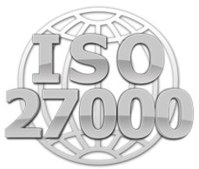
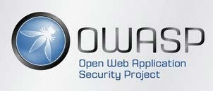
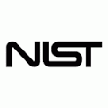
Step 6: Assess the security provisions for cloud applications
Considerations
Infrastructure as a Service
Customer responsible for majority of security components
Platform as a Service
Provider responsible to provide secure operating system, middleware, network
Customer responsible for application security
Software as a Service
Provider provides application security
Customer must understand data encryption standards, audit capabilities, SLAs
Application security in cloud environment over complete lifecycle
ISO 27034
Application Security
Secure development, secure deployment (OWASP, ISO 27034)
Security testing (NIST 800-115)
Deployment model impacts application security
SP 800-115
13

Slide 88

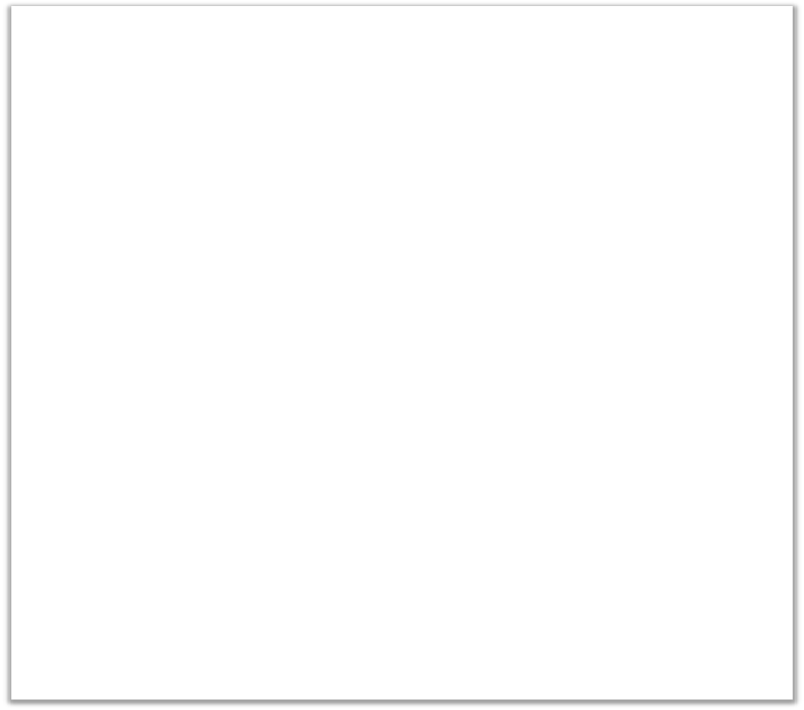

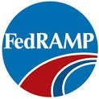
Step 7: Ensure cloud networks & connections are secure
Considerations
Customer should gain assurance on provider’s internal and external network security
Areas of concern
ISO 27033
Network Security
Confidentiality Integrity Availability
External network requirements
Traffic screening
Intrusion detection / prevention
Logging and notification
Internal network requirements
Protect clients from each other
Protect the provider’s network
Monitor for intrusion attempts
ISO 27033 addresses network security
NIST 800-53 R4 has useful controls
FedRAMP specifies specific controls
14

Slide 89

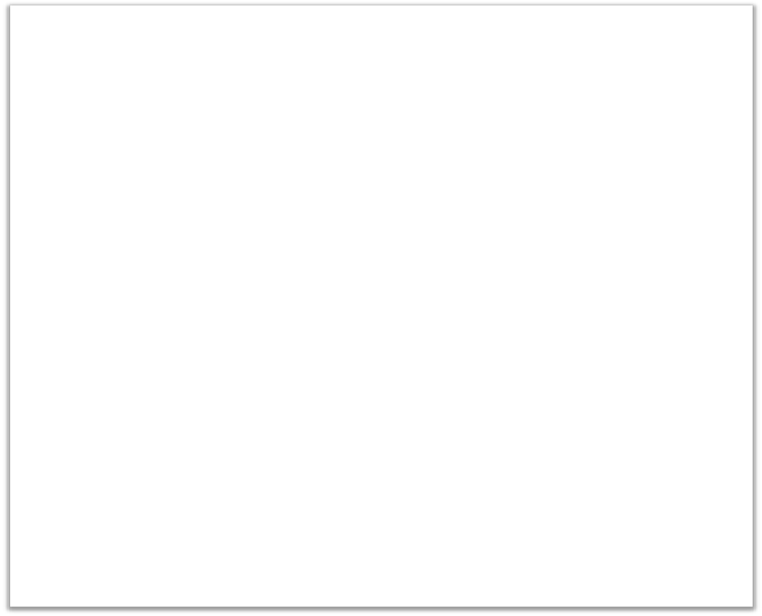

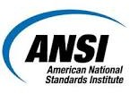
Step 8: Evaluate security controls on physical infrastructure & facilities
Considerations
Customer should gain assurance on provider’s physical security
Physical infrastructure & facilities should be in a secure area
Protection against external & environmental threats
Control of personnel in working areas
Equipment security controls
Controls on supporting utilities
Control security of cabling
Proper equipment maintenance
Removal & disposal of assets
Human resource security
DR & BC plans in place
Look for certification to ISO/IEC 27002 standard
ANSI TIA-942 covers physical security
ISO 27002
Security Techniques: Code of Practice for Information Security Controls
TIA-942
15

Slide 90






Step 9: Manage security terms in the cloud service agreement (CSA)
Considerations
Understand who is responsible for what (provider or customer)
CSA should specify that (and how) customer is notified of security incidents
CSA must also cover recovery measures and customer compensation
Security clauses in the CSA apply to cloud provider as well as its subcontractors
SLAs must include metrics for performance and effectiveness of information security management (see ISO/IEC 27004 and 19086, NIST 800-55 and CIS Consensus Metrics)
Data protection should follow ISO/IEC 27018
Require compliance reports to covering security controls, services and mechanisms
ISO/IEC 27017 specializes ISO/IEC 27002 to the cloud
ISO/IEC 19086
ISO/IEC 27004
ISO/IEC 27017
ISO/IEC 27018
SP 800-55
CIS Consensus Metrics 1.1.0
Common Weakness Enumeration
STAR
Registry
TR178
16

Slide 91

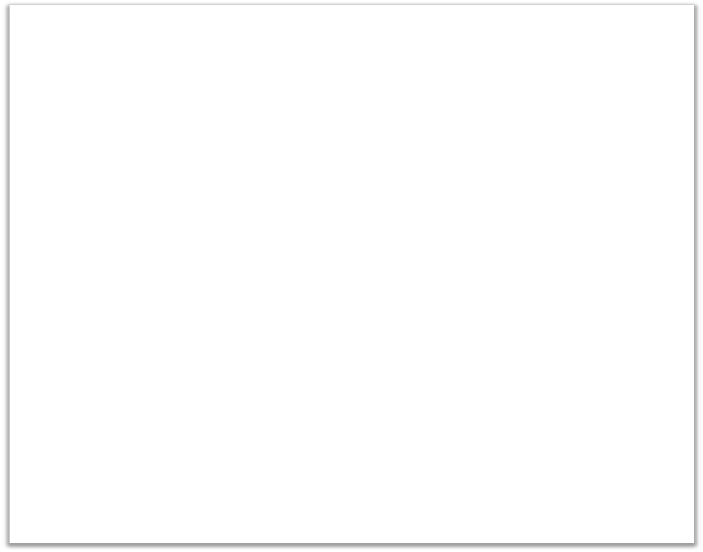

Step 10: Understand the security requirements of the exit process
Considerations
Once termination process is complete, “the right to be forgotten” should be achieved
No customer data should reside with provider after the exit process
Require provider to cleanse log and audit data
Some jurisdictions may require retention of records of this type for specified periods by law
Exit process must allow customer a smooth transition without loss or breach of data
The emerging ISO/IEC 19086 standard contains language on the exit process
ISO/IEC 19086
Cloud Computing – Service Level Agreement Framework
91

