Slide 1
INTERNET-BANKING
A Web-Application for Bank Management
GROUP-4
HARSHITHA KESANI 2279919 TEAMLEAD, FULL STACK
GUNA SEKHAR SIDDABATHUNI 2312120 FULL STACK
SUGUNA CHANDANA SIBBENA 2311362 DATABASE , BACKEND
ANIKET DAS 2352713 FRONTEND, BACKEND
HARISH KUMAR ALLADA 2351427 FRONTEND, BACKEND
LIKHITHA REDDY KESARA 2296664 FRONTEND , BACKEND
SANJANA PONAGANTI 2312535 DATABASE, FRONTEND
POOJITHA BOMMU 2311344 FRONTEND, BACKEND QUERING
DEVI CHIKKALA 2290061 DATABASE AND QUERING
HARSHINI NIMMALA 2316672 DATABASE, QUERING IN BACKEND

Slide 2
Roadmap
Introduction & Scope
Implementation &
Development
Project Validation & Testing
1
3
5
2
4
6
Design
& Planning
Database &
System Details
Conclusion & Future Scope
Notes:
Project Introduction and Scope
This stage covers the introduction, aim, and scope of the project. It provides an overview of the Banking Management System and what the project intends to achieve.
Design and Planning
This stage involves the design decisions, including the gathering of business requirements, creation of ER and relational diagrams, and the design of the database schema.
Implementation and Development
This stage covers the implementation details of the project, including the development of the user interface, the creation of the database, and the implementation of various modules.
Database and System Details
This stage delves into the details of the database and system, including the explanation of user roles, business rules, ER Diagram, Relationship Diagram, Entities, and the Data Dictionary.
Validation and Testing
This stage involves the validation of the database using specific queries and the testing procedures to ensure the functionality and reliability of the system.
Conclusion and Future Scope
This stage wraps up the presentation with a conclusion summarizing the project’s achievements and a discussion on the future scope for potential enhancements and features.

Slide 3
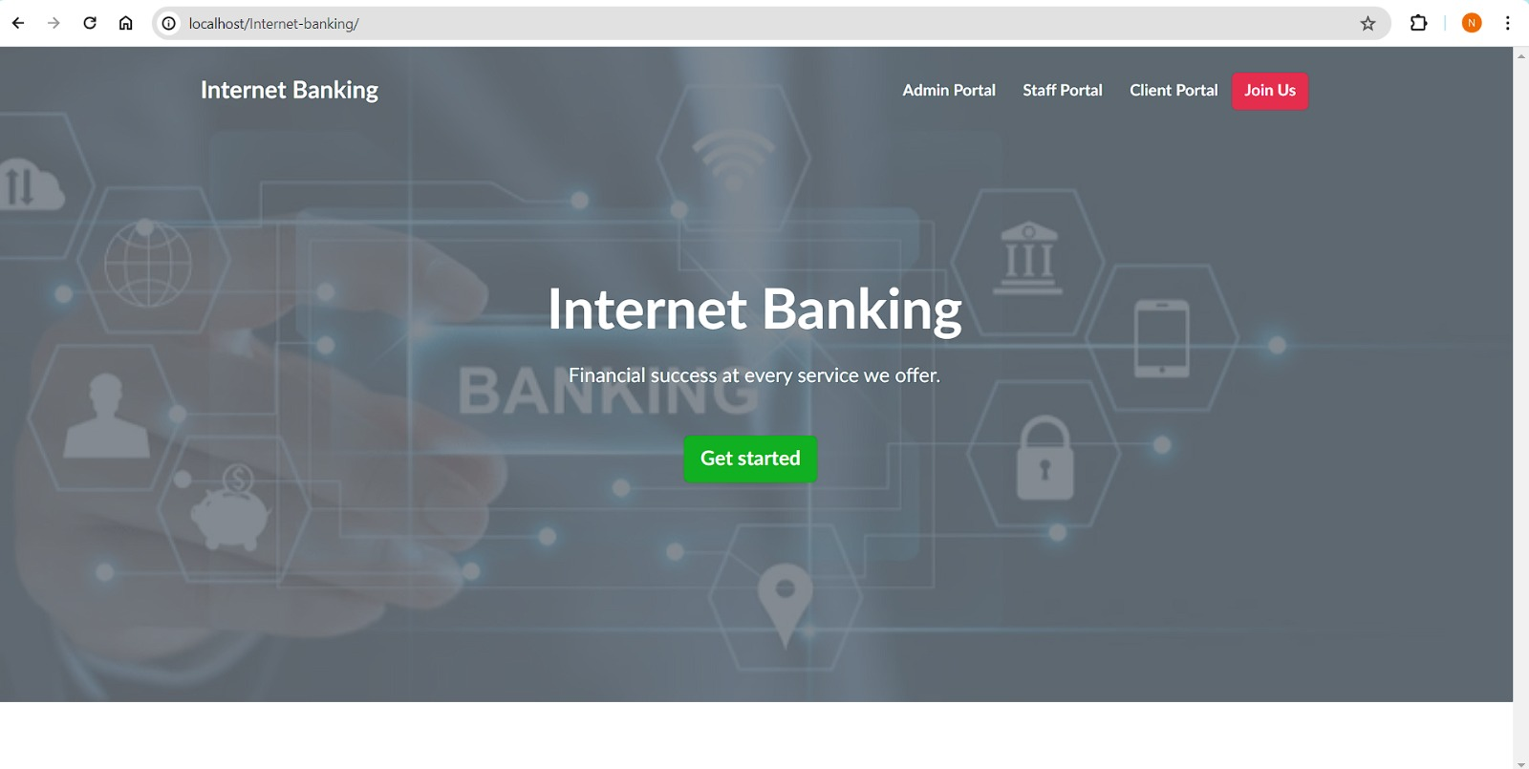
Introduction to Internet Banking (Proposal)
We propose to create a comprehensive web-based Bank Account Management System to provide users with secure access to their accounts, facilitate financial transactions, and manage banking operations efficiently.
Notes:
Project Introduction and Scope
This stage covers the introduction, aim, and scope of the project. It provides an overview of the Banking Management System and what the project intends to achieve.
Design and Planning
This stage involves the design decisions, including the gathering of business requirements, creation of ER and relational diagrams, and the design of the database schema.
Implementation and Development
This stage covers the implementation details of the project, including the development of the user interface, the creation of the database, and the implementation of various modules.
Database and System Details
This stage delves into the details of the database and system, including the explanation of user roles, business rules, ER Diagram, Relationship Diagram, Entities, and the Data Dictionary.
Validation and Testing
This stage involves the validation of the database using specific queries and the testing procedures to ensure the functionality and reliability of the system.
Conclusion and Future Scope
This stage wraps up the presentation with a conclusion summarizing the project’s achievements and a discussion on the future scope for potential enhancements and features.

Slide 4
Project Scope & Objectives
The main Objectives of our project are
To design and implement a comprehensive, web-based Banking Management System that not only provides secure and efficient banking services to users but also effectively manages vast amounts of data related to banking operations.
Central to this aim is the creation of a robust and scalable relational database system using Mysql.
Our goal is to leverage the power of database management systems to bring about a significant improvement in the way banking operations are conducted and secured services are delivered to users.
Technologies Used: PHP , MYSQL ,HTML,JAVASCRIPT,XAAMP,VISUAL STUDIO CODE.
Notes:
This database will store and manage user information, account details, transactions, and other relevant data. It will be designed to handle large volumes of data and transactions efficiently, ensuring data integrity, security, and performance.

Slide 5
Design Decisions (Business Rules)
1. User Registration & Authentication
a. Must provide unique and valid user information to register.
b. While logging in the password must be entered correctly.
c. Cannot register the client with the existing username or email or National id.
3. Account Management
a. Each user can have one or more accounts (savings, checking, investment)
b. Every user will receive a unique account number from bank.
c. Balances and transactions must be updated accurately.
d. Each new account must be associated with existing user.
e. Users can check their account balances, review their transaction history, and modify account information like personal details.
f. Must display the result of the transaction whether it’s success or failure.
2. Reporting and Analytics
a. System administrators can generate reports on various aspects of account activity, transaction trends, and financial performance.
b. Reports must be accurate, customizable, and accessible to authorized personnel only and must be customized based on specific criteria.
c. Analytics tools may be used to identify patterns, anomalies, or opportunities for improvement in banking operations.

Slide 6
Business Rules (Cont.d)
4. Admin & Staff panel
a. Administrators have privileged access to manage users, staff, accounts, transactions, obtain reports and can be able to edit frontend.
b. Admin actions, such as account creation, transaction approvals, or managing staff logged for auditing purposes.
c. Staff manages the clients and their accounts.
5. Funds Transfer
a. Must have sufficient amount to complete a transaction.
b. Can transfer to external or self accounts.
c. All transactions from the client side must be authenticated and authorized by the account holder.
d. All transactions must be recorded accurately including the amount transferred.

Slide 7
Modules
User Roles
Entities
IB_ACC_TYPES
IB_ADMIN
IB_BANKACCOUNTS
IB_CLIENTS
IB_NOTIFICATIONS
IB_STAFF
IB_SYSTEMSETTINGS
IB_TRANSACTIONS
User Registration & Authentication
Account Management
Funds Transfer
Reporting & Analytics
Admin Panel
Customer
Bank Staff
Administrator

Slide 8
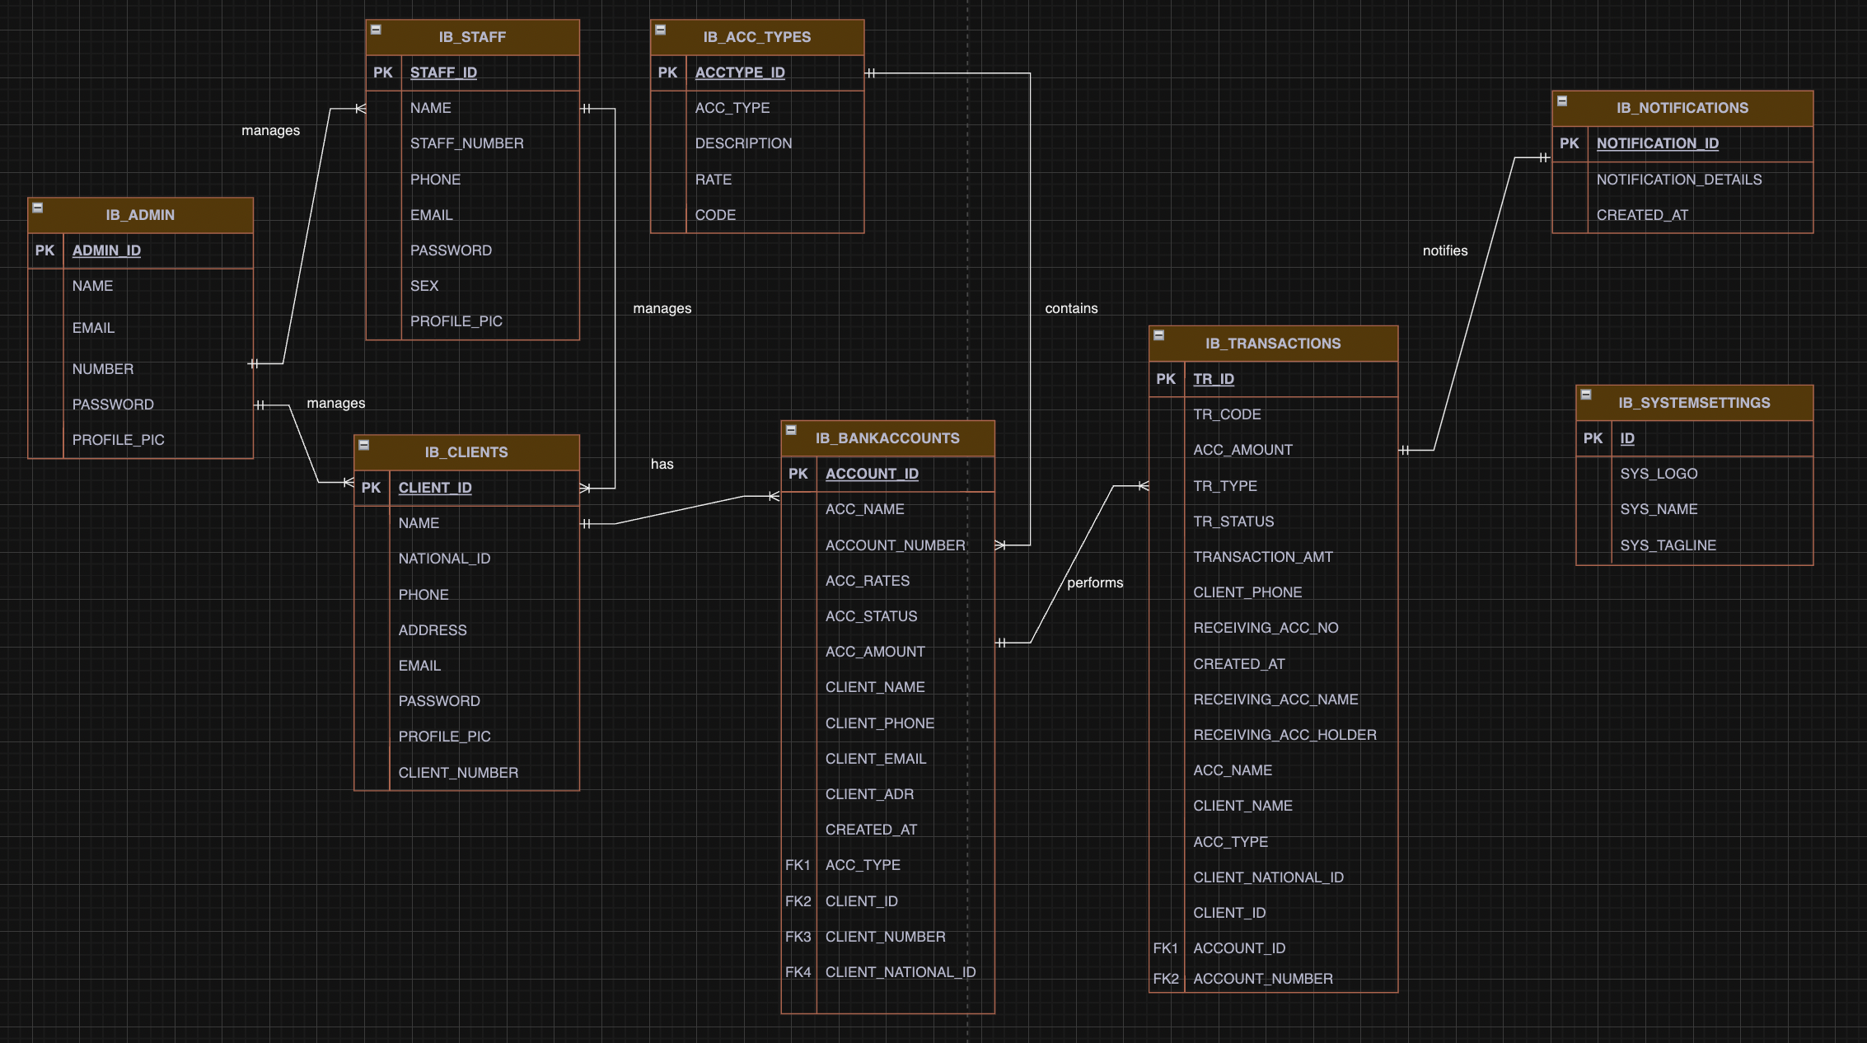
Entity Relationship diagram

Slide 9
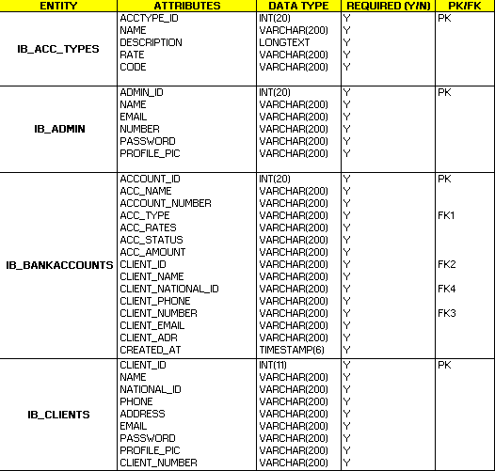
DATA DICTIONARY

Slide 10
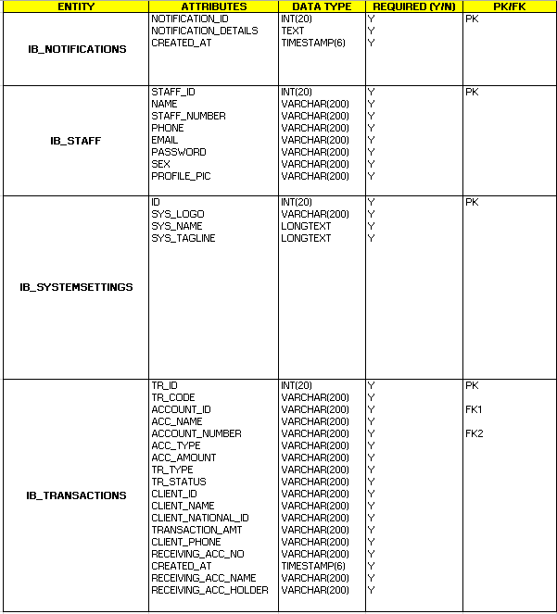
DATA DICTIONARY (CONT.D)

Slide 11
Functionality & Features
Our landing page to our Web-App is created.
Home Page with all options

Slide 12
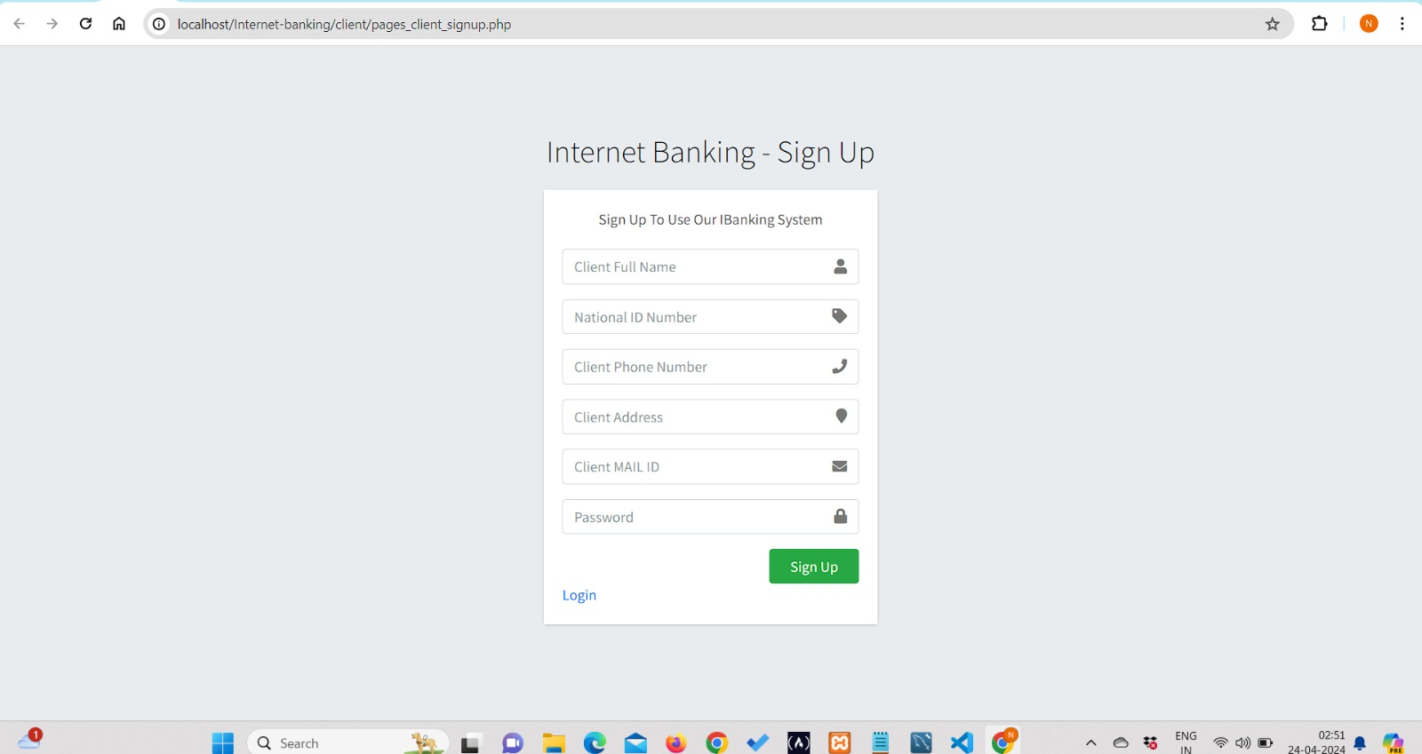
Login/Signup
Login / SignUp for Clients

Slide 13
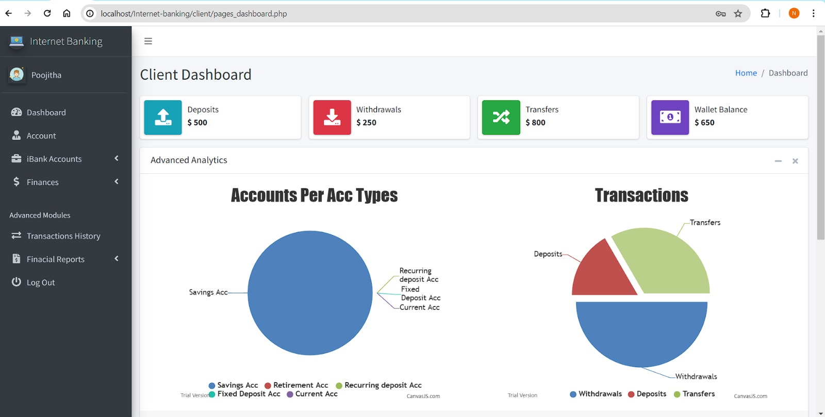
DashBoard- Client

Slide 14
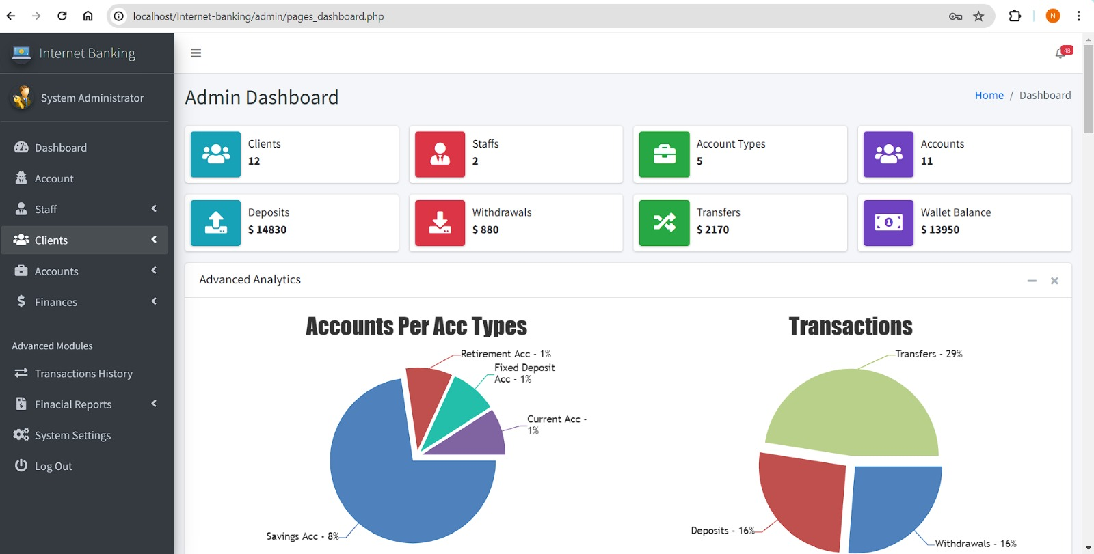
DashBoard- Admin

Slide 15
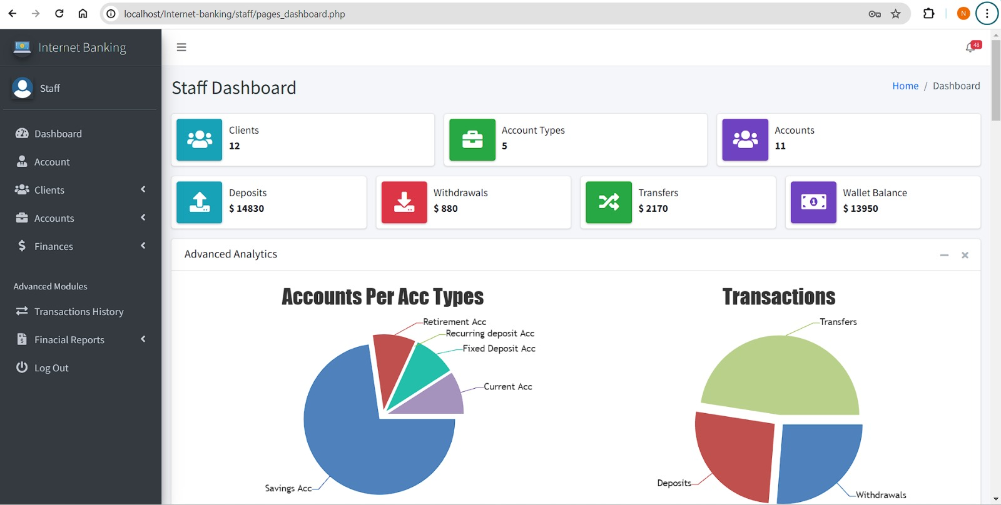
DashBoard- Staff

Slide 16
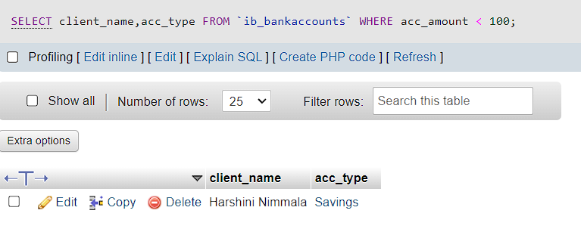
Validation Queries and Outputs
Retrieve the account holder's name and account type for all accounts with a balance less than $100.

Slide 17
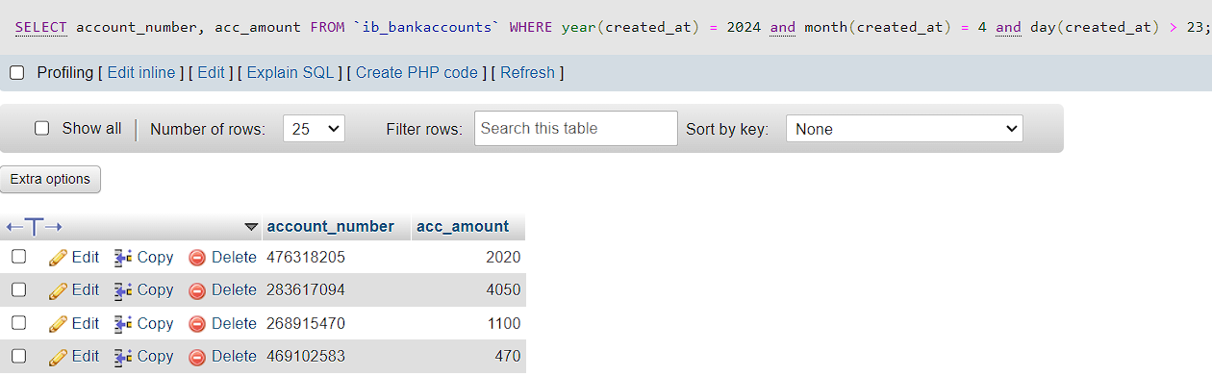
Retrieve the account number and balance for all accounts opened after April 23, 2024

Slide 18
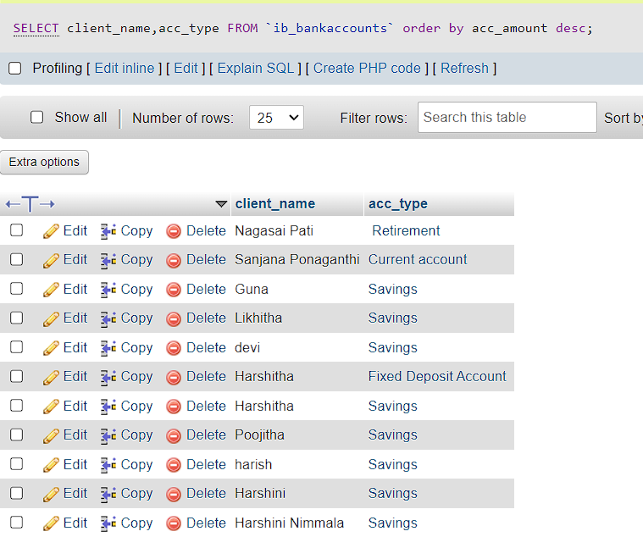
Retrieve the account holder's name and account type for all accounts in descending order of their balance.

Slide 19
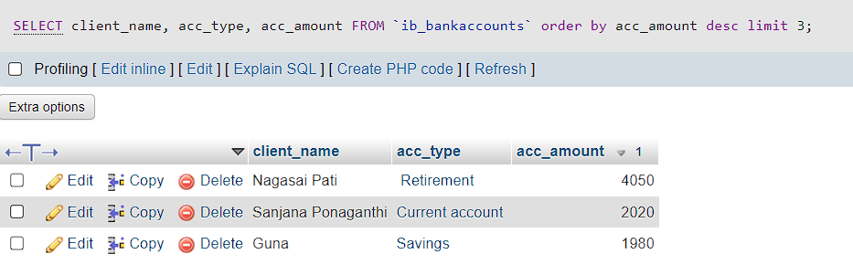
Retrieve the account holder's name, account type, and balance for the top 3 accounts with the highest balance

Slide 20
Conclusion
PROJECT USAGE, PROSPECT & POTENTIAL
A comprehensive solution for managing banking operations, providing potential usage for individual users, corporate clients, and even government entities.
The system is designed to be user-friendly, saving time for users and making banking operations more efficient.
The secure and robust database design ensures the safety of user data and smooth operation of banking services.
Saves a lot of time and helpful especially for those who have difficulty in visiting banks manually
PROJECT EXPERIENCE & TEAMWORK
Finding solutions to the problems encountered
Improved coding skills and database Knowledge.
Gained integrating database and development experience
Success of the project demonstrates the team’s commitment to excellence and vision for a future where banking is more accessible, secure, and user-friendly for all.

Slide 21


Future Work
Block-Chain Integration
AI-Driven Customer Service
Mobile Banking Advancements
Smart Contracts for Loans and Mortgages
Bug improvements
INTERFACE IMPROVEMENTS
DATABASE IMPROVEMENTS
ADDITIONAL FUNCTIONS/
FEATURES
Notes:
Advanced Analytics and Personalization: Implementing machine learning algorithms to analyze transaction patterns and provide personalized financial advice to users.
Blockchain Integration: Utilizing blockchain technology to secure transactions and enhance transparency in banking operations.
AI-Driven Customer Service: Introducing AI-powered chatbots for customer support and predictive services to anticipate user needs.
Cybersecurity Upgrades: Continuously updating cybersecurity measures to protect against emerging threats and ensure the safety of user data.
Mobile Banking Advancements: Developing more sophisticated mobile banking features that allow users to manage their finances on-the-go with enhanced ease and security.
Open Banking APIs: Adopting open banking standards to allow third-party developers to create innovative financial services and apps.
Financial Health Dashboard: Creating a dashboard that provides users with insights into their financial health and suggestions for improvement.
Smart Contracts for Loans and Mortgages: Implementing smart contracts to automate the processing and management of loans and mortgages.

Slide 22
Our Gantt Chart
TASKS
MAR 18 - 23
MAR 24 - 30
MAR 31 – APR 6
APR 7 -13
APR 14 - 20
APR 21 - 22
Database design
Implementation of ERD
Overall Architecture
Frontend Development
Cohesive Tech
UI design
Integrating front end with Database
Validation Queries & Security
Project Management and Overseeing Progress
Review & Final Adjustments

Slide 23



Thank You!

