Slide 1


Placement Portal for Campus Placement
Minor Project
By
22BCE545 Jatin Varyani and 21BCE245 Dhruvil Rana
minor project reivew2

Slide 2
Introduction
The campus placement portal is a digital platform designed to simplify the recruitment process for students and placement coordinators.
Students can easily register on the portal, providing their academic and professional details to create a resume automatically.
Placement coordinators can efficiently post job openings when companies come for recruitment.
Students receive notifications about these job opportunities through the system.
The portal allows students to view and apply for jobs online, submitting their resumes directly.
It reduces the need for physical paperwork and manual processes, making the placement process more organised and accessible.
Overall, the platform enhances the entire placement experience for both students and coordinators.
minor project reivew2

Slide 3
Motivation
Reduce Administrative Burden: Minimize the physical paperwork and manual processes involved in job applications and placements, making it more efficient for students, placement coordinators, and companies.
Enhance Accessibility: Provide students with an accessible platform where they can easily register, apply for jobs, and submit resumes from anywhere, improving convenience and participation.
Organized Data Management: Centralize and streamline the handling of student data, job posts, and applications to improve the overall organization of the placement process.
Improved Coordination: Facilitate smoother coordination between placement coordinators, students, and recruiters by digitizing the process and reducing logistical hurdles.
minor project reivew2

Slide 4
Problem Statement
The traditional campus placement process is often cumbersome, involving manual paperwork, delayed notifications, and inefficient coordination between students, placement coordinators, and companies. This leads to unnecessary delays, missed opportunities, and administrative burdens. The problem is to develop a digital platform that automates job postings, resume submissions, and notifications, streamlining the entire placement process for better efficiency and accessibility.
minor project reivew2

Slide 5




Proposed Approach
Security and Scalability:
Strong login mechanisms protect data, and the system can handle a large number of users efficiently.
Eligibility Automation: Automatically checks if students meet job requirements, allowing only eligible candidates to apply.
Role-Based Access
Each user has specific permissions based on their role. Admins manage the portal and job postings, while students apply for jobs and track their applications, ensuring a streamlined and secure process.
APIs
The system uses backend programs (APIs) to handle tasks like user management, job postings, academic records, and interview scheduling, ensuring smooth operation.
minor project reivew2

Slide 6
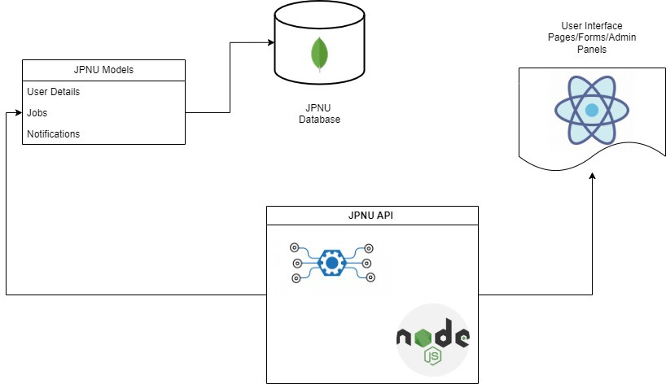
MVC architecture
The diagram illustrates a data flow for a JPNU system. Users interact with the system through a user interface, which communicates with a JPNU API. The API processes requests and interacts with a JPNU database to retrieve and store data. The system models include user details, jobs, and notifications. The database likely stores information related to these models. The overall flow represents the interaction between users, the system's interface, the API, and the database.
minor project reivew2

Slide 7
Flow for Campus Placement Portal
User Authentication: Users create accounts and log in to access their respective dashboards.
Student Dashboard: Students set up their profiles by entering academic and professional details.
Placement Coordinator Dashboard: Coordinators can create, publish, and manage job postings for recruitment.
Job Notifications: Students receive real-time alerts about new job postings relevant to their profiles.
Job Search and Application: Students browse and filter job listings to find suitable opportunities.
Resume Submission: Students apply for jobs by submitting their generated resumes and additional information.
Application Tracking: Students can track the status of their job applications through their dashboard.
Feedback and Notifications: Placement coordinators provide feedback and notify students about interview schedules.
minor project reivew2

Slide 8
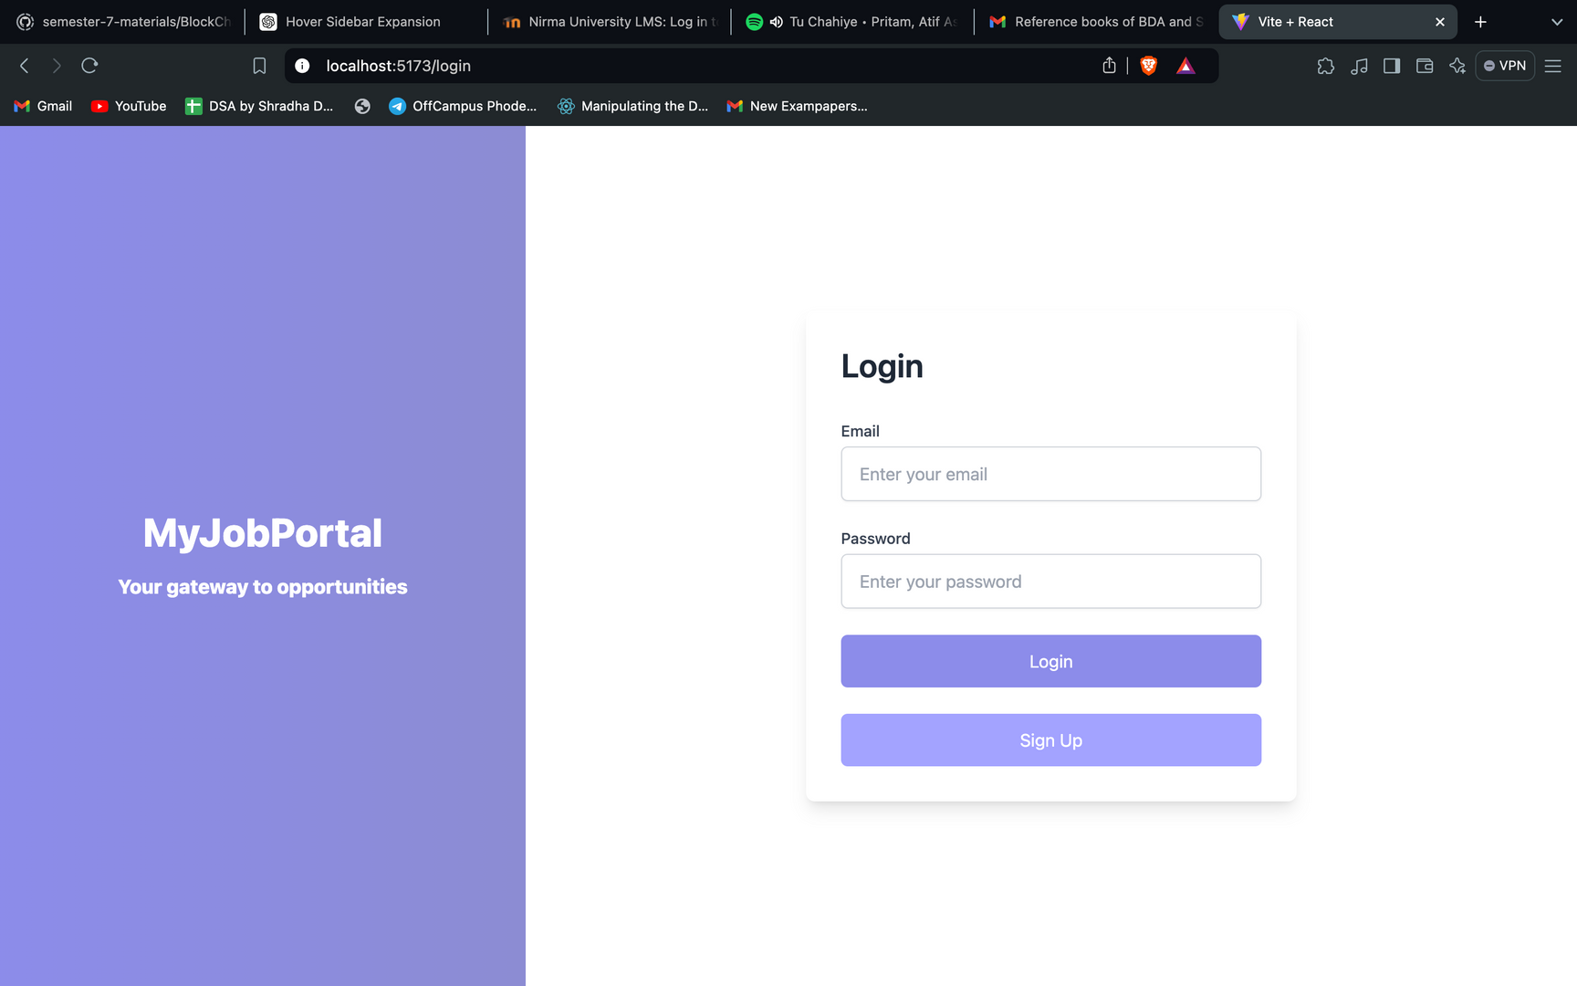
Screenshots of workdone
minor project reivew2

Slide 9
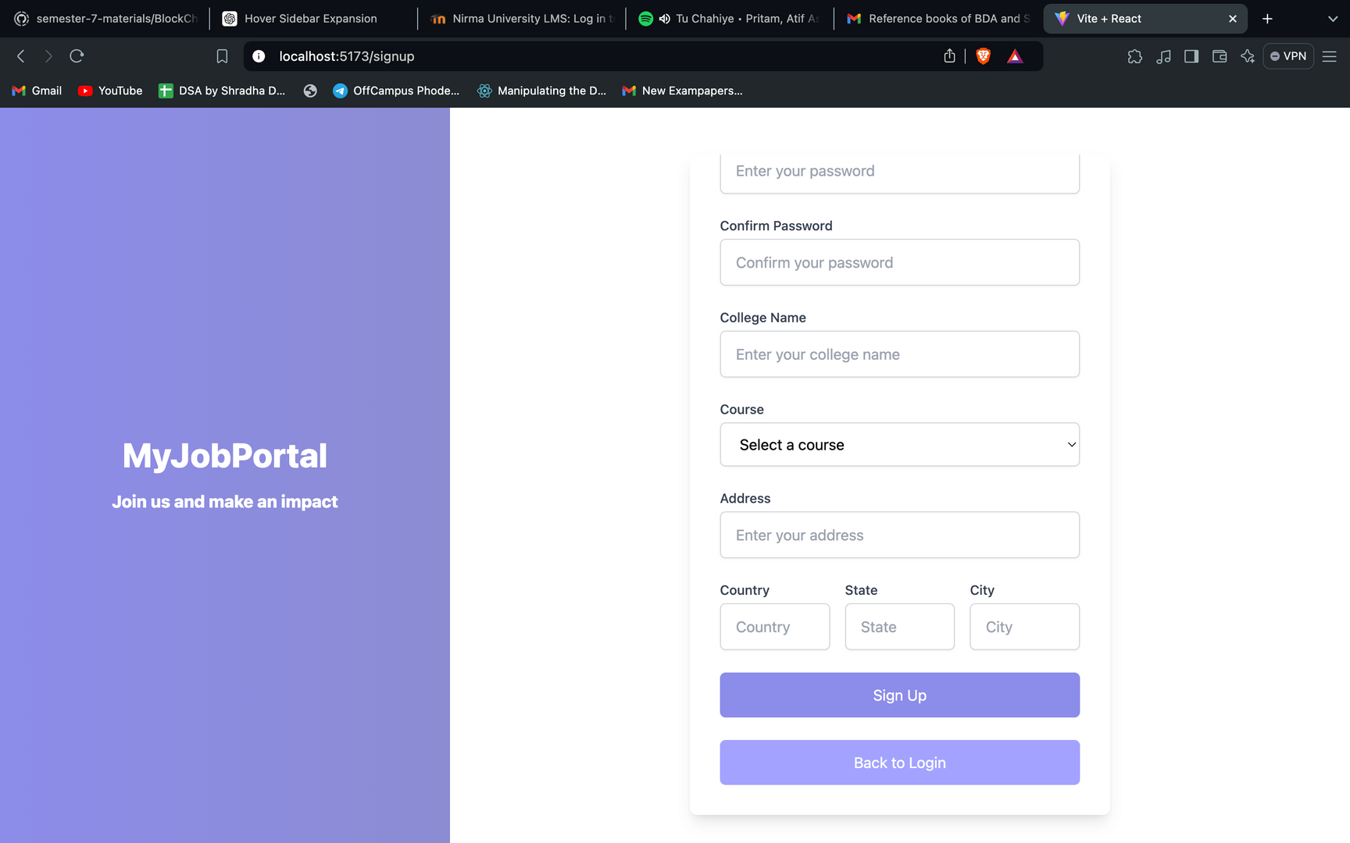
minor project reivew2

Slide 10
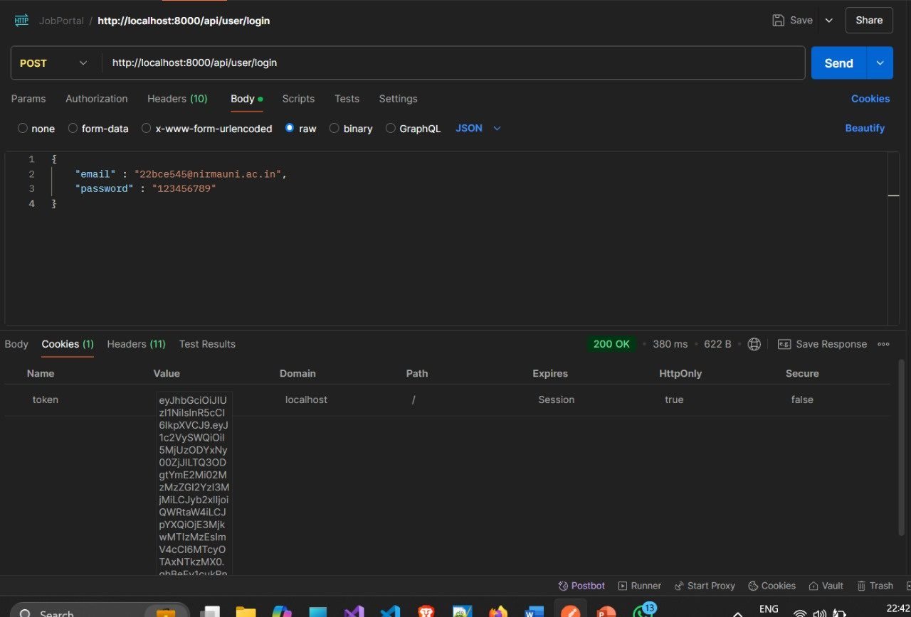
JWT Authentication Implementaion
When a user logs in, their password is validated against the encrypted version stored in the database.
Upon successful authentication, a JWT (JSON Web Token) is generated.
This JWT is returned as an encrypted cookie containing the userId and role of the user.
The token is essential for authentication and authorization within the application.
Each request is verified using the JWT to ensure the user has the necessary permissions based on their role (e.g., Admin, Student).
This approach enhances security by avoiding the storage of sensitive information like passwords on the client-side.
minor project reivew2

Slide 11
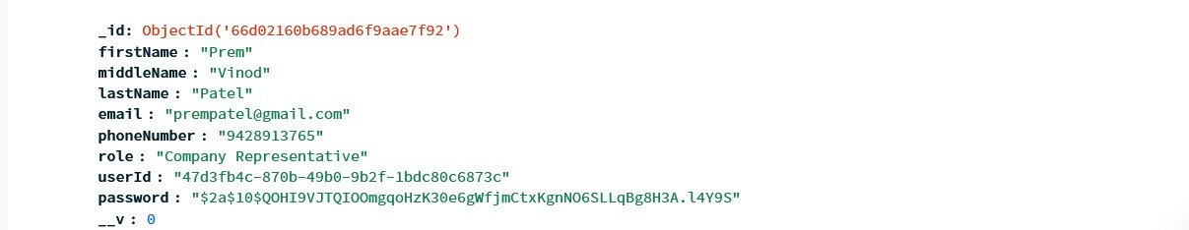
JWT Authentication Implementaion
The screenshot shows user details in the database, including email, userId, and role. The password field is encrypted, ensuring that even if someone gains unauthorized access, the actual passwords remain secure and unreadable. This encryption protects user credentials and enhances the overall security of the application.
minor project reivew2

Slide 12
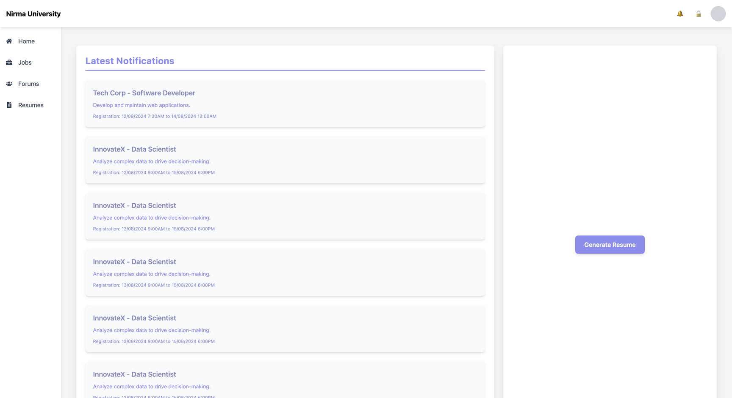
Student dashboard
This section of the JPNU website displays a list of available job opportunities. Users can view the job title, company, location, and salary for each position.
minor project reivew2

Slide 13
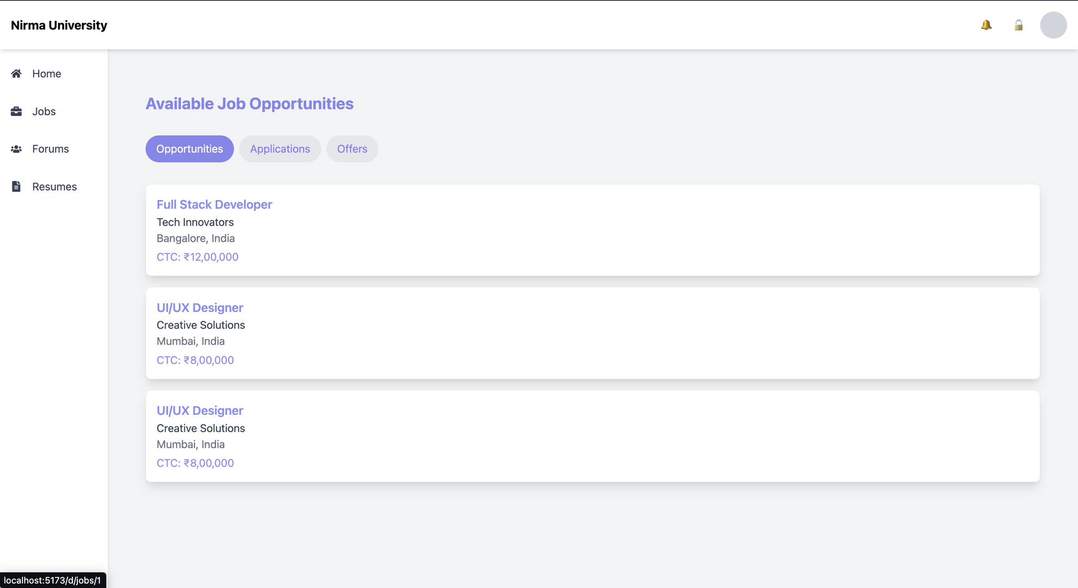
This section of the JPNU website displays a list of available job opportunities. Users can view the job title, company, location, and salary for each position.
minor project reivew2

Slide 14
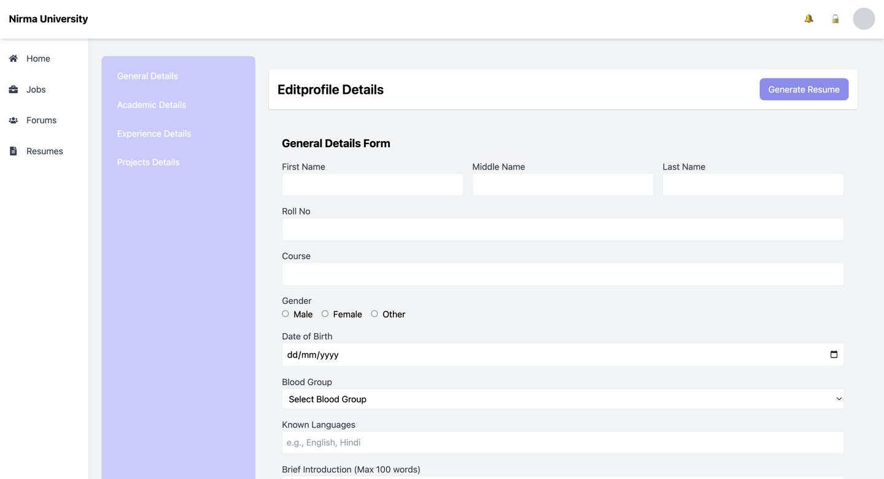
This section of the JPNU website is a form for students to edit their profile details. Students can update their personal information such as name, date of birth, gender, course, skills, achievements, languages, contact number, and blood group. This information is likely used for various purposes within the university, such as academic records, student services, and communication.
minor project reivew2

Slide 15
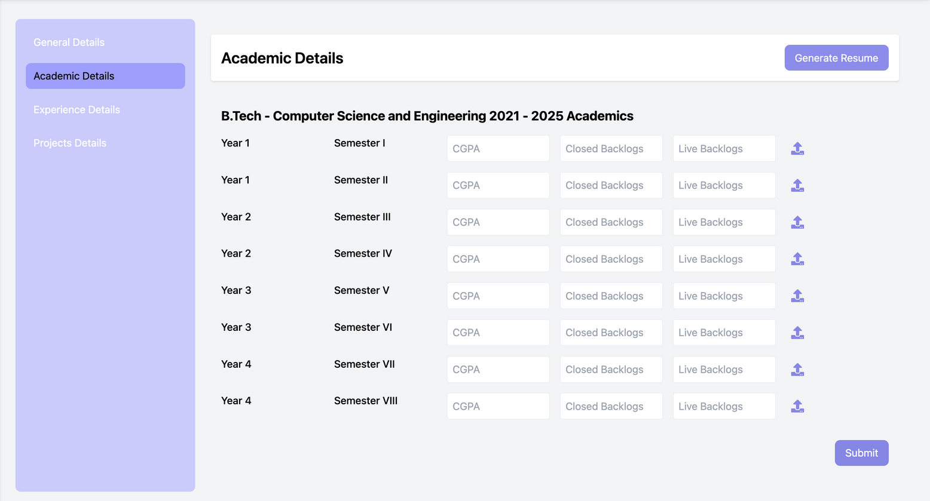
This section of the JPNU website is a form for students to input their academic details. Students can enter their course, year, semester, CGPA, closed backlogs, and live backlogs for each semester. They can also provide details about their 12th and 10th grade percentages and school names. This information is likely used for academic records, degree verification, and other administrative purposes within the university.
minor project reivew2

Slide 16
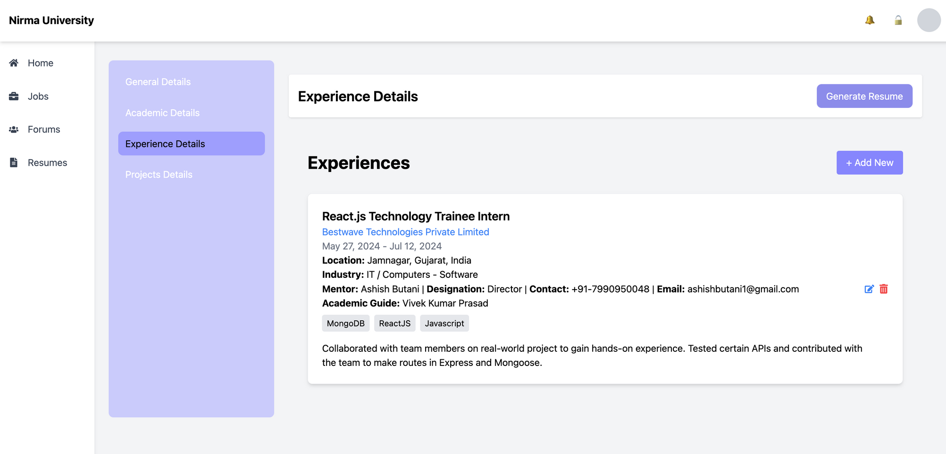
This section of the JPNU website is a form for students to input their work experience details. Students can add new experiences, including the company name, job title, start and end dates, location, industry, mentor details, academic guide, and skills used.
minor project reivew2

Slide 17
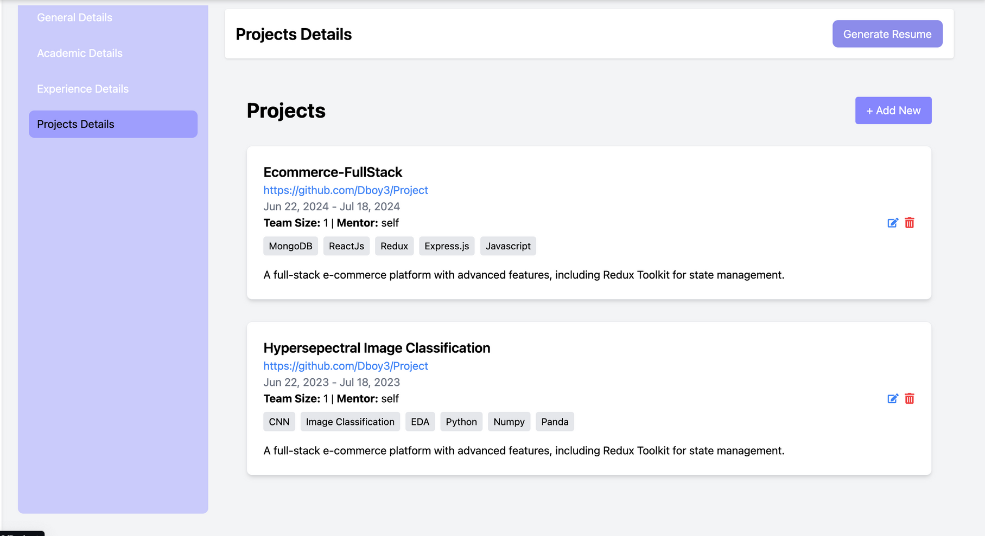
This section of the JPNU website is a form for students to input their project details. Students can add new projects, including the project name, start and end dates, team size, mentor, and a brief description.

Slide 18
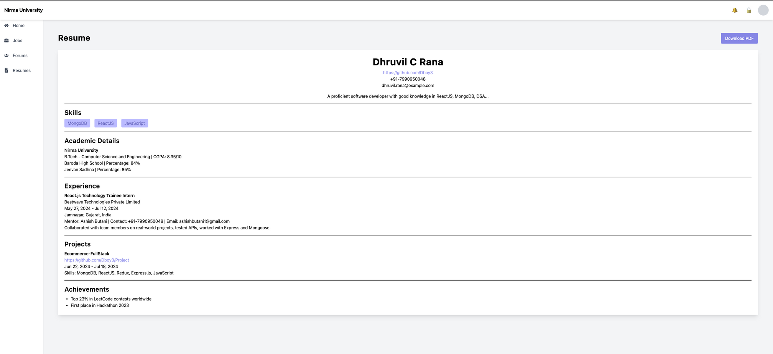
This page shows the resume generated by the student

Slide 19
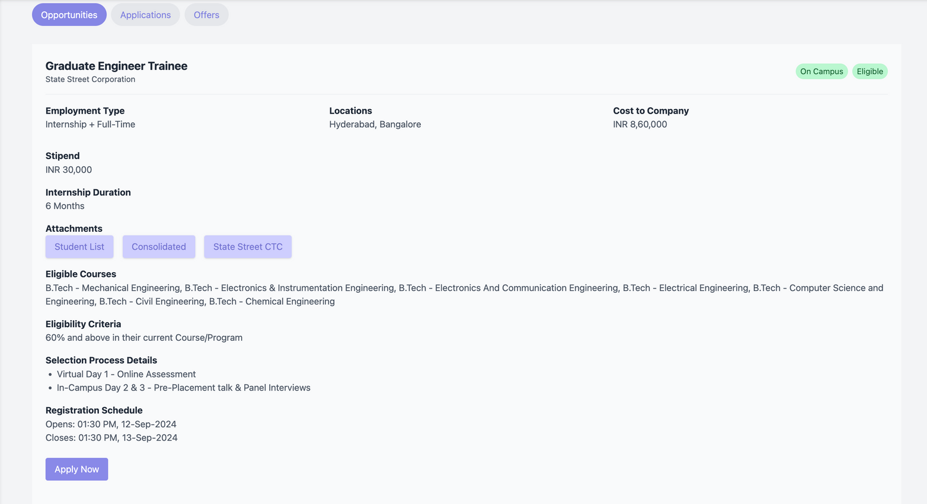
when the student click on the job card. It opens the page where detailed information is mentioned and by clicking on apply button
he/she can register himself/herself for that specific company

Slide 20
ThankYou
minor project reivew2

