Slide 1

Driving University Applications: The Role of Institution Type, Acceptance Rate, and Enrollment Trends
Group 10
Omar Elhussein
Dennis Campoverde-Lema

Slide 2

Research Question and Objective
Question: What factors influence the number of university applications?
Objective: Identify predictors such as acceptance rates, enrollment rates, and University type to help universities optimize strategies.
Dataset: Collected from 777 universitates across the U.S. (public and private)

Slide 3
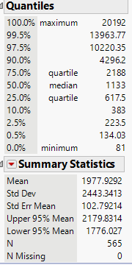
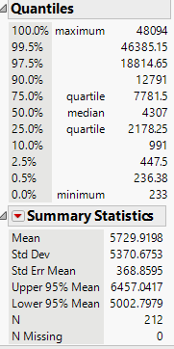
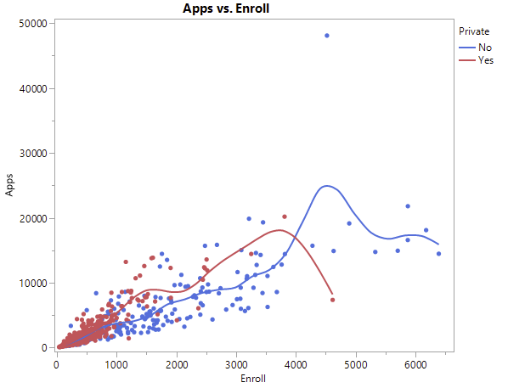
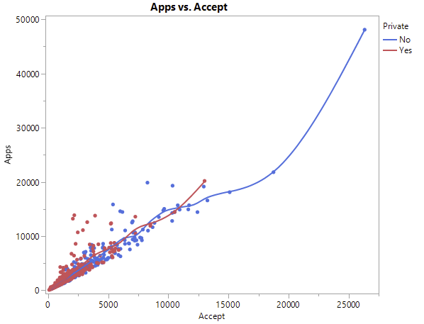
Data Set Summary
Dependent Variable: Applications received.
Independent Variables:
Quantitative: Accept (accepted students), Enroll (enrolled students).
Qualitative: Private (university type).
Sample Size: 777 universities.
Visuals: Statistical Summary showing distribution of private vs. public universities.
Private
Public

Slide 4
Regression Models and Steps
Models:
Model 1: Quantitative predictors (Accept, Enroll)
Model 2: Adds qualitative predictor (Private)
Model 3: Includes interaction Includes Quadratic terms from Accept*Accept and Erroll*Enroll
Model 4: only studying the qualitative predictor

Slide 5
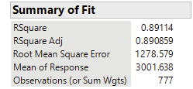

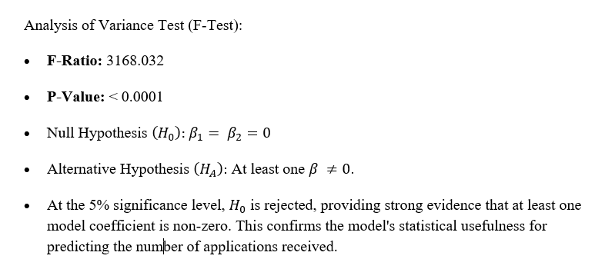
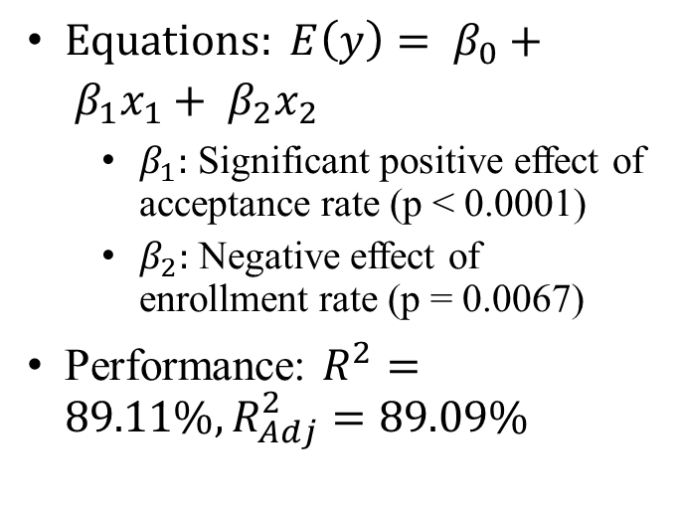
Results – Model 1
$Equations: E\left(y\right)= β_{0}+ β_{1}x_{1}+ β_{2}x_{2}$
$β_{1}:$ Significant positive effect of acceptance rate (p < 0.0001)
$β_{2}:$ Negative effect of enrollment rate (p = 0.0067)
Performance: $R^{2}=89.11\%, R_{Adj}^{2}=89.09\%$

Slide 6
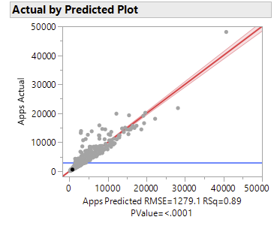
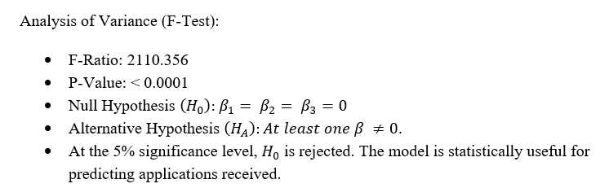
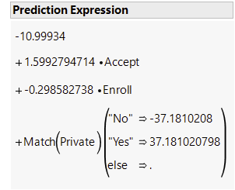

Results – Model 2
Equation:$E\left(y\right)= β_{0}+ β_{1}x_{1}+ β_{2}x_{2}+ β_{3}x_{3}$
Private Universities have a slight advantage in application ( $β_{3}=37.181$)
Performance: $R^{2}=89.12\%, R_{Adj}^{2}=89.08\%$

Slide 7
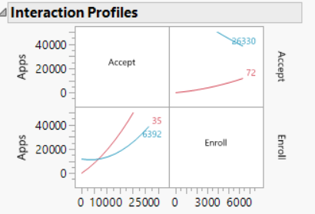
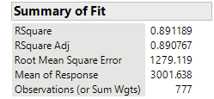
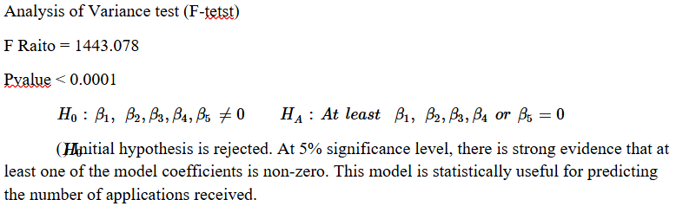
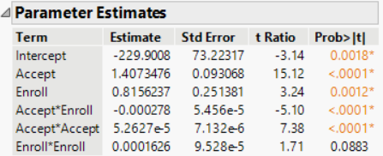
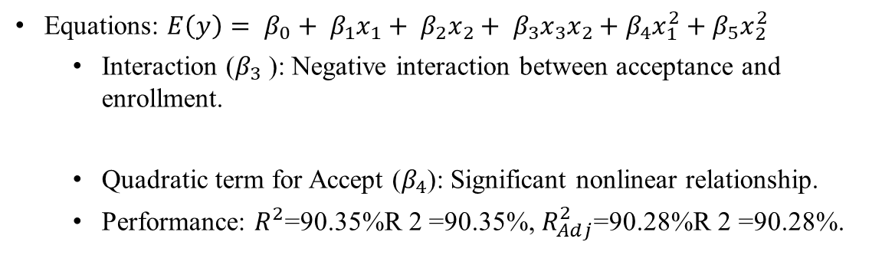
Results – Model 3
Equations: $E\left(y\right)= β_{0}+ β_{1}x_{1}+ β_{2}x_{2}+ β_{3}x_{3}x_{2}+β_{4}x_{1}^{2}+β_{5}x_{2}^{2}$
Interaction ($β_{3}​$ ): Negative interaction between acceptance and enrollment.
Quadratic term for Accept ($β_{4}$): Significant nonlinear relationship.
Performance: $R^{2}$=90.35%R 2 =90.35%, $R_{Adj}^{2}$=90.28%R 2 =90.28%.

Slide 8
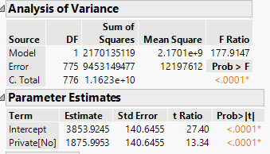
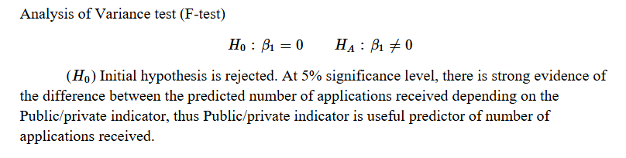
Results – Model 4

Slide 9
Key Takeaways
Factors Studied: Applications accepted, applications enrolled, public/private status.
Key Findings:
Higher acceptance rates = More applications.
Higher enrollment rates = Fewer applications.
Private universities attract more applications.
Applications increase slower as acceptance rates grow but faster with enrollment rate growth.
Conclusion: In summary universities depending on mor acceptance and enrollment rates will create a slow growth of number of applications, they should focus more in creating an extra incentive for students to apply, for example they can reduce tuition or connect with more scholarship funders. Also, they can work on introducing their majors and programs to high schools' juniors or seniors.

