Slide 1

Crime analysis
Carlos Dave Sidney
DATA205
Spring 2026

Slide 2
Project context, Importance, Goals
Importance of understanding the causes of criminal activities due to concerns about safety
The project aims to examine the relationship between crime rate, income, and population.
Such project can help tailor strategic approaches for facing criminality and develop better policies

Slide 3

Data overview
The primary dataset used originates from datamontgomery
approximately 315,000 observations & 30 variables
It gives information about incidents reported to MCPD
The project also used socioeconomic data collected from U.S Census Bureau that provide information about median household income and population across MOCO districts

Slide 4

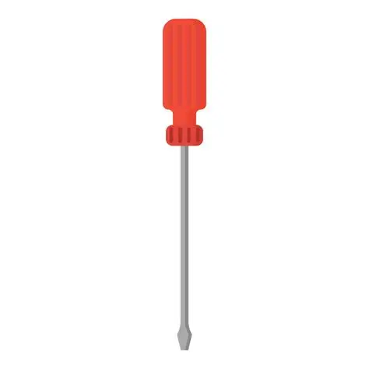
Tools
Pandas: for data manipulation/ cleaning
matplotlib, seaborn, power BI: for data visualization
Scipy: for correlation analysis

Slide 5

Cleaning process
Imputation of missing values across police district name using the mode
Removal of duplicated records
Conversion of data types
Reconciliation of inconsistent district names
This process help ensure data quality, consistency, and readiness.

Slide 6
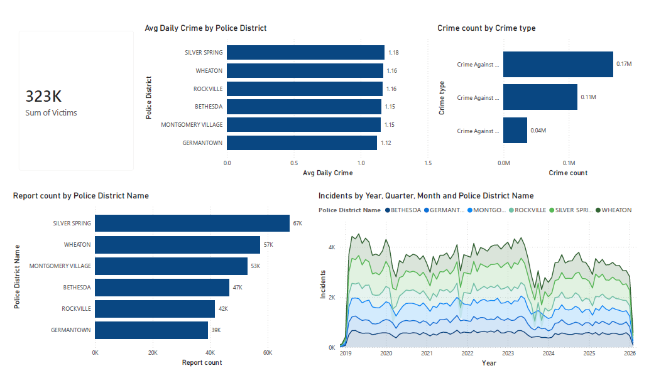
Summary of criminal activities
Crime against property is the most common offense with 170,000 counts
Silver Spring top the list of district with about 67k reports, and it averages 1.18 incidents per day
All these incidents caused a total of approximately 323k victims across the county

Slide 7
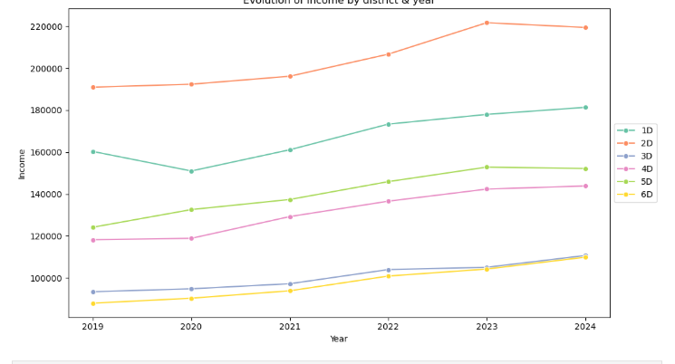
Evolution of income
Over the entire period, 2nd district(Bethesda) has shown the highest income level followed by 1st district(Rockville)
3rd district(Silver Spring) and 6th district (Montgomery village) recorded the lowest income level
There’s a considerable gap between certain districts
There’s an observable growth in income over the period

Slide 8
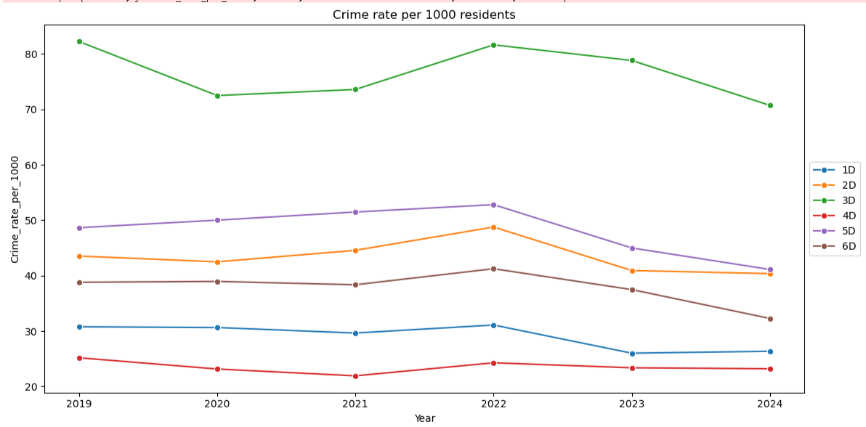
Crime rate
District 3 recorded the highest crime rate over the period
District 5 with the second highest rate
All district have experienced their peak in 2022, but there has been an overall decline ever since

Slide 9
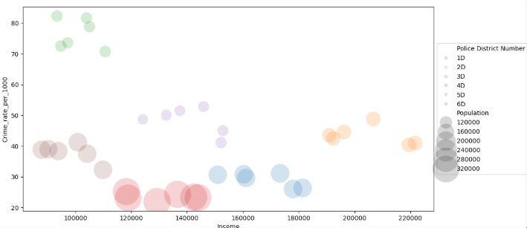
Population, Income, and Crime
Positioned in the lower income range, with not quite a big population size, district 3 shows a tremendously high crime rate, as opposed to district 6
District 2 and 1are positioned in the higher end of income, they recorded a significantly lower rate 3D
It is to observe that 4D has the lowest rates, yet it has the highest population, and it recorded a high count of incidents

Slide 10
Correlation analysis
A spearman correlation was used to examine the strength of the correlation between the factors
A spearman correlation was used because it is less influenced by outliers, it does not require that the data to be normally distributed
Ho : Income and population have no relationship with crime rate
Ha : Income and population have a relationship with crime rate

Slide 11
Analysis outcome
correlation matrix | annual income | population
crime_rate_per_100 | -0.211326 | -0.901673
annual income | 1.000000 | 0.085199
Population | 0.085199 | 1.00000
The relationship between population and crime rate returned a p-value below the standard threshold, meaning the negative association is not due to random variance
The relationship between income and crime rate returned values that indicates that income is not a reliable predictor
P-values matrix | Income | Population
crime rate per 1000 | 2.159995e-01 | 6.251207e-14
Income | 0.00000000 | 0.621267
Population | 0.621267 | 0.00000000

Slide 12
Conclusion/Recommendation
The descriptive findings identified 3D as the most crime intensive area
Population size showed a stronger association with criminal activities while income demonstrated a weaker association according to the spearman correlation analysis conducted, making population size a more reliable driver of criminal activities
To better understand criminal activities across Montgomery County, future analysis should incorporate more social indicators, which will enable a better comprehension of the contribution of income and population

Slide 13
THANK YOU!

