Slide 1
Predicting Business Major’s GPA with machine learning
Daniel Carter

Slide 2
Overview
Why
What this project implies
What can be done with this project

Slide 3
Purpose
Research Question:
Can a machine learning linear regression model successfully predict a Business Major’s G.P.A. based on credits attempted and credits earned, classes, gender, whether the student is an athlete, style of class (online or in-person), and the grade received for each class?

Slide 4
Tools Used
Python
VSCode

Slide 5
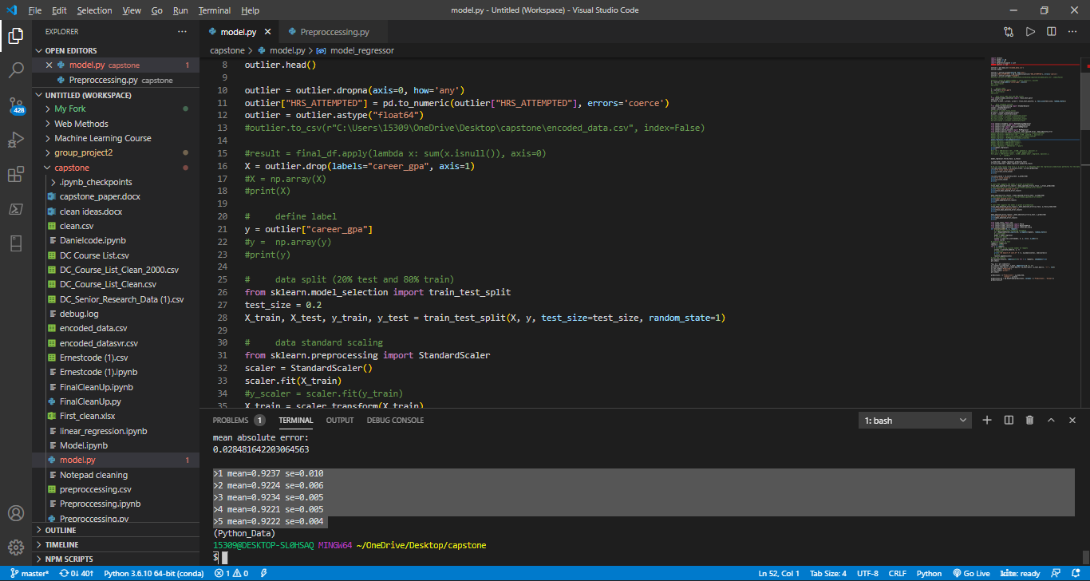

Slide 6
Data
Where the data is from
How I got the data
Different ways data can be accessed

Slide 7
Preprocessing
Merge the two CSV files
Drop “NA’s”
Feature Selection
Label Encoding

Slide 8
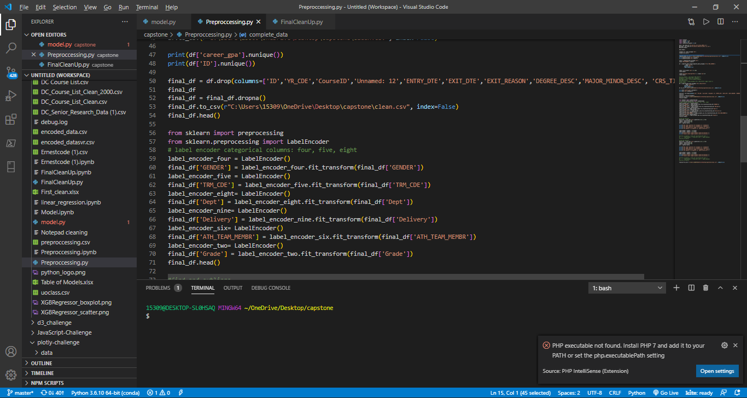

Slide 9
Model
List of Regression Models
Linear Regression
Support Vector Regression
DecisionTreeRegressor
RandomForestRegressor
MLPRegressor
XGBRegressor

Slide 10
Results

Slide 11
Results (continued)

Slide 12
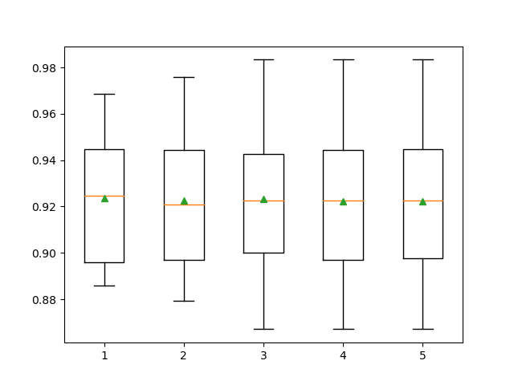
Results (Continued)

Slide 13
Conclusion
Best overall model
Significance
Give thanks

Slide 14
Questions?

