Slide 1


Agile Development

Slide 2


Explaining agile roles
Product Owner
Maximizes product’s value and the work for the development team
Scrum Master
Provides team guidance in agile principals
Facilitates scrum-events
Facilitates communication between team members and leadership
Development Team
Consist of developers and testers
Self-Organized
Cross functional
Developers
Designs and develops the code
Collaborates with team to produce design
Testers
Executes test and analyzes results
Talks with the team to resolve issues

Slide 3
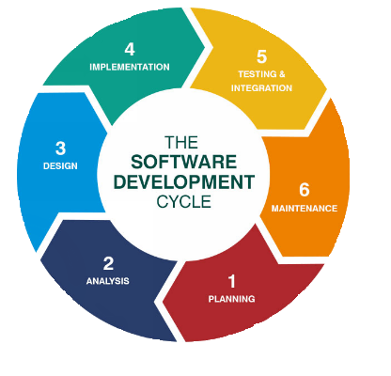
Software development life cycle
Analysis
Collaborate with stakeholders.
Gather Requirements.
Design
Define detailed process for functionality.
Define technologies, limitations, time frames and budget.
Implementation
Development begins.
Functionality is broken up into smaller increments.
Testing
Occurs In conjunction with Development.
Process for identifying and mitigating reported defects and issue tracking.
Deployment
Testing complete and product is released to market.
Maintenance
Product in production environment.
Developers must be ready to implement NEW features and bug fixes as they come up.
Notes:
Analysis –This is where leadership consults the stakeholders to find out as much information as possible on the requirements for the desired product in question
Design – during this phase of the life cycle the details on how the product needs to function. This is where the product resources, limitations of the product, and timeframe and budget is determined.
Development – In this phase, the development begins. This is the longest phase of the life phases, this is due to the fact that each item is broken down into small increments and assigned accordingly.
Testing – In conjunction with development, testing is also a common activity. This happens at all phases, but this is where the already existing code is checked for bugs and any functional issues.
Deployment – In this stage, testing is complete, and the product is ready to be deployed to market. UAT (User Acceptance Testing) may be performed in a limited environment before releasing to the market.
Maintenance – In this stage, the product has been deployed into the market. Developers must be ready and able to address any new features and bug fixes that users request and experience in production.

Slide 4
Describing waterfall model
Traditional development model that was used
Linear, sequential, and plan-driven.
Requires detailed documentation before starting development.
Step-wise model:
Analysis
Design
Implementation
Testing
Maintenance

Slide 5
Waterfall vs. agile
Waterfall
Agile
Requirements are easily defined upfront
Clear understanding final product vision
Future changes are not expected
Client is less involved
Time frame is fixed and can be easily planned for
Requirements are defined with greater detail
Final product is a hard start
High client involvement
More flexible scope
Harder to estimate
Easier to adjust to required changes

Slide 6
References
Charles G. Cobb. (2015). The Project Manager’s Guide
to Mastering Agile : Principles and Practices for an Adaptive Approach. Wiley. Software Development Life Cycle (SDLC). (2021, May 19). Retrieved February 2022, from
linkedin.com: https://www.linkedin.com/pulse/software-development-life-
cycle-sdlc-tutorial-richard-harris/

