Slide 1
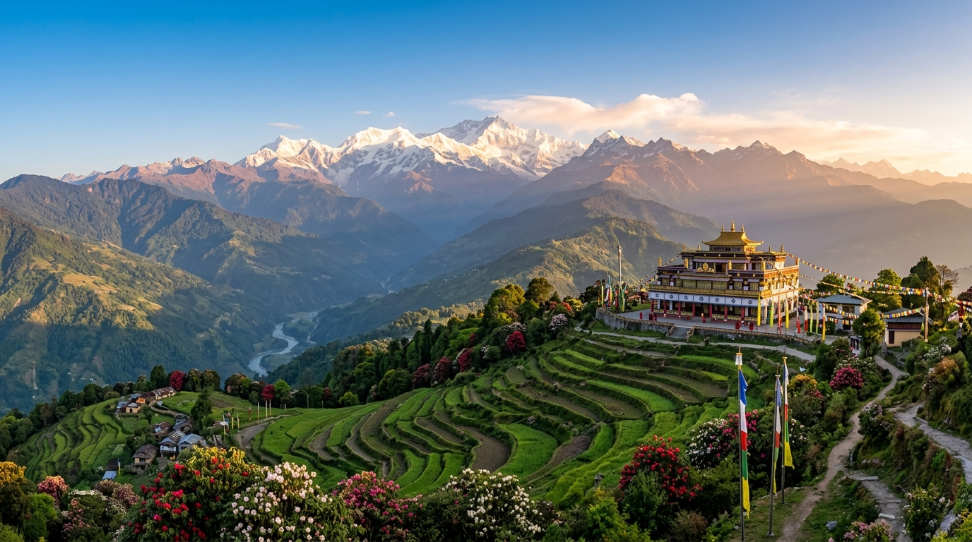
ART-INTEGRATED COMPARATIVE STUDY
Glimpses of India: Goa & Sikkim
A comparative exploration of Portuguese-influenced Konkan coastal traditions and sacred Himalayan Buddhist monastic arts.
Collaborative Research Faculty • Autumn Exhibition • EK BHARAT SHRESHTHA BHARAT

Slide 2
HIMALAYAN HERITAGE
Sacred Traditions of Sikkim
Where ancient Lepcha folklore, Bhutia monastic rituals, and Nepalese rhythms converge.
8th C.
FOLKLORE
Singhi Chham & Snow Lion
GURU PADMASAMBHAVA ORIGINS
Masked Cham dances originated in the 8th century as sacred spiritual choreographies designed to purify negative energies and bestow communal blessings.
MUSIC
Acoustic Percussion: The Damphu

Slide 3
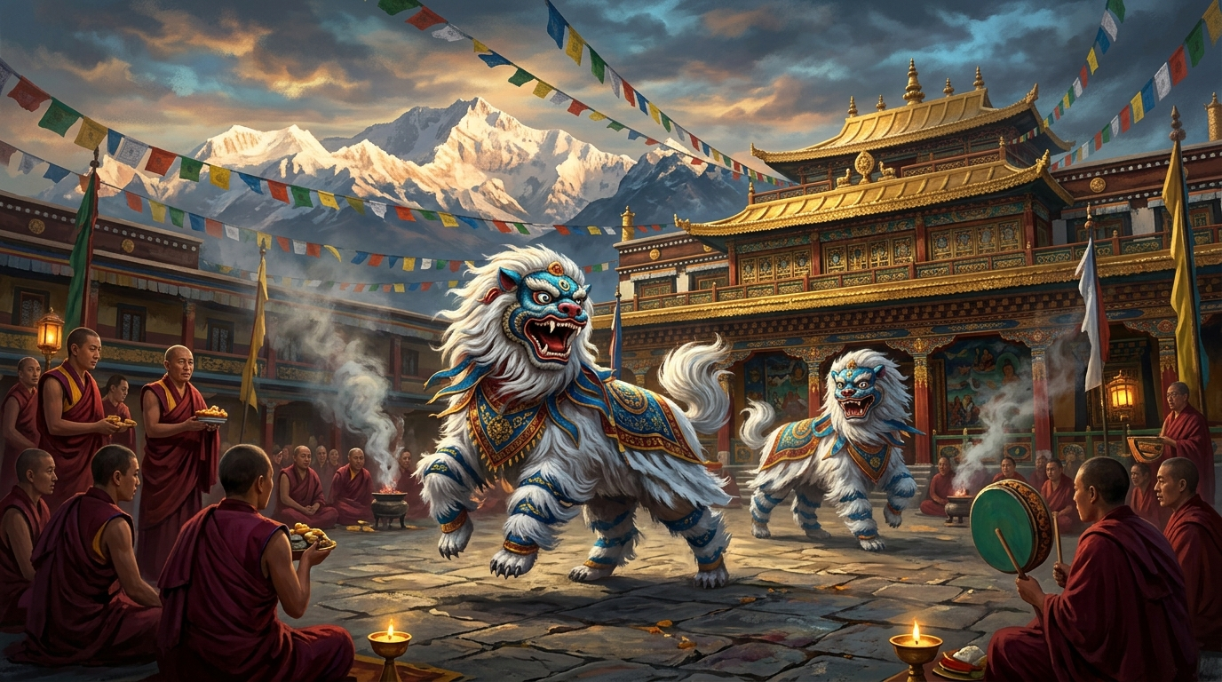
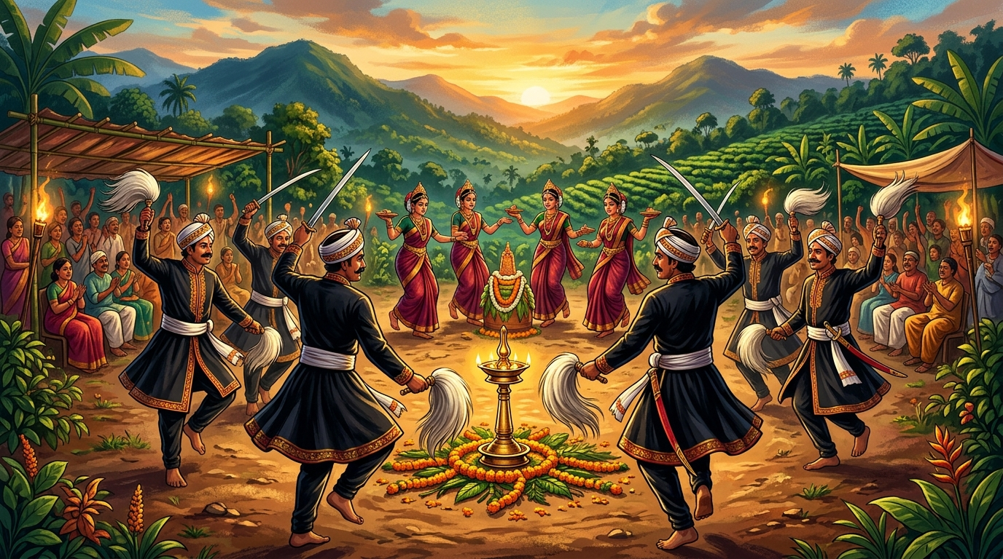
VISUAL ARTS & SACRED DANCE
Living Traditions: Cham Rituals & Folk Dances
Photographic documentation of sacred masked choreography and coastal festival expressions.
SIKKIM: Cham Sacred Mask Ritual
WESTERN GHATS & KONKAN: Folk Expressions
Monastic lamas enact spiritual protector deities during sacred annual festivals.
Communal agrarian harvests celebrated with rhythmic percussion and martial choreography.

Slide 4
ARCHITECTURAL COMPARISON
Baroque Churches vs. Timber Gompas
Two distinct architectural solutions shaped by geography, geology, and spiritual devotion.
GOA • LATIN COLONIAL
SIKKIM • HIMALAYAN TIBETAN
Basilica of Bom Jesus
Pemayangtse Gompa
Constructed in 1605 from volcanic red laterite stone
Centuries-old timber joinery resilient to Himalayan seismic shifts
Soaring Baroque façade with Corinthian and Doric capitals
Multi-tiered wooden mandalas hand-carved over five years
VS
Houses the sacred relics of St. Francis Xavier in silver casket
Vibrant mineral pigment murals depicting Buddhist cosmologies

Slide 5
SYNTHESIS & REFLECTION
The Fabric of Cultural Synergy
Understanding how diverse geographies shape human expression and collective memory.
“
"Despite thousands of miles of geographical separation—from the salt breezes of the Arabian Sea to the snow-crested peaks of Kanchenjunga—both cultures preserve their history through rhythmic movement, communal feast lore, and sacred architecture."
— Art-Integrated Learning Project, CBSE National Curriculum Integration

