Slide 1
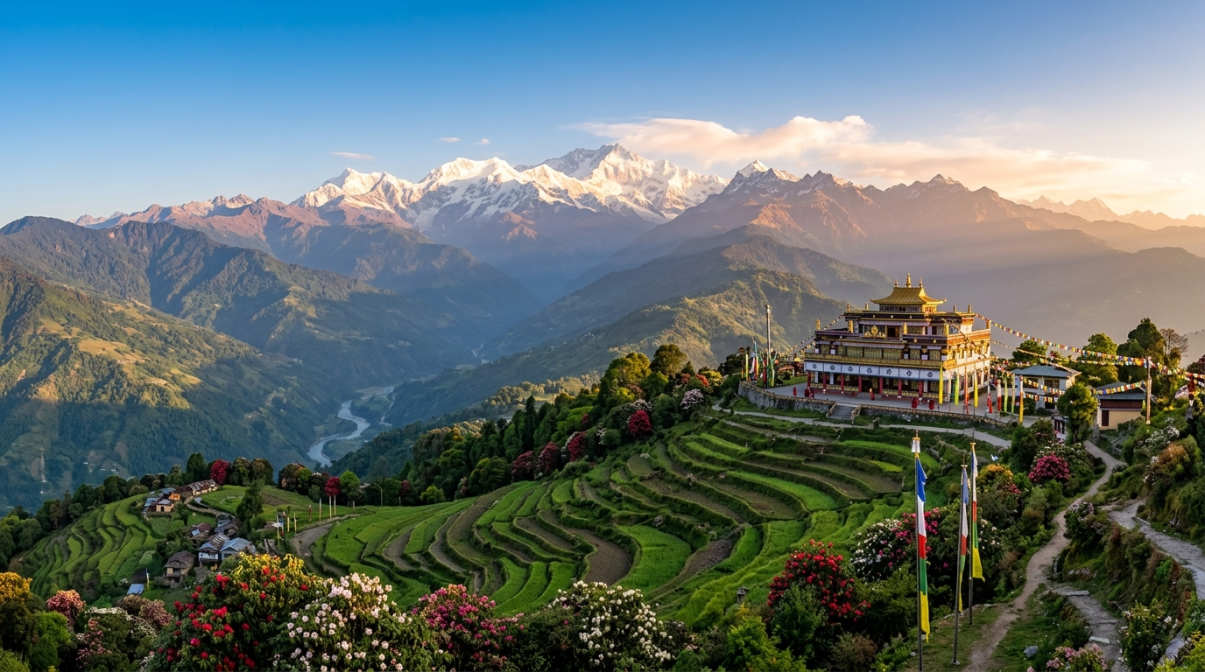
VISUAL SHOWCASE
Himalayan Vistas
Natural landscape and biodiversity of Sikkim.
Kanchenjunga and surrounding glacial ranges captured at sunrise.

