Slide 1
ARTEMIS ANALYTICS QUANT RESEARCH COMPETITION — TRACK 1
Funding-Rate Mean Reversion:
An Honest Null
A Sharpe-1.9 backtest that we deliberately tried to break — and the honest reasons we would not trade it.
Crypto Factor Rebalancing · Hyperliquid Perpetual Futures
Presented by Daniel Connelly & Jack Brogan · June 1, 2026
Notes:
Our entry is an honest null result. We found a funding-rate mean-reversion strategy with a Sharpe of 1.9 in backtest, then ran a battery of honesty tests designed to detect luck. It failed two of four gates. We are presenting the diagnosis, not a trade. The competition rewards the best thinking, not the best P&L — that is exactly the spirit of this deck.

Slide 2
THE INTUITION
The Idea, in Plain English
Funding rate = a crowding thermometer.
The everyday analogy
A perpetual future is a crypto bet with no expiry date. To keep its price glued to the real (spot) price, traders pay each other a small recurring fee called the funding rate.
When a trade gets crowded, that fee spikes:
• Everyone piling in LONG -> very high funding (longs pay).
• Everyone piling in SHORT -> very negative funding (shorts pay).
Our bet: the over-loved, over-leveraged side tends to snap back. Crowded longs underperform; crowded shorts outperform.
“Betting Against the Crowd.”
When a stock — or a coin — becomes everyone's favorite, it has often already had its run. The most loved end of the market tends to earn less than its risk would suggest.
Funding rate just gives us a clean, real-money gauge of exactly how crowded each coin is, every single day.
Notes:
Keep this plain. A perpetual future has no expiry, so an exchange uses the funding rate — a real fee one side pays the other — to keep it pinned to spot. Extreme funding means a crowded, over-leveraged trade. Our hypothesis is mean reversion: the crowded side snaps back. It's the same instinct as betting against the most-hyped stock.

Slide 3
HOW IT WORKS
The Trade
1
2
3
4
Rank
Buy the cheap side
Sell the hot side
Stay neutral
Every day, score the top-35 coins by how extreme their funding is.
Go LONG the coins with the lowest (most negative) funding — the crowded shorts.
Go SHORT the coins with the highest funding — the crowded longs.
Equal dollars long and short, so we bet on the gap, not on the market direction.
Two terms, defined once:
• Market-neutral — equal money on both sides, so a broad crypto crash or rally roughly cancels out. We only profit from the spread between the two baskets.
• Rebalanced daily — we refresh the baskets each day, holding each position about two weeks (a 14-day horizon).
Notes:
Mechanically simple. Each day we rank the top-35 coins by a funding z-score, buy the lowest-funding names, short the highest, equal-weight, dollar-neutral, rebalanced daily with roughly a two-week holding horizon. Market-neutral means we are betting on the spread, not on whether crypto goes up or down. Note for later: the parameters were chosen by a sweep — we mined them, which is the seed of the whole honesty story.

Slide 4
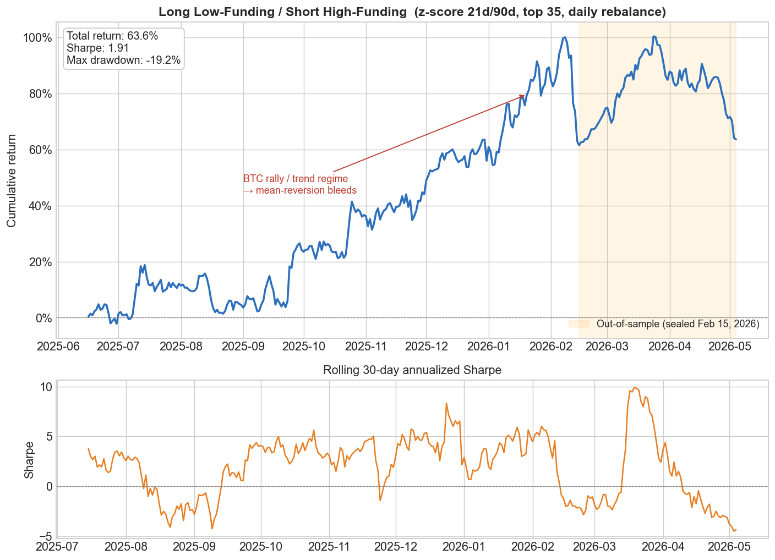
THE BACKTEST
Act 1: It Looked Like a Winner
+63.6%
1.91
Total return (~1 yr)
Sharpe ratio
-19%
May '25–'26
Max drawdown
Backtest window
On paper, a strong result.
A Sharpe near 2 with a manageable drawdown is the kind of curve that gets a strategy funded. The honest question is: is it real, or did we get lucky?
Notes:
This is the seductive part. Plus 63.6% over about a year, Sharpe 1.91, worst drawdown only minus 19 percent. The shaded region is out-of-sample and the dip is the January 2026 BTC rally — hold that thought. A naive team ships this. We didn't, because the parameters were mined and one year of crypto is thin, regime-driven data.

Slide 5
ACT 2 BEGINS
Why We Didn't Trust It
A great-looking number is the beginning of the work, not the end.
We mined the parameters
Crypto history is short
The market changes regime
The look-back windows and holding period were picked by searching over dozens of combinations. Search hard enough and something always looks great by chance.
About one year of data. That isn't enough to tell skill from luck, especially for a daily-rebalanced strategy.
Crypto swings between calm, range-bound stretches and violent trends. A strategy can look brilliant in one regime and bleed in the next.
So we stopped trying to confirm the strategy and started trying to kill it.
Notes:
Three reasons for suspicion. One, we mined the parameters over 56 combinations — searching hard guarantees something looks good by chance. Two, only about a year of data. Three, crypto is regime-driven. The right scientific move is to invert the goal: instead of confirming the strategy, actively try to falsify it.

Slide 6
OUR HONESTY SCORECARD
The Four-Gate Stress Test
Four pass/fail gates a strategy must clear before we would ever deploy it.
Gate | The question it asks | Result
1. Statistical significance | After correcting for how many combos we tried, is the edge still real? (0 of 56 survive; traded-spread p = 0.057) | FAIL
2. Sign stability | Does the edge point the same way on a sealed out-of-sample window? (+12.7% out-of-sample, ~76% of in-sample Sharpe) | PASS
3. Overfitting penalty | Discounting for how hard we searched, is it better than a coin flip? (Deflated Sharpe = 47%, bar is 95%) | FAIL
4. Survives real costs | Does it still work after realistic trading fees, even doubled? (gross 107.8% -> net 94.8% ann.; 82.7% at 2x) | PASS
Notes:
This scorecard is the heart of the entry. Four gates. Gate 1, significance after multiple-testing correction: zero of 56 combos survive, the traded spread is p = 0.057 — FAIL. Gate 2, sign stability out-of-sample: +12.7%, about 76 percent of in-sample Sharpe — PASS. Gate 3, the Deflated Sharpe penalizes for search effort: 47 percent, a coin flip versus a 95 percent bar — FAIL. Gate 4, costs: 107.8% gross to 94.8% net, +82.7% even at double fees — PASS. Two of four.

Slide 7
THE VERDICT
2 of 4 gates
NOT DEPLOYABLE
It makes money and survives costs — but it cannot clear an honest significance bar. That conclusion is the deliverable.
Notes:
Two of four. The verdict is NOT DEPLOYABLE. We want to be very clear: this is not us hiding a loser. It is us refusing to ship a winner we cannot statistically defend. The discipline to say no here is the point of the whole exercise.

Slide 8
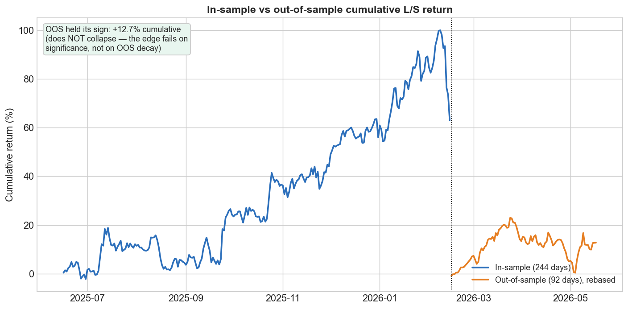
THE KEY INSIGHT
The Twist: How It Failed Matters
It didn't fail by losing money.
The strategy is big, survives realistic costs, and even stayed positive on data it had never seen (+12.7% out-of-sample).
It died on exactly — and only — the two tests built to detect luck:
• significance after a hard search, and the search-penalized Deflated Sharpe.
A big, cost-robust, out-of-sample-positive number that still can't clear an honest significance bar is the textbook fingerprint of data-mining.
In-sample vs. out-of-sample: the edge carried forward (+12.7%) — yet still fails the luck tests.
Notes:
Here is the insight the judges should remember. This strategy fails in the most instructive way possible. It is not a money-loser; it makes a lot, beats costs, and even carries into out-of-sample. It dies specifically on the two tests for luck. That precise signature — large, robust, OOS-positive, but significance-failing — is the textbook fingerprint of data-mining. Diagnosing that is our actual deliverable.

Slide 9
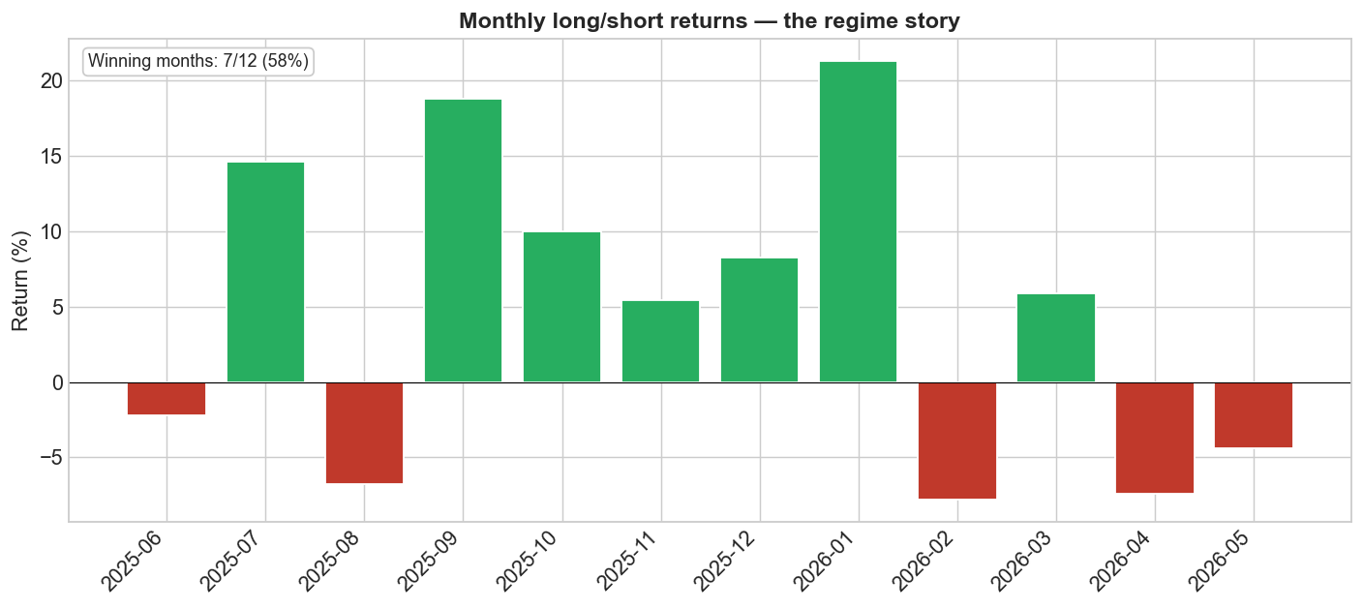
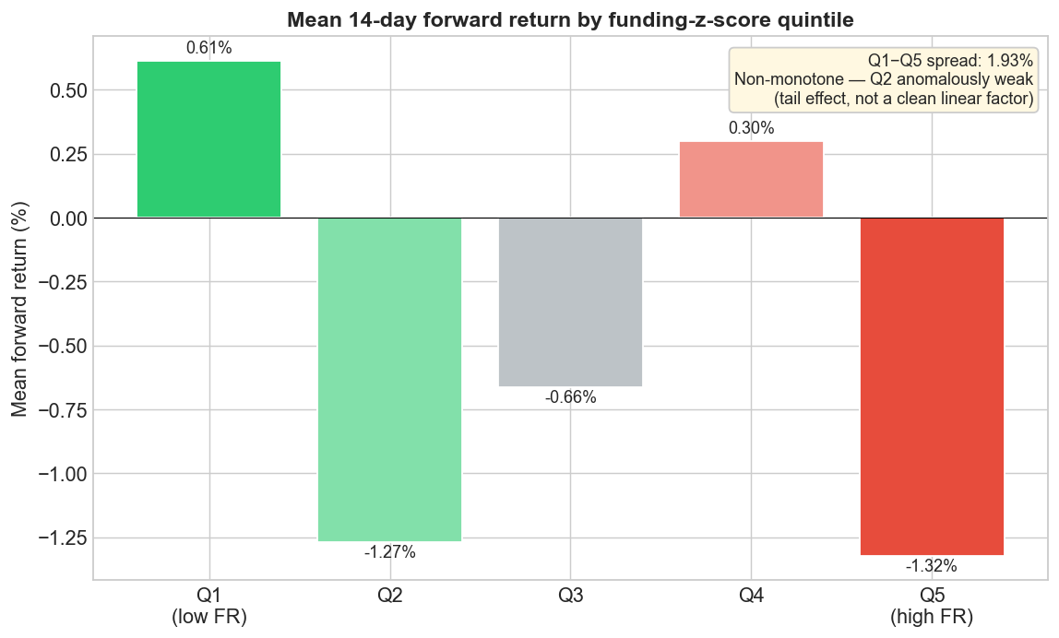
THE LESSONS
What We Learned
1. Regime is everything
2. It's a tail effect, not a clean factor
The factor works when the market is range-bound and bled during the January-2026 BTC rally — when crowded longs kept being right, mean reversion is the wrong bet.
Returns aren't a clean line across funding levels — the relationship is non-monotone (the second-lowest-funding bucket is anomalously weak). The edge lives only in the extreme tails, fragile and easy to mis-trade.
Notes:
Three lessons. One, regime is everything — the factor works range-bound and bled during the Jan-2026 BTC rally, because when crowded longs keep being right, betting on reversion loses. Two, the signal is a non-monotone tail effect, not a clean linear factor — Q2 is anomalously weak (nearly as low as Q5), so the edge lives only in the extreme tails. Three, and most important, the rigor changed the conclusion: a naive process would have shipped a Sharpe-1.9 winner.

Slide 10
FOR THIS COMPETITION
Why This Is the Right Answer
“We are not looking for the most profitable strategy — we are looking for the best thinking. A negative-Sharpe strategy that is correctly understood and honestly evaluated will score better than impressive returns with no critical analysis.”
— Artemis competition brief
We delivered the thinking
What would make it deployable
• A clear, plain-English hypothesis with real economic logic.
• A pre-committed pass/fail framework, not after-the-fact rationalizing.
• A correct diagnosis: an attractive backtest that is most likely data-mining.
• Named limitations and a concrete path forward.
• Add a regime filter — only trade when BTC is range-bound.
• Get a longer, survivorship-corrected history.
• Pair it with an offsetting trend / momentum factor.
• Trade only the extreme tails, where the real edge lives.
Notes:
Tie it back to the brief: best thinking over best backtest. We delivered a clear hypothesis, a pre-committed pass/fail framework, the correct diagnosis of data-mining, and named limitations with a path forward. To make it real we would add a regime filter, get longer survivorship-corrected data, pair it with a trend factor, and trade only the tails.

Slide 11
REFERENCE
Appendix: Methodology & Numbers
Methodology, one page
• Universe: top-35 Hyperliquid perpetuals by volume.
• Signal: funding z = (21-day mean − 90-day mean) / 90-day std.
• Trade: long lowest-z, short highest-z; equal-weight, dollar-neutral.
• Horizon: 14-day holding; rebalanced daily.
• Params chosen by a multi-parameter sweep (hence the overfitting tests).
Known limitations:
survivorship bias (delisted coins silently dropped); point-in-time universe bias (7 coins listed mid-study); ~1-year history; partially-burned out-of-sample.
Metric | Value
Total return (backtest) | +63.6%
Sharpe ratio | 1.91
Max drawdown | -19%
Out-of-sample return | +12.7%
Bootstrap p-value (spread) | 0.057
Combos surviving correction | 0 of 56
Deflated Sharpe | 47%
Costs ~6.5%/yr: 107.8% gross -> +94.8% net ann. (+82.7% at 2x).
Reproducible: code + notebooks on GitHub; run end-to-end to regenerate every figure and number.
Notes:
Reference slide for Q&A. Methodology recap on the left, the headline numbers in the table, and the cost / reproducibility note at the bottom. Everything here is reproducible from the GitHub repo and notebooks. Be ready to talk through the named limitations: survivorship bias, point-in-time universe bias, short history, and a partially-burned out-of-sample window.

