Slide 1
Axel Wallau
Bootstrap4 (Alpha)
Entwicklertag 25.09.2015

Slide 2
Bootstrap4 (Alpha)
WAS ?
Bootstrap v4.0.0-alpha

Slide 3
Bootstrap4 (Alpha)
WOHER ?
http://v4-alpha.getbootstrap.com/
https://github.com/twbs/bootstrap/tree/v4-dev
CDN: https://cdn.rawgit.com/twbs/bootstrap/v4-dev/dist/css/bootstrap.css

Slide 4
Bootstrap4 (Alpha)
WAS IST NEU ?
SASS
  +1 grid tier
px
IE8 (IE9)
Cards
JS (ES6)

Slide 5
Bootstrap4 (Alpha)
WIE ? SASS-Version
one fits all
  (autoprefixer)

Slide 6
Bootstrap4 (Alpha)
WIE ? CSS-Version
Flex- / Table-Version

Slide 7
Bootstrap4 (Alpha)
UPDATE VON V3
Einfach!
(thumbnails, wells, panels)

Slide 8
Bootstrap4 (Alpha)
SASS-CONFIG (BEISPIELE)
            $enable-flex: true;
            $container-max-widths: (
                xs: 0,
                sm:34rem,
                md:48rem,
                lg:62rem,
                xl:75rem
            );

Slide 9
Bootstrap4 (Alpha)
ROOT:
font-size: 16px
XS
x < 34em
SM
34em < x < 48em
MD
48em < x < 62em
LG
62em < x < 75 em
XL
x > 75em

Slide 10
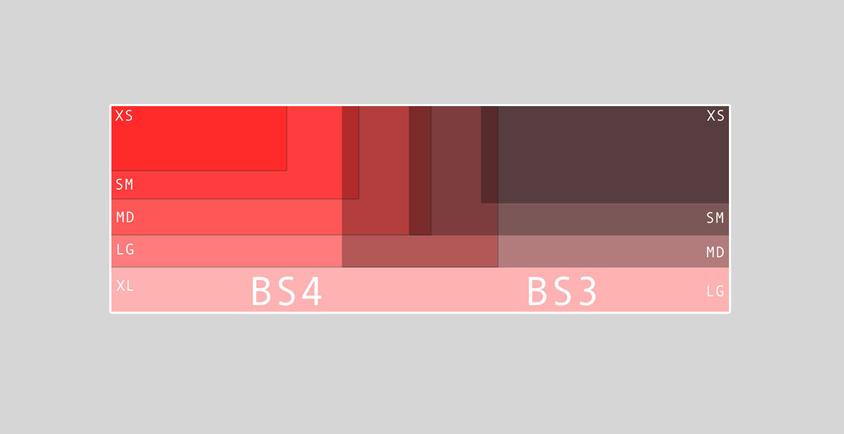
Bootstrap4 (Alpha)

Slide 11
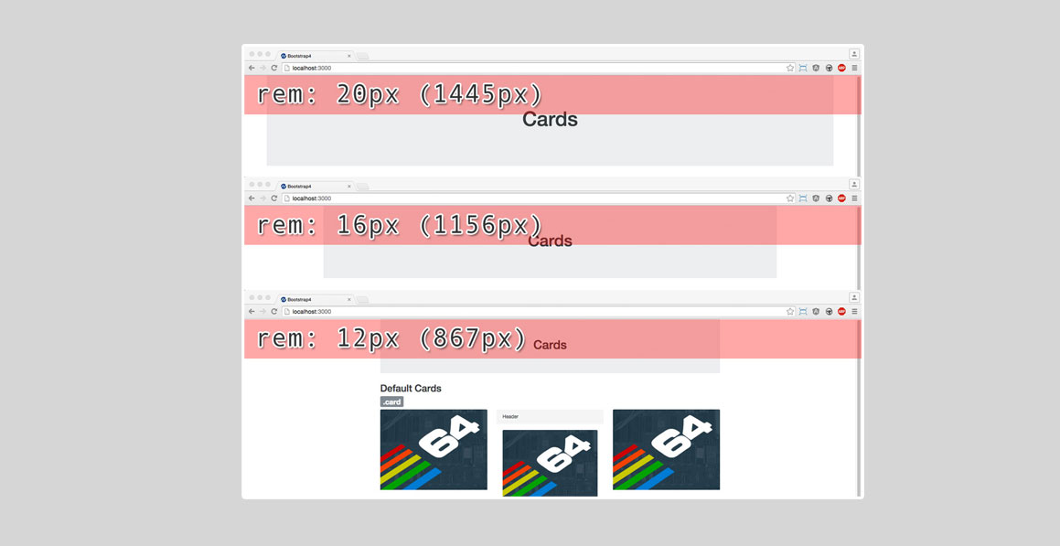
Bootstrap4 (Alpha)

Slide 12
Bootstrap4 (Alpha)
CARDS
Eierlegende Wollmilchsau
Ersetzen:
Thumbnails
Wells
Panels

Slide 13
Bootstrap4 (Alpha)
FLEXBOX
CSS3
IE10+
FF38+, GC31+
ANDROID 4.1+ (GC 44+)
IOS 7.1+

Slide 14
Bootstrap4 (Alpha)
FLEXBOX
<div id="flex_demo_container">
<div id="flex_header" class="flex">
<h2>Header</h2>
<div id="flex_icons">
<% %w(alarm bulb home settings trash).each do |ico| %>
<%= image_tag "icon_#{ico}.png" %>
<% end %>
</div>
</div>
<div id="flex_body">
<div id="flex_main" class="flex">Main</div>
<div id="flex_nav" class="flex">
<ul>
<% (1..7).each do |idx| %>
<li><%= idx %></li>
<% end %>
</ul>
</div>
<div id="flex_sidebar" class="flex">Sidebar</div>
</div>
<div id="flex_footer" class="flex">Footer</div>
</div>

Slide 15
Bootstrap4 (Alpha)
#flex_demo_container {
flex-flow: column;
height: 100vh;
}
#flex_header {
align-items: center;
justify-content: space-between;
}
#flex_body, #flex_main {
flex-grow: 1;
}
#flex_nav, #flex_sidebar {
min-width: 200px;
}
#flex_nav {
order: -1;
ul {
display: flex;
justify-content: space-between;
}
}
@media (max-width: 768px) {
#flex_header, #flex_body {
flex-flow: column;
}
#flex_nav {
background-color: orange;
}
}

