Slide 1
UR3 CobotOps Automation Analysis
Deirdre Boland
28 Mar 2025

Slide 2
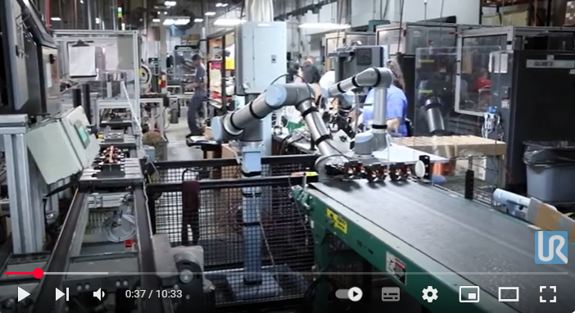
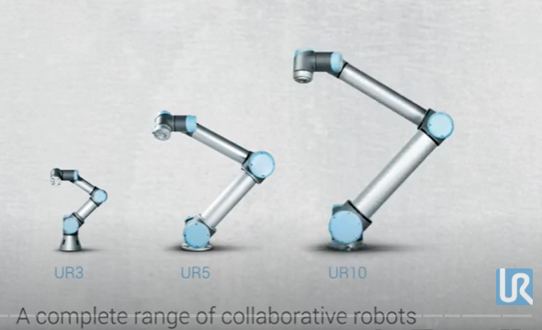
Introduction and Dataset
Robotics/automation: Working with robotics and automation creates workflow efficiencies.
To get the most out of your robotic system and optimise planning, you must understand its operation and mitigate for issues.
Dataset: UR3 CobotOps Dataset - time-series data from the UR3 cobot
offers insights into operational parameters and faults.
Currents, speeds across joints (J0-J5), gripper/tool current, operation cycle count, protective stops, and grip losses
Objective: Explore data and investigate feasibility of error prediction
Pre-processing: All features continuous except cycle, grip lost and protective stop
Only continuous features had missing data - filled missing data with data from previous row
Grip lost changed False to 0 and True to 1
Extracted timestamp, date and time data in correct format
Dataset Reference: M. Tyrovolas, K. Aliev, D. Antonelli, and C. Stylios. "UR3 CobotOps," UCI Machine Learning Repository, 2024. https://doi.org/10.24432/C5J891
Video reference: Robotics applications by Universal Robots - Easy Automation with Collaborative Robots [ 2020 ]
Collaboration at all levels – experience Universal Robots in 21 applications at Hanover Fair 2017

Slide 3
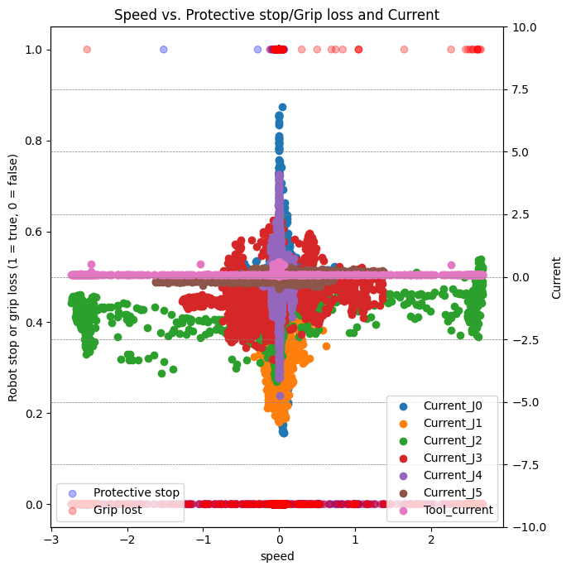
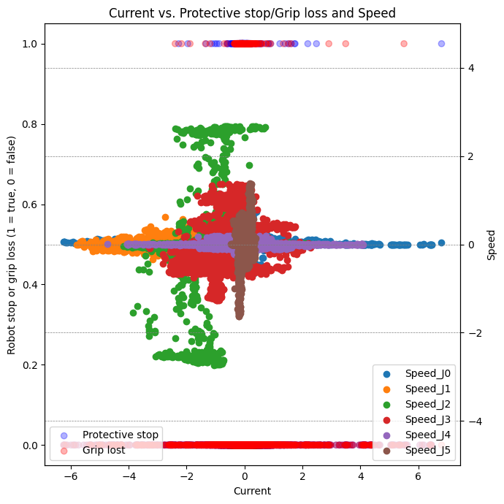
EDA: Current and speed
Current and speed centralised on zero with negative and positive indicating or controlling cobot arm movement in different directions
Each arm J0-J5 and the tool/gripper has it’s own pattern
Grip loss or protective stop faults happen less in negative range
*EDA:Exploratory data analysis

Slide 4
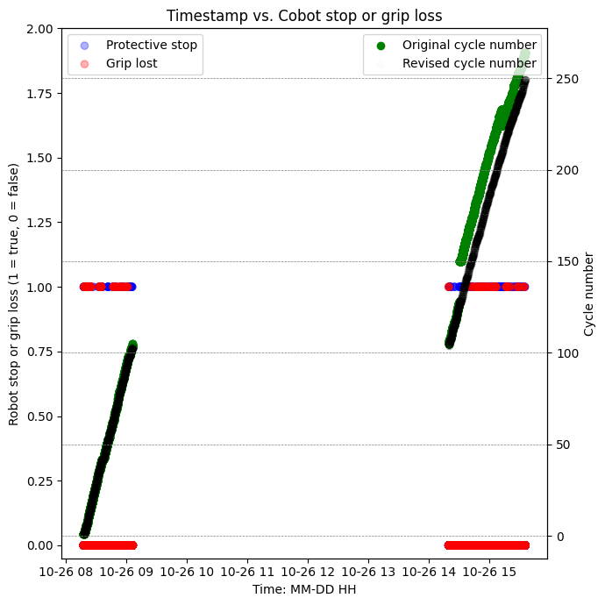
EDA: Cycles and faults over time
Major stop in operations from approx 09:00 until 14:00
Cycles out of sync of expected after this
Could be planned or human intervention and re-planning due to robot issues
Generated new features
New cycle such that cycles are continuous with timestamp
Likely errors that cycles were skipped/repeated
Cycle timepoint sec
Compare cycle stages as cycles are varying durations

Slide 5
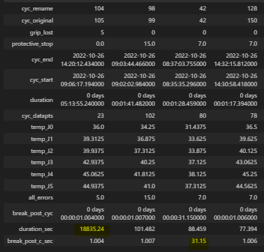
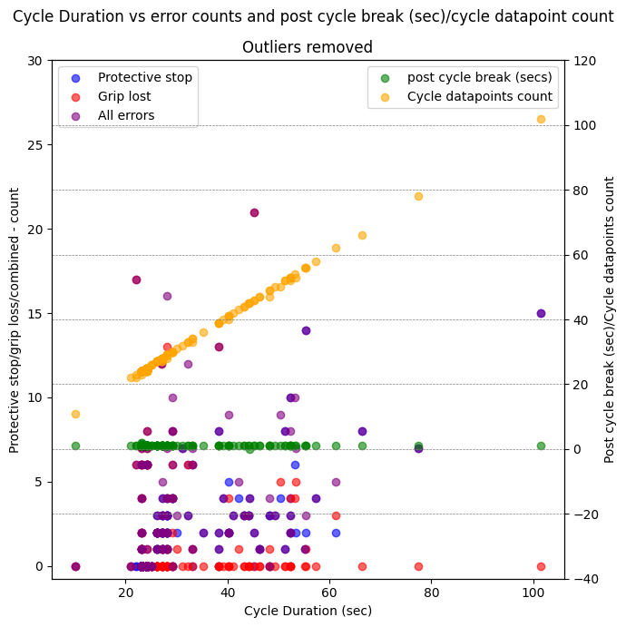
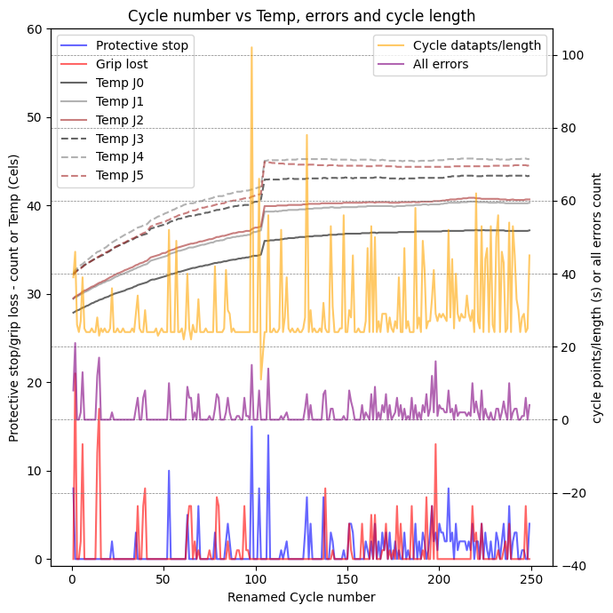
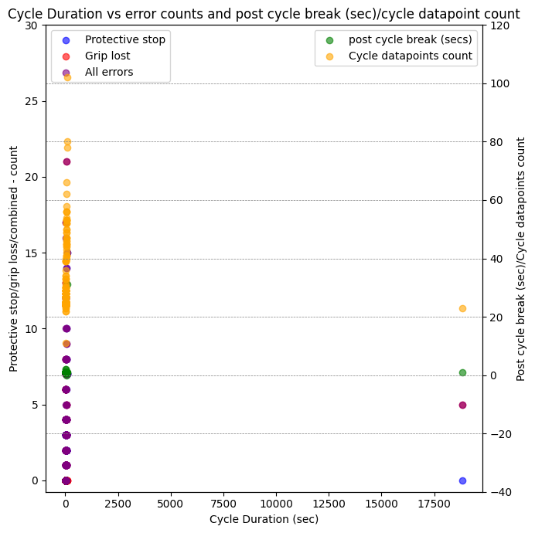
EDA: Cycle Summary – Temperature, duration, post cycle & error behaviour
Generated summary table for each cycle
2 outlier data rows removed
Break post cycle consistently approx 1sec
Automation controlled unless human interference (deleted outlier)
Expected might be a relationship of higher error counts and longer
cycle duration - linear relationship is only cycle datapoints count
Different activities each cycle?
or
Robot automatically devising next best move, making cycles length inconsistent – is timing an issue for the cycles/process?
Temperature increase over course of day with uptick at cycle 104 where long break occured
Protective stops most cycles at higher temps, later in the day

Slide 6
Streamlit (video): Updated 02Apr Data Summary Generator Application
DevAcProj_CobotOps/Cobot_data_summ_app_vid.mp4 at main · Ddbol/DevAcProj_CobotOps

Slide 7
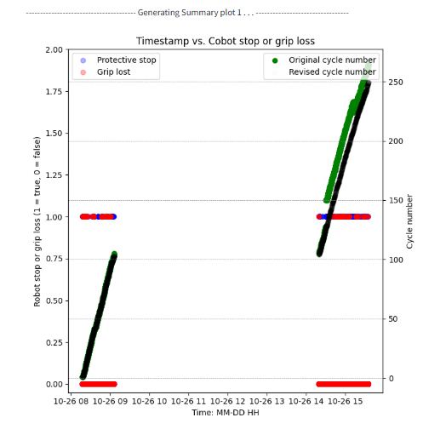
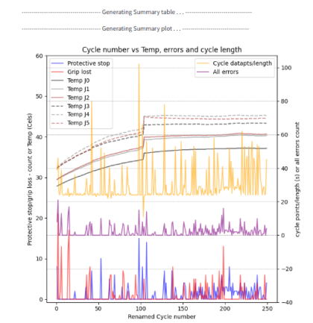
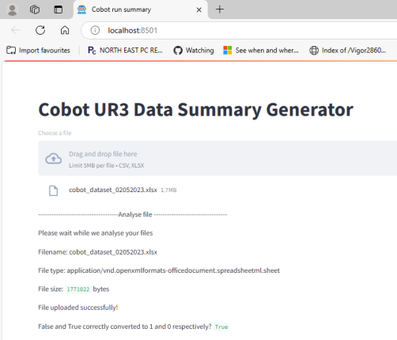
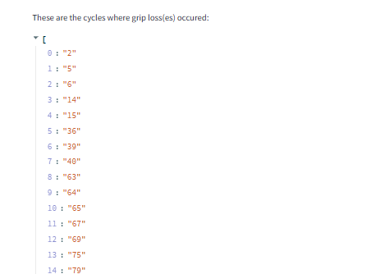
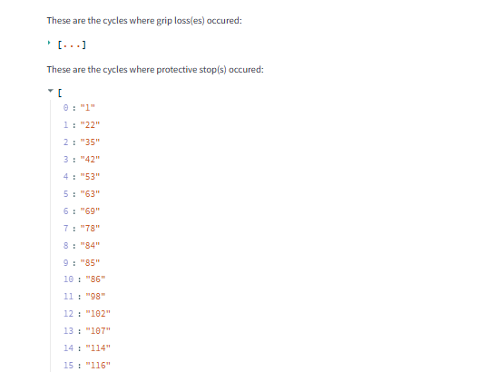
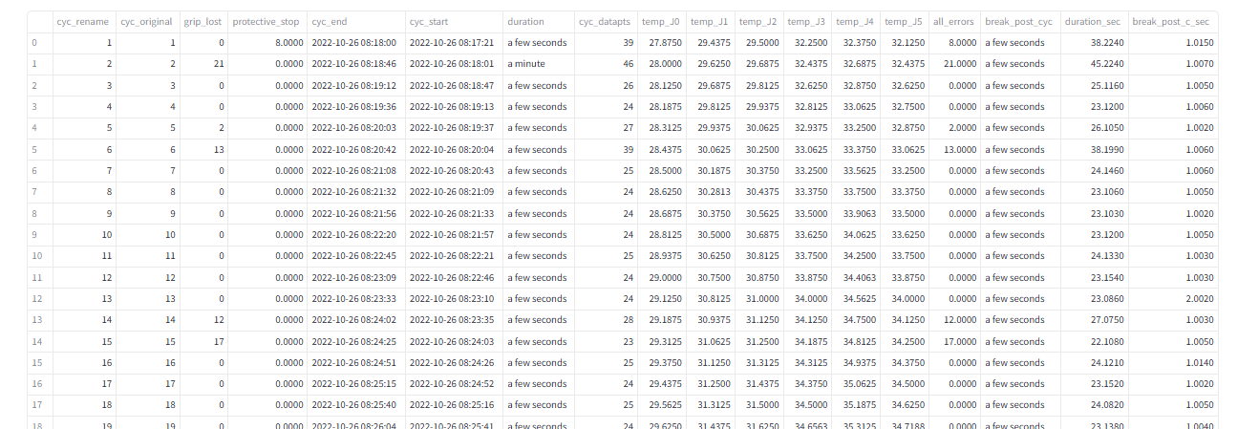
Streamlit (screenshots): Data Summary Generator Application

Slide 8
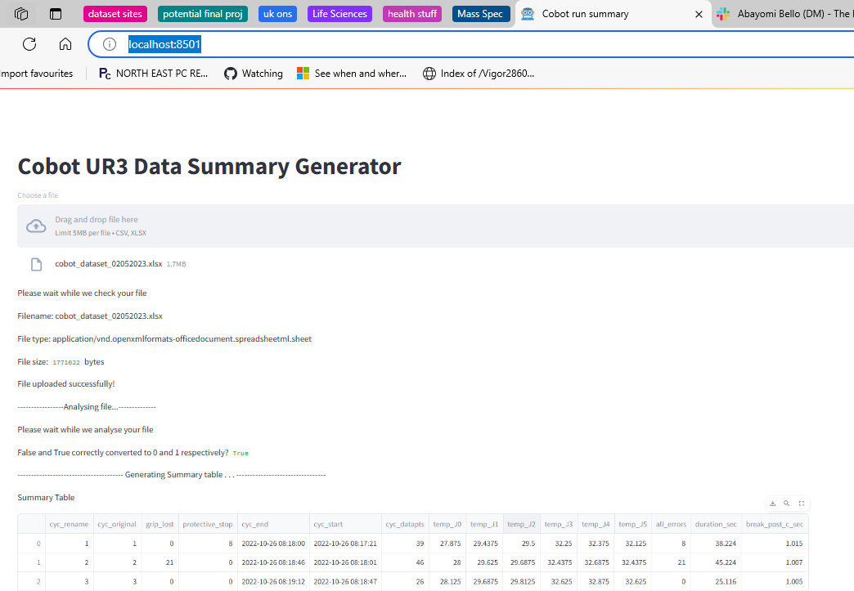
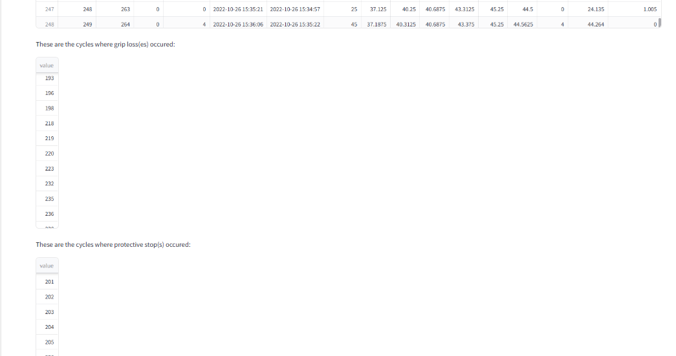
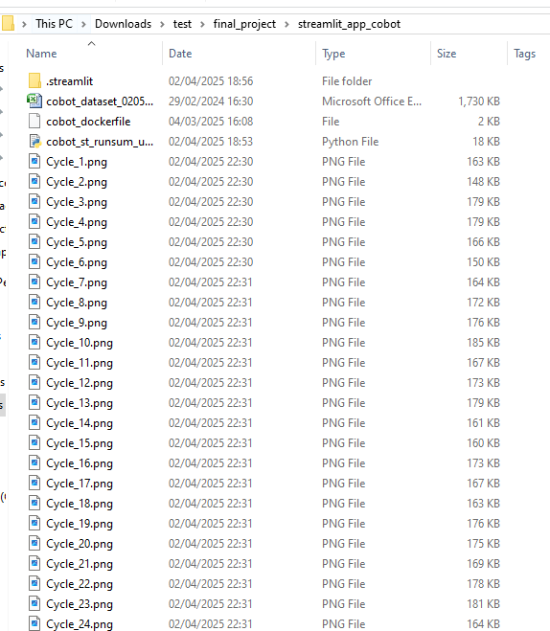
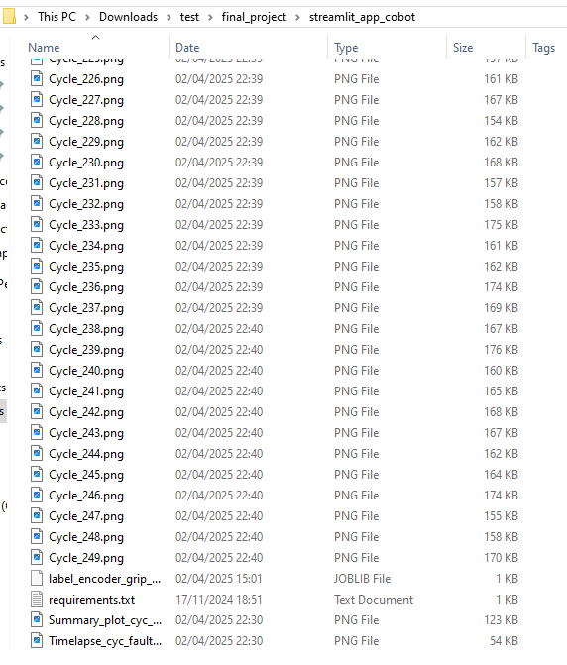
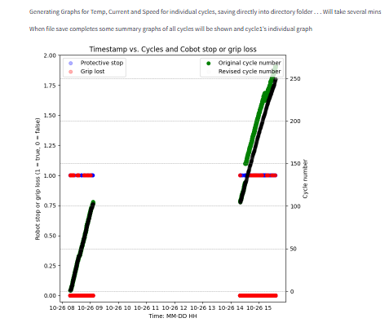
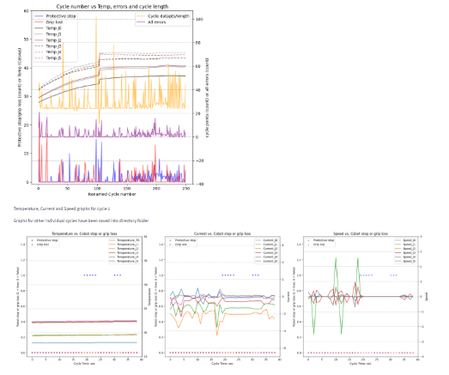
Streamlit (screenshots): Updated 02Apr Data Summary Generator Application
Generated files for each cycle in directory

Slide 9
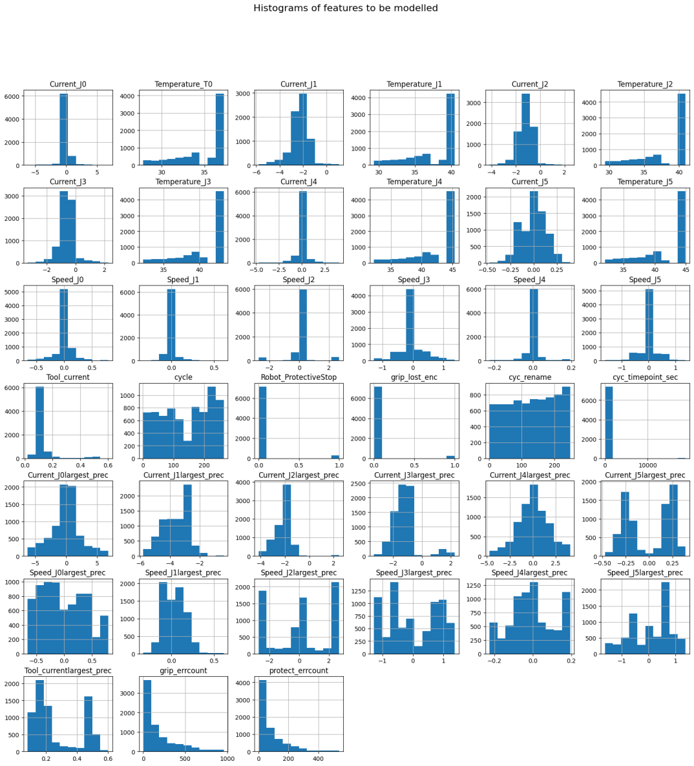
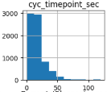
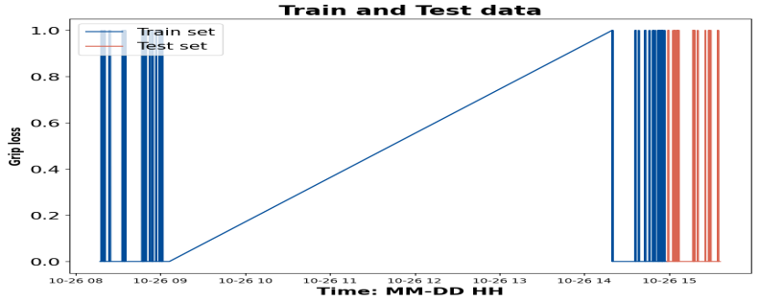
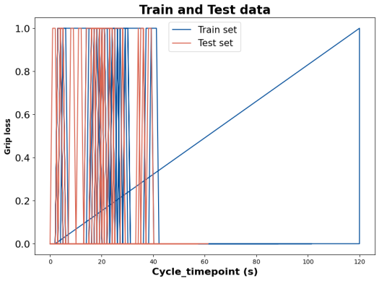
Machine Learning (ML) modelling prep
Timeseries - Ideally predict next fault/error based on previous data of day. (80/20 trainin/testing dataset)
Used AutoML AutoGluon to check feasibility but returned no models – likely due to large chunks missing data
Transform the dataset so can solve with traditional, tabular classification algorithms - Connect data from previous rows
Errors/faults – Very imbalanced, mostly no errors/faults
Errors/faults – Count up how long since last error happened
Current and speed – look back at previous 10 rows and extract the number of largest magnitude (positive or negative)
Removed timestamp - covered by cycle and cycle timepoint
Clipped cycle timepoint (secs) to remove several hour outlier
AutoML AutoGluon suggested RandomForest and KNN, among others
Ref: https://stackoverflow.com/questions/44744584/multiple-time-series-with-binary-grip_lost_enc-prediction

Slide 10
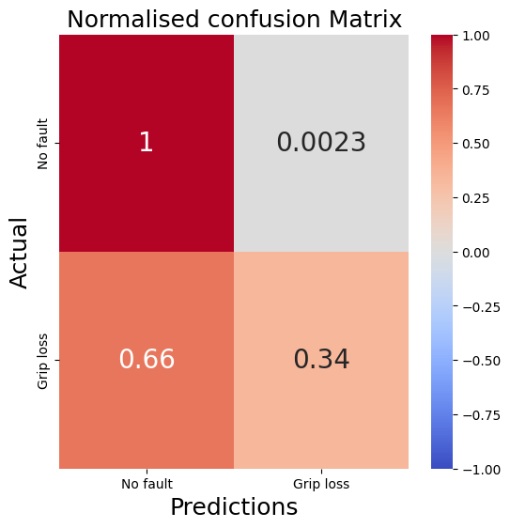
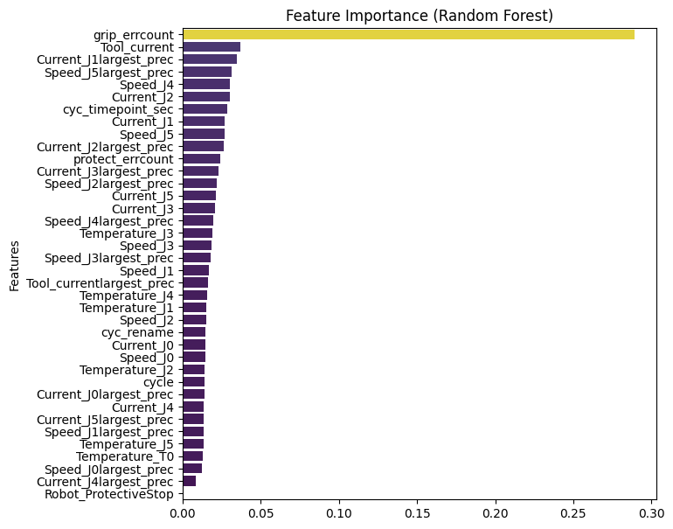
ML modelling - results
Data scaled
Random Forest and KNN trialled based on AutoGluon results
Due to imbalanced data, high accuracy but not good at predicting the grip loss correctly
Best Random Forest gave AUC of 0.67 (measures how well predicts both outcomes), accuracy 0.97 or 97%
Unsurprising that the count of how long since last error happened has high importance

Slide 11
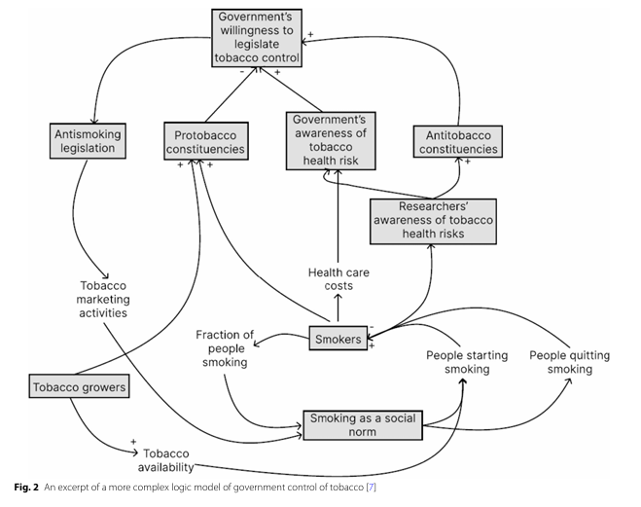
ML modelling considerations
Want to predict rest of days risk of errors/faults but need some information about what robot plans to do
Inconsistent cycle time which errors add to
hard to provide in advance for modelling
Discuss with team if can correlate robot programmed actions to this data better
Potentially better predictability if can generate expected robot actions and relate it back to the data the UR3 cobot is generating
Dataset authors using Information Flow Based – Fuzzy Cognitive Maps (IF- FCMs) to help predict machine operations – may be better approach to investigate
modification of FCMs – visual modelling approach. Image on right shows FCM of government control of tobacco. Part of modelling is to adjust weightings of interactions
References IF-FCMs and FCMs
Tyrovolas, M., Stylios, C., Aliev, K., Antonelli, D. (2024). Leveraging Information Flow-Based Fuzzy Cognitive Maps for Interpretable Fault Diagnosis in Industrial Robotics. In: Camarinha-Matos, L.M., Ferrada, F. (eds) Technological Innovation for Human-Centric Systems. DoCEIS 2024. IFIP Advances in Information and Communication Technology, vol 716. Springer, Cham. https://doi.org/10.1007/978-3-031-63851-0_6
Tyrovolas, M., Liang, X.S. & Stylios, C. Information flow-based fuzzy cognitive maps with enhanced interpretability. Granul. Comput. 8, 2021–2038 (2023). https://doi.org/10.1007/s41066-023-00417-7 (Link to github marios-tyrovolas/Information-Flow-Based-Fuzzy-Cognitive-Maps-with-Enhanced-Interpretability: Information Flow-Based Fuzzy Cognitive Maps with Enhanced Interpretability)
Mkhitaryan et al. BMC Public Health. (2023) How to use machine learning and fuzzy cognitive maps to test hypothetical scenarios in health behavior change interventions: a case study on fruit intake https://doi.org/10.1186/s12889-023-17367-z

Slide 12
Conclusions and Recommendations
Extensive exploratory data analysis lead to greater understanding of UR3 Cobot behaviour
This should help with process understanding, optimisation and planning
Generation of application to view summary data from UR3 Cobot logs to support this - to be deployed on Docker
More knowledge from team about desired outcome of cycles, impacts of inconsistent cycle times and what other data it would be useful to explore/make available to them
IF-CMs may be a better approach to automation/robotics operations modelling compared to traditional machine learning methods

Slide 13
Thank you! Q&A?
Thank you! Q&A?

