Slide 1
Predict Diabetes From Medical Records - Neural Network model investigation
Deirdre Boland 28 Feb 2025

Slide 2
Dataset and Objective
Dataset
Several medical features given with the output of whether patient is diabetic or not.
Objective
Compare performance of an artificial neural network (ANN) to other supervised classification models to predict diabetic or not
Reference – Kaggle: https://www.kaggle.com/code/paultimothymooney/predict-diabetes-from-medical-records/input?select=diabetes.csv

Slide 3
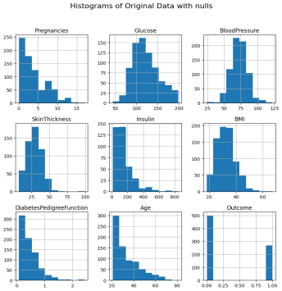
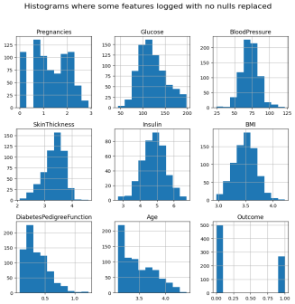
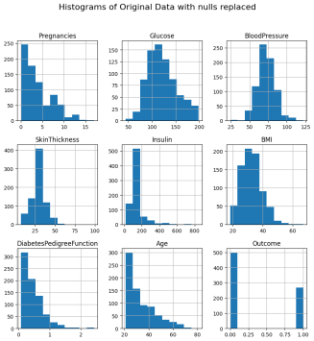
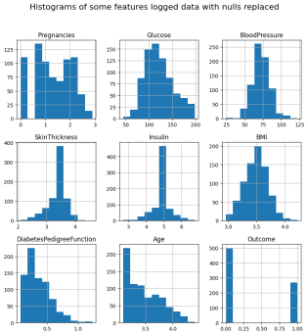
Data exploration and cleaning
1 target Outcome:
~2:1 ratio non-diabetic (0) to diabetic (1)
8 predictor features – no nulls
Initial assessment:
Illogical 0 values for several features –> likely missing data -> 0 values made null
Glucose: Plasma glucose concentration after 2 hours in an oral glucose tolerance test
Blood Pressure: Diastolic blood pressure (mm Hg)
Skin Thickness: Triceps skin fold thickness (mm)
Insulin: 2-Hour serum insulin (mu U/ml)
BMI: Body mass index (weight in kg/(height in m)^2)
No changes made to values:
Pregnancies state number of times pregnant but can’t distinguish 0 values into male or female or missing data
Diabetes Pedigree function – assess the genetic predisposition of an individual to diabetes based on their family history of disease.
Age
Compared non-logged and logged of skewed features
Replaced nulls with median/mean depending on skew post logging if applicable:
A lot of replacements affected correlation
nulls
Correlation matrix | Original data Outcome |  | Some Features Logged Outcome
 | nulls | nulls filled | nulls | nulls filled
Pregnancies | 0.22 | 0.22 | 0.18 | 0.18
Glucose | 0.49 | 0.49 | 0.49 | 0.49
BloodPressure | 0.17 | 0.17 | 0.17 | 0.17
SkinThickness | 0.26 | 0.21 | 0.26 | 0.22
Insulin | 0.30 | 0.20 | 0.35 | 0.25
BMI | 0.31 | 0.31 | 0.32 | 0.32
Diabetes Pedigree Function | 0.17 | 0.17 | 0.18 | 0.18
Age | 0.24 | 0.24 | 0.27 | 0.27
Outcome | 1.00 | 1.00 | 1.00 | 1.00
Nulls filled

Slide 4
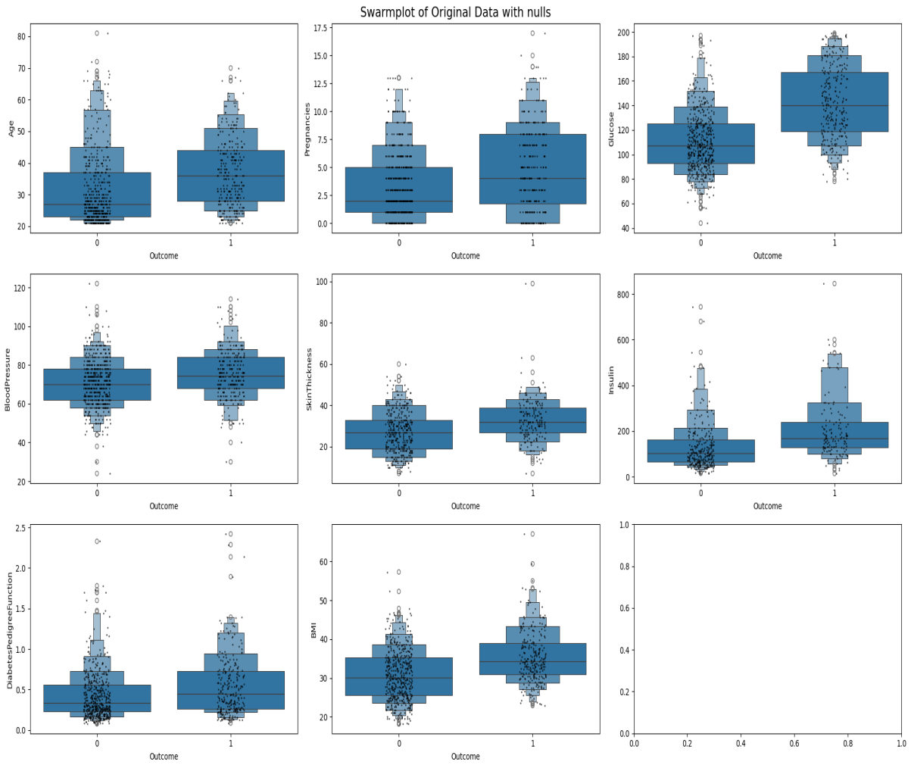
Data visualisation
Features by 0 non-diabetic and 1 diabetic:
Diabetic data tends to skew higher

Slide 5
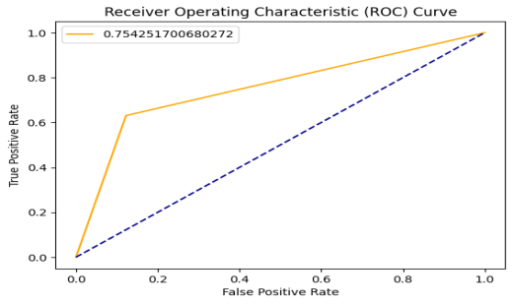
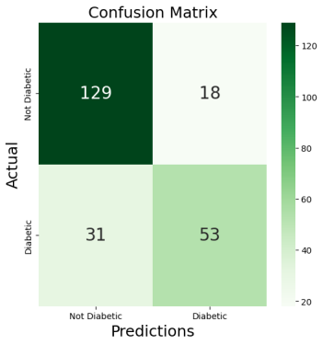
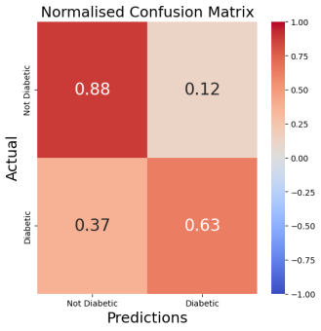
Model performance metrics
Model performance comparison AUC score
Area under ROC curve (AUC) plots the sensitivity /recall (true positive = TP/(TP+FN)] and the specificity (false positive = TN/TN+FP).
0 (poor) to 1 (perfect).
Data Z- scaled before modelling
70/30 train/test split
Supervised classification models:
Logistic regression (LR) model:
Null filled logged features (AUC: 0.754) better than null filled non-logged (AUC: 0.729)
LR better than null filled logged features SVM (AUC linear: 0.749 AUC, sigmoid: 0.699 AUC, rbf: 0.691)
Logistic regression model evaluation:
TN
FP
TN
FP
FN
TP
FN
TP

Slide 6
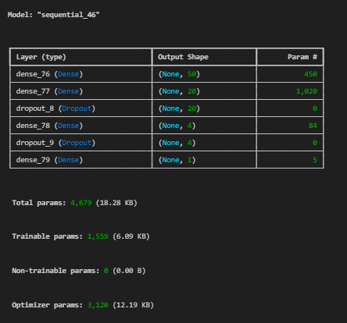
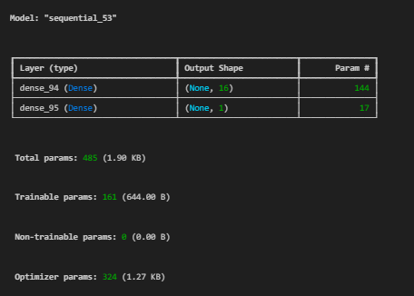
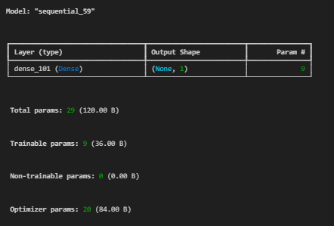
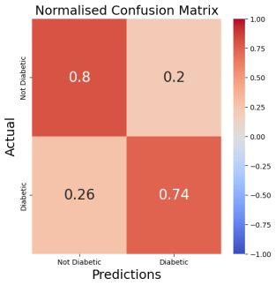
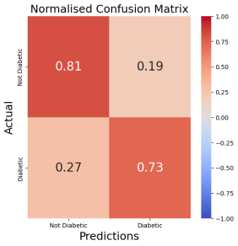
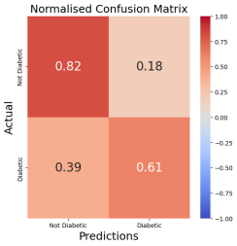

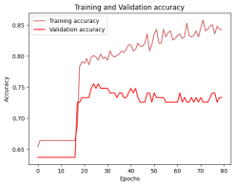
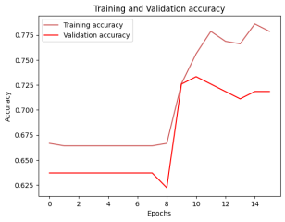
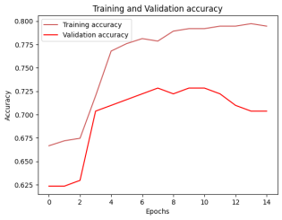
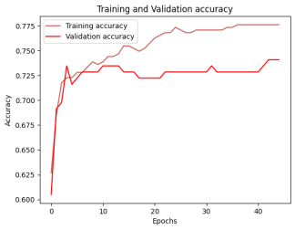
Do neural networks predict better?
Logistic regression (LR) model AUC: 0.754
Sequential ANN models:
most ->--------------------------------------- > -------------------- > least complex
3 hidden layers [8 - (50-20-4) - 1] 1 hidden layer [8 - (16) - 1] Binary preceptron
Early stop16 epochs AUC: 0.760
80 epochs
AUC: 0.712
AUC | Last epoch
0.773 | 13
0.770 | 14
0.764 | 25
0.767 | 13
0.761 | 35
0.767 | 15
AUC | Last epoch
0.762 | 44
0.762 | 44
0.759 | 43
0.759 | 44
0.759 | 42
0.768 | 45
Model re-run 6 times with early stop
Model re-run 6 times with early stop

Slide 7
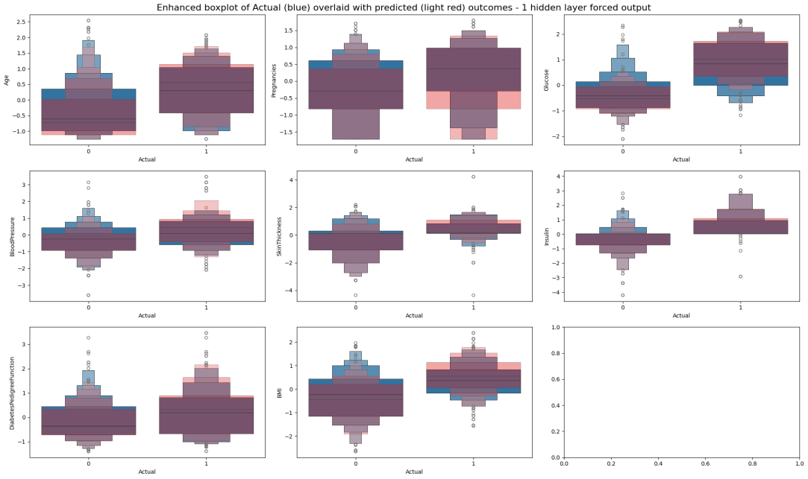
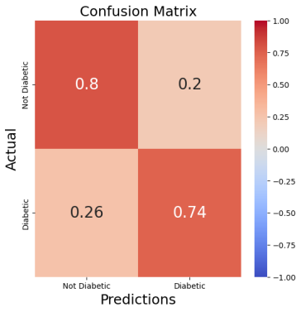
Exploring an ANN prediction
1 hidden layer [8 - (16) - 1] Epoch 13 AUC: 0.767
Forced model to give consistent output with random seed
Actual (blue), predicted (light red), overlap (purple)
Predicted tends to skew low for non-diabetic (0 – red below/low purple overlap) and high for diabetic (1 - red above/high purple overlap) except diabetic (1) pregnancies

Slide 8
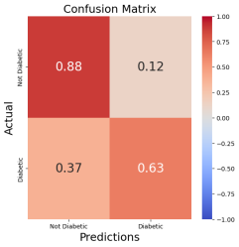
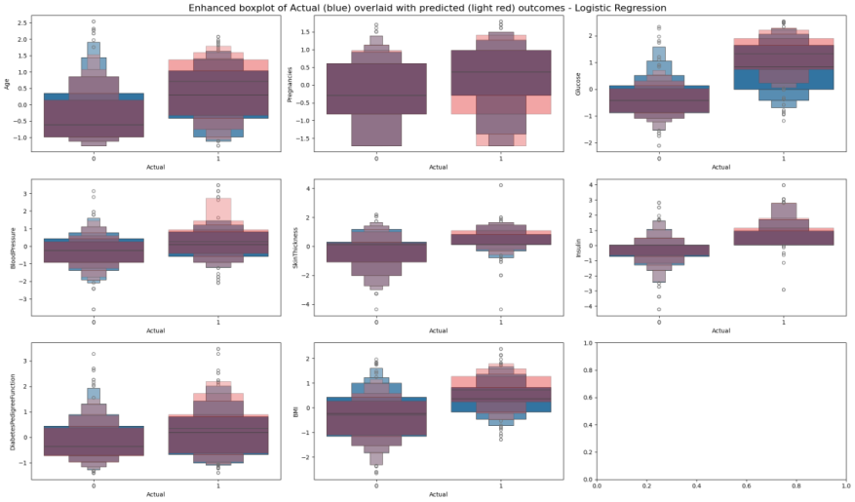
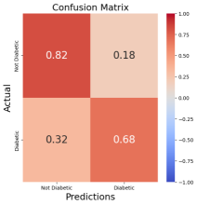
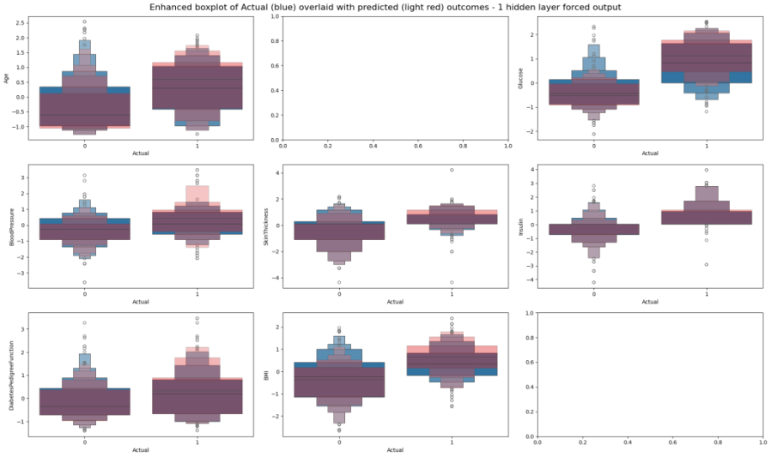
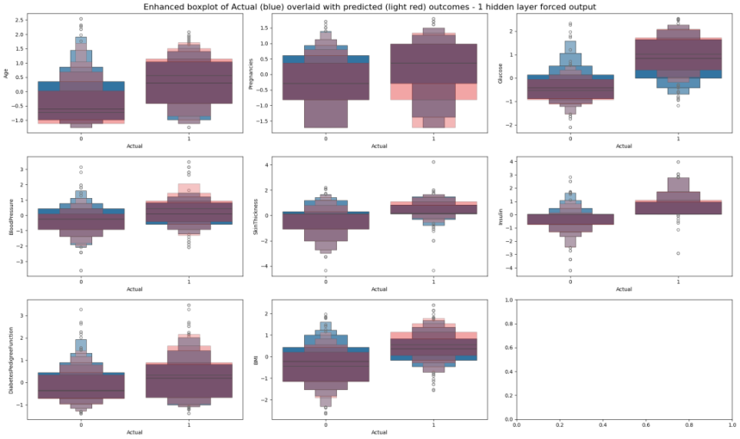

Comparing model predictions
Actual (blue), predicted (light red), overlap (purple)
Logistic Regression AUC: 0.754
Forced 1 hidden layer – pregnancy removed AUC: 0.747
AUC: 0.747449
Forced 1 hidden layer –AUC: 0.767
Pregnancy impacts performance for models shown:
without pregnancy ANN more similar to logistic regression (2 models above)
Predicting non-diabetic (0 outcome) 2 models above better :
almost perfect layover predicted and actual for some features vs. model on left, see more blue
Predicting diabetic (1) model to left best:
Less red predicted above the overlap (purple)on the 1 outcome (right) vs. 2 models above

Slide 9
Conclusion
Conclusion
Simple neural network models with early stopping generally better prediction than linear regression/SVM
Takes longer time to compute for not too major an improvement
Prediction performance could be further improved:
Best models will give 20-25% false positive or false negative
Future work
Better way to handle illogical 0 data e.g. Glucose, insulin?
Pregnancy data appeared to improve one ANN model:
More runs to confirm
More data on gender as there are differences in BMI and hormone regulation
Tweak parameters of ANN models to improve accuracy

Slide 10
Q&A
Thanks for your attention!

