Slide 1


Synopsis Presentation on Proactive Road Safety: A Hybrid Machine Learning Model for Predicting Traffic Accidents and Severity
Guided By: Presented By:
Prof. Pawan Makhija Ananya Panwar(0827CD221010)
https://github.com/Ananya2517
Bhoomika Sharma(0827CD221021)
https://github.com/Bhoomika71
Devanshi Joshi(0827CD221027)
https://github.com/Ddevanshii10
Hemanshi Adlak(0827CD221036) https://github.com/Hemanshi-Adlak

Slide 2
Contents
Introduction
1.1 Overview
1.2 Purpose
Literature Review
Problem Statement
Proposed Solution
Objectives
Theoretical Analysis
6.1 Block Diagram
6.2 Hardware Requirements
6.3 Software Requirements
Applications
REFERENCES

Slide 3
1. Introduction
1.1 Overview
This project develops a system to analyze and predict road accidents, their causes, and severity using machine learning techniques, specifically Random Forest and Time Series Analysis.
The system utilizes historical data, including traffic patterns and weather conditions, to generate accurate hourly and weekly forecasts of accident occurrences and their severity.
By providing predictive insights, the system aims to enhance road safety, improve emergency response strategies, and aid in infrastructure planning, ultimately reducing the frequency and impact of road accidents
1.2 Purpose
The project aims to predict road accidents using machine learning techniques to reduce their frequency and severity.
By providing accurate forecasts, the system assists traffic authorities in enhancing safety measures and optimizing emergency response strategies.
Additionally, it aids urban planners in designing safer infrastructure, ultimately lowering accident risks and minimizing the financial burden associated with delays and emergency services.

Slide 4
2. Literature Review
Sr. No. | Name of Solution/System | Features | Limitations/ Drawbacks
1. | Road accident predictor using machine learning (Dipanshu Gupta, Vagisha Goel) | Used machine learning algorithms such as Logistics Regression, Random Forest with only numerical predictors and Support Vector Machine (SVM) which provide real-time insights, route optimization, and high-risk area identification. | Focused on UK accident-prone areas, limiting generalizability. Missing key factors like traffic volume and driver behavior, reducing prediction accuracy. Model accuracy is 83%, but lacks advanced optimization like hyperparameter tuning and real-time data integration.
2. | Time Series Analysis of Road Accidents Using ARIMA Model ( Chelule, J. C., Ngetich) | Focused on Time Series Analysis of Road Accidents using the ARIMA model. | This research paper focuses only on linear trends and seasonal patterns, limiting its ability to handle complex non-linear relationships and multiple features like weather, traffic volume, and road conditions.
3. | Road Accident Prediction Using Machine Learning (Dr. M. Hemalatha, S. Dhuwaraganath) | The paper features a machine learning-based system using models like Decision Tree, AdaBoost, and KNN to predict road accidents by analyzing factors such as speed, traffic conditions, and weather, with an interactive web interface for identifying accident-prone areas. | Limited to basic machine learning models. No use of advanced time series analysis (LSTM, SARIMA). Lacks real-time data integration (traffic, weather). Restricted to specific geographic datasets. No focus on predicting accident severity.

Slide 5
3. Problem Statement
Existing road accident prediction models face challenges like limited generalizability, use of basic algorithms, and failure to account for important factors such as traffic volume, weather, and driver behavior. These limitations reduce the accuracy and real-time effectiveness of predictions. This project aims to overcome these issues by using advanced machine learning techniques like Random Forest along with time series models such as LSTM and SARIMA. By integrating these approaches, the system will offer more accurate, real-time predictions, helping improve traffic management and reduce accidents in various regions and conditions.

Slide 6
4. Proposed Solution
Time Series Model: A method for predicting future values by analyzing data trends over time. It helps forecast accident occurrences by understanding patterns in past data.
LSTM (Long Short-Term Memory): A deep learning model used to predict future accidents by analyzing time-dependent data. It captures trends and patterns in past accident data to forecast upcoming events.
SARIMA (Seasonal AutoRegressive Integrated Moving Average): A statistical model that helps predict future accident occurrences by accounting for both seasonal patterns and trends in the data.
Random Forest: An ensemble learning algorithm used to classify the severity of predicted accidents. It combines multiple decision trees to accurately determine if accidents will be minor, moderate, or severe based on factors like traffic and weather.

Slide 7
5. Objectives
Forecast Future Road Accidents: Predict the likelihood of accidents in specific time intervals (e.g., hourly, daily) based on historical data and influencing factors.
Identify Patterns and Trends: Analyze historical accident data to identify temporal trends and patterns, such as rush-hour peaks or seasonal increases in accidents.
Assess Accident Severity: Classify predicted accidents into different severity levels (minor, moderate, severe) to prioritize responses and interventions..
Improve Traffic Safety and Reduce Economic Losses: Enable better traffic management, timely interventions, and resource allocation to prevent accidents and minimize their impact on urban safety and economics. These objectives will give your audience a clear understanding of the purpose and scope of your model.

Slide 8
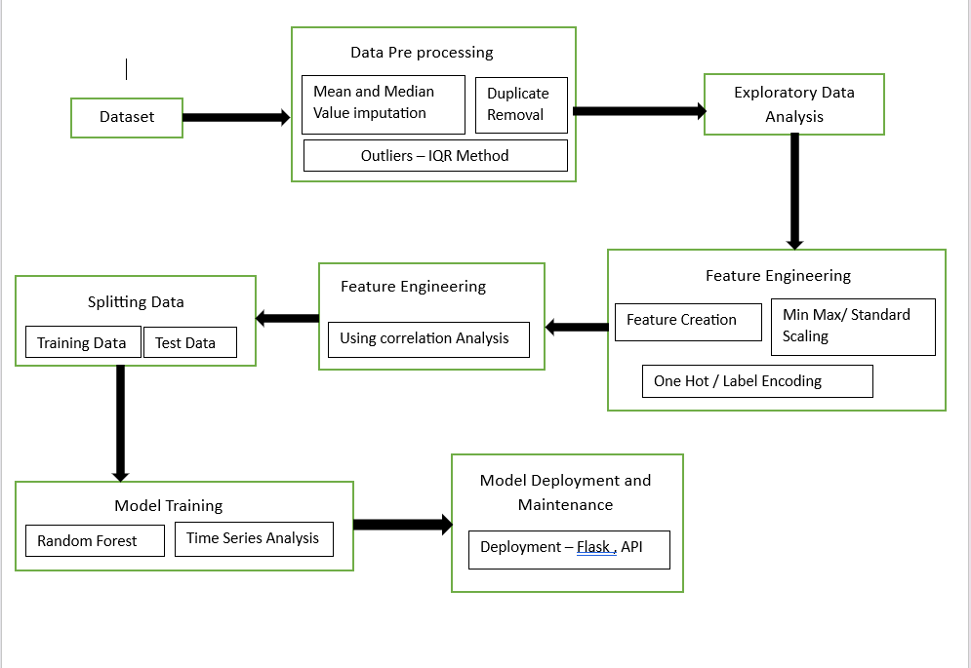
6. Theoretical Analysis
6.1 Block Diagram

Slide 9
6.2 Hardware Requirements
Server: 32 GB RAM, 2 TB SSD, with high-speed internet connectivity.
User Interface: Monitors and mobile devices, GPS-enabled for delivering traffic and accident alerts.
6.3 Software Requirements
Operating System: Windows.
IDE: Jupyter Notebook , VS Code, Google Colab.
Languages: Python, JavaScript, CSS and HTML for the user interface.
Libraries: Scikit-learn, TensorFlow, Pandas, NumPy.
Version Control: Git

Slide 10
Applications
Proactive Accident Management: Predictive models will enable authorities to manage accident risks proactively. By anticipating high-risk periods and locations, timely measures can be implemented, such as rerouting traffic or deploying emergency services in advance.
Urban Infrastructure Planning: Long-term accident and risk data will inform infrastructure development, such as optimizing road design, building safer intersections, and enhancing pedestrian and cyclist safety features.
Public Transportation Efficiency: Accident prediction data will help optimize public transportation schedules, ensuring that buses, trains, and trams are not delayed by road accidents and can reroute to avoid accident-prone areas.
Smart City Integration: The system can be integrated into smart city frameworks, delivering real-time accident risk data to drivers, autonomous vehicles, and traffic management systems, contributing to smoother and safer traffic flow.
Environmental and Economic Benefits: Reducing accident-related delays lowers vehicle emissions, improving air quality. Economically, reduced congestion and fewer accidents translate into lower costs for commuters and businesses, enhancing overall productivity.

Slide 11
Conclusion
The hybrid model will effectively incorporate Random Forest, LSTM, and SARIMA, ensuring a comprehensive approach to predicting both the occurrence and severity of road traffic accidents. By analyzing historical data, the model offers actionable insights for traffic authorities and urban planners to improve road safety, reduce accidents, and enhance emergency response. Its implementation can significantly contribute to safer urban environments and reduce accident-related fatalities and economic impacts.
Future work:
Real-Time Data: IoT sensors provide live traffic and weather data for more accurate accident predictions.
Smart Traffic: IoT-based signals adjust traffic flow to reduce accident risks.
V2X Communication: Vehicles share real-time data for instant accident warnings and automated responses.
Emergency Response: IoT alerts emergency services with faster routes, improving response times.
Smart City Integration: The model connects with smart city systems to enhance overall safety.

Slide 12
GitHub Link
https://github.com/Ddevanshii10/Proactive-Road-Safety-

Slide 13
REFERENCES
[1] Augustine, T., & Shukla, S. (2022). Road Accident Prediction Using Machine Learning Approaches. International Conference on Advance Computing and Innovative Technologies in Engineering (ICACITE), IEEE, pp. 808–811.
[2] Behboudi, N., Moosavi, S., & Ramnath, R. (2024). Recent Advances in Traffic Accident Analysis and Prediction: A Comprehensive Review of Machine Learning Techniques. A review paper, 26 pages. Subjects: Machine Learning (cs.LG). arXiv:2406.13968 [cs.LG]. Available: https://doi.org/10.48550/arXiv.2406.13968.
[3] Chelule, J. C., Ngetich, M. K., Anapapa, A., & Imboga, H. (2019). Time Series Analysis of Road Accidents Using Autoregressive Integrated Moving Average (ARIMA) Model. International Journal of Science and Research (IJSR), 8(4), 2319-7064. From: www.ijsr.net.
[4] Dr. M. Hemalatha, & Dhuwaraganath, S. (2024). Road Accident Prediction Using Machine Learning. PG & Research Department of Computer Science, Sri Ramakrishna College of Arts and Science, Coimbatore, Tamil Nadu, India, vol 11, Issue 2202, pp. 454-457.
[5] Gupta, D., Goel, V., Gupta, R., Shariq, M., & Singh, R. (2022). Road Accident Predictor Using Machine Learning. International Research Journal of Modernization in Engineering, Technology and Science, vol. 4, May 2022.
[6] Krishna, U. V., Sudhakaran, S., Sanju, S., Vignesh, E., & Kaladevi, R. (2023). Accident Prediction and Analysis Using Machine Learning Models. International Conference on Innovative Data Communication Technologies and Application (ICIDCA), IEEE, pp. 37–40.
[7] Mor, N., Sood, H., & Goyal, T. (2020). Application of Machine Learning Technique for Prediction of Road Accidents in Haryana - A Novel Approach. Journal of Intelligent & Fuzzy Systems, 38(5), 6627–6636.

Slide 14
Thank You
Queries ?

