Slide 1


Presentation on Proactive Road Safety: A Hybrid Machine Learning Model for Predicting Traffic Accidents and Severity
Guided By: Presented By:
Prof. Pawan Makhija Ananya Panwar(0827CD221010)
https://github.com/Ananya2517
Bhoomika Sharma(0827CD221021)
https://github.com/Bhoomika71
Devanshi Joshi(0827CD221027)
https://github.com/Ddevanshii10
Hemanshi Adlak(0827CD221036) https://github.com/Hemanshi-Adlak

Slide 2
Contents
Introduction
1.1 Overview
1.2 Purpose
Requirement Engineering
2.1 Requirement Collection
2.2 Functional Requirements
2.3 Non Functional Requirements
2.4 Use Case Diagram
Technical Design
3.1 Technical Architecture
3.2 Sequence Diagram
3.3 Class Diagram
3.4 DFD
User Interface Design
Data Design
5.1 Schema Design
5.2 E-R Diagram
REFERENCES

Slide 3
1. Introduction
1.1 Overview
This project develops a model to analyze and predict road accidents, their causes, and severity using machine learning techniques, specifically Random Forest and Time Series Analysis.
The model utilizes historical data, including traffic patterns and weather conditions, to generate accurate hourly and weekly forecasts of accident occurrences and their severity.
By providing predictive insights, the model aims to enhance road safety, improve emergency response strategies, and aid in infrastructure planning, ultimately reducing the frequency and impact of road accidents.
1.2 Purpose
The project aims to predict road accidents using machine learning techniques to reduce their frequency and severity.
By providing accurate forecasts, the system assists traffic authorities in enhancing safety measures and optimizing emergency response strategies.
Additionally, it aids urban planners in designing safer infrastructure, ultimately lowering accident risks and minimizing the financial burden associated with delays and emergency services.

Slide 4
2. Requirement Engineering 2.1 Requirement Collection
The requirement collection phase focuses on gathering all necessary features and expectations for the "Proactive Road Safety: A Hybrid Machine Learning Model for Predicting Traffic Accidents and Severity" system.
Stakeholders:
Users: Commuters and drivers who will receive accident predictions based on historical data for safer travel planning.
Admin: System administrators responsible for managing historical datasets, training the machine learning models, and ensuring system operations.
Research Papers Reviewed
“Time Series Analysis of Road Accidents Using ARIMA Model” by Chelule, J. C., Ngetich, M. K., Anapapa, A., & Imboga, H. (2019).
“Recent Advances in Traffic Accident Analysis and Prediction” by Behboudi, N., Moosavi, S., & Ramnath (2024).
Dataset Used: Past traffic accident records (location, time, weather conditions, accident severity) from Kaggle.

Slide 5
2.2 Function Requirements
User Input : Users will provide details like location, time, and weather conditions for accident prediction.
Add & Update Historical Data: Admin will manage the historical data of accidents (e.g., location, severity) to ensure predictions are based on up-to-date and accurate information.
Preprocess Data: The system will clean and preprocess data, including handling missing values and outliers, ensuring that the input data is ready for prediction.
Model Training: Train machine learning models (Random Forest, Time Series) for accident prediction and forecasting.
Generate Prediction: After running the models, the system will generate predictions for the likelihood of an accident and its severity (e.g., slight, serious, fatal).
Display Results: Display predictions clearly, showing accident likelihood and severity.
Update Models: Admin can update the models with new data or training techniques to improve prediction accuracy.

Slide 6
2.2 Non Functional Requirements
Performance: High accuracy and quick prediction times for accident forecasting.
Scalability: Handle large datasets and multiple users without performance loss.
Security: Data privacy and security must be ensured for all collected datasets, particularly if sensitive information (e.g., accident locations or driver information) is used.
Usability: The system should be easy to navigate for users.
Reliability: The system should remain operational with minimal downtime, especially during peak traffic periods. Ensure 99% uptime with backup and recovery mechanisms..
Portability: Deployable on cloud or local servers, cross-platform compatibility.

Slide 7
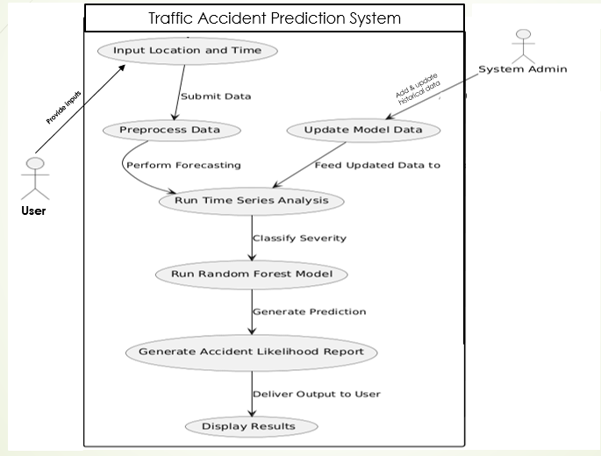
2.3 Use Case Diagram

Slide 8
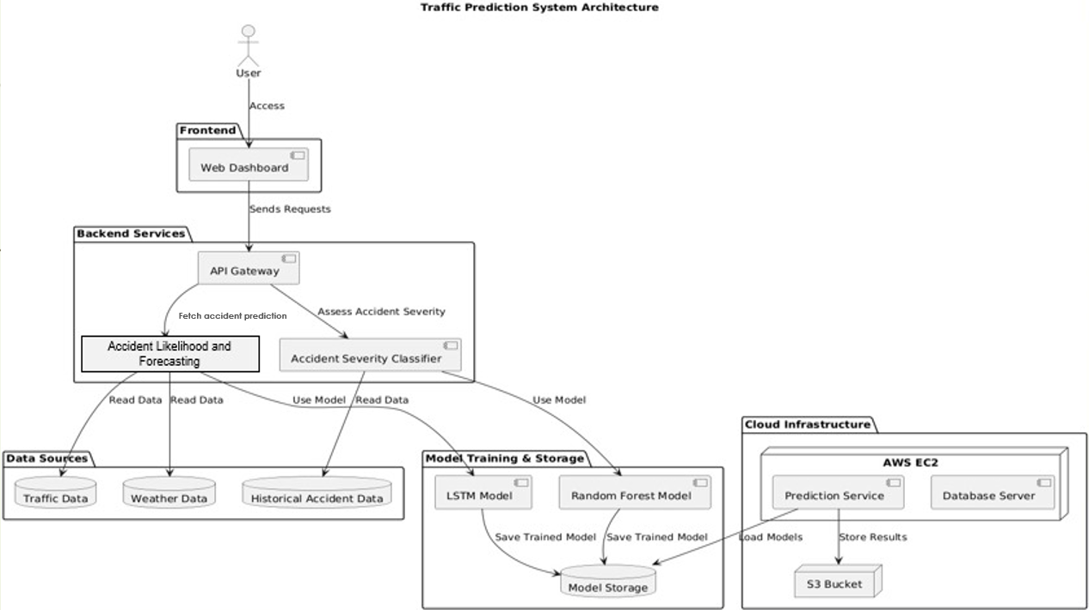
3. Technical Design 3.1 Technical Architecture

Slide 9
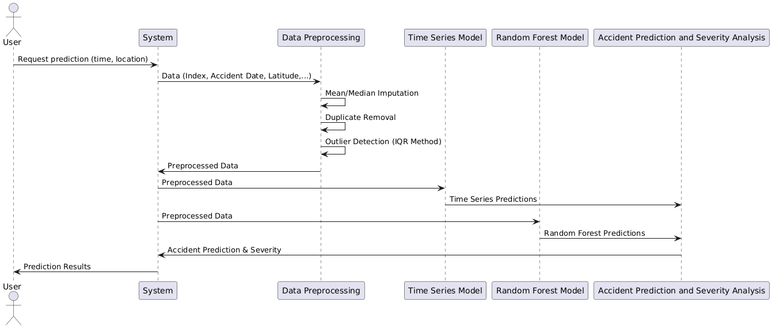
3.2 Sequence Diagram

Slide 10
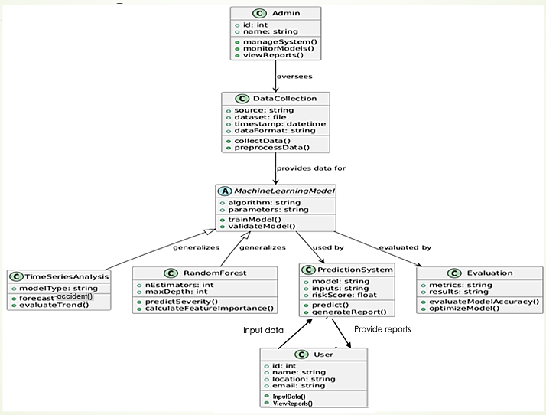
3.3 Class Diagram

Slide 11
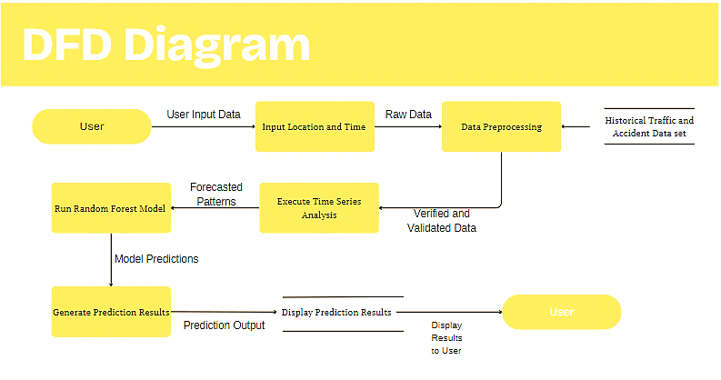
3.4 DFD

Slide 12
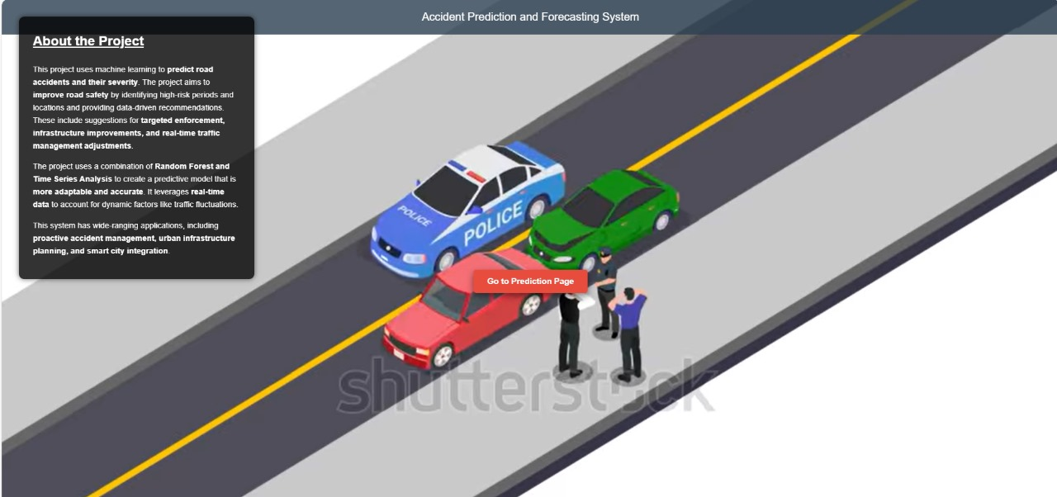
4. User Interface Design

Slide 13
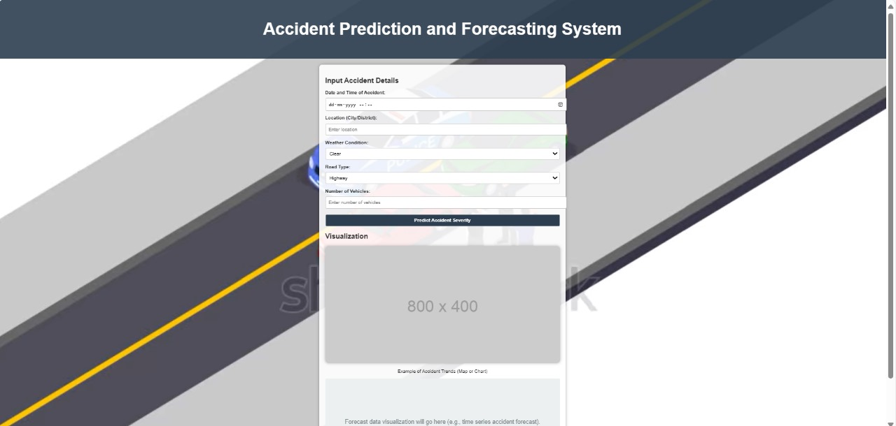

Slide 14
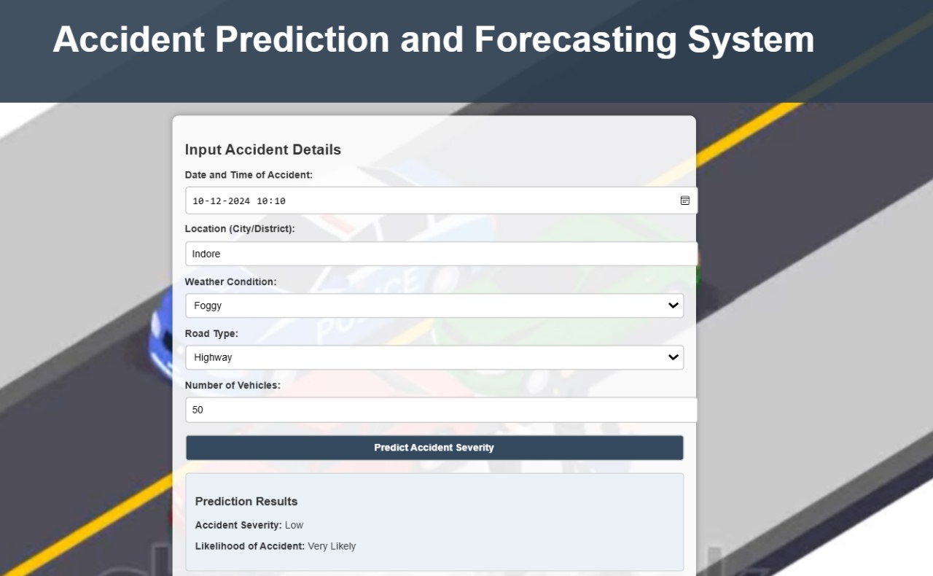

Slide 15
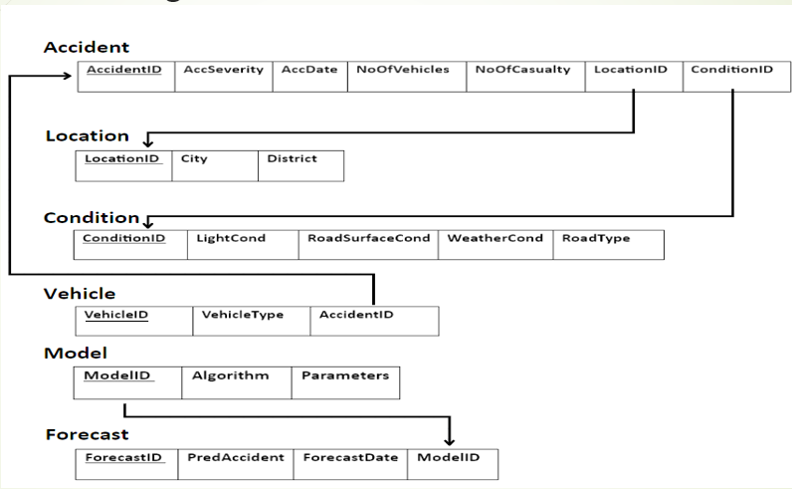
4. Data Design 4.1 Schema design

Slide 16
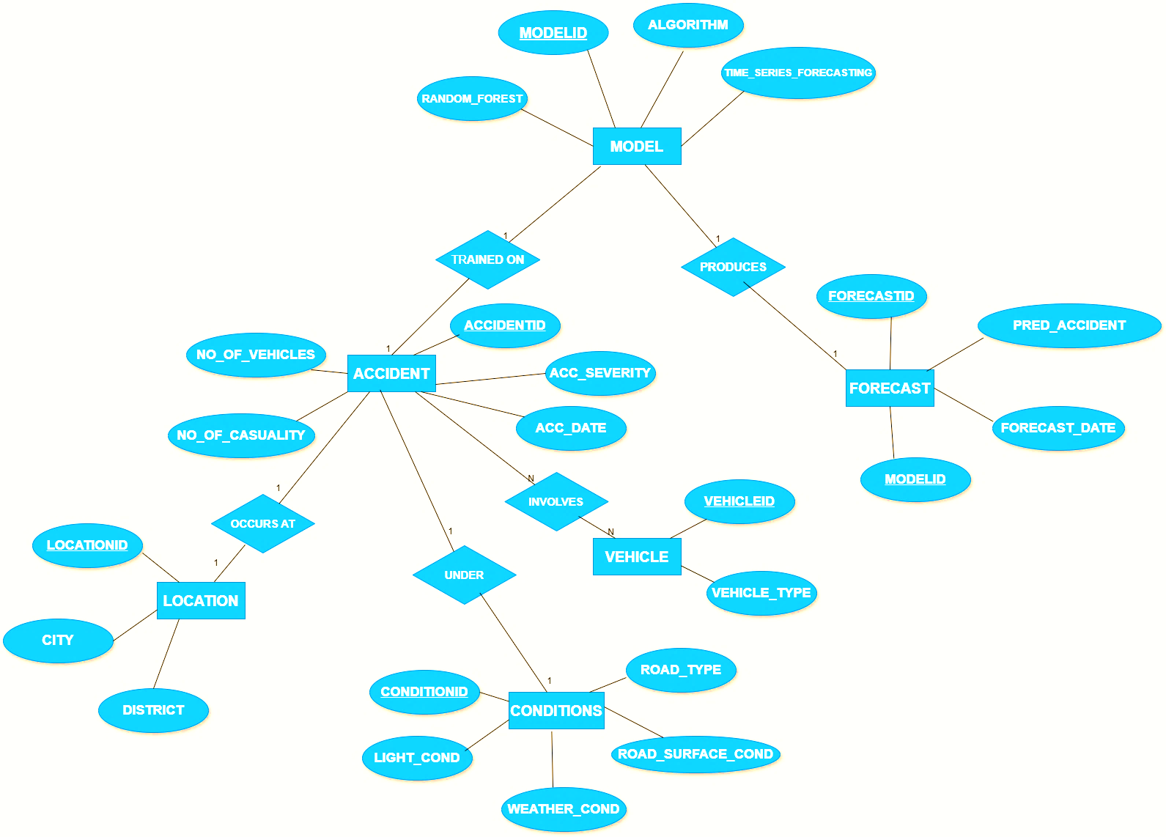
4.2 E-R Diagram

Slide 17
GitHub Link
https://github.com/Ddevanshii10/Proactive-Road-Safety-

Slide 18
REFERENCES
[1] Augustine, T., & Shukla, S. (2022). Road Accident Prediction Using Machine Learning Approaches. International Conference on Advance Computing and Innovative Technologies in Engineering (ICACITE), IEEE, pp. 808–811.
[2] Behboudi, N., Moosavi, S., & Ramnath, R. (2024). Recent Advances in Traffic Accident Analysis and Prediction: A Comprehensive Review of Machine Learning Techniques. A review paper, 26 pages. Subjects: Machine Learning (cs.LG). arXiv:2406.13968 [cs.LG]. Available: https://doi.org/10.48550/arXiv.2406.13968.
[3] Chelule, J. C., Ngetich, M. K., Anapapa, A., & Imboga, H. (2019). Time Series Analysis of Road Accidents Using Autoregressive Integrated Moving Average (ARIMA) Model. International Journal of Science and Research (IJSR), 8(4), 2319-7064. From: www.ijsr.net.
[4] Dr. M. Hemalatha, & Dhuwaraganath, S. (2024). Road Accident Prediction Using Machine Learning. PG & Research Department of Computer Science, Sri Ramakrishna College of Arts and Science, Coimbatore, Tamil Nadu, India, vol 11, Issue 2202, pp. 454-457.
[5] Gupta, D., Goel, V., Gupta, R., Shariq, M., & Singh, R. (2022). Road Accident Predictor Using Machine Learning. International Research Journal of Modernization in Engineering, Technology and Science, vol. 4, May 2022.
[6] Krishna, U. V., Sudhakaran, S., Sanju, S., Vignesh, E., & Kaladevi, R. (2023). Accident Prediction and Analysis Using Machine Learning Models. International Conference on Innovative Data Communication Technologies and Application (ICIDCA), IEEE, pp. 37–40.
[7] Mor, N., Sood, H., & Goyal, T. (2020). Application of Machine Learning Technique for Prediction of Road Accidents in Haryana - A Novel Approach. Journal of Intelligent & Fuzzy Systems, 38(5), 6627–6636.

Slide 19
Thank You
Queries ?

