Slide 1
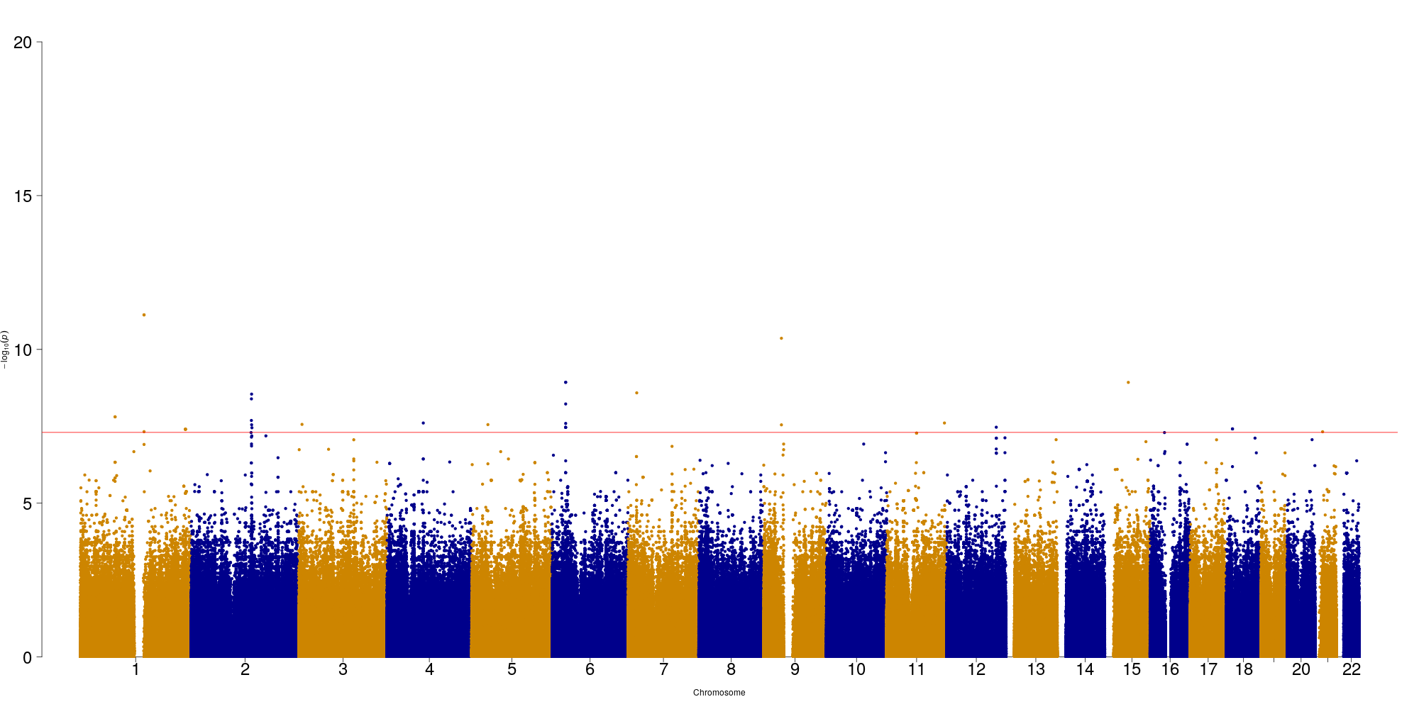
GBR shown
LCT
MHC
-log10(p-value) of selection evidence
SNPs along genome

