Slide 1

IAS 0600
Digital Systems Design
  Algorithmic State Machines
  FSM Synthesis
  Lab 7
Alexander Sudnitson
Tallinn University of Technology

Slide 2
FSM with binary inputs and outputs
x₁
y₁
x₂
...
...
y₂
x_{L}
y_{N}
Logical conditions
Micro-operations
If, for example, FSM has 30 input variables (L=30), the total number of input vectors is equal to 2³⁰, and if each time the values of the output variables depended on the values of all the input variables, no designer could either describe or construct such an FSM.
Fortunately, practically, each time the values of the output variables depend only on the values of a small number of the input variables (as a rule, not more than 8 – 10 variables).

Slide 3
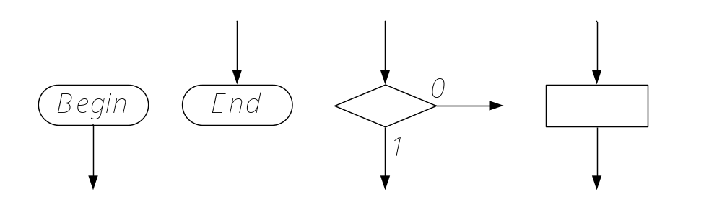
ASM
An Algorithmic state machine (ASM) is the directed connected graph containing an initial vertex (Begin), a final vertex (End) and a finite set of operator and conditional vertices.
The final, operator and conditional vertices have only one input, the initial vertex has no input. Initial and operator vertices have only one output, a conditional vertex has two outputs marked by "1" and "0". A final vertex has no outputs.

Slide 4
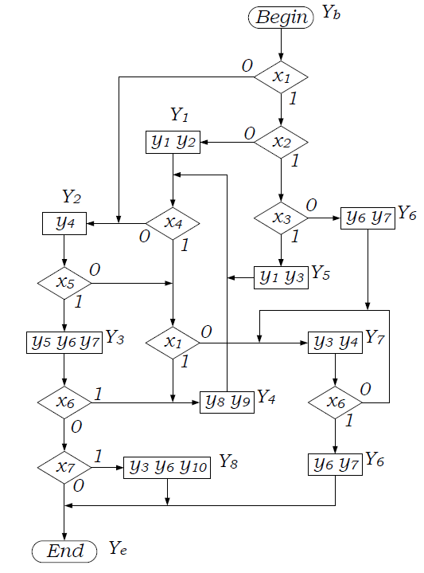
Example ASM (GSA)

Slide 5
ASM
ASM vertices are connected in such a way that:
Inputs and outputs of the vertices are connected by arcs directed from an output to an input, each output is connected with only one input;
Each input is connected with at least one output;
Each vertex is located on at least one of the paths from vertex “Begin” to vertex “End”.
One of the outputs of a conditional vertex can be connected with its input. We will call such conditional vertices the “waiting vertices”, since they simulate the waiting process in the system behavior description.
In our example, there are 7 logical conditions X = {x₁, …, x₇} and 10 microoperations Y = {y₁, …, y₁₀}. This ASM has eight operators Y₁, …, Y₈, they are written near operator vertices.

Slide 6
Construction of a marked ASM
A Mealy FSM implementing given ASM may be constructed in two stages:
Stage1. Construction of a marked ASM;
Stage 2. Construction of a state diagram (state graph).
At the first stage, the inputs of vertices following operator vertices are marked by symbols a¹, a2, …, aM as follows:
1. Symbol a1 marks the input of the vertex following the initial vertex “Begin” and the input of the final vertex “End”;
2. Symbols a2, …, aM mark the inputs of all vertices following operator vertices;
3. Vertex inputs are marked only once;
4. Inputs of different vertices, except the final one, are marked by different symbols.
It is important that each marked vertex follows an operator vertex.

Slide 7
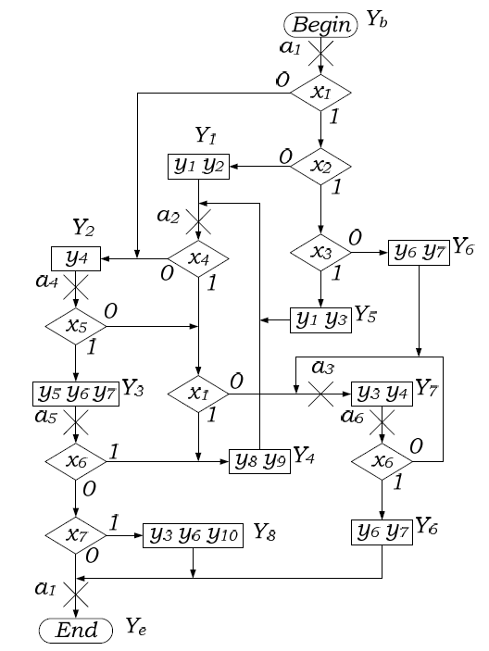
ASM marked for the Mealy FSM

Slide 8
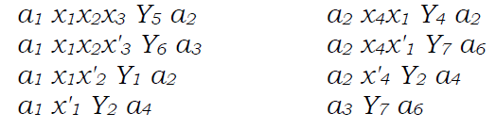
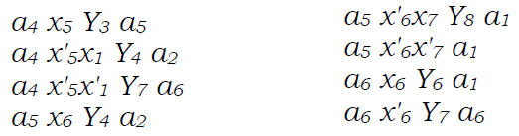
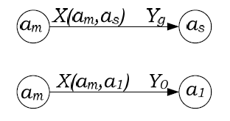
Transition paths
The path from a_{m} to a_{s} and contains only one operator vertex at the end of this path.

Slide 9
Transition table of ex. FSM
a_{m} – a current state; a_{s} – a next state;
X(a_{m,}a_{s}) – an input signal;
Y(a_{m,}a_{s}) – an output signal;
H – a number of line.
a_{m} | a_{s} | X(a_{m,}a_{s} ) | Y(a_{m,}a_{s} ) | H
a₁ | a₂ a₃ a₂ a₄ | x₁ x₂ x₃ x₁ x₂ x’₃ x₁ x’₂ x’₁ | y₁y₃ y₆y₇ y₁y₂ y₄ | 1 2 3 4
a₂ | a₂ a₆ a₄ | x₄ x₁ x₄ x’₁ x’₄ | y₈y₉ y₃y₄ y₄ | 5 6 7
a₃ | a₆ | 1 | y₃y₄ | 8
a₄ | a₅ a₂ a₆ | x₅ x’₅ x₁ x’₅ x’₁ | y₅y₆y₇ y₈y₉ y₃y₄ | 9 10 11
a₅ | a₂ a₁ a₁ | x₆ x’₆ x₇ x’₆ x’₇ | y₈y₉ y₃y₆y₁₀ - | 12 13 14
a₆ | a₁ a₆ | x₆ x’₆ | y₆y₇ y₃y₄ | 15 16

Slide 10
Transition table of ex. FSM
The specific feature of such FSM is the multiplicity of inputs in the column X(a_{m,}a_{s}), maybe several tens or even hundreds, but each product in one row contains only few variables from the whole set of input variables.

Slide 11
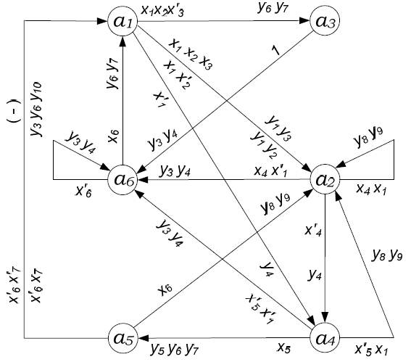
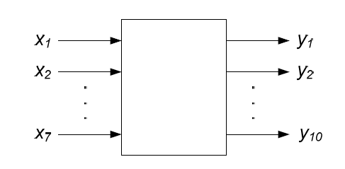
The state diagram

Slide 12
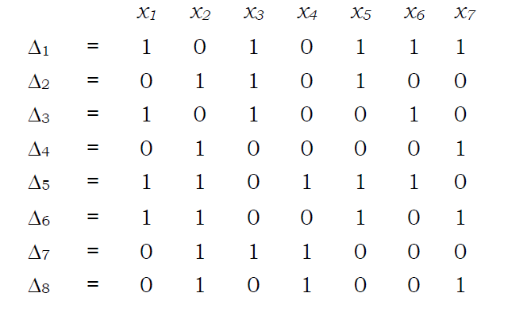
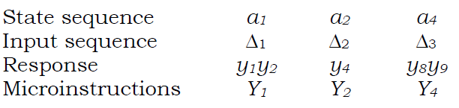
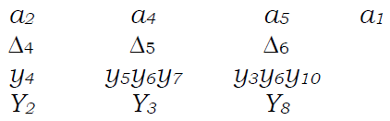
The response of FSM (ex)
In this example, initial state is a1.

Slide 13
KISS2 format FSM specification
.i 7
.s 6
.o 10
.p 16
111---- st1 st2 1010000000
110---- st1 st3 0000011000
10----- st1 st2 1100011000
0------ st1 st4 0001000000
1--1--- st2 st2 0000000110
0--1--- st2 st6 0011000000
---0--- st2 st4 0001000000
------- st3 st6 0011000000
----1-- st4 st5 0000111000
1---0-- st4 st2 0000000110
0---0-- st4 st6 0011000000
-----1- st5 st2 0000000110
-----01 st5 st1 0000011000
-----00 st5 st1 0000011000
-----1- st6 st1 0000011000
-----0- st6 st6 0000011000

Slide 14
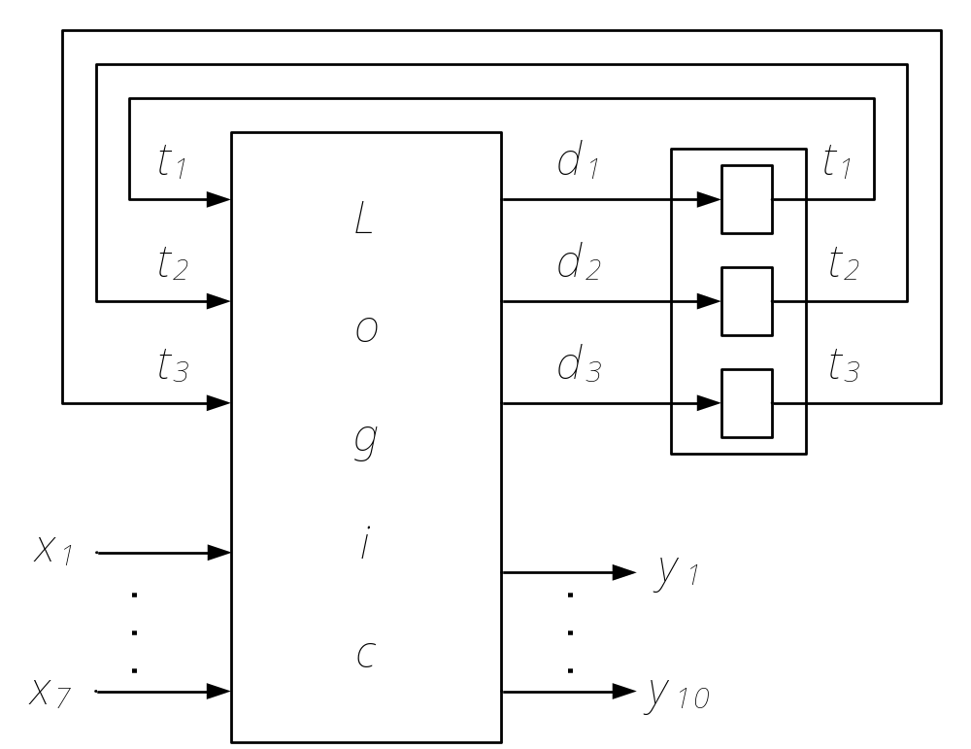
The structure for Mealy FSM

Slide 15
Structure table of ex. FSM
a_{m} | K(a_{m}) | a_{s} | K(a_{s}) | X(a_{m,}a_{s}) | Y(a_{m,}a_{s}) | D(a_{m,}a_{s}) | H
a₁ | 001 | a₂ a₃ a₂ a₄ | 000 101 000 010 | x₁ x₂ x₃ x₁ x₂ x’₃ x₁ x’₂ x’₁ | y₁y₃ y₆y₇ y₁y₂ y₄ | – d₁d₃ – d₂ | 1 2 3 4
a₂ | 000 | a₂ a₆ a₄ | 000 100 010 | x₄ x₁ x₄ x’₁ x’₄ | y₈y₉ y₃y₄ y₄ | – d₁ d₂ | 5 6 7
a₃ | 101 | a₆ | 100 | 1 | y₃y₄ | d₁ | 8
a₄ | 010 | a₅ a₂ a₆ | 110 000 100 | x₅ x’₅ x₁ x’₅ x’₁ | y₅y₆y₇ y₈y₉ y₃y₄ | d₁d₂ – d₁ | 9 10 11
a₅ | 110 | a₂ a₁ a₁ | 000 001 001 | x₆ x’₆ x₇ x’₆ x’₇ | y₈y₉ y₃y₆y₁₀ - | – d₃ d₃ | 12 13 14
a₆ | 100 | a₁ a₆ | 001 100 | x₆ x’₆ | y₆y₇ y₃y₄ | d₃ d₁ | 15 16
K(a_{m}) – a code of the current state;
K(a_{s}) – a code of the next state;
D(a_{m,}a_{s}) – an input memory function.

Slide 16
State assignment
a_{s} | p(a_{s}) | t₁ t₂ t₃
a₁ | 3 | 0 0 1
a₂ | 5 | 0 0 0
a₃ | 1 | 1 0 1
a₄ | 2 | 0 1 0
a₅ | 1 | 1 1 0
a₆ | 4 | 1 0 0
To encode FSM states we constructed the table above where p(a_{s} ) is the number of appearances of each state in the next state column a_{s.}
Than, first we use the zero code for state a₂ with max p(a₂) = 5. Then codes with one '1' are used for states a₆, a₁, a₄ with the next max appearances and, finally, two codes with two 'ones' are used for the left states a₃ and a₅.

Slide 17
The expressions for outputs of circuit “Logic”
y₁ = e₁ + e₃ = t'₁t'₂t₃ x₁x₂x₃ + t'₁t'₂t₃ x₁x'₂;
y₂ = e₃ = t'₁t'₂t₃ x₁x'₂;
y₃ = e₁ + e₆ + e₈ + e₁₁ + e₁₃ + e₁₆ = t'₁t'₂t₃ x₁x₂x₃ + t'₁t'₂t'₃ x₄x'₁ + t₁t'₂t₃ + t'₁t₂t'₃ x'₅x'₁ + t₁t₂t'₃ x'₆x₇ + +t₁t'₂t'₃ x'₆;
. . .
y₁₀ = e₁₃ = t₁t₂t'₃ x'₆x₇;
d₁ = e₂ + e₆ + e₈ + e₉ + e₁₁ + e₁₆ = t'₁t'₂t₃ x₁x₂x'₃ + t'₁t'₂t'₃ x₄x'₁ + t₁t'₂t₃ + t'₁t₂t'₃ x₅ + t'₁t₂t'₃ x'₅x'₁ + +t₁t'₂t'₃ x'₆;
d₂ = e₄ + e₇ + e₉ = t'₁t'₂t₃ x'₁+ t'₁t'₂t'₃ x'₄ + t'₁t₂t'₃ x₅;
d₃ = e₂ + e₁₃ + e₁₄ + e₁₅ = t'₁t'₂t₃ x₁x₂x'₃ +
+t₁t₂t'₃ x'₆x₇ + t₁t₂t'₃ x'₆x'₇ + t₁t'₂t'₃ x₆.

Slide 18
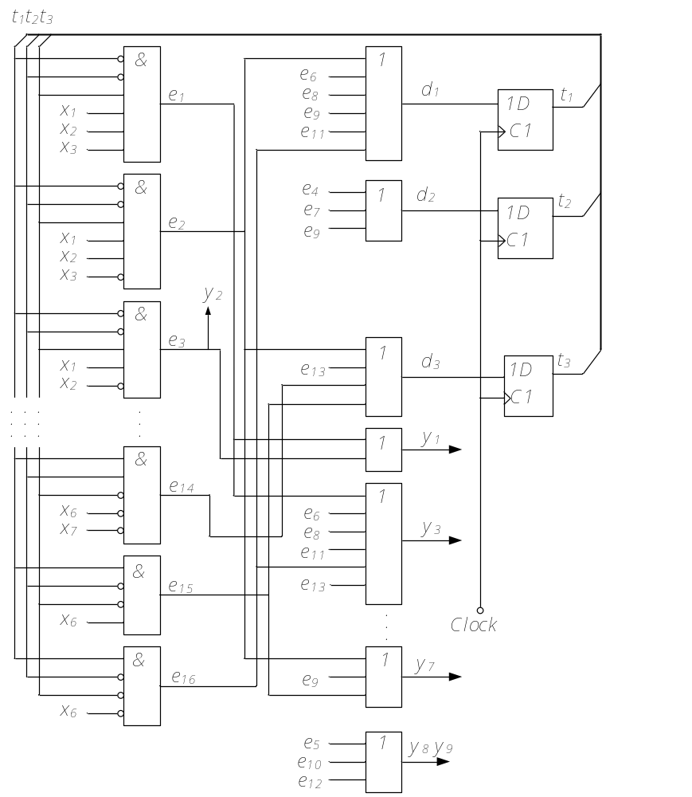
The logic circuit for Mealy FSM (exs)

Slide 19
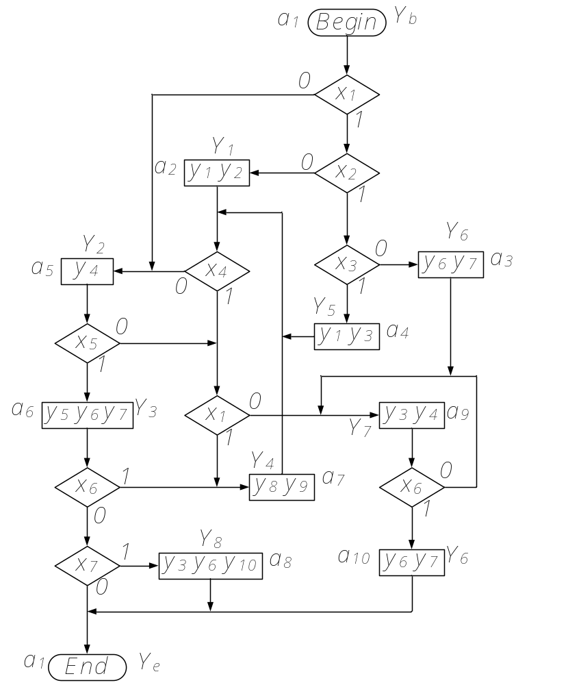
ASM marked for the Moore FSM

Slide 20
The transition table of Moore FSM
a_{m} | Y(a_{m}) | a_{s} | X(a_{m}, a_{s}) | h
a₁ | – | a₄ a₃ a₂ a₅ | x₁x₂x₃ x₁x₂x’₃ x₁x’₂ x’₁ | 1 2 3 4
a₂ | y₁y₂ | a₇ a₉ a₅ | x₄x₁ x₄x’₁ x’₄ | 5 6 7
a₃ | y₆y₇ | a₉ | 1 | 8
a₄ | y₁y₃ | a₇ a₉ a₅ | x₄x₁ x₄x’₁ x’₄ | 9 10 11
a₅ | y₄ | a₆ a₇ a₉ | x₅ x’₅x₁ x’₅x’₁ | 12 13 14
a₆ | y₅y₆y₇ | a₇ a₈ a₁ | x₆ x’₆x₇ x’₆x’₇ | 15 16 17
a₇ | y₈y₉ | a₇ a₉ a₅ | x₄x₁ x₄x’₁ x’₄ | 18 19 20
a₈ | y₃y₆y₁₀ | a₁ | 1 | 21
a₉ | y₃y₄ | a₁₀ a₉ | x₆ x’₆ | 22 23
a₁₀ | y₆y₇ | a₁ | 1 | 24

Slide 21
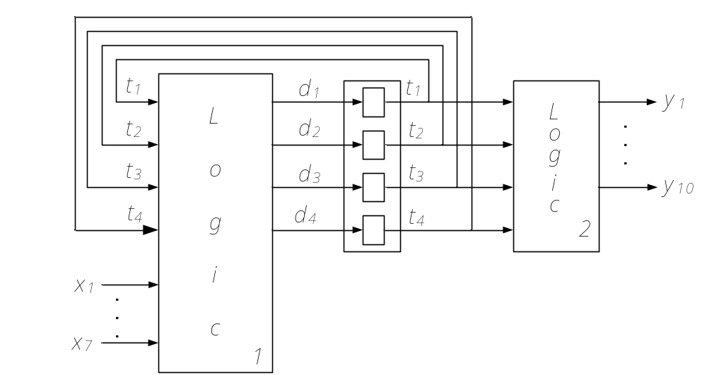
State assignment for the Moore FSM
Table 7. State assignment
The algorithm for state assignment is absolutely the same as in the case of Mealy FSM. First, we use the zero code for state a₉ with max p(a₉) = 6. Then codes with one '1' are used for states a₇, a₅, a₁ and a₂ with the next max appearences and, finally, five codes with two 'ones' are used for the left five states a₃, a₄, a₆, a₈ and a₁₀.
a_{s} | p(a_{s}) | t₁t₂t₃t₄
a₁ | 3 | 0100
a₂ | 1 | 0010
a₃ | 1 | 1001
a₄ | 1 | 0110
a₅ | 4 | 0001
a₆ | 1 | 1100
a₇ | 5 | 1000
a₈ | 1 | 0011
a₉ | 6 | 0000
a₁₀ | 1 | 0101

Slide 22
The structure table of Moore FSM
a_{m} | Y(a_{m}) | K(a_{m}) | a_{s} | K(a_{s}) | X(a_{m,}a_{s}) | D(a_{m,}a_{s}) | h
a₁ | – | 0100 | a₄ a₃ a₂ a₅ | 0110 1001 0010 0001 | x₁x₂x₃ x₁x₂x’₃ x₁x’₂ x’₁ | d₂d₃ d₁d₄ d₃ d₄ | 1 2 3 4
a₂ | y₁y₂ | 0010 | a₇ a₉ a₅ | 1000 0000 0001 | x₄x₁ x₄x’₁ x’₄ | d₁ – d₄ | 5 6 7
a₃ | y₆y₇ | 1001 | a₉ | 0000 | 1 | – | 8
a₄ | y₁y₃ | 0110 | a₇ a₉ a₅ | 1000 0000 0001 | x₄x₁ x₄x’₁ ~x’₄ | d₁ – d₄ | 9 10 11
a₅ | y₄ | 0001 | a₆ a₇ a₉ | 1100 1000 0000 | x₅ x’₅x₁ x’₅x’₁ | d₁d₂ d₁ – | 12 13 14
a₆ | y₅y₆y₇ | 1100 | a₇ a₈ a₁ | 1000 0100 0011 | x₆ x’₆x’₇ x’₆x’₇ | d₁ d₂ d₃d₄ | 15 16 17
a₇ | y₈y₉ | 1000 | a₇ a₉ a₅ | 1000 0000 0001 | x₄x₁ x₄x’₁ x’₄ | d₁ – d₄ | 18 19 20
a₈ | y₃y₆y₁₀ | 0011 | a₁ | 0100 | 1 | d₂ | 21
a₉ | y₃y₄ | 0000 | a₁₀ a₉ | 0101 0000 | x₆ x’₆ | d₂d₄ – | 22 23
a₁₀ | y₆y₇ | 0101 | a₁ | 0100 | 1 | d₂ | 24

Slide 23
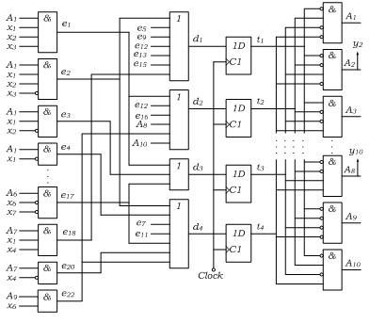
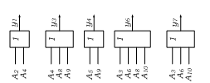
The logical circuit for the Moore FSM
Table 7. State assignment

