Slide 1

IAS 0600
Digital Systems Design
  Register Transfer Level Design
  (GCD example)
  Lab. 7
Alexander Sudnitson
Tallinn University of Technology

Slide 2
Basic units of RT-level design
Control
CONTROL
Control
Inputs
UNIT
Outputs
Control
Status
Inputs
Signals
Data path
DATA PATH
Data path
UNIT
Inputs
Outputs

Slide 3
Register Transfer Level
The Register Transfer Level (RTL) is characterized by
  A digital system is viewed as divided into a data path (data subsystem) and control path (controller);
  The state of data path consists of the contents of a set of registers;
  The function of the system is performed as a sequence of transition transfers (in one or more clock cycles).
  A register transfer is a transformation performed on a datum while the datum is transferred from one register to another.
  The sequence of register transfers is controlled by the control path (FSM).
A sequence of register transfers is representable by an execution graph.

Slide 4
Control
The control subsystem produces control signals based on its external inputs, status inputs from the data path, and its present state. Control signals direct data routing in the data path by selecting multiplexer and demultiplexer channels and enabling or disabling registers. In addition to their clock inputs, registers typically have one or more enable inputs that are controlled to determine whether or not a register stores its input data at the next triggering clock edge. Combinational logic blocks may also have control inputs that determine what function they perform at any given time. For example, the select inputs to demultiplexers and multiplexers are controlled to route data.

Slide 5
RTL design ‏
The control subsystem controls the functions performed in the data path. The control system is a FSM and the architecture is also referred to as a finite state machine with data path (FSMD). Registers in the data path and the control unit (FSM) use the same system clock signal. The data path is used to perform data manipulations or numerical computations. It consists of the registers that store data and the combinational logic used to transform the data. Input data flows into the data path and the result flows out. Input and output data are often vectors and the data path connections implemented as buses. The data path receives control signals from the control subsystem and provides status signals to the control subsystem. The control inputs to the data path determine what functions are performed by the combinational logic and when data path registers are loaded.

Slide 6
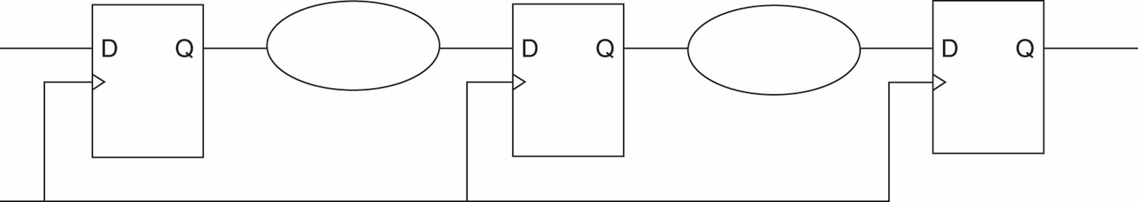
The cloud representation of a data path ‏
The data path stores, routes, and processes data. Its operation is described in terms of data transfers from one register to another register and data manipulations performed by combinational logic that exists between the registers.
Each combinational logic “cloud” either transforms or routes the output of the storage register to its left and provides the transformed or routed value as input to the storage register on its right. Often, a simple storage register and the combinational logic associated with it combine to produce an operational register such as a shift register, counter, or arithmetic and logic unit (ALU). Alternatively, the combinational logic might provide data routing between registers, such as demultiplexing or multiplexing.

Slide 7
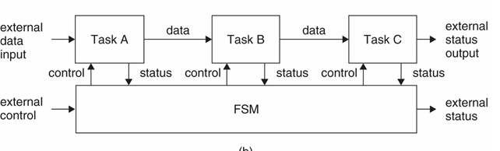
Data path and control ‏
The system is decomposed into a collection of functional units through which data flows (a data path). Each functional unit consists of combinational logic and a register. The control enables each functional unit to carry out a particular task (data manipulation) on the data as it passes along the data path. The sequence of data manipulations performed accomplishes the desired overall transformation of data. The data output from the data path is the computed result..

Slide 8
An example: word description ‏
The design ranges over several levels of representation. We begin the design process with a word description of an example device.
Digital unit performs an operation of computing the greatest common divisor (GCD) of two integers corresponding to
Euclid algorithm:
The gist of this algorithm is computing the remainder from division of the greater number with the less one and further exchanging the greater number with the less one and this less number with the division remainder. This converging process is looped until the division remainder is equal to zero. That means the termination of the algorithm with the current less number as the result.

Slide 9
GCD computation of 15 and 24
OP1
OP2
RG1
RG2
15
24
RG1 < RG2
RG1 := RG2; RG2 := RG1;
24
15
Remainder = 9
9
15
RG1 /= 0
RG1 := RG2; RG2 := RG1;
15
9
Remainder = 6
6
9
RG1 /= 0
RG1 := RG2; RG2 := RG1;
9
6
Remainder = 3
3
6
RG1 /= 0
RG1 := RG2; RG2 := RG1;
6
3
Remainder = 0
0
3
RG1 = 0
READY := 1; ANSW := 3;
Dividend =Quotient × Divisor + Remainder

Slide 10
The flowchart (example)‏
BEGIN
START
No
Yes
RG1 := OP1;
RG2 := OP2;
Yes
RG1 = RG2
No
RG1 < RG2
Yes
RG1 := RG2;
RG2 := RG1;
No
Remainder Computation
Yes
Remainder = 0
No
READY := 1;
ANSW := RG2;
END

Slide 11
Block diagram (example)‏
It is assumed that input operands are unsigned 8-bit numbers and none of them is zero.
Start
Ready
OP1
DISCRETE
OP2
SYSTEM
ANSW
The interface description
entity EUCLID is
port (START: in BIT;
--The first and the second operand bus
OP1, OP2: in INTEGER range 0 to 255;
--Answer is ready signal
READY: out BIT;
--Answer bus
ANSW: out INTEGER range 0 to 255);
end EUCLID;

Slide 12
Behavioral Description
architecture COMMON of EUCLID is
process
-- Temporary variables:
variable RG1, RG2, temp: INTEGER range 0 to 255;
begin
-- Waiting for the start:
wait on START until START’event and START = ‘1’;
RG1 := OP1; RG2 := OP2;
if RG1 /= RG2 then
if RG1 < RG2 then
-- Exchange operands:
temp:=RG1; RG1 := RG2; RG2:=temp;
end if;
while RG1 /= 0 loop
-- Calculation of the reminder:
RG1 := RG1 rem RG2;
if RG1 /= 0 then
temp:=RG1; RG1 := RG2; RG2:=temp;
end if;
end loop;
end if;
--Answer output:
ANSW <= RG2; READY <= ‘1’;
end process;
end COMMON;

Slide 13
Data path -1-
The data path is specified by the set of operations presented in the behavioral descriptions and by the set of basic elements which it will be implemented by.
In our example, we assume that there is some set of such basic elements that are appropriate for us to use in our design.
Notice, that we suppose that remainder computation chip (or macro) doesn’t exist. We need to synthesize it on the next design step basing upon its behavioural description and existing (or virtual) elements of the lower level - e.g. adders, shift registers, counters. It would in its turn lead to appearing the control part of the lower level and so on (top-down design methodology, hierarchy).

Slide 14
Remainder computation from restoring division algorithm
normalization
RG2(7) = 1
No
L1(RG2.0);
C := C + 1;
Yes
RG1 := RG1 - RG2;
Yes
RG1(8) = 1
No
RG1 := RG1 + RG2;
Yes
C = 0
No
R1(0.RG2);
C := C - 1;
restore the original value
shift to the right, setting the new bit to 0e

Slide 15
The flowchart
BEGIN
START
No
Yes
RG1 := OP1;
RG2 := OP2;
Yes
RG1 = RG2
No
Yes
RG1 := RG2;
RG2 := RG1;
RG1 < RG2
No
Remainder
Computation
RG2(7) = 1
No
L1(RG2.0);
C := C + 1;
Yes
RG1 := RG1 - RG2;
Yes
RG1(8) = 1
No
RG1 := RG1 + RG2;
Yes
C = 0
No
R1(0.RG2);
C := C - 1;
Yes
Remainder = 0
No
READY := 1;
ANSW := RG2;
END

Slide 16
Data path -2-
Consider in our example the data path that is based upon some ALU which completes four arithmetic operations (addition, subtraction, left shift and right shift) with registers RG1 and RG2 for storing the intermediate results, with up/down counter and with control buses for data transfer. It is considered that RG1 and RG2 are Master-Slave registers that allows to exchange their contents during one clock cycle.
Input operands are 8-bit wide. For this example it is assumed that input operands are positive and none of them is 0. Note, that RG1 and RG2 have a sign bit, as remainder computation algorithm deals with negative values as well.

Slide 17
ALU (combinational)
OP1 >= OP2 0
OP1 < OP2 1
0 OP1 /= OP2
1 OP1 = OP2
x2
x1
Result
y8
ALU
y9
OP1
OP2
+
–
L1
R1
y8
0
1
0
1
y9
0
0
1
1

Slide 18
VHDL description of ALU
process (OP1, OP2, op_sel)
begin
case op_sel is
when "00" =>
result <= std_logic_vector(unsigned(OP1) + unsigned(OP2));
when "01" =>
result <= std_logic_vector(unsigned(OP1) - unsigned(OP2));
when "10" =>
result <= OP2(7 downto 0)&'0';
when "11" =>
result <= '0'&OP2(8 downto 1);
when others =>
result <= (others => '0');
end case;
if OP1 = OP2 then
equal <= '1';
else
equal <= '0';
end if;
if OP1 < OP2 then
greater <= '1';
else
greater <= '0';
end if;
end process

Slide 19
Registers
x6
x4
NOR
x3
0 … 7
8
RG1
S
i
g
n
RG2
S
i
g
n
enable
enable
y0
y1
Input operands are 8-bit wide. For this example, it is assumed that input operands are positive and none of them is 0. Note, that RG1 and RG2 have a sign bit, as remainder computation algorithm deals with negative values as well.

Slide 20
Counter
x5
NOR
Counter
y2
enable
y3
0 C + 1
1 C – 1
process (clk)
begin
if clk'event and clk = '1' then
if counter_en = '1' then
if count_direction = '1' then
counter_value <= std_logic_vector(unsigned(counter_value) - 1);
else
counter_value <= std_logic_vector(unsigned(counter_value) + 1);
end if;
end if;
end if;
end process;

Slide 21
Multiplexers
y5
y4
y5
y4
RG1 Input
OP1
0
0
ALU
ALU
RG1 Input
0
1
RG2
1
–
OP1
RG2
OP2
ALU
RG2 Input
RG2 Input
y7
y6
RG1
0
0
ALU
0
1
RG1
1
–
OP2
y7
y6

Slide 22
Control bus
B
8
y
A
ANSW(0)‏
ANSW(1)‏
ANSW(7)‏
&
&
&
y10
RG(0)‏
RG(1)‏
RG(7)‏

Slide 23
The structure of GCD device
CONTROL UNIT
START
x0
y0
x1
FSM
y1
●
●
●
●
●
●
X5
READY
y10
y5
y4
y0
x4
x6
y9
y8
OP1
RG1
ALU
x1
x2
RG2
OP2
y7
y6
y1
x3
ANSW
Counter
x5
y10
DATA PATH UNIT
y3
y2

Slide 24
The structure of GCD device
START
CONTROL
READY
UNIT
...
x0
x5
Status
Control
...
Signals
Inputs
y1
y10
OP1
DATA PATH
ANSW
UNIT
OP1

Slide 25
Control part
At every description level after the (regular) structure of data path is defined it is possible to extract the remaining control part from the current level of behavioral description. Naturally this extracted control part description may be at first only behavioral one and the methods of finite state machines synthesis are required for control part (controller) implementation.
In this stage it is convenient to represent the extracted control behavior by means of algorithmic state machine (graph-scheme of algorithm).
The flowchart corresponding to our algorithm was obtained as the first step of ASM (GSA) synthesis.
In this flowchart simultaneously executed statements are grouped into common blocks.
The ASM (GSA) we got from the flowchart by replacing the computational statements (actions of ALU and counter) with the corresponding control signals (y-s) and the conditions - with binary conditions signals (x-s).

Slide 26
Graph-scheme of algorithm
BEGIN
x0
0
1
y7 y5 y1 y0
1
x1
0
x2
1
y6 y4 y1 y0
0
x3
0
y9 y2 y1
1
y8 y0
1
x4
0
y0
1
x5
0
y9 y8 y3 y2 y1
1
x6
0
y10
END

Slide 27
Moore type FSM synthesis ‏
Step 1. The construction of marked GSA.
At this step, the vertices “Begin”, “End” and oerator vertices are marked by the symbols s1, s2, … as follows:
vertices “Begin”, “End” are marked by the same symbol s1;
the symbols s2, s3, … mark all operator vertices;
all operator verteces should be marked;
Note that while synthesizing a Moore FSM symbols of states mark not inputs of vertices following the operator ones but operator vertices.
Step2. The construction of transition list (state diagram) of a controller.
Y(Spres)‏
Y(Snext)‏
X(Spres, Snext)
Spres
Snext

Slide 28
Moore type FSM
BEGIN
S1
x0
0
1
y7 y5 y1 y0
S2
1
x1
0
x2
1
y6 y4 y1 y0
S3
0
x3
0
y9 y2 y1
S4
1
y8 y0
S5
1
x4
0
y0
S6
1
x5
0
y9 y8 y3 y2 y1
S7
1
x6
0
y10
S8
END
S1

Slide 29
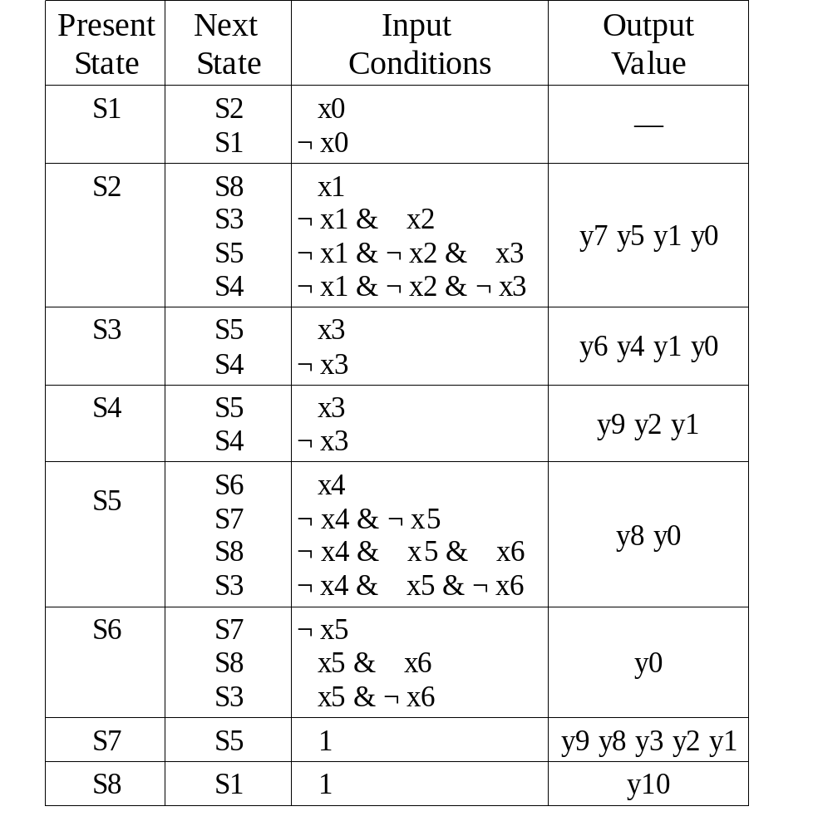
The transition list (Moore FSM)‏

Slide 30
Microoperation and microinstruction
Let a microoperation be an elementary indivisible step of data processing in the datapath and let Y be a set of microoperations.
Microoperations are induced by the binary signals y₁, … ,y_{T} from a controller.
To perform the microoperation y_{i} (i = 1, …, T) the signal y_{i} = 1 has to appear at the output y_{i} .
A set of microoperations executed concurrently in the datapath is called a microinstruction.
Thus if β_{h} = {y^{h}₁, … , y^{h}_{t}} is microinstruction, then β_{h} is represented as subset of Y and the microoperations y^{h}₁, … , y^{h}_{t} are executed at the same clock period.
The Y_{t} could be empty and we denote such an empty microinstruction Y₀ (“-“).

